Slide 1
More into Findability
February 22nd 2024

Slide 2
Findability
“Digital resources should be easy to find for both human and computers.”
The NMCB research data
Lab data; biobank data; survey data, etc.
The NMCB deliverables:
Codes, reports, papers, repostitories, etc.
(3) The NMCB Consortium information
Website, descriptive information, etc.
Notes:
What are digital resources? Data and metadata on any type of digital objects: such as ontologies, repositories, analysis algorithms, websites, etc.

Slide 3
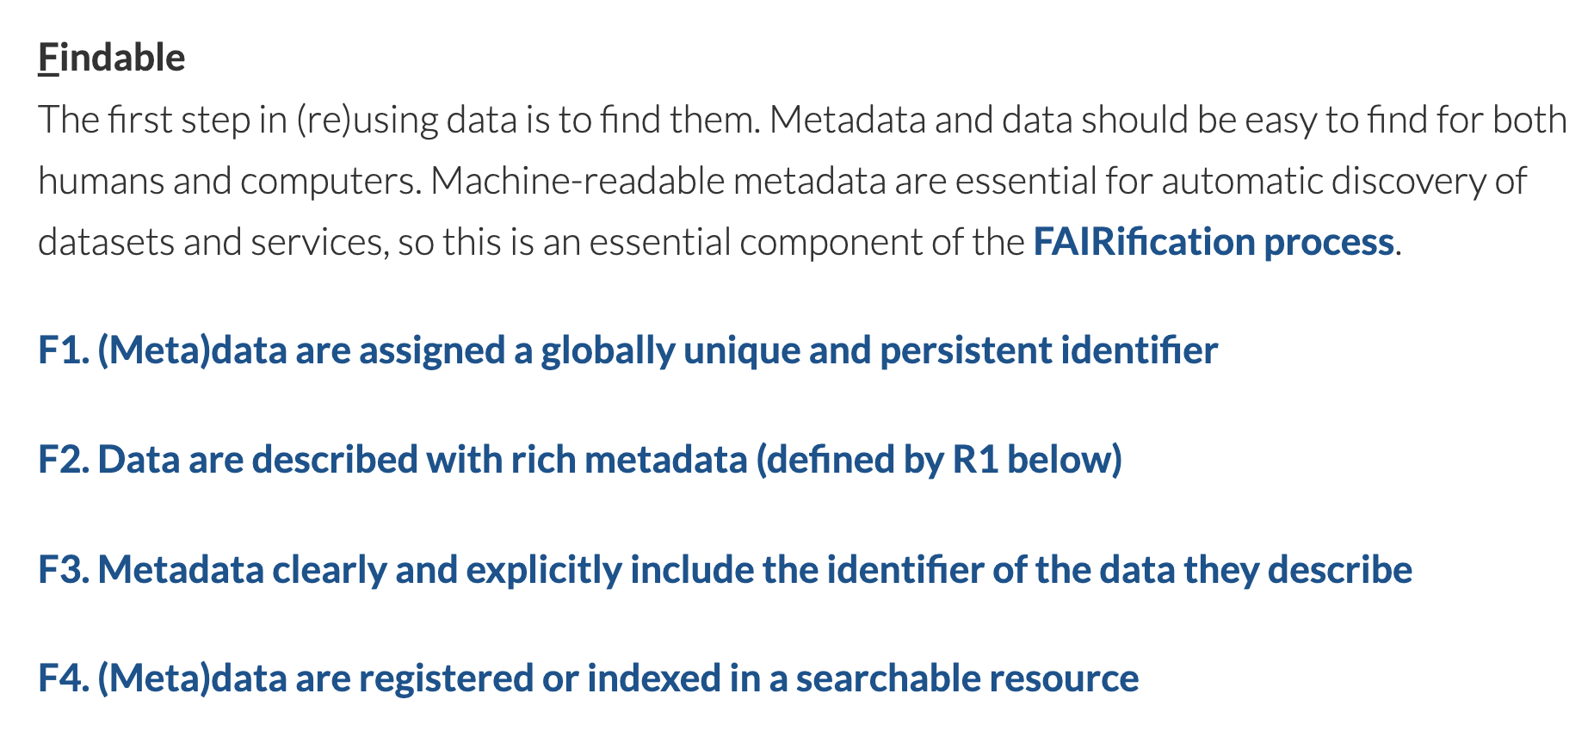
Source: https://www.go-fair.org/fair-principles/

Slide 4
Findability – F1
Globally unique, persistent, and resolvable identifiers (GUPRIs)
Assign such GUPRIs to every digital resource
DOI is a type of GUPRIs
https://www.doi.org/10.1038/sdata.2016.18
Redirected
Actual locator of the resource:
https://www.nature.com/articles/sdata201618
Consideration:
The PURL system: https://purl.org/
W3C Permanent Identifier: https://w3id.org/
The Identifiers.org Resolution Service: https://identifiers.org/
https://identifiers.org/uniprot:P38938
Redirected
The UniProt page https://www.uniprot.org/uniprot/P38938

Slide 5
Findability – F2-F4
F2:Rich metadata, which should
F3: Link to data
F4: Be registered in a searchable resource
The metadata of NMCB research data
For a single SQL dataset: title, description, license, distribution, format, last change, etc
The metadata of the NMCB deliverables:
For a guideline document: title, description, type, homepage, creation year, etc.
(3) The metadata of the NMCB Consortium information
Project name, funder, start year, affiliation, etc.

Slide 6
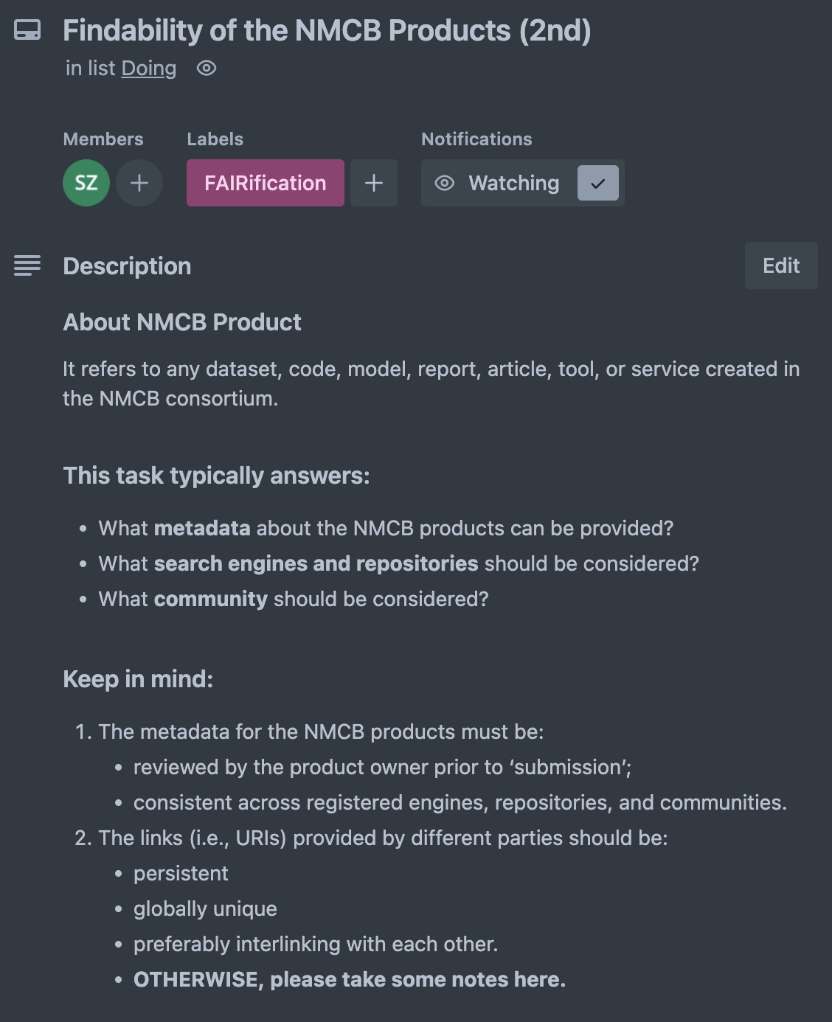
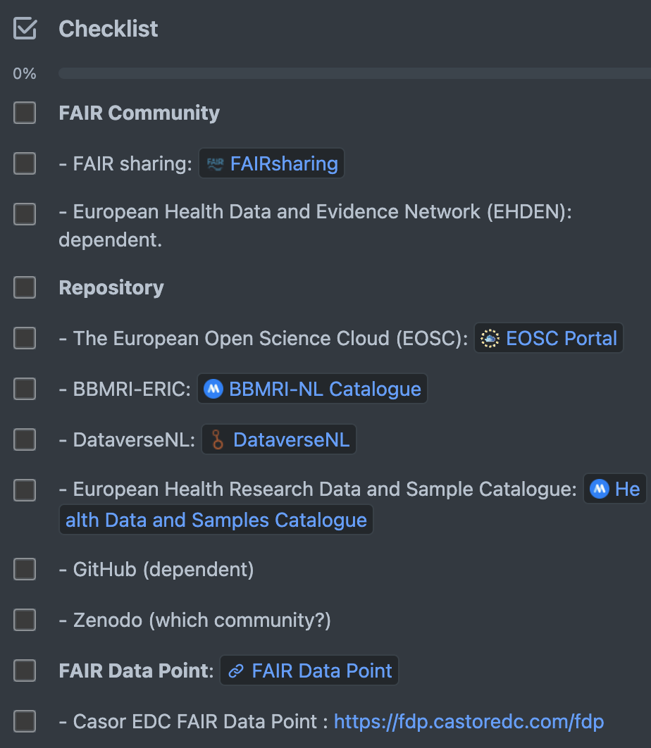
Findability of NMCB Research Data & Deliverables
Note:
Find it does not mean Access it

Slide 7
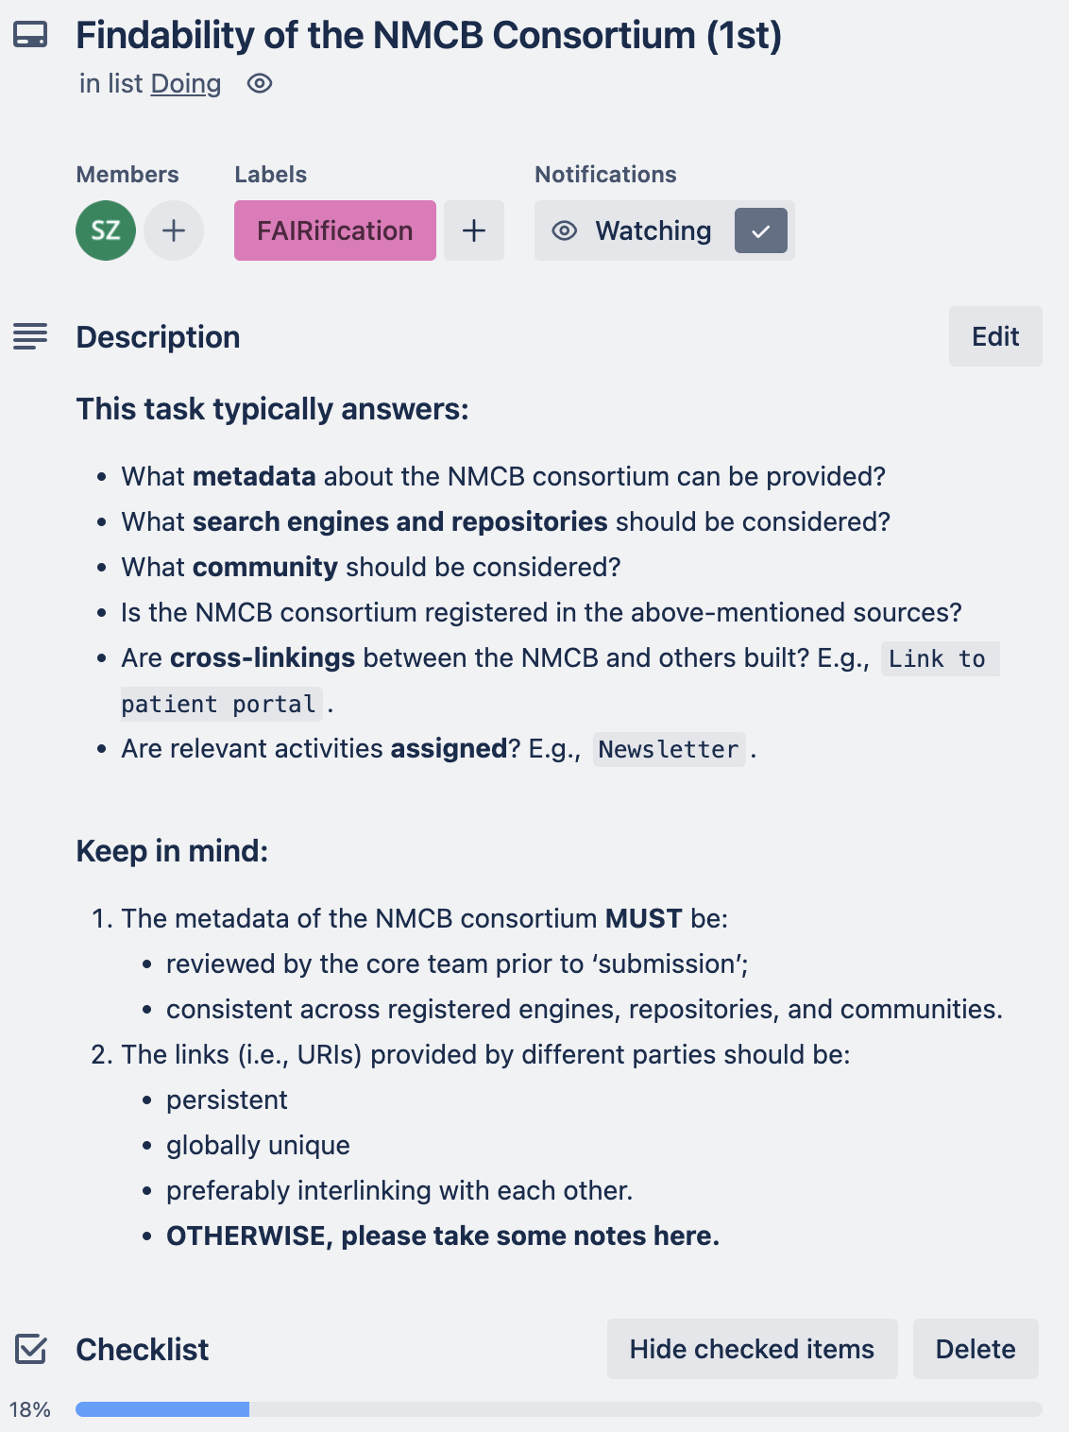
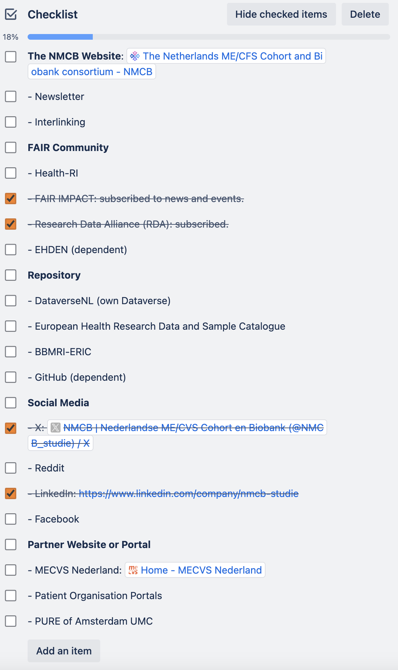
Findability of NMCB Consortium

Slide 8
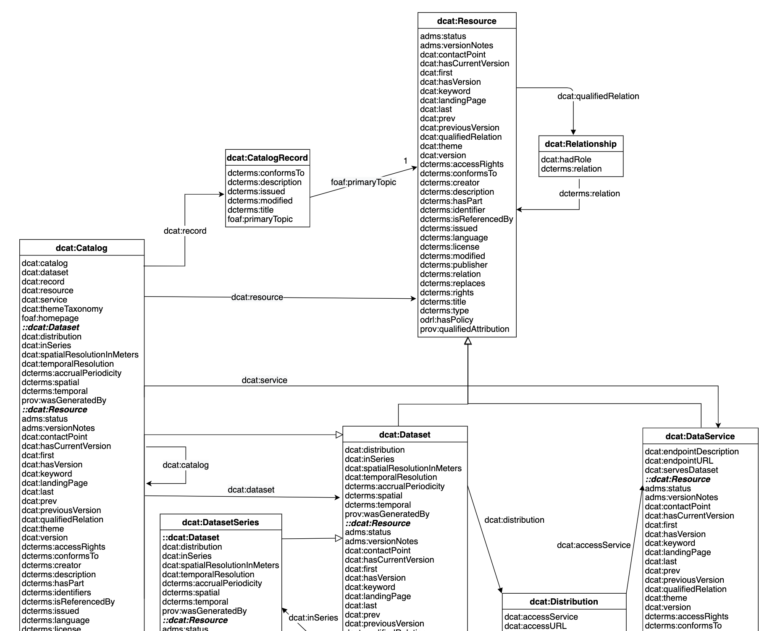
Metadata Schema
“A structured framework or set of guidelines that specifies which types of information (metadata) should be provided about data, documents, or other digital resources.”

Slide 9
Metadata Schema
“A structured framework or set of guidelines that specifies which types of information (metadata) should be provided about data, documents, or other digital resources.”

Slide 10
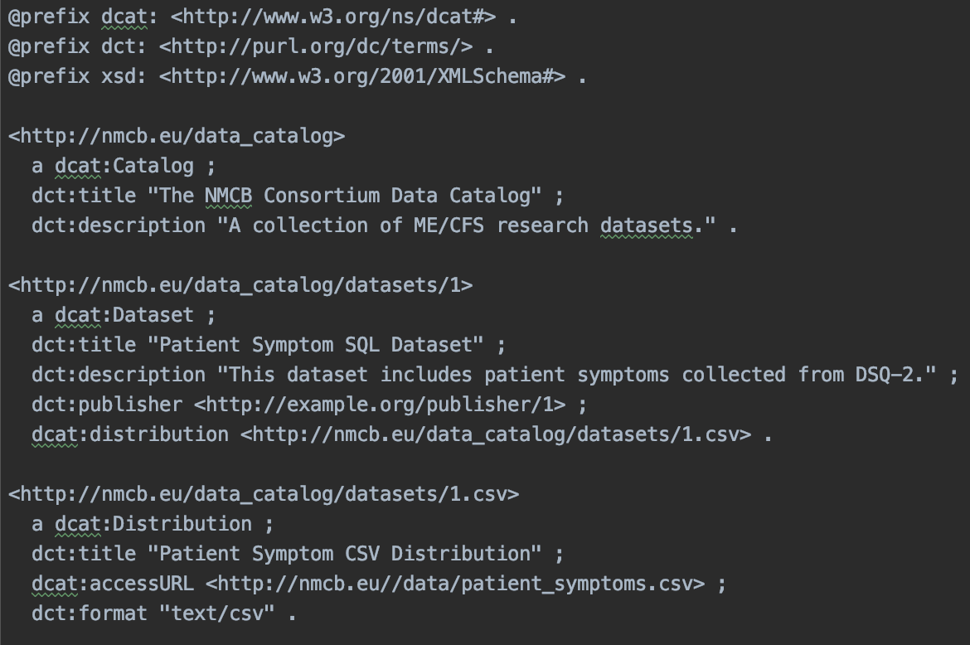
So the metadata following the schema might look like:

Slide 11
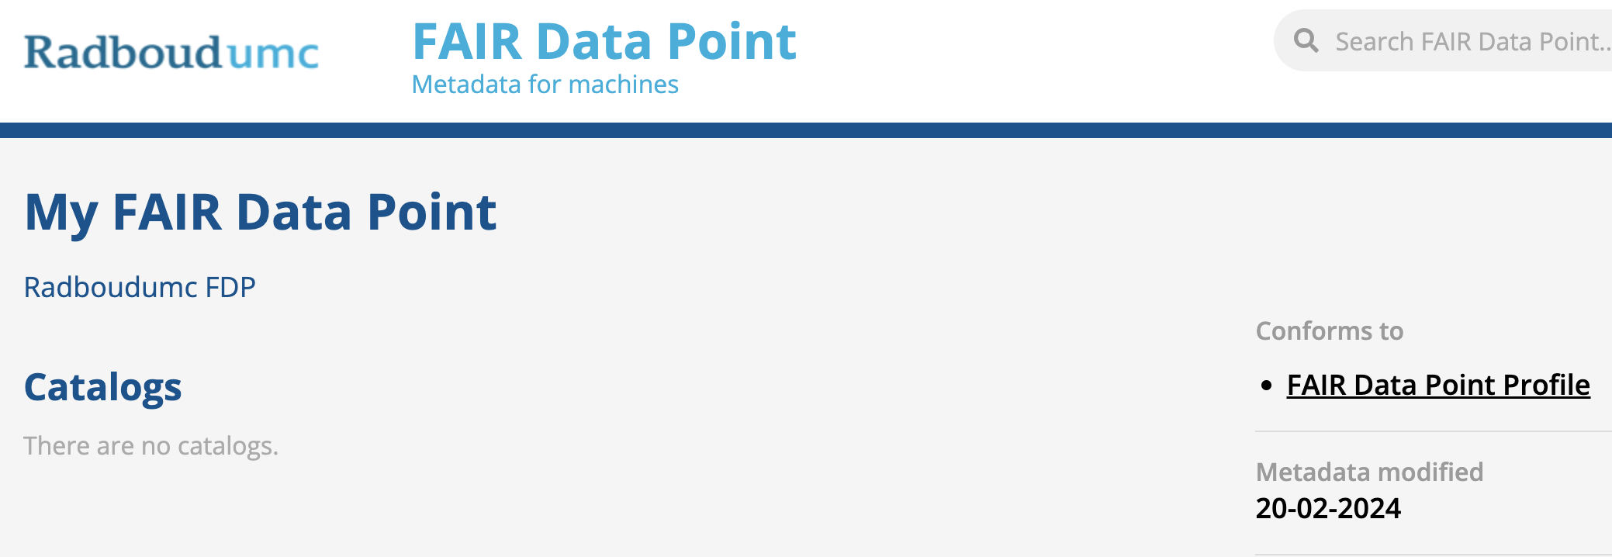
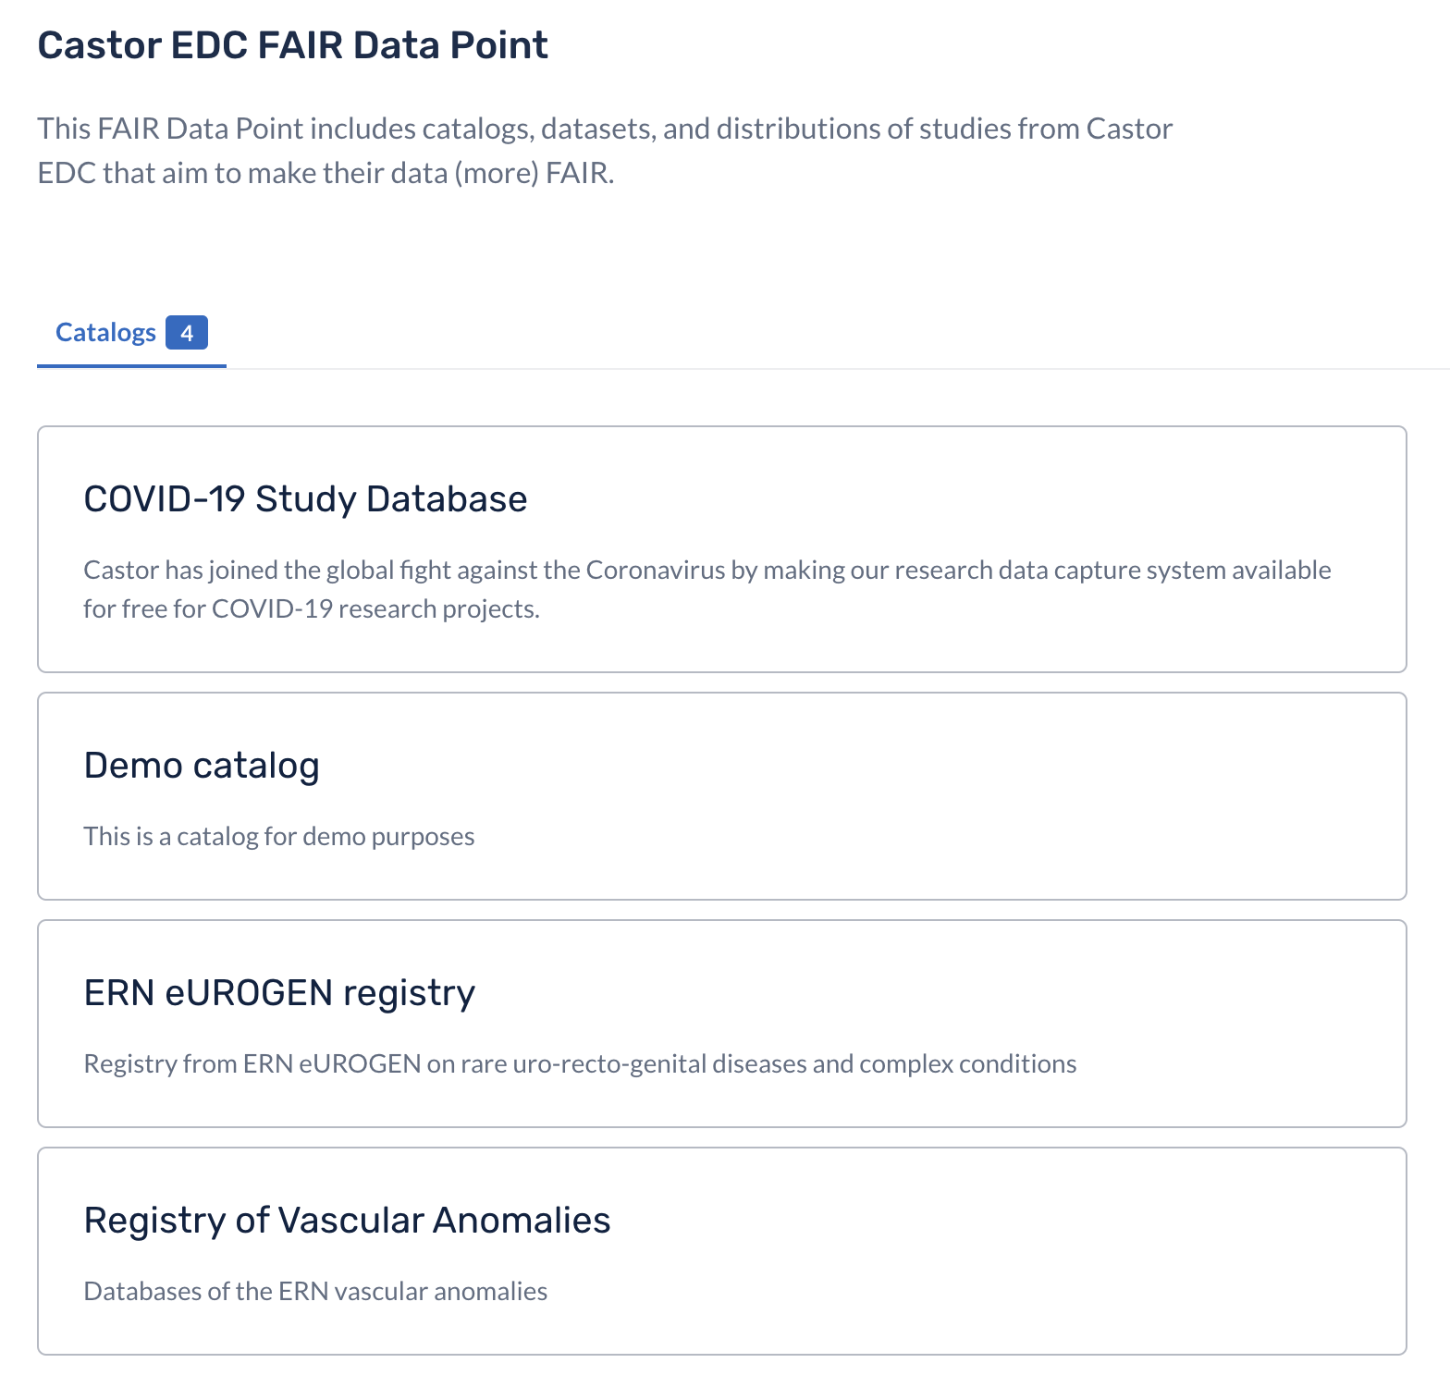
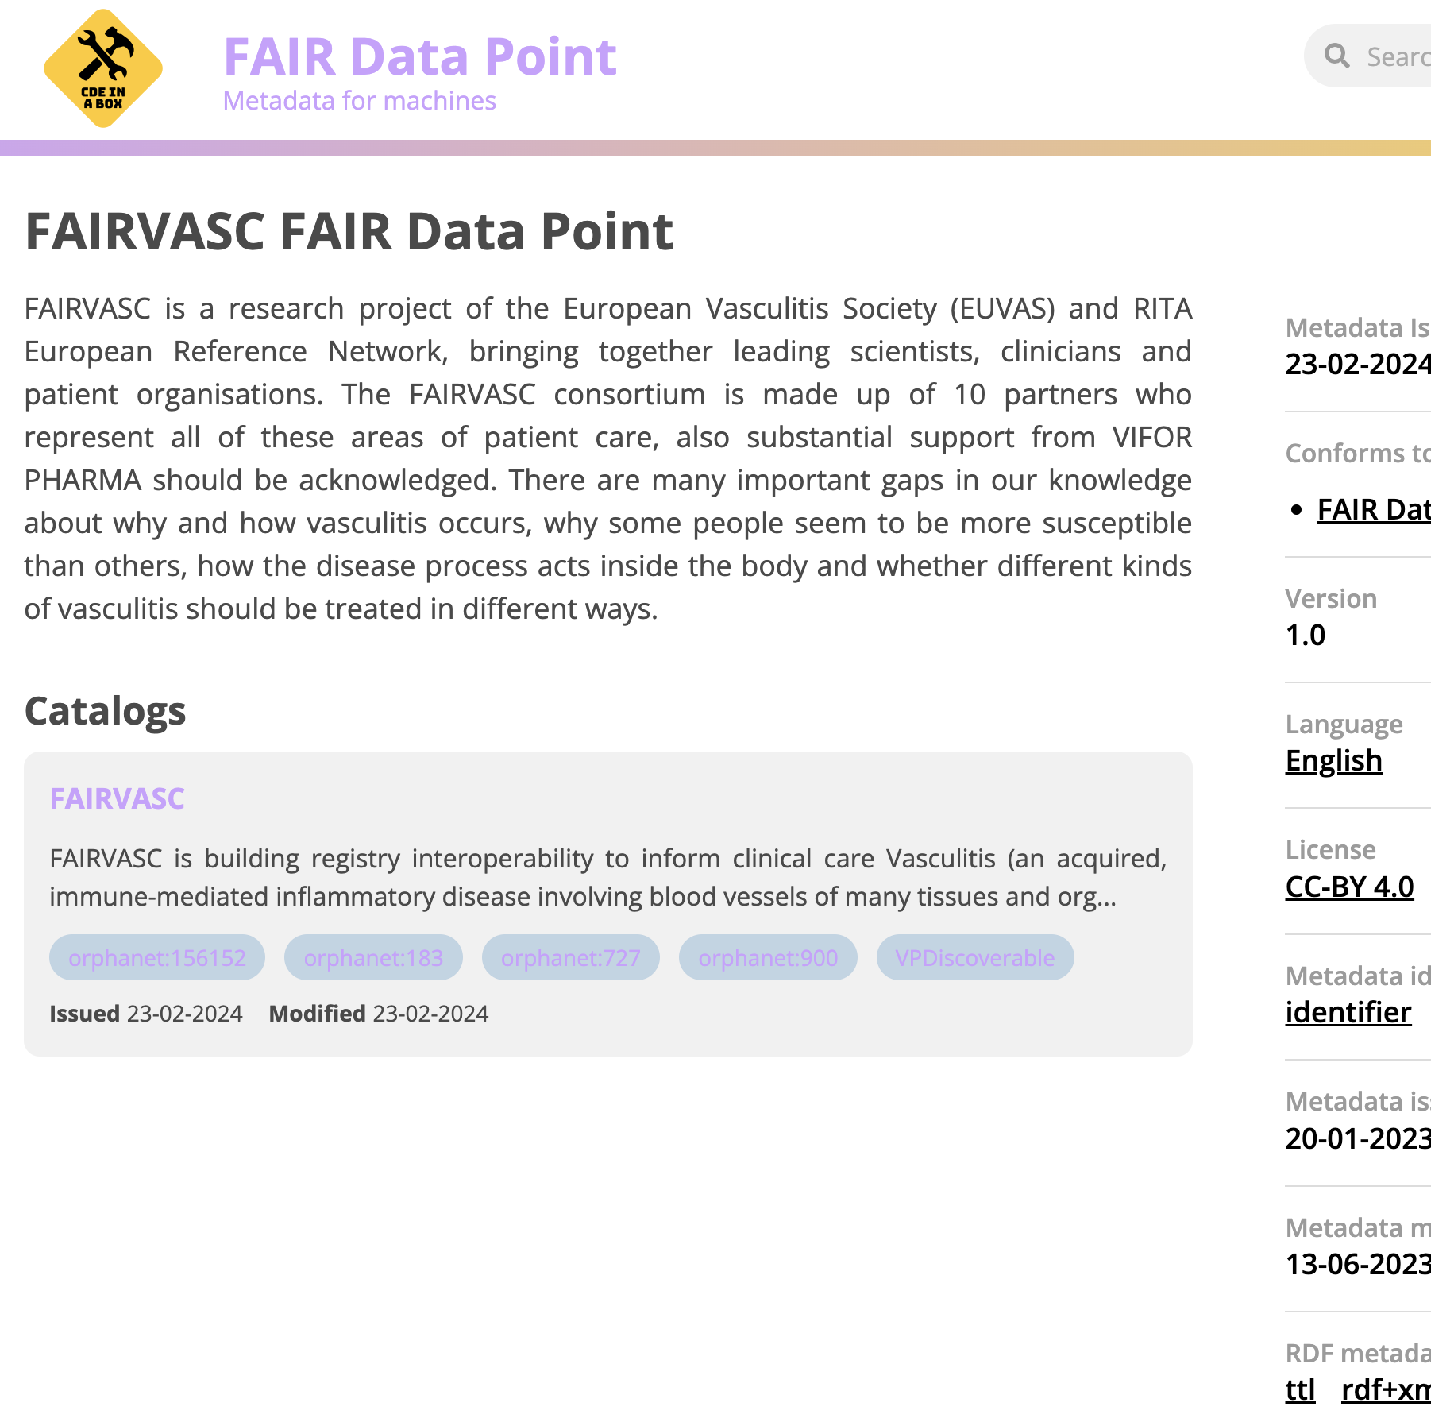
Such metadata can be rendered on the Web:
Examples:
https://fdp.castoredc.com/fdp
https://fdp.radboudumc.nl/
https://fairvasc-fdp.adaptcentre.ie/
https://twoc.fpoc.flos.navify.com/

Slide 12
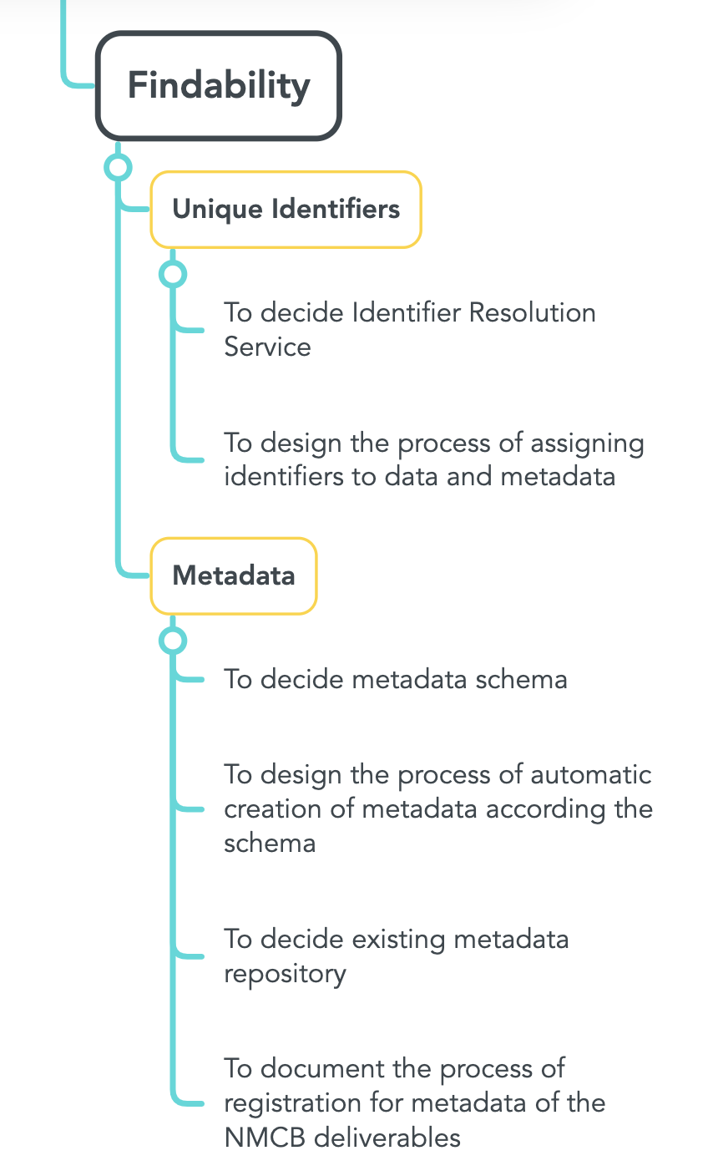
In Short

