Slide 1
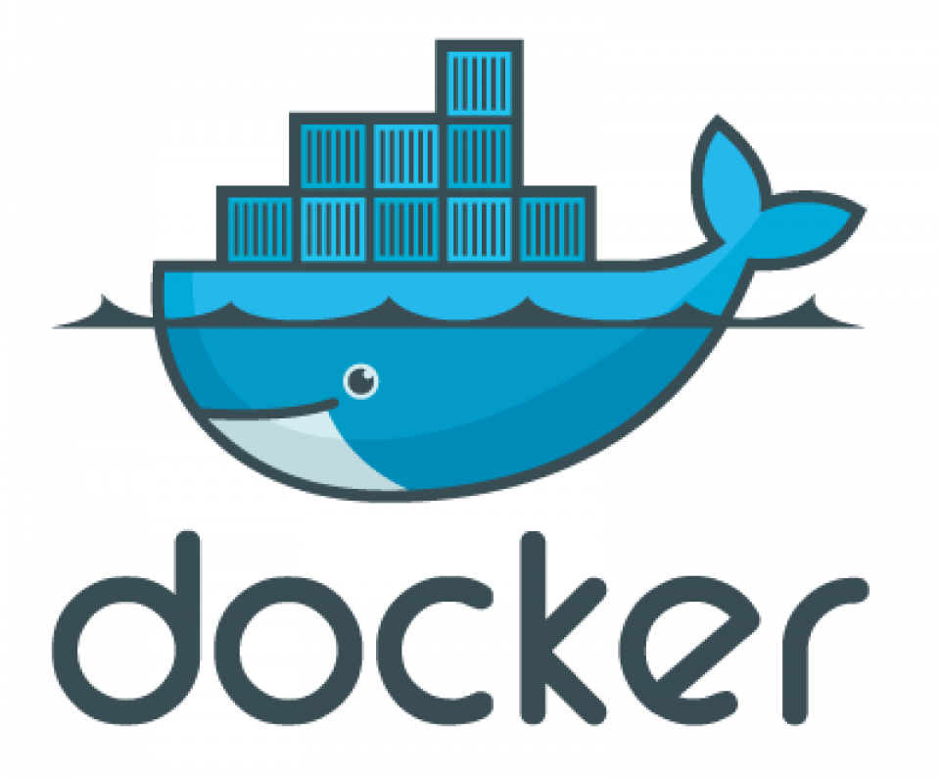
What is Docker
By Nial

Slide 2
Understanding the Basics
Docker is an open-source platform for developing and running applications in containers.
It leverages containerization to provide a consistent and lightweight way to package and deploy software.
Key terms:
Image
Container
Host
Notes:
Docker Image: This is a blueprint or a snapshot of a container. these are usually stored in a registry to allow the images to be access from multiple machines
Docker Container: An instance of a Docker image that runs the application.
Host Operating System: The server or computer running Docker, where containers are deployed.

Slide 3
Why use Docker
Docker containers are useful as they are:
Quick to deploy
Lightweight
Consistent
Easily scalable
More secure/Isolation
Notes:
Fast: Containers start and stop in seconds, unlike virtual machines that take minutes.
Lightweight: Containers share the host’s kernel and only use the resources they need, unlike virtual machines that have their own operating system and consume more memory and disk space.
Consistent: Containers run the same way on any machine, regardless of the operating system or hardware.
Scalable: Containers can be easily replicated, distributed, and orchestrated across multiple hosts, unlike virtual machines that are harder to manage and automate.
Secure: Containers are isolated from each other and from the host, and can be restricted in their access to resources, ensuring applications don't interfere with each other.

Slide 4
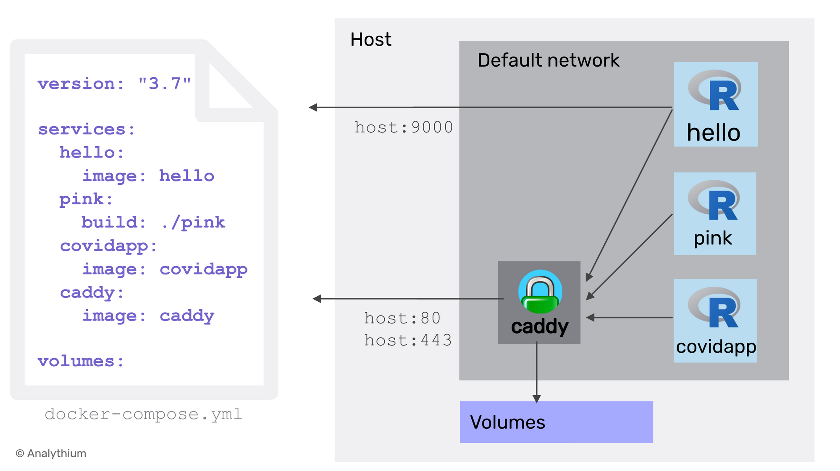
Docker compose
Docker compose is a tool for defining and running multiple docker containers at once
Key features:
Multi-service applications
Definable networking
Volumes
Dependencies
Use cases:
Ideal for applications where multiple services are needed to work togehter
Notes:
Why Docker Compose?
It simplifies the management of complex applications across multiple hosts
Allows defining multi-container applications in a single, easy-to-read YAML file.
Using a docker compose file you cant define exactly how containers can communicate with one another and the outside world
Volumes allow for persistent data storage
Define dependencies between services, ensuring they start in the right order.
Such as a website, you would have one container running your website frontend, one doing the backend and one running an SQL database

Slide 5
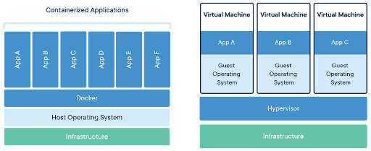
Docker vs Virtual Machines
Docker containers
Shares the host OS kernel
Faster startup
Lower reasource usage
Advantages
Faster provisioning
Can run more containers per host
Easier to manage at scale
Better efficiency
Virtual Machines
Each VM runs a separate OS
Slower startup
Higher resource usage
Advantages of VMs
More isolation between VMs
Support for multiple OS types

Slide 6


