Slide 1
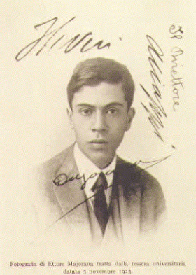




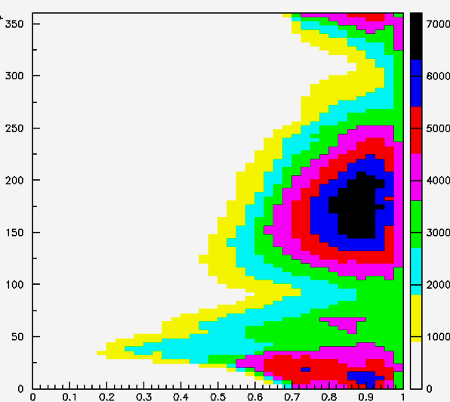
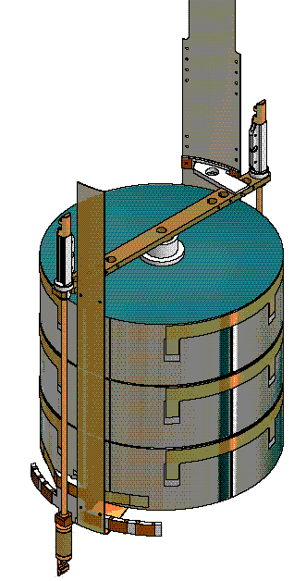
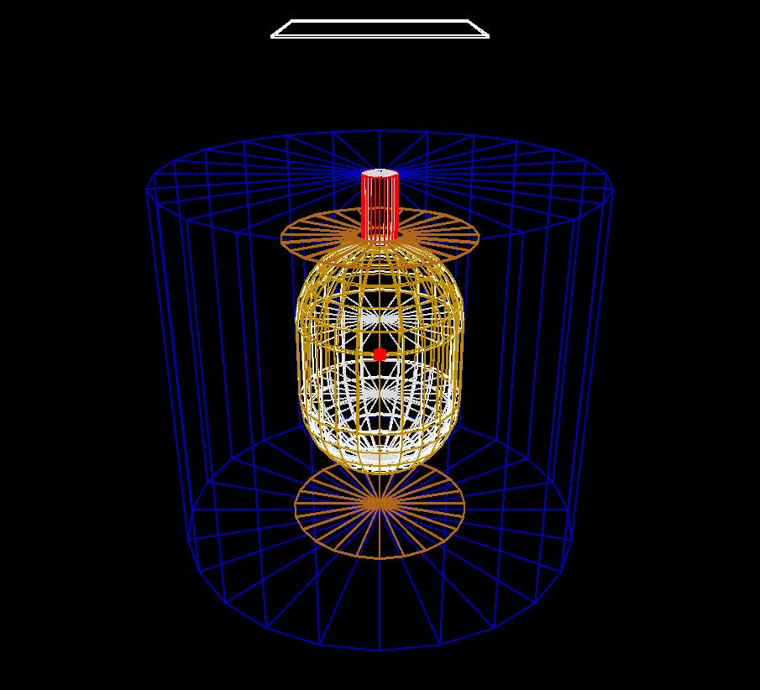
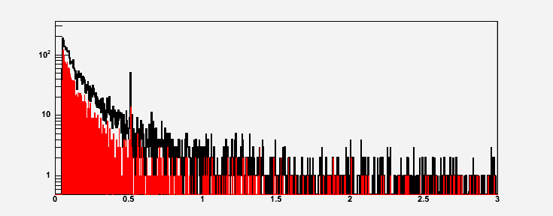
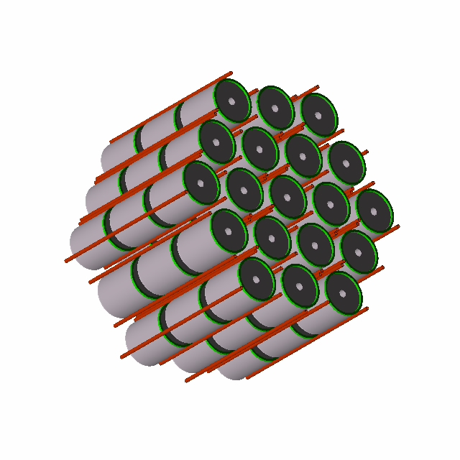
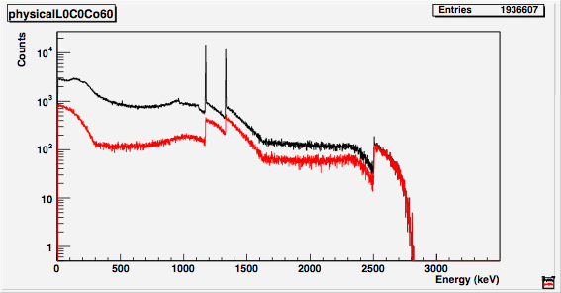
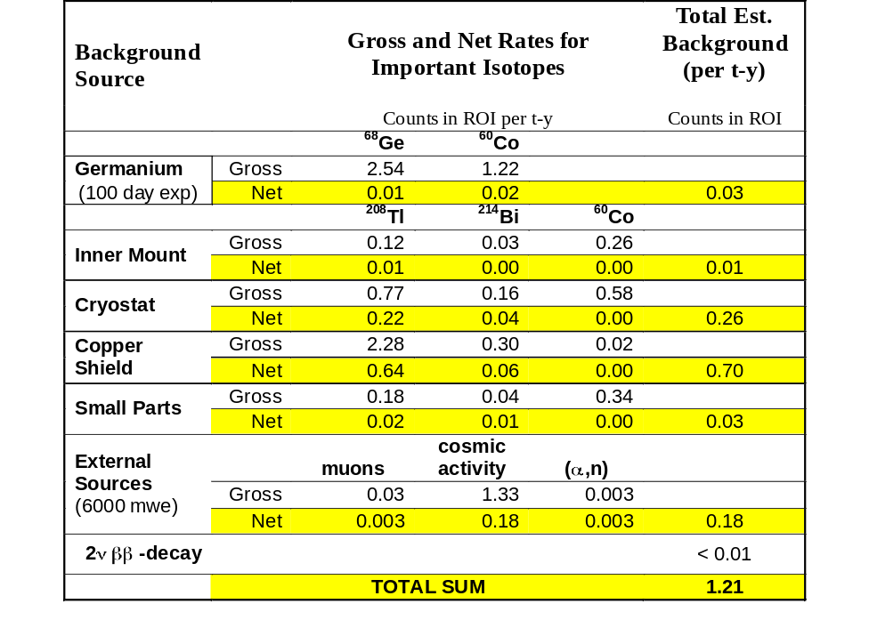
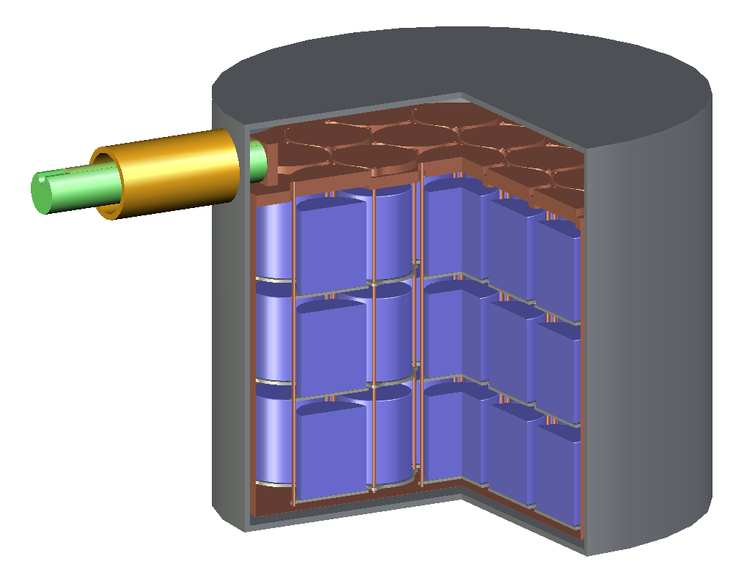
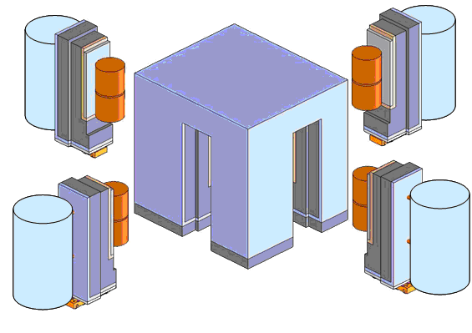
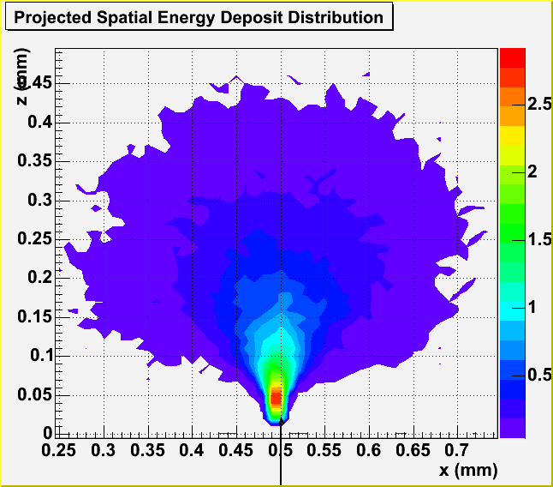
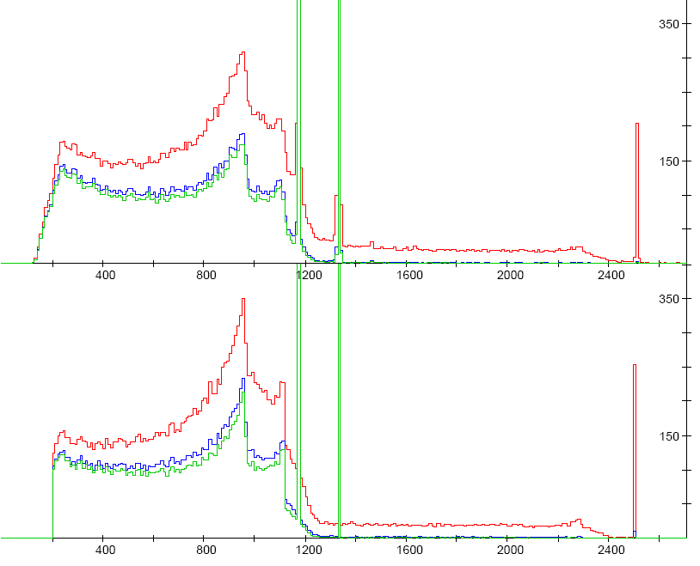
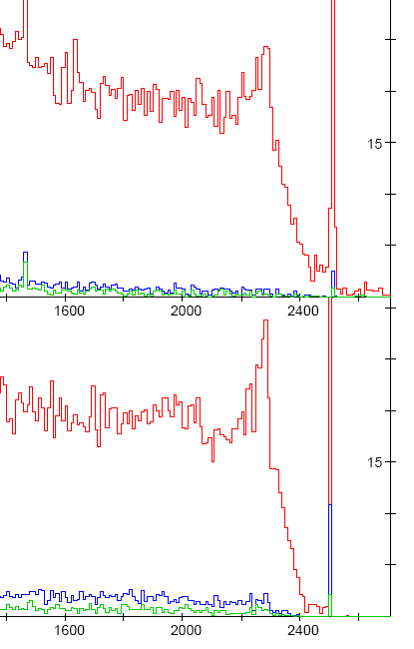
MaGe: a Monte Carlo framework for the Gerda and Majorana double beta decay experiments
M. Bauer, S. Belogurov, Y.D. Chan, M. Descovich, J. Detwiler, M. Di Marco, B. Fujikawa, D. Franco, V. Gehman, R. Henning, K. Hudek, R. Johnson, D. Jordan, K. Kazkaz, A. Klimenko, M. Knapp, K. Kroeninger, K. Lesko, X. Liu, M. Marino, A. Mokhtarani, L. Pandola, M. Perry, A. Poon, D. Radford, C. Tomei, C. Tull
What is MaGe?
Present status of MaGe
MaGe is a Monte Carlo simulation package dedicated to experiments searching for 0ν2β decay in ⁷⁶Ge. Created by the Majorana collaboration, MaGe is now developed jointly by the Majorana and GERDA simulation groups.
MaGe is based on GEANT4, a software well established and widely used in experimental physics.
A common CVS repository is hosted at Munich, allowing people from both groups to easily commit new contributions to the code and keep their version of MaGe always up to date.
The idea of MaGe is to share a common simulation framework with an abstract set of interfaces, while each experiment adds its concrete implementations (geometry, output, etc...).
A discussion forum is hosted at Berkeley to periodically exchange ideas and suggestions for the development of the package and to keep both sides informed about recent implementations and results.
Majorana geometry
MaGe
GERDA geometry
Why MaGe?
avoids duplication of the work for the common parts of the simulations (generators, physics, materials, management)
provides the complete simulation chain
allows a more extensive validation of the simulation with experimental data coming from both experiments
Event generators, description of physics processes, properties of the materials, management
The whole package can be configured and tuned by macros without accessing the code → accessible to new users and non experts of C++
No constraints to both sides (geometry, physics, etc.) → each component can be independently re-written
can be run by script and is flexible for experiment-specific implementation of geometry and output;
is suitable for the distributed development
MJ output
GERDA output
The Gerda ⁷⁶Ge 0ν2β experiment
Muon background Study @ LNGS
Radioactive bck Study @ MPI Munich
GERDA is a new experiment for the search of ⁷⁶Ge neutrinoless double-β decay at the Gran Sasso Laboratory (LNGS). The basic principle is to operate Ge detectors made out of isotopically enriched material inside a cryogenic fluid shield.
The MaGe simulation package has been used to study the background induced by cosmic muons in the GERDA experiment and to optimize the design of the muon veto (plastic scintillators and Cerenkov μ-veto)
Background events from decays of radioactive elements (⁶⁰Co, ⁴⁰K, ²³⁸U & ²³²Th chains) inside crystals, support and electronic cables are studied.
φ
angular distribution of cosmic muons at LNGS
(from the MACRO experiment)
Energy window (1.5 – 2.5) MeV
Most background events come from photons, depositing energy in several crystal segments, while signal events have electrons depositing energy locally.
Crystal (3z X 6φ segments)
Results on the efficiency of the muon vetoes | Background index (cts/keV kg y)
No cuts | 1.9 · 10⁻³
Ge anti-coincidence | 4.1 · 10⁻⁴
Ge anti-coincidence Top μ-veto (above penthouse) | 3.5 · 10⁻⁴
Cerenkov μ-veto (thr = 120 MeV, 30,000 photons) | < 3 · 10⁻⁵ (95% CL)
top μ-veto
water tank
MaGe simulation of the GERDA geometry including the detectors and the shielding
Teramo side
Segment anticoincidence cut → background < 10⁻³ cts/keV/kg/y Signal efficiency > 85%.
Pulse-shape under study, will further reject background.
Electronic cables
neck
cryo vessel
lead shielding
cosθ
Support
GERDA will be located in Hall A of LNGS. The main goals of the experiment are:
Meets the requirements of GERDA in terms of background !
Simulation of muon-induced spectrum in germanium
Source
Activity
Survival
probability
Background Index
[10⁻³ cts/kg/keV/y]
Ge array
Phase I: 9 Ge crystals for a total mass of 19 kg. The threshold for Ge crystals is 50 keV
²⁰⁸Tl (support)
9 μBq/kg
1.2 ·10⁻⁴
0.3
to probe the neutrinoless double beta decay of ⁷⁶Ge with a sensitivity of T_{1/2} > 2 · 10²⁶ y at 90% CL, corresponding to a range of effective neutrino mass < 0.09 - 0.20 eV within 3 years.
to be a pioneering low-level facility demonstrating the possibility of reducing the background by 2-3 orders of magnitude below the current state-of-the-art.
annihilation peak
6.2 years
Sum spectrum without and with anticoincidence
²¹⁴Bi (support)
25 μBq/kg
2.5 ·10⁻⁵
0.2
Reduction of more than a factor 4 by means of the anticoincidence
⁶⁸Ge (crystal)
60 /kg/year*
2.2 ·10⁻⁴
0.8
⁶⁰Co (crystal)
15 /kg/year
4.7 ·10⁻⁵
0.07
Energy [MeV]
2νββ
T_{1/2} = 1.74·10²¹ y
< 10⁻⁶
< 0.45
* First year only
Majorana is US, Canadian, Russian, and Japanese Collaboration, about 50 scientists are involved.
The initial, proposed deployment consists of 180 kg of crystals, scalable to 500kg.
The expected sensitivity is T_{1/2} ~ 5x10²⁶ y within 3 years.
The shielding consists of ultra-pure copper, ancient lead and active muon veto.
Majorana uses careful material selection. Crystal-to-crystal veto, segmentation, pulse-shape discrimination, deep site location, and other techniques are used to reduce backgrounds.
The Majorana ⁷⁶Ge 0ν2β experiment
Background Model for Proposal
Proposed Geometry
Selected Majorana Studies with MaGe
Ionization Energy Distribution
Vacuum jacket
Cold Plate
Segmentation Studies
Cold Finger
Crystal
Experiment
1.1 kg Crystal
1x8
Counts / keV / 10⁶ decays
Thermal
Shroud
4x8
GEANT
Bottom Closure
1 of 19 crystal stacks

