Slide 1
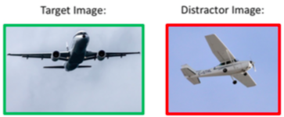

Generating Referring Expressions for Objects in Image
Background
Model
Task: Create unambiguous caption for specific image or object
Ambiguous caption:
“An airplane is flying in the sky.”
Unambiguous caption:
“A large passenger jet is flying across a cloudy sky.”
Target Image
Target Features
Target Word Probabilities
Beam Search
Next Word
VGG19
RNN
Distractor
Image
DistractorFeatures
Target Word Probabilities
Bayes
Related Work:
Vedantam, et al., train a model on individual images and use the probabilities of either image producing a given caption
Mao, et al., train a model that on image regions and entire images to learn to discriminate
Datasets
Experimental Results
MS COCO: Images of common objects in context with human generated captions
Google Refexp: Some MS COCO images with bounding boxes around objects of interest and specific, human-generated captions for bounded objects
TODO
Referring Expression:
“The man who is touching his head.”

