Slide 1

Bright TV analysis.
Presentation by Andiswa Asanda Mchunu.

Slide 2
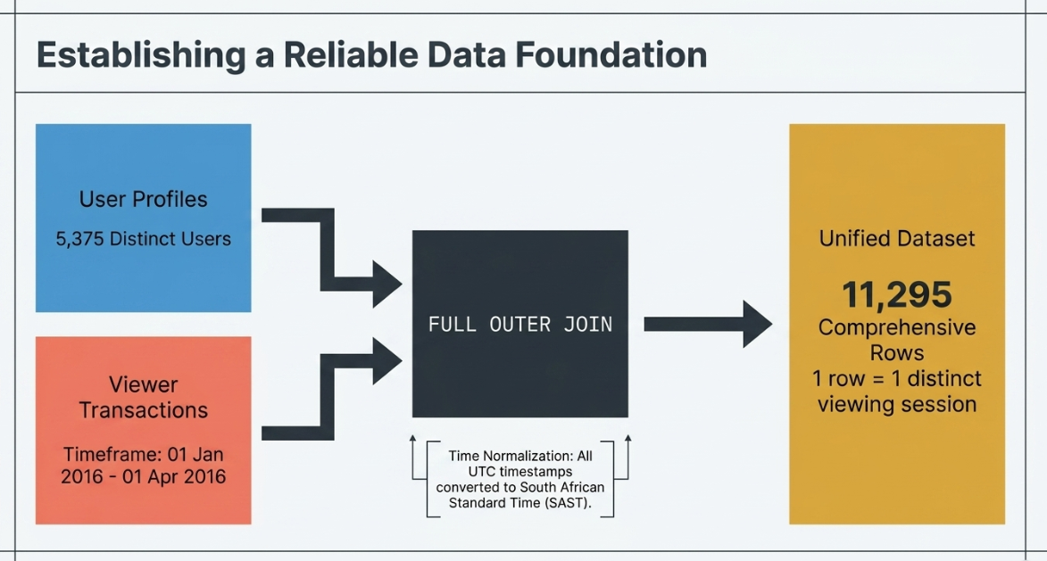
Understanding the data.
Sample Size | Duration
5375 Distinct Users | Start date: 01 January 2016
11295 rows or people after using OUTER FULL JOIN to join the tables. | End date: 01 April 2016

Slide 3
Viewership per province
Gauteng
Has the highest number of viewers, in this case 3 786 viewers. This is because it has the highest population, housing approximately 15.9 million to 16.1 million people according to Stats SA.
Northern Cape
Has the lowest number of viewers, in this case it is 236 viewers. This is because it is approximately housing 1.38 million people.
NULLS/ Nones
The sum of 1049 viewers where unaccounted for, as to which province are they from.

Slide 4
Viewership by race
Black people are leading with the total viewers that summed to 4516.
Other races that are not specified have the least number of viewers which is only 108
235 viewers are unaccounted for. The race is not known at all, hence it was null.

Slide 5
Viewer demographics by gender
Total viewers analysed:
Male: 9190 (82%)
Female: 1056 (9%)
Other: 828(7)
Null: 221(2%)
Male viewers represent 82% of the viewers.
Top-performing content was sport-related, which historically indexes higher with male audiences per industry benchmarks.
Other gender is non-binary and NULLs are people who did not specify their gender.

Slide 6
Viewership by age
The TRENDLINE clearly shows that the more people age, the less they watch TV.
Adults and young adults are leading with 4991 and 3933, respectively
Teenagers views are at 181, might because the get to watch TV on weekends and attending school on weekdays.
Seniors has the lowest number of viewers because they barely watch TV, reasons can be weak eye sight and they sleeping early.

Slide 7
VIEWERSHIP BY MONTH
March has the highest number of viewers, at this case 4816. March has an extremely high viewership for sports.
April has the lowest number of viewers, at this case only 5. This could have happened because of many reasons.
Examples: Rise of Digital and Social Media.
Spring Break and better weather: Fewer people stay indoors because the majority is outside.

Slide 8
DAILY viewership
The afternoon slot has the highest number of viewers (3734) because it targets specific demographics who are home, such as homemakers, retires, adults from works and students from school. It is time to relax after a long day.
Late nights has the lowest (561) because most programs have adult-orientated scenes or stronger language.
Midnight viewing at 1295 is because of night shift workers or people with insomnia.

Slide 9
Views per channel

Slide 10
Top 5 Of most watched shows.
SuperSport Live Events is leading with 1638 viewers. This is because it was sport season as ICC Cricket World Cup is in the second place with 1465 viewers.
Music shows made 21% of the views.
There is an unknown show that has 1295 viewers.

Slide 11
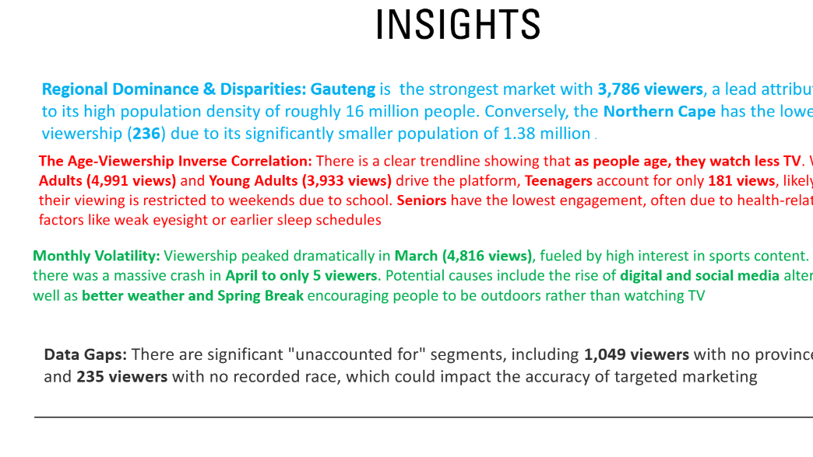

Slide 12
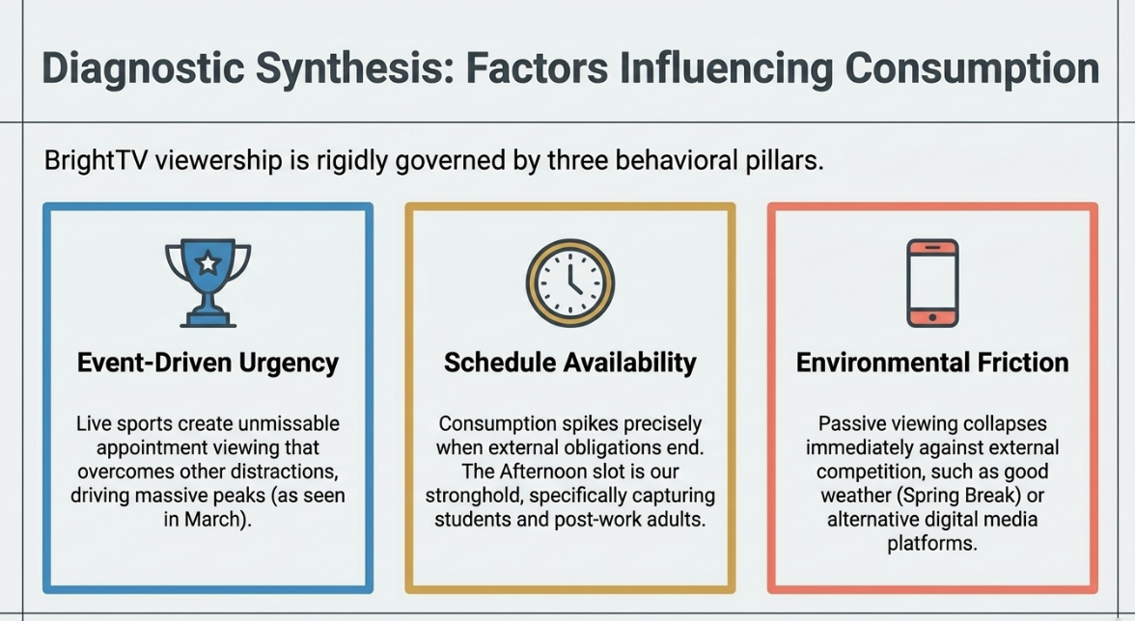

Slide 13
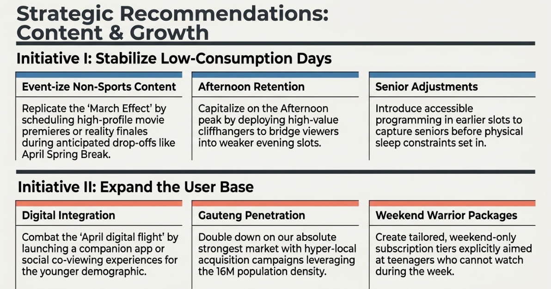

Slide 14


