Slide 1
An Investigation into Police Employment vs. Arrests
Nichole Gosselin
Christina Schwaller

Slide 2
Scientific Questions
What has been happening to police employment and the number of arrests over the last 10 years?
How does the number of police officers compare to the number of arrests nationally and also by state?
How do the numbers of female employees compare to the numbers of arrests?

Slide 3

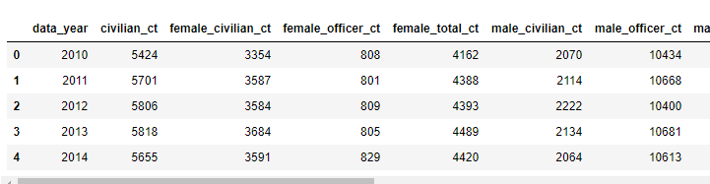
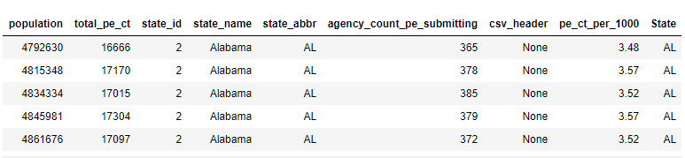
About the data:
We got our data from the Crime Data Explorer. There were multiple datasets, but we chose to explore the police employment data and the arrest data. Some available data from the police employment data is shown below.
We chose to look at data from the ten-year period 2010-2019. 2019 was the most recent year for data on the website.
Data was organized by year and by state for both datasets. We also chose to look at arrests for “all crimes”, but you could also select individual types of crimes.

Slide 4
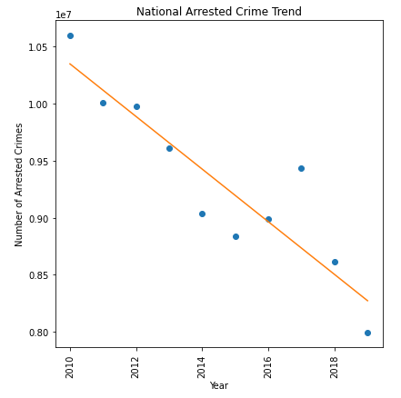
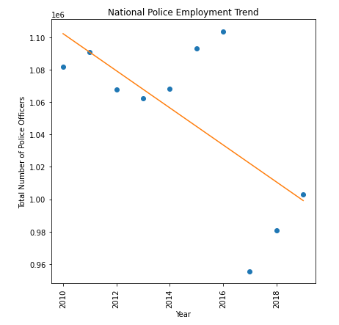
Question 1: What has been happening to national police employment and the number of arrests over the last 10 years?

Slide 5
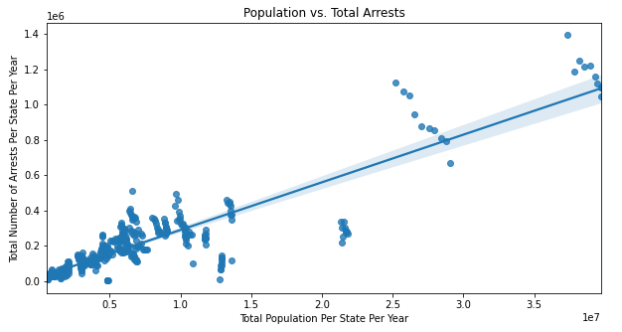
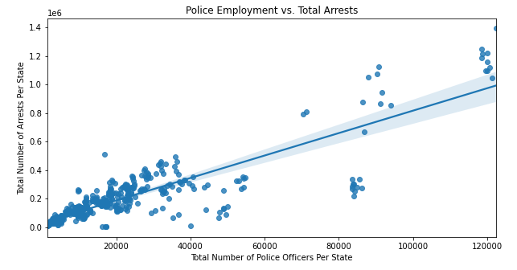
What is the correlation between total number of officers per state and total number of arrests per state?
The correlation between the total number of arrests per state and the total number of officers per state is very high (0.87), but after investigating this further and color-coding individual states, we see that both of these are just tied to population. So, it does not mean that more officers improves arrest rate.
In fact, correlation between arrests and population, shown in the bottom figure, is very strongly positive (0.90).

Slide 6

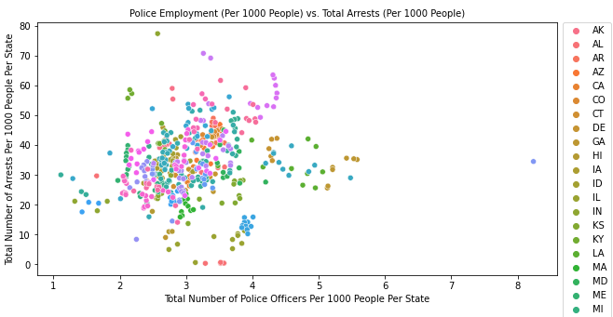
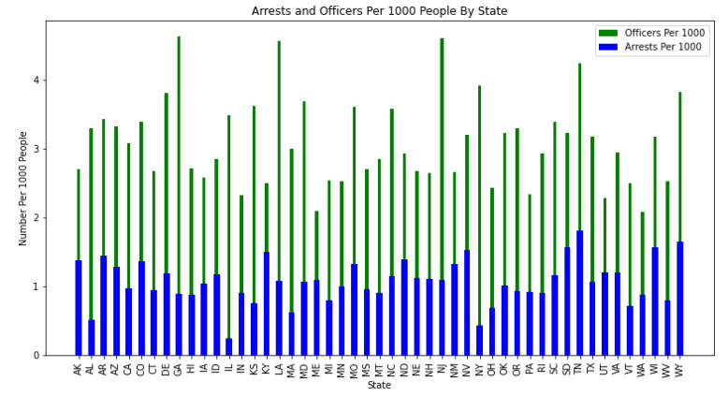
Question 2: How does the number of police officers compare to the number of arrests by state? (when looking at it per capita)
The correlation between the total number of police officers per 1000 people and the total number of arrests per 1000 people is actually not strong at all (0.16). It looks like there is an optimal number of officer (between 2 and 4) per 1000 people that is adequate to make arrests.

Slide 7
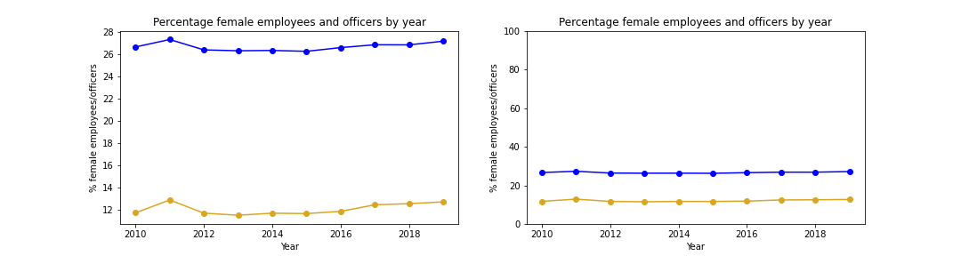
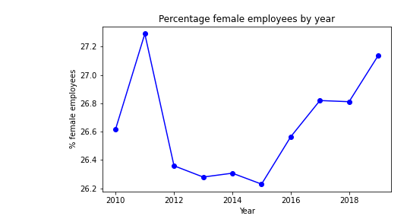
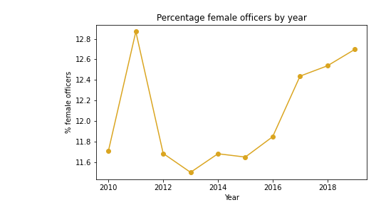
Question 3: How do the numbers of female employees compare to numbers of arrests?
First we determined that all employees were listed as either male or female.
We looked at the percentage of employees and officers who were female for each year.
Although the percentage of female employees was uniformly higher than the percentage of female officers, changes during this 10-year period look almost identical for both groups.

Slide 8
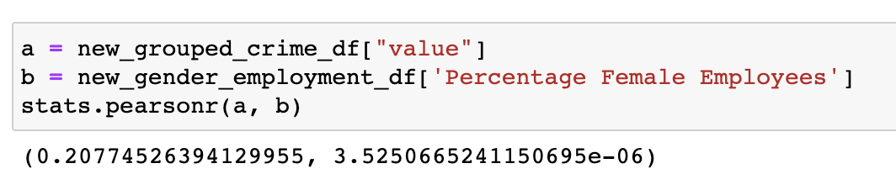
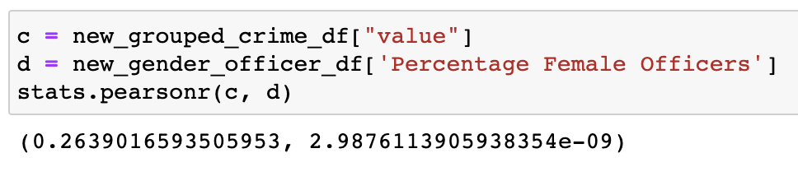
No significant correlations between number of arrests per year and either employee or officer gender.
Number of arrests vs. % female employees:
Number of arrests vs. % female officers:

Slide 9
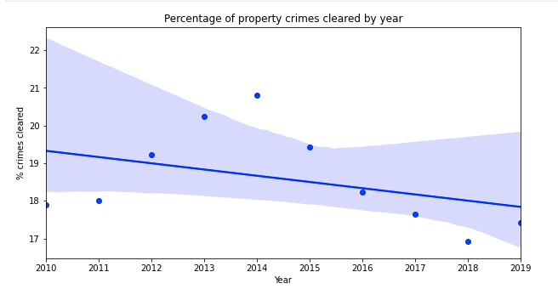
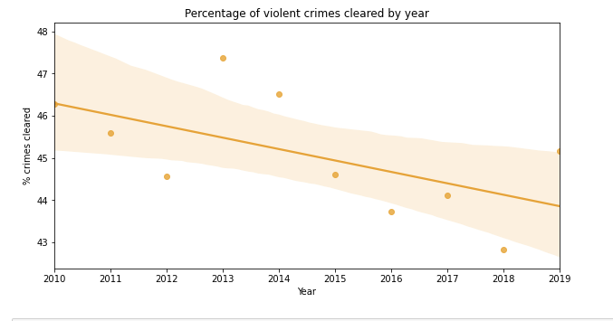
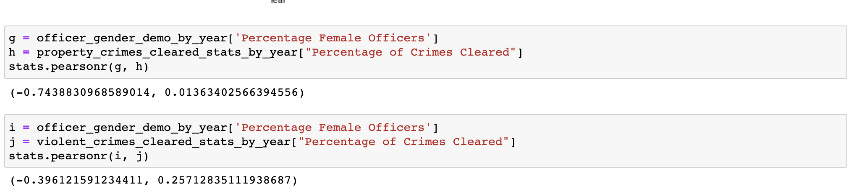
Gender vs. property crime & violent crime

Slide 10
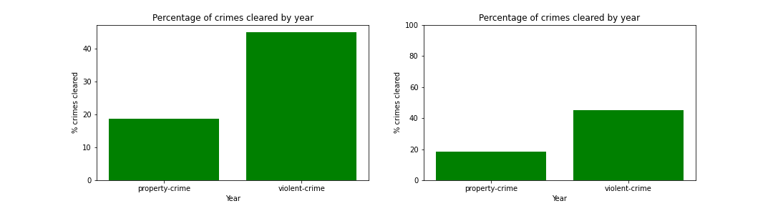
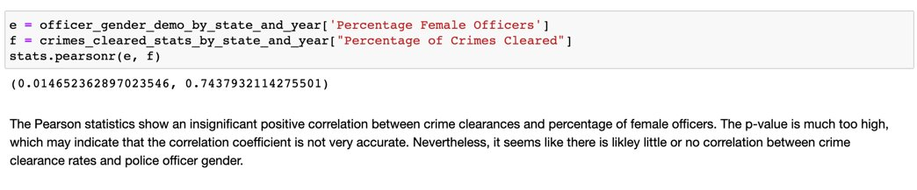
Gender vs. cleared crimes

