Slide 1
Predicting Political Instability
Nichole Gosselin
Christina Schwaller

Slide 2

Project Goal
In 2015, the UN proposed a set of Sustainable Development Goals to improve the quality of life on Earth.
When countries struggle with sustainability, political tension can arise because of lack of good health, quality food and water, and poor economies.
For this project, we use global sustainability indicators to predict political instability in countries.

Slide 3
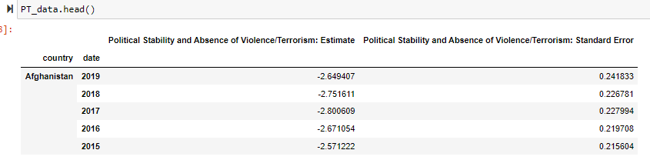
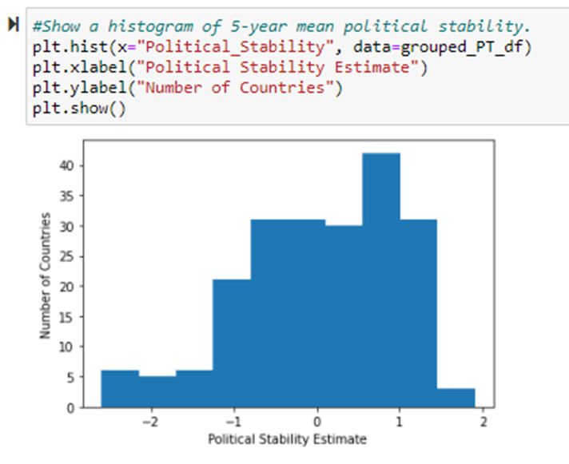
Political Stability Data
Political Stability Data for each country from 2010-2020 were obtained from the Worldwide Governance Indicators Database from the World Bank Data Bank.
Political Stability and Absence of Violence/Terrorism measures perceptions of the likelihood of political instability and/or politically-motivated violence, including terrorism. Standard error indicates the precision of the estimate of governance. Larger values of the standard error indicate less precise estimates. A 90 percent confidence interval for the governance estimate is given by the estimate +/- 1.64 times the standard error.

Slide 4
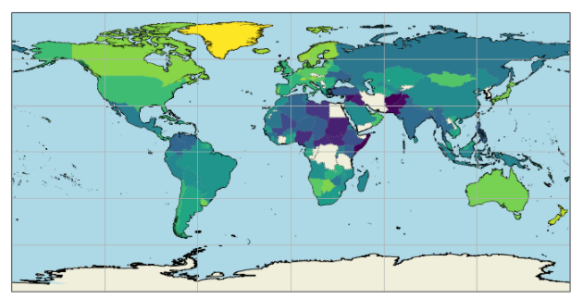
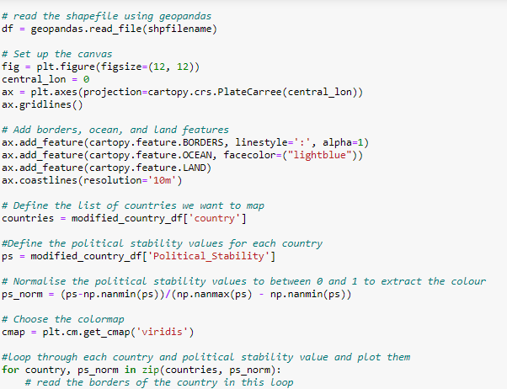
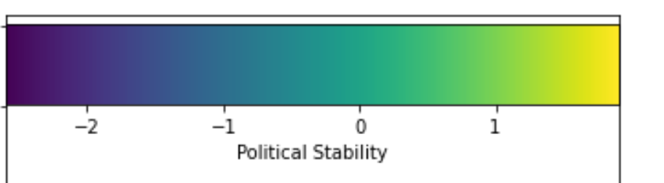
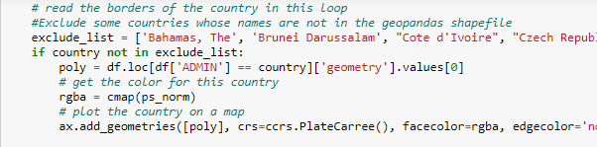
Political Instability Data
Ten-Year Mean Political Stability:
Highest: Greenland (1.9)
Lowest: Somalia (-2.59)
United States: 0.5

Slide 5
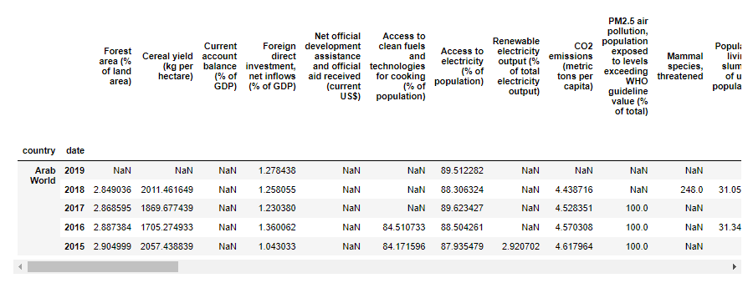
Sustainability Indicator Data
Sustainability Indicator Data were obtained for each available country from 2010-2020 from the Sustainable Development goals database in the World Bank Data Bank.

Slide 6
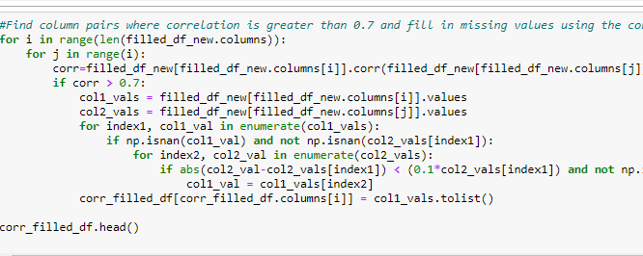
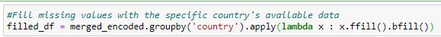
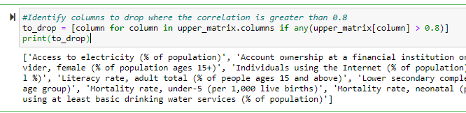
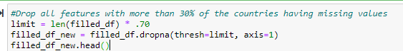
Preprocessing Steps 1-4
3. Use columns with high correlations to fill in missing values.
4. Dropped columns with high correlations to another
Biggest preprocessing challenge was figuring out how to remove or fill all the Nan values.
Methods:
Filled in missing values from each countries closest yearly value.
2. Removed features with more than 30% missing data.

Slide 7
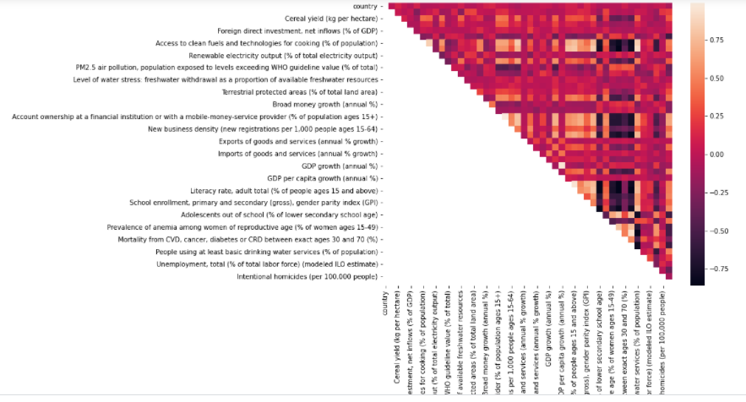
Preprocessing Step 4.
Upper Matrix used to find columns with high correlations (>0.8) with one another and remove one.

Slide 8
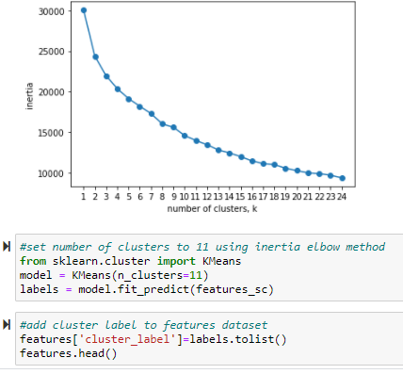
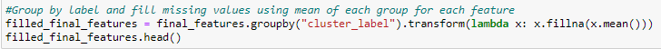
Preprocessing Step 5
Use unsupervised learning to cluster like countries and then use available data from the same cluster to fill in missing data.
Steps:
Remove the features that have lots of missing values that you will impute a later time.
Keep the features that have no missing values to do the supervised learning.
Use k-means to cluster the data
Append the cluster results to the data table and add back in the earlier removed rows
Fill in the missing data with the mean of the cluster for each feature.

Slide 9
Supervised Learning Methods
Models used:
Multiple linear regression
Decision tree regression
Random forest regression
XGBoost regression
PyTorch neural network
Keras neural network

Slide 10
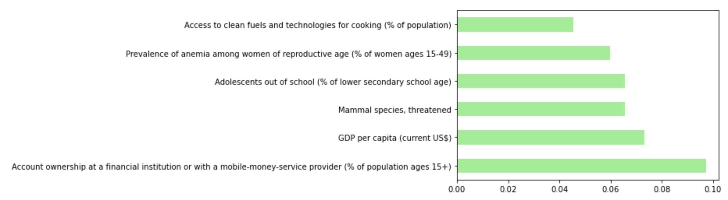
Random Forest Regression
Tuned Random Forest Regressor Scores:
RMSE = 0.35
R2 score = 0.84
MAE = 0.27

Slide 11
PyTorch Neural Network
Steps:
Create tensors
Build a class containing the network of layers/perceptrons as attributes.
Instantiate the model from the class.
Set loss function and optimizer.
Run model through multiple epochs of loss/optimization.
Make predictions with the optimized model.
Calculate MSE, RMSE, and R² of predicted vs. test values.
PyTorch Neural Network Scores:
MSE = 0.08
RMSE = 0.29
R² score = 0.9

Slide 12
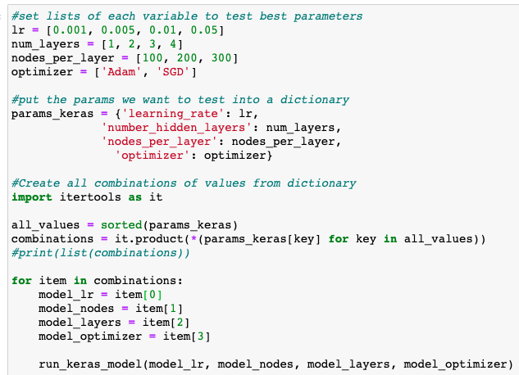
Keras Neural Network

Slide 13
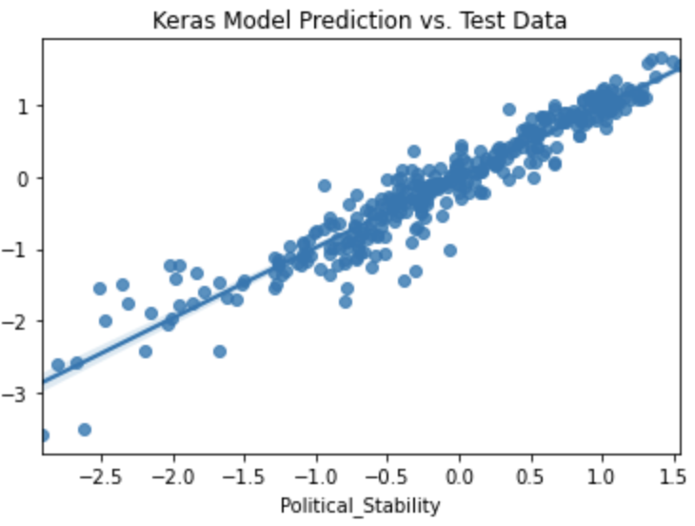
Keras Neural Network
Keras Neural Network Scores:
MSE = 0.07
RMSE = 0.27
R² score = 0.91

Slide 14
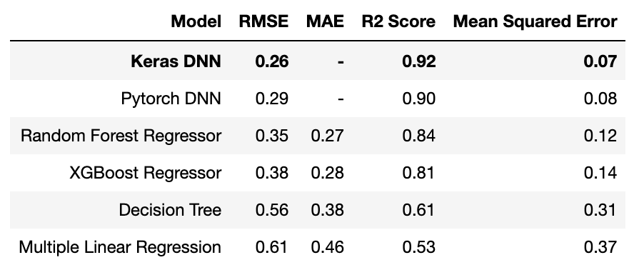
Summary of Machine Learning Results

