Slide 1
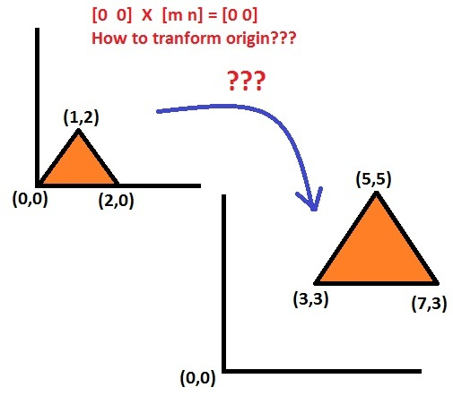
Translations (transforming center)
Center origin (0,0) remains unchanged after transformation.

Slide 2
Homogeneous coordinates
x*=ax+cy+m and y*=bx+dy+n
No room in T for translation constant m & n.
Homogeneous of vector [x,y] → [x’,y’,h]
Where, x=x’/h & y=y’/h ,
h→ any real no. (by default 1)
[6,4,2] , [12, 8, 4], [3,2,1] → H-coordinates of [3,2]

Slide 3
[x* y* 1] = [x y 1]* 1 0 0 = [x+m y+n 1]
0 1 0
m n 1
Origin x=0 and y=0 is also transformed to (m,n).

Slide 4
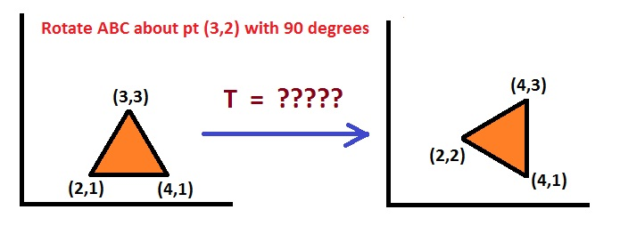
Example

Slide 5
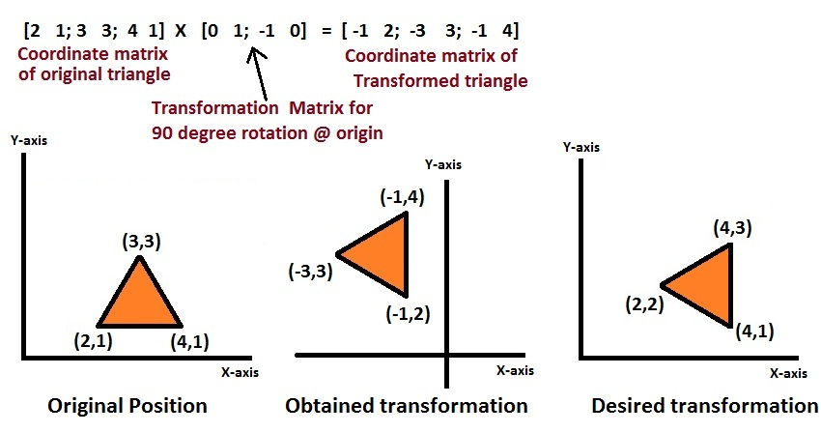

Slide 7
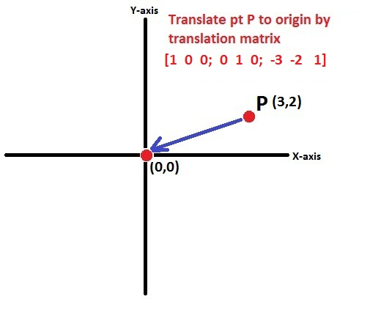

1.Translate pt (3,2) to origin

Slide 8
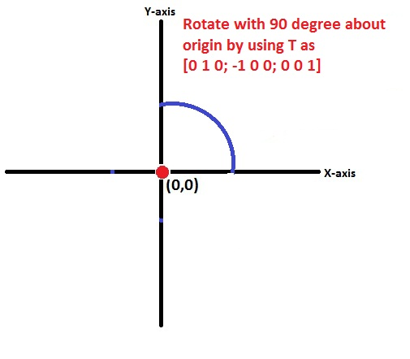
2.Rotate it by 90 degree about origin

Slide 9
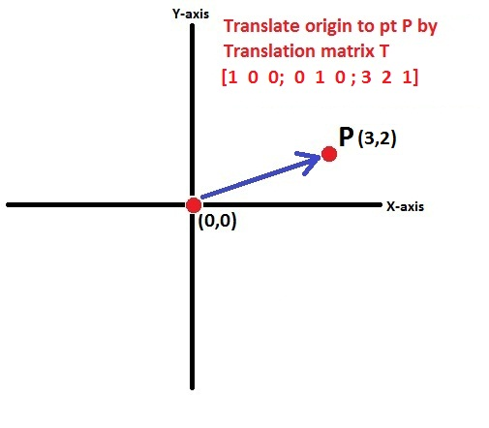
3. Translate origin to pt (3,2)

Slide 10
1.Translate pt (3,2) to origin
  T1= [1 0 0; 0 1 0; -3 -2 1]
2.Rotate it by 90 degree about origin
  T2=[0 1 0; -1 0 0; 0 0 1]
3.Translate origin to pt (3,2)
  T3=[ 1 0 0; 0 1 0; 3 2 1]
Hence, Actual Transformation Matrix
T= T1 X T2 X T3

Slide 11

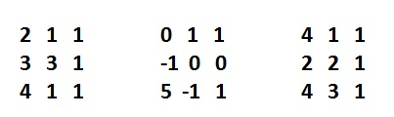
T= [ 0 1 0; -1 0 0; 5 -1 1]
Desired transformed triangle is

Slide 12
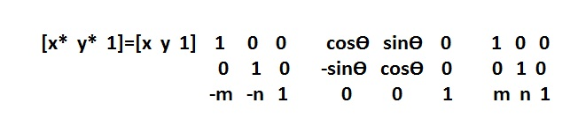
Rotation about an arbitrary point (m,n)
Translate the object’s center point to origin
Perform required rotation
Translate the result back to arbitrary point

Slide 13
Solve Example
Rotate triangle ABC with 270 degrees about point (4,3). Coordinates of ABC are as follows,
A→(3,1)
B→(5,1)
C→(4,4)

Slide 14
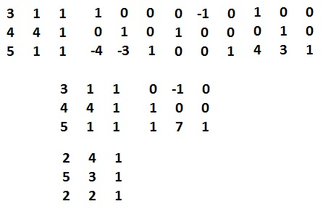

Slide 15
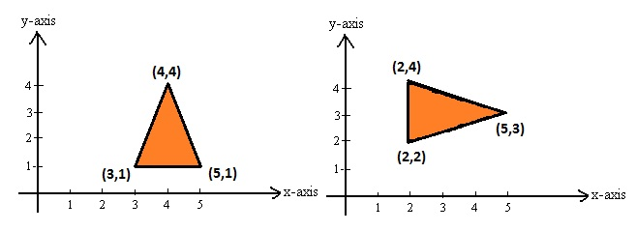
Plotting on coordinate system

Slide 16
Solve Example
Rotate triangle ABC with 180 degrees about point (-2,-2). Coordinates of ABC are as follows,
A→(-1,-1)
B→(-2,-3)
C→(-3,-1)

Slide 17
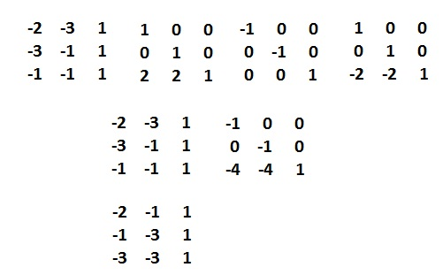

Slide 18
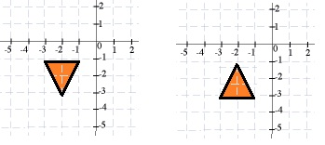
Plotting on coordinate system

Slide 19
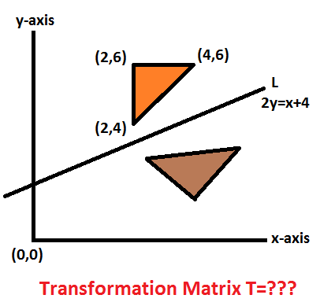
Reflection about an arbitrary line

Slide 20
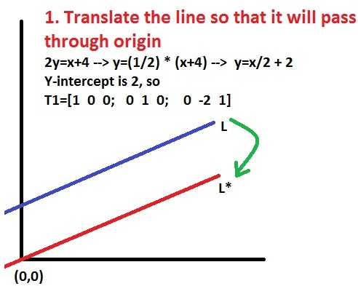
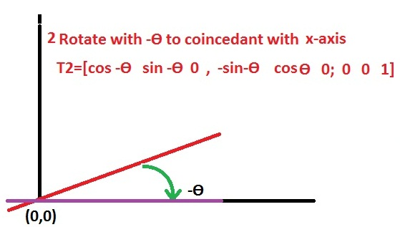
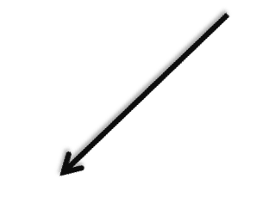
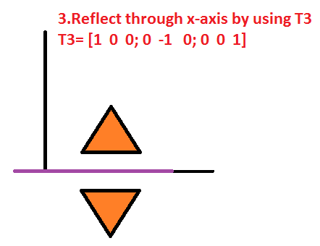

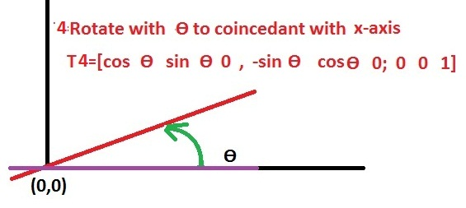
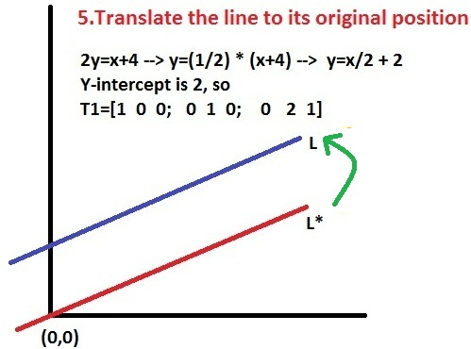

Slide 21
1. Translate the line such that it will pass through origin
Line→ 2y=x+4 → y=1/2 (x+4) → y=(x/2)+2
General line → y=mx+c , m→slope, c→y-intercept
We have to decrease y-intercept to ‘0’ for line passing through origin.
T1= 1 0 0
0 1 0
0 -2 1
Y-intercept

Slide 22
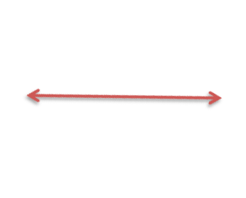
2. Rotate line so that it will coincident with one of the 2 axes
Line→ 2y=x+4 → y=1/2 (x+4) → y=(x/2)+2
General line → y=mx+c , m→slope, c→y-intercept
So, m= ½ and c=2.
m= tan Ɵ, so Ɵ=tan^-1 (m)
Tan^-1(1/2) = 26.57 degrees
T2= cos(- 26.57) sin(-26.57) 0 = 0.8944 -0.4473 0
-sin(-26.57) cos(-26.57) 0 0.4473 0.8944 0
0 0 1 0 0 1

Slide 23
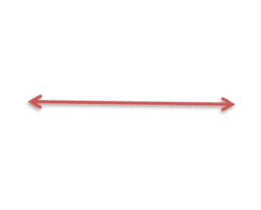
3.Reflect through main axis using general reflection T
T3= 1 0 0
0 -1 0
0 0 1

Slide 24


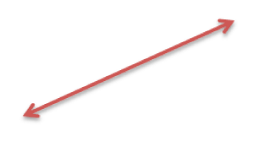

4.Rotate Back to its original angle in opposite direction
T4= cos(26.57) sin(26.57) 0 = 0.8944 0.4473 0
-sin(26.57) cos(26.57) 0 - 0.4473 0.8944 0
0 0 1 0 0 1

Slide 25

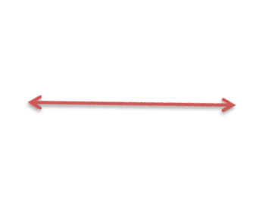
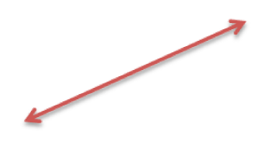
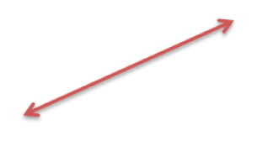

5.Translate Back to original position of line
We have to increase y-intercept to ‘2’ for obtaining line’s original position.
T5= 1 0 0
0 1 0
0 2 1

Slide 26
T=T1 X T2 X T3 X T4 X T5
= 1 0 0 0.894 -0.447 0 1 0 0 0.894 0.447 0 1 0 0
0 1 0 0.447 0.894 0 0 -1 0 - 0.447 0.894 0 0 1 0
0 -2 1 0 0 1 0 0 1 0 0 1 0 -2 1
= 0.6 0.8 0
0.8 -0.6 0
-1.6 3.2 1

Slide 27

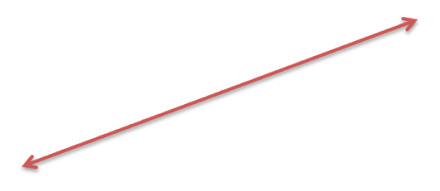

Coordinate matrix of ABC X T = Coordinate matrix of A*B*C*
2 4 1
4 6 1
2 6 1
0.6 0.8 0
0.8 -0.6 0
-1.6 3.2 1
2.8 2.4 1
5.6 2.8 1
4.4 1.2 1

Slide 28
Solve example
Reflect triangle ABC with respect to line
y=x+3 , The coordinates are as given below,
A→ (1,7)
B → (1,9)
C → (3,9)

Slide 29
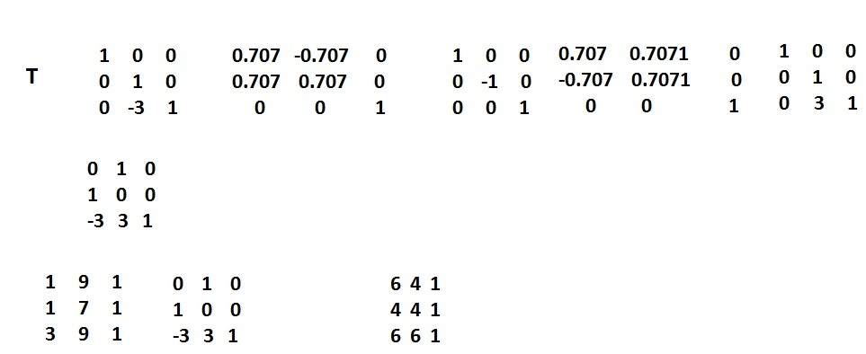

Slide 30
