Slide 1
Interpretation and reporting of instrumental variable analyses
Neil M Davies
MRC Integrative Epidemiology Unit
Bristol Medical School, University of Bristol
K.G. Jebsen Center for Genetic Epidemiology, Department of Public Health and Nursing, NTNU,
11th December 2020
All the materials are available here:
https://github.com/nmdavies/causal_inf_course/

Slide 2
Overview
1. Introduction to causal inference
2. Principals of instrumental variable analysis
3. Estimation with instrumental variables
4. Interpretation and reporting of instrumental variable analyses

Slide 3
Objectives
Be able to interpret instrumental variable estimates and the relevance and implications of different “4th IV assumptions”
Know key information to report and look for in IV studies
Instrument core instrumental variable assumptions
Instrumental variable bounds
What are “4th IV assumptions”?
Constant treatment effects
No effect modification
Monotonicity
No simultaneous heterogeneity (NOSH)
Lifetime versus transitory effects
Reporting of instrumental variable studies

Slide 4
Motivation
Getting instrumental variable estimates is easy
Interpretation can be very hard!
Who do estimates apply to?
How do they compare to hypothetical interventions

Slide 5
The instrumental variable DAG
Unmeasured confounders
(C)
Instrument
(Z)
Exposure
(X)
Outcome
(Y)
Three core IV assumptions:
Instrument associates with the exposure
The instrument and outcome have no unmeasured common cause
The instrument only affect the outcome via the exposure

Slide 6
Interpreting instrumental variable estimates
The three assumptions define an instrumental variable
Without a further, fourth, ‘point identifying assumption’ instrumental variable analyses only estimate bounds on the causal effect of exposure
These bounds are imprecise but require relatively weak assumptions
The instrument-outcome association – tests whether exposure affects the outcome but not the direction of the causal effect
Possible point identifying assumptions
Constant causal effect
Monotonic effect of the instrument on the exposure
No effect modification of the instrument

Slide 7
What is point identification?
Point identification is estimation of a specific parameter for the effect of exposure (or treatment) on the outcome
i.e. a single number or point, e.g. the average effect of treatment
Without a fourth IV assumption the three core IV assumptions only bound the treatment effect
Bounds are easy to calculate (bpbounds command) in Stata
But bounds are typically very wide and imprecise
Thus, the precision of and inference from IV estimates depends on the fourth assumption
Palmer, T.M., Ramsahai, R.R., Didelez, V., Sheehan, N.A., 2011. Nonparametric Bounds for the Causal Effect in a Binary Instrumental-Variable Model. The Stata Journal: Promoting communications on statistics and Stata 11, 345–367. https://doi.org/10.1177/1536867X1101100302
Swanson, S.A., Hernán, M.A., Miller, M., Robins, J.M., Richardson, T.S., 2018. Partial Identification of the Average Treatment Effect Using Instrumental Variables: Review of Methods for Binary Instruments, Treatments, and Outcomes. Journal of the American Statistical Association 113, 933–947. https://doi.org/10.1080/01621459.2018.1434530

Slide 8
Instrumental variable bounds
Simple IV simulation (see GitHub for Stata code)
Core IV assumptions hold:
Z ∼ Bern(0.5)
U ∼ Bern(0.5)
pX = 0.05 + 0.1U, X ∼ Bern(pX)
p = 0.1 + 0.05X + 0.1U
Y ∼ Bern(p)
N=10,000

Slide 9
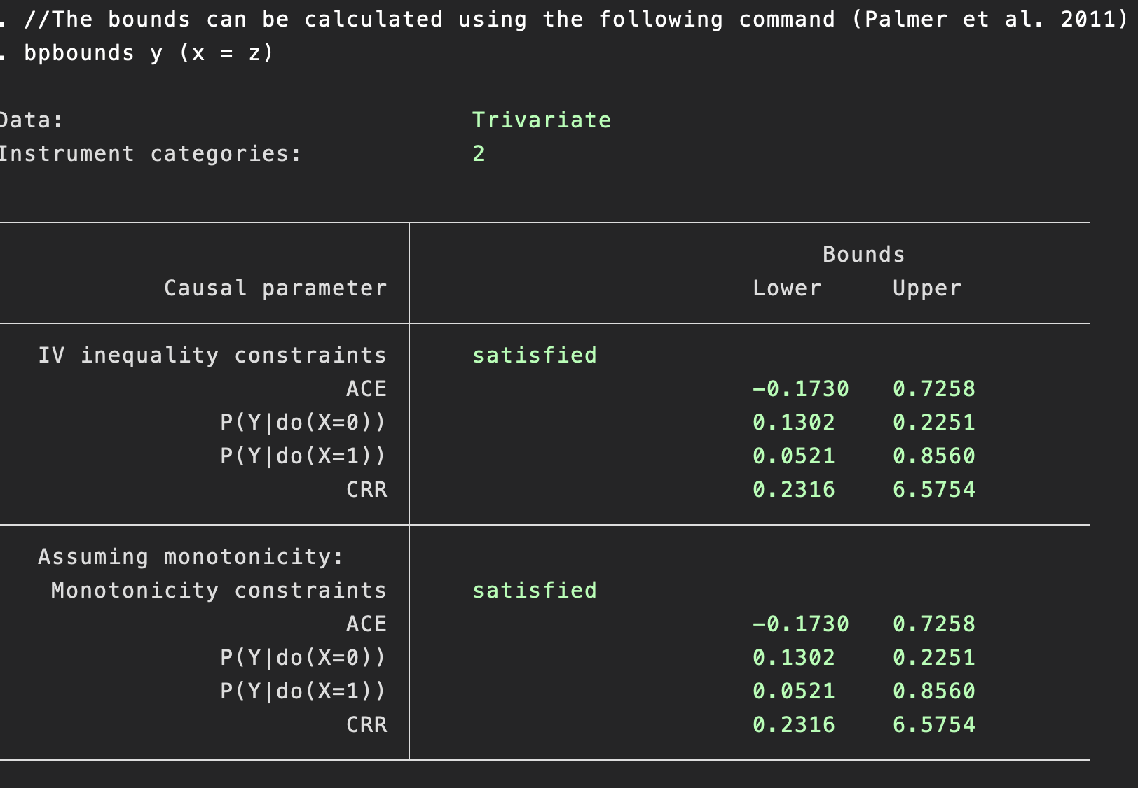
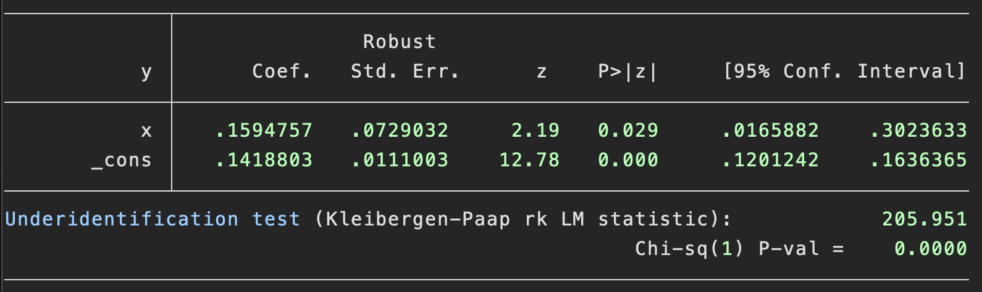
Balke-Pearl IV bounds
Balke-Pearl bounds:
Estimates largest and smallest values of the causal effect (ACE) consistent with the data
Note – these are not confidence intervals
A function of the mean values of the data (see Palmer et al. 2011) for derivation.
Two-stage least squares:
(N=10,000)

Slide 10
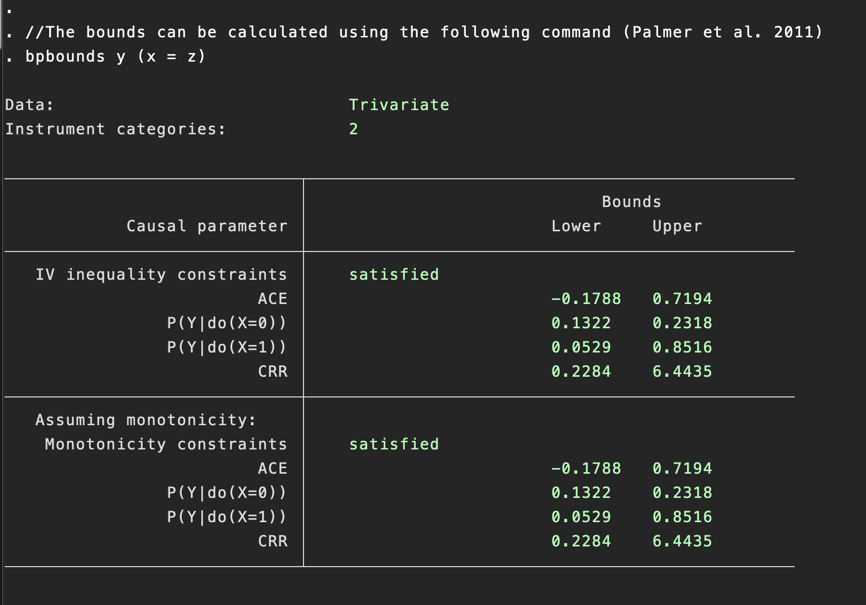
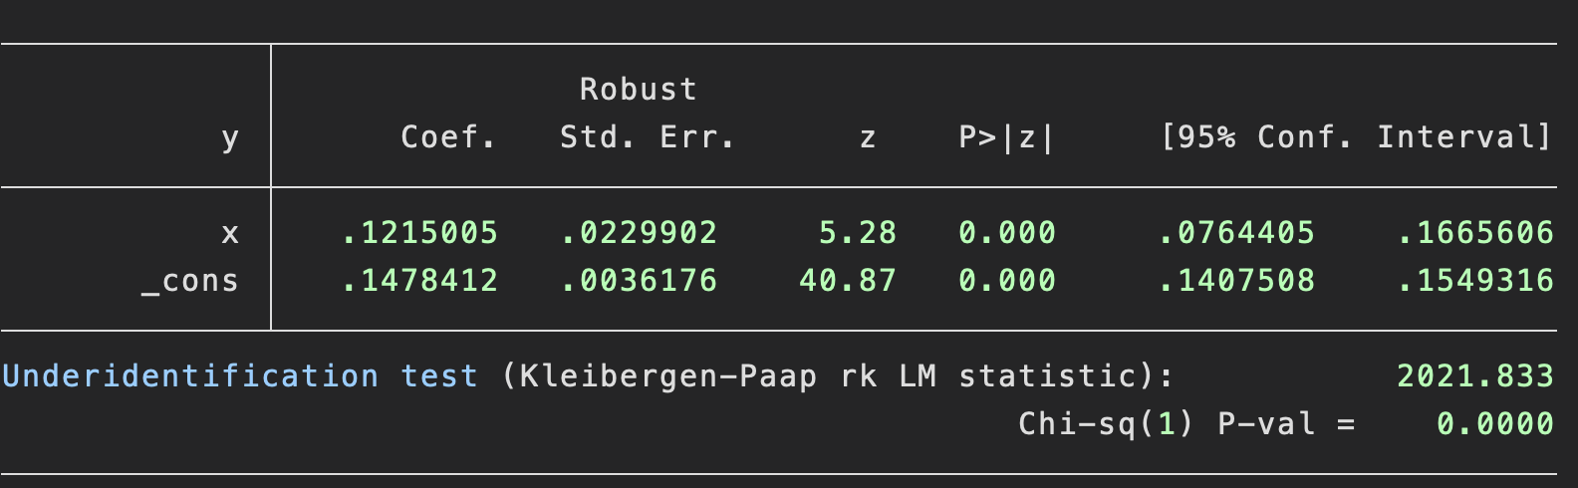
Balke-Pearl IV bounds
Balke-Pearl bounds:
Estimates largest and smallest values of the causal effect (ACE) consistent with the data
Note – these are not confidence intervals
A function of the mean values of the data (see Palmer et al. 2011) for derivation.
Two-stage least squares:
(N=100,000)

Slide 11
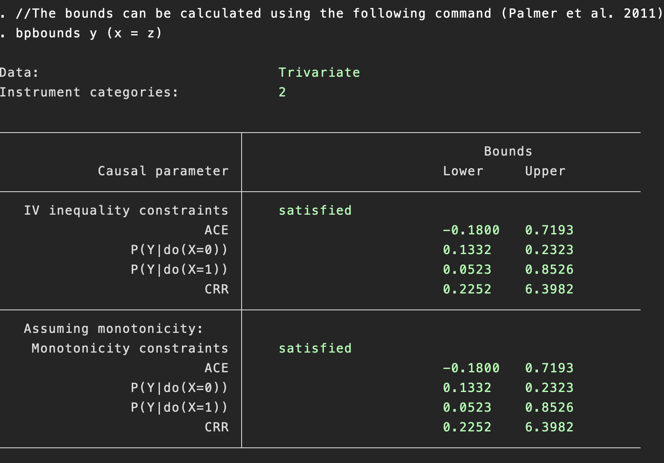
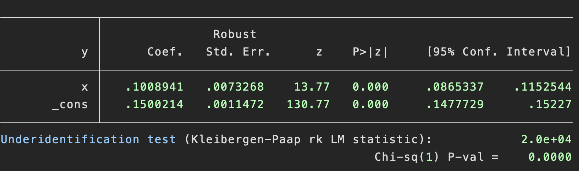
Balke-Pearl IV bounds
Balke-Pearl bounds:
Estimates largest and smallest values of the causal effect (ACE) consistent with the data
Note – these are not confidence intervals
A function of the mean values of the data (see Palmer et al. 2011) for derivation.
Unlike confidence intervals, IV bounds do not get more precise with more data
Two-stage least squares:
(N=1,000,000)

Slide 12
IV Bounds
Methodologically important
However, IV Bounds generally very imprecise
So practically not very useful
Can include in the supplement if a reviewer insists
Generally, we cannot identify the effect of an exposure solely using the 3 core IV assumptions.
Therefore, most IV analysis will make stronger “point identifying assumptions”

Slide 13
Point identifying assumptions: the fourth IV assumption
Assumption | Target parameter | Relevant population | Notes
1. Constant effect of the exposure | Average treatment effect | Whole population | Implausible for binary outcomes.
2. No effect modification | Average effect of treatment in the treated | Those who are treated
3. Monotonicity | Local average treatment effect | People who exposure was affected by the instrument | Unidentified sub-group
4. No simultaneous heterogeneity (NOSH) | Average treatment effect | Whole population | Validity depends on the correlation between the effects
Other 4th IV assumptions are available…

Slide 14
A. Constant effect of the exposure
This assumption requires that the exposure has the same effect on the outcome in everyone.
Target parameter: The average treatment effect
Relevant population: Everyone
Notes
Rarely plausible for continuous outcomes
Are the effects of a treatment likely to be identical for everyone?
Implausible for binary outcomes
Only plausible if treatment entirely determines outcome

Slide 15
B. No effect modification
This assumption assumes that the effects of the exposure are the same irrespective of the value of the instrument.
Target parameter: The average effect of treatment on the treated
Relevant population: Those who are treated
Notes
Plausible for binary and continuous outcomes
Can be used to identify causal risk-ratios and odds-ratios
Theory based on binary exposures; interpretation less clear for continuous exposures
Potentially not externally valid for those who were not treated

Slide 16
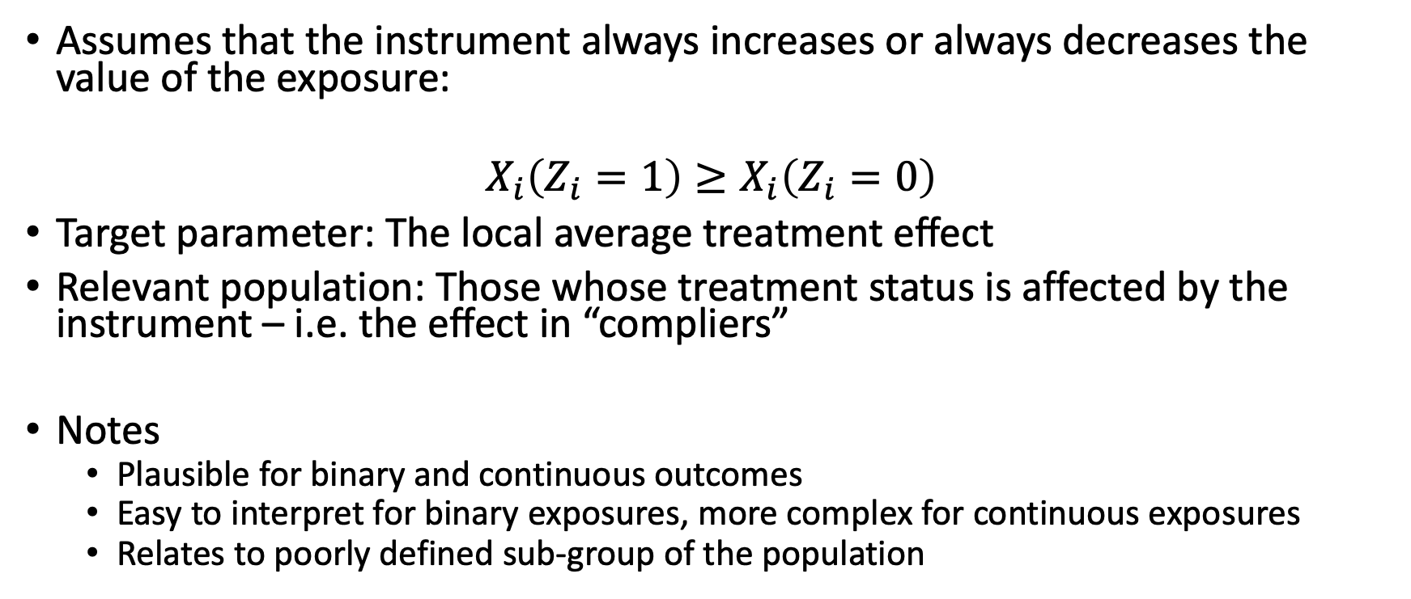
C. Monotonic effect of the exposure
Assumes that the instrument always increases or always decreases the value of the exposure:
$$X_{i}\left(Z_{i}=1\right)≥X_{i}\left(Z_{i}=0\right)$$
Target parameter: The local average treatment effect
Relevant population: Those whose treatment status is affected by the instrument – i.e. the effect in “compliers”
Notes
Plausible for binary and continuous outcomes
Easy to interpret for binary exposures, more complex for continuous exposures
Relates to poorly defined sub-group of the population

Slide 17
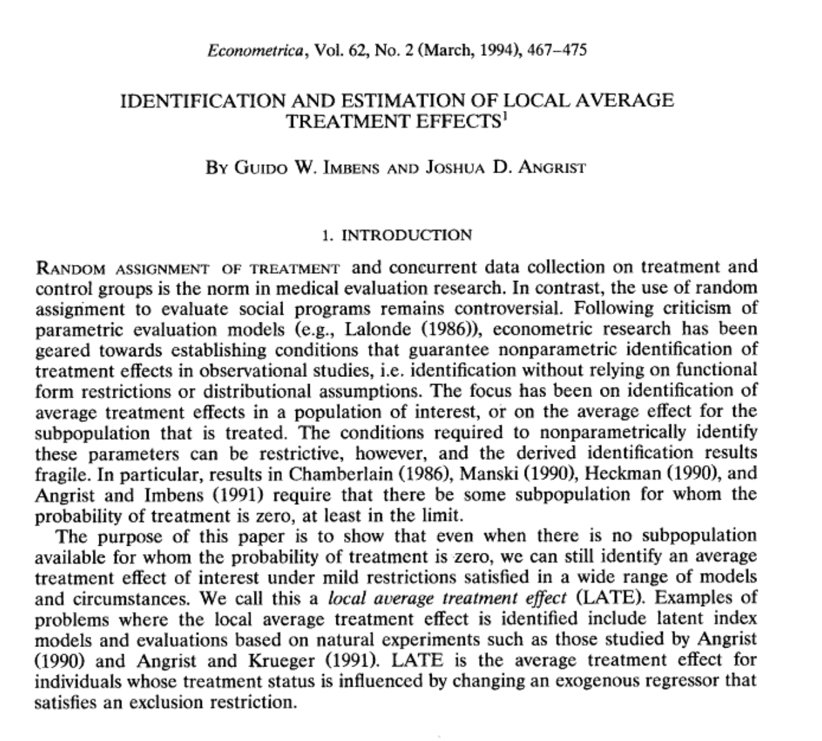
C. Monotonicity: RCT
Interpretation in a RCT with non-compliance
Monotonicity requires that: Pr(exposure|treatment)>=Pr(exposure|control)
The instrument affects the probability of exposure in the same direction for everyone.
Requires no defiers – i.e. people who do the opposite of their allocation.
Identifies the effect of treatment in those whose allocation was affected by treatment i.e. the compliers – those who comply with their allocation.
This effect relates to an unidentified sub-group of the population

Slide 18

C. Monotonicity: RCT
Swanson and Hernán’s questions for papers assuming monotoncity:
What sub-group of the population are compliers?
What proportion of the population are compliers?
Can we describe the compliers?
Can we quantify the sensitivity of the estimates to violations of monotonicity?

Slide 19
C. Monotonicity: Physician’s prescribing preferences
Who are the compliers?
Patients who treatment is affected by their physicians’ preferences
Can we describe this sub-group?
Is this sub-group likely to be representative of the population?
No – e.g. people with strong contraindications for treatments
Maybe – clinical relevant marginal population

Slide 20
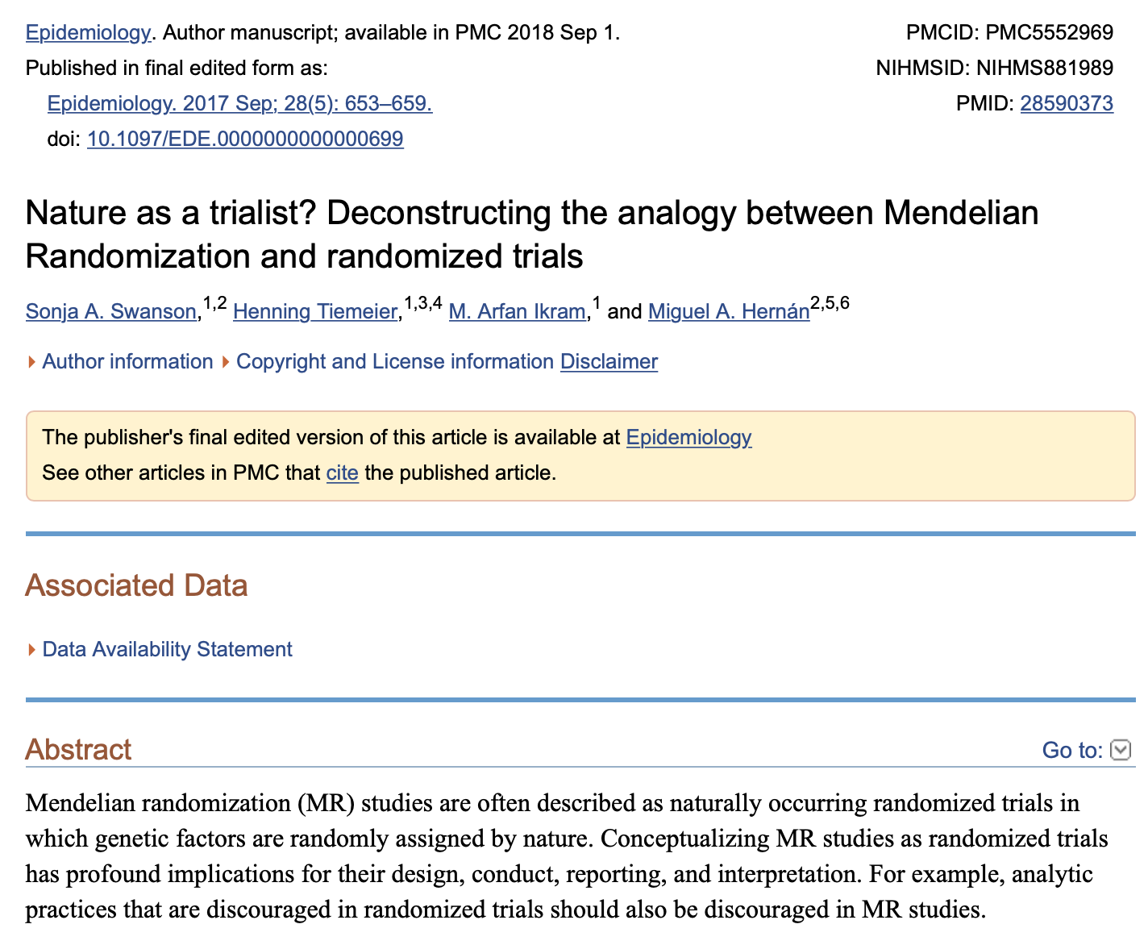
C. Monotonicity: Mendelian randomization
Monotonicity assumption is not very well defined for Mendelian randomization studies
Monotonicity typically invoked for binary exposures where defiers and compliers have a clear definition.
Definition of a defiers less clear for MR
If the exposure is continuous – what is the LATE? A weighted average across everyone in the population?
A lot of unanswered methodological questions
MR studies normally assume homogeneity

Slide 21
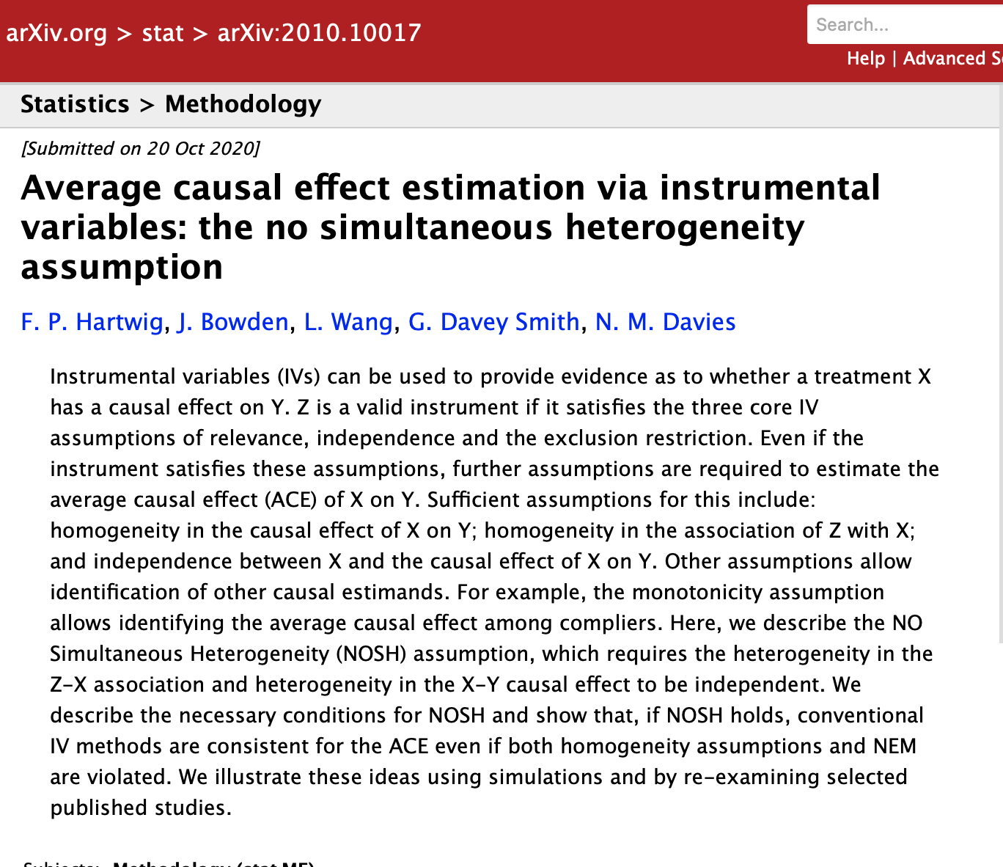
D. No Simultaneous Heterogeneity (NOSH)
A lot of LATE literature in econometrics assumes that selection into treatment will be correlated with the effects of treatment
E.g. selection into a job training scheme
Avoiding the draft
These examples have correlated effects of the instrument and the exposure – or simultaneous heterogeneity.
If there is No Simultaneous Heterogeneity (NOSH) – we can get reliable estimates.

Slide 22
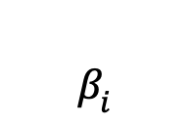
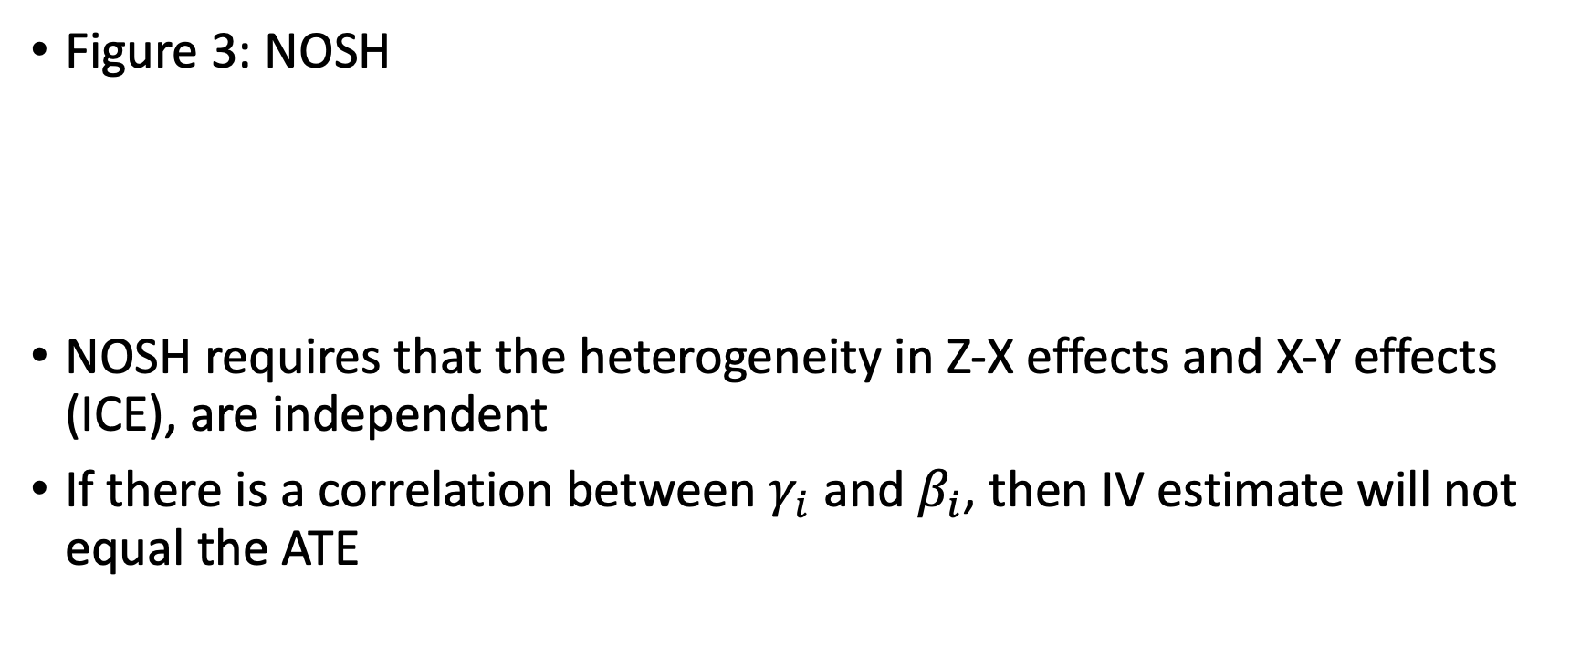

NOSH – no simultaneous heterogeneity
Confounder
(U)
Figure 3: NOSH
NOSH requires that the heterogeneity in Z-X effects and X-Y effects (ICE), are independent
If there is a correlation between $γ_{i}$ and $β_{i}$, then IV estimate will not equal the ATE
$$γ_{i}$$
$$β_{i}$$
Instrument
Exposure
Outcome

Slide 23
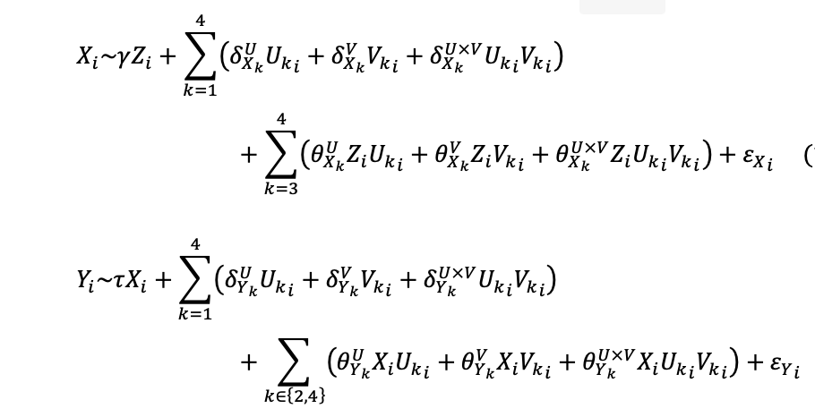

Illustrative simulation
$Z_{i}\sim Binom\left(0.5\right)$
${U_{k}}_{i}\sim Binom\left(0.5\right)$for $k∈\left\{1,2,3,4\right\}$
${V_{k}}_{i}\sim Binom\left(0.5\right)$for $k∈\left\{1,2,3,4\right\}$

Slide 24
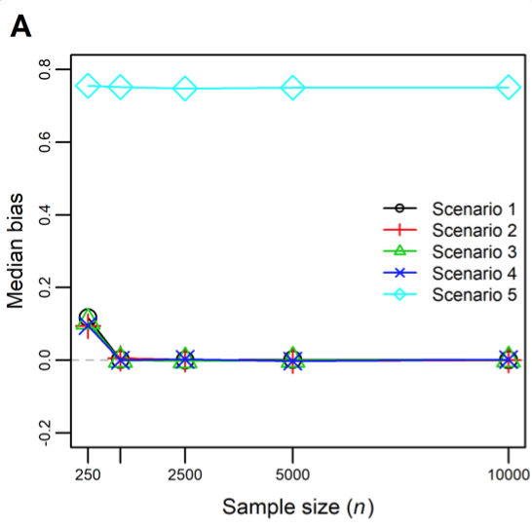
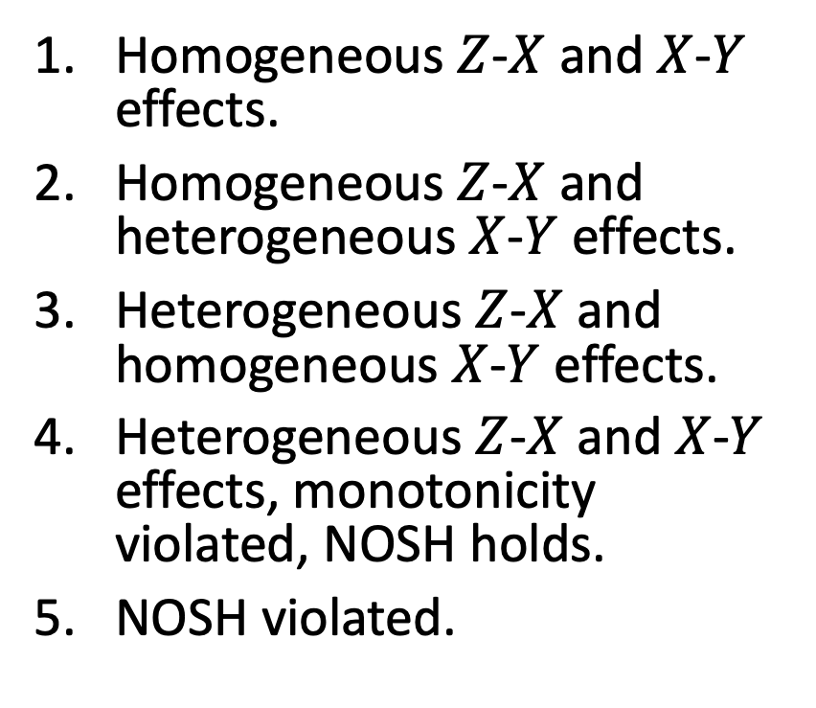
Figure 1: Median bias of two-stage least squares as an estimator of the ACE
Homogeneous $Z$-$X$ and $X$-$Y$ effects.
Homogeneous $Z$-$X$ and heterogeneous $X$-$Y$ effects.
Heterogeneous $Z$-$X$ and homogeneous $X$-$Y$ effects.
Heterogeneous $Z$-$X$ and $X$-$Y$ effects, monotonicity violated, NOSH holds.
NOSH violated.

Slide 25
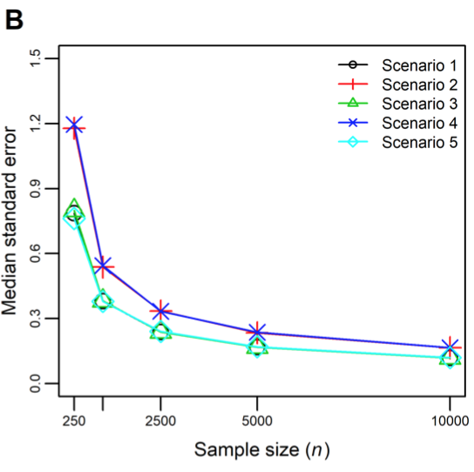
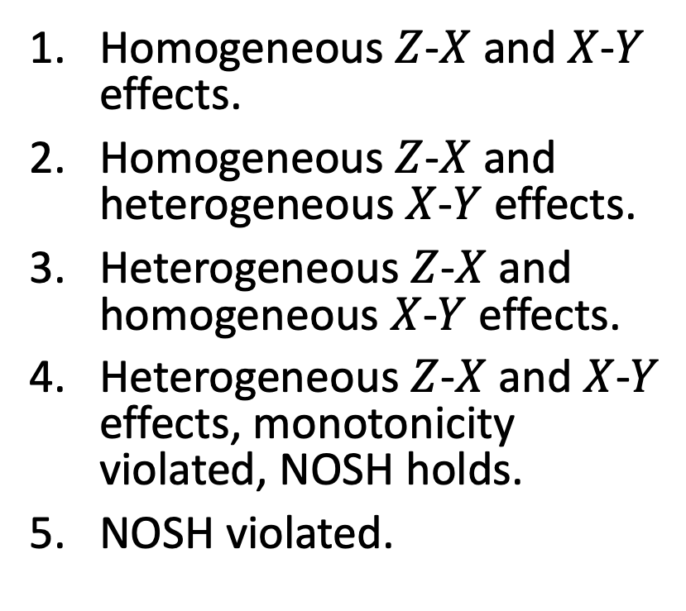
Figure 2: Median standard error of two-stage least squares as an estimator of the ACE
Homogeneous $Z$-$X$ and $X$-$Y$ effects.
Homogeneous $Z$-$X$ and heterogeneous $X$-$Y$ effects.
Heterogeneous $Z$-$X$ and homogeneous $X$-$Y$ effects.
Heterogeneous $Z$-$X$ and $X$-$Y$ effects, monotonicity violated, NOSH holds.
NOSH violated.

Slide 26
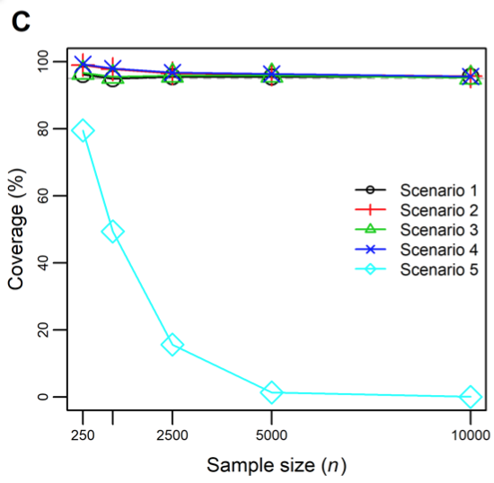
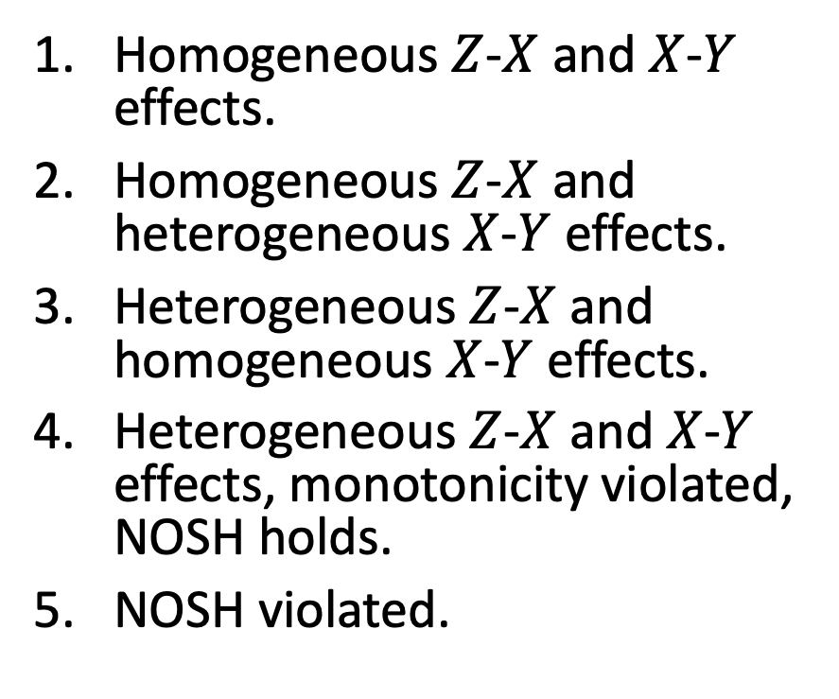
Figure 3: Coverage of two-stage least squares as an estimator of the ACE
Homogeneous $Z$-$X$ and $X$-$Y$ effects.
Homogeneous $Z$-$X$ and heterogeneous $X$-$Y$ effects.
Heterogeneous $Z$-$X$ and homogeneous $X$-$Y$ effects.
Heterogeneous $Z$-$X$ and $X$-$Y$ effects, monotonicity violated, NOSH holds.
NOSH violated.

Slide 27
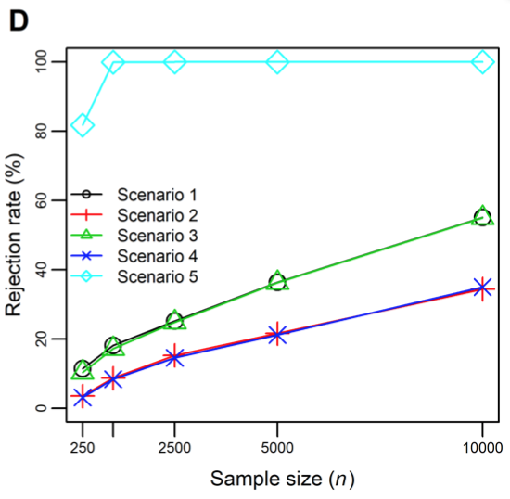
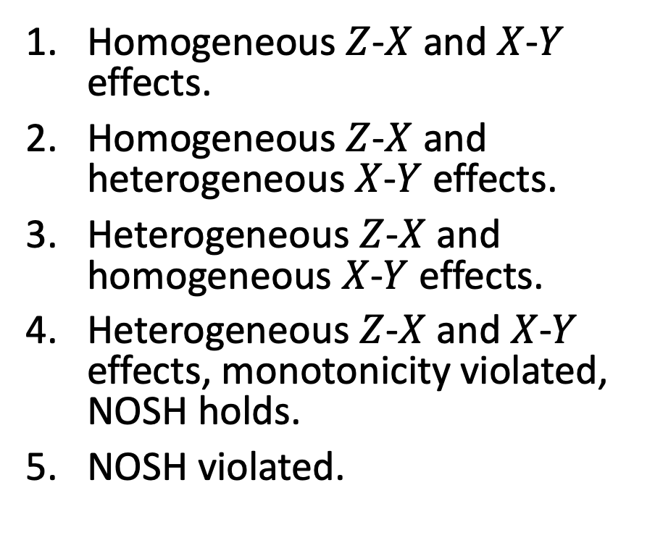
Figure 4: Rejection rate of two-stage least squares as an estimator of the ACE
Homogeneous $Z$-$X$ and $X$-$Y$ effects.
Homogeneous $Z$-$X$ and heterogeneous $X$-$Y$ effects.
Heterogeneous $Z$-$X$ and homogeneous $X$-$Y$ effects.
Heterogeneous $Z$-$X$ and $X$-$Y$ effects, monotonicity violated, NOSH holds.
NOSH violated.

Slide 28
Summary of simulations
IV estimate can equal ATE even if Homogeneity, NEM, monotonicity do not hold
If effect heterogeneity is independent, then can still be unbiased
Bias requires violation of NOSH
How is plausible NOSH?

Slide 29
Figure 8 Mendelian randomization: the effect of BMI on coronary heart disease (Dale et al. (2017)
FTO
MC4R
…
…
BMI SNP₉₇
Confounder
(U)
BMI
Under a constant treatment effect:
Identifies the average effect of BMI on CHD
Under monotonicity
Identifies a weighted local average treatment effect – more weight to SNPs with bigger effects
NOSH:
Heterogeneity in effect of instrument? Maybe (e.g. FTO)
Heterogeneity in effect of treatment? Yes (binary outcome/probably)
Is NOSH plausible? Maybe
Is the heterogeneity in effect of SNPs on BMI and the effect of BMI on CHD likely to be dependent?
CHD

Slide 30
Summary of NOSH
NOSH requires independence of the:
Instrument-exposure heterogeneity
Exposure-outcome heterogeneity
NOSH identifies the average effect of treatment (ATE) even if constant treatment effect, NEM, and monotonicity are violated
Homogeneous treatment effects and NEM assumptions are special cases of NOSH
Monotonicity does not identify an ATE is not directly comparable to NOSH
Untestable

Slide 31

4. Lifetime versus transitory effects
MR estimates lifetime effects
Randomization occurs at conceptions
Estimates may not equate to the effects of changing a risk factor later in life
Timing can be investigated using multivariable MR
Requires SNPs that affect the exposure at different points in time.
Define two exposure exposures
Power often an issue.

Slide 32
5. Reporting of instrumental variables studies
A possible reporting checklist:
Description of the definition of the instrument
Assumptions, 3 core IV assumptions + 4th assumption
Tests of IV assumptions where possible
Instrument strength (F-tests)
Balance of covariates
Estimates of the IV-outcome association (reduced form)
IV estimates + CI
E.g. 2SLS or other estimator
Tests for differences between the IV and other analyses
Hausman tests
Sensitivity analyses
Hansen/Sargen tests for heterogeneity

Slide 33
5. Reporting of instrumental variables studies
Choosing between IV estimates and other approaches
IV estimates and multivariable adjusted estimates can be very similar.
For example, Thomas et al. (2013) – IV and OLS estimates were comparable.
Which should we prefer?
OLS – precise, potentially more biased
IV – imprecise, potentially less biased
Most clinical journals will only want to see one estimate – gets very confusing and unclear to readers if multiple estimates based on the same data are presented.
If there’s little evidence of differences between the OLS and IV methods, consider having OLS as primary analysis and presenting IV analysis in supplement
If there’s clear evidence of differences, and you are convinced that the IV assumptions hold/are plausible, then focus on the IV analyses.

Slide 34
Summary interpretation and reporting of instrumental variable analyses
The 3 core instrumental variable assumptions only identify bounds
4th IV assumption required to point identify effects
Constant treatment effects (ATE)
No effect modification (ATT)
Monotonicity (LATE)
No simultaneous heterogeneity (ATE)
Timing of effects
Clearly report of information from IV analyses
Assumptions
Tests of assumptions where possible
Sensitivity analyses
Consider which results to present as primary analyses

