Slide 1
The principals of instrumental variable analysis
Neil M Davies
neil.davies@Bristol.ac.uk
Population Health Sciences, Bristol, Medical School, University of Bristol, UK

Slide 2
Objectives
Define an instrumental variable
Assess the plausibility of an instrumental variable
Estimate causal effects with an instrumental variable
Interpret instrumental variable estimates

Slide 3

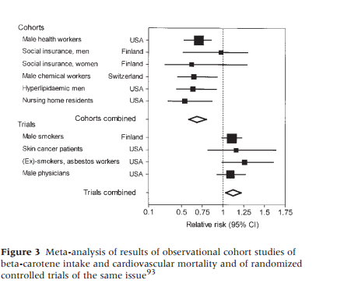
Why use instrumental variables?

Slide 4
Why use instrumental variables?
Most statistical methods for observational data assume that all potential confounders are measured.
This implies that exposures were randomly allocated conditional on observed confounders.
This is a very strong assumption!
Is it likely to hold?
Instrumental variables depend on different assumptions
They do not require measures of all the confounders of the exposure-disease relationship.

Slide 5
Definition of an instrumental variable (1)
C
Z
X
Y
Instrumental variables (Z) are defined by three assumptions:
Are associated with the exposure (Z associates with X)
AKA The relevance assumption

Slide 6
Definition of an instrumental variable (2)
C
Z
X
Y
Instrumental variables (Z) are defined by three assumptions:
Are associated with exposure
Have no common cause with the outcome (Z is independent of C)
AKA The independence assumption or no confounding

Slide 7
Definition of an instrumental variable (3)
C
Z
X
Y
Instrumental variables (Z) are defined by three assumptions:
Are associated with exposure
Have no common cause with the outcome
Do not directly affect outcome Y (Z is independent of Y given X & C)
AKA The exclusion restriction criteria

Slide 8
Three potential instrumental variables
Assignment to treatment in an RCT with non-compliance
Greenland, Int J Epid 2000
GPs’ past prescribing history
Thomas et al., BMJ, 2013
Genotype – (Mendelian randomization)
Davey Smith & Ebrahim, Int J Epidemiol, 2003
Lots more potential instruments (e.g. geography, time, day of week, wealth, relations characteristics) are discussed in:
Davies NM, Davey Smith G, Windmeijer F, Martin RM. Issues in the reporting and conduct of instrumental variable studies: a systematic review. Epidemiology. 2013 May;24(3):363–9.

Slide 9
Instrumental variable example 1: Allocation to treatment in an RCT with non-compliance to assigned intervention
C Factors affecting compliance
Z
Allocation
to treatment
X
Treatment
compliance
Y
Outcome

Slide 10
Instrumental variable example 1: Allocation to treatment in an RCT with non-compliance to assigned intervention
C Factors affecting compliance
Z
Village allocation
to vitamin A
X
Child receipt
vitamin A
Y
Death
Greenland, S., 2000. An introduction to instrumental variables for epidemiologists. Int J Epidemiol 29, 722–729.

Slide 11
Greenland 2000
12,094 children were allocated to receive the vitamin A
11,588 children were allocated to control
However only 80% of children assigned to the treatment received it
The difference in mortality between those who took the medication and those who did not will be a biased estimate of the causal effect (confounding)
The ITT estimates the effect of being allocated to the intervention, not the effect of taking vitamin A
The effect of taking the treatment may be more relevant to decision-making by clinicians and patients than the ITT effect

Slide 12
Greenland 2000
As treated estimate:
risk difference (RD) = -0.65% (95%CI: -0.49%, -0.81%)
Likely to be an overestimate of the average treatment effect in individuals who received treatment because of confounding
Intention to treat estimate (ITT) :
RD = -0.26% (95%CI: -0.08%, -0.44%)
Likely to be an underestimate of the average treatment effect
Instrumental variable estimate:
RD = -0.32 (95%CI: -0.10%, -0.55%)
Estimate of the effect of taking vitamin A
Calculated by ITT/difference in likelihood of exposure =-0.26/0.80
ITT analysis estimates the effect of assignment to intervention (the ‘intention-to-treat’ effect)
Instrumental variable analysis estimates the effect of taking the vitamins in individuals who took vitamins, not the effect of assignment (more on the meaning of IV estimates later…)

Slide 13
Greenland 2000: do the instrumental variable assumptions hold?
Relevance
Yes – allocation associates with taking vitamin A
Independence
Yes – there are no causes of randomization
Exclusion restriction
Yes – there were no other likely effects of the intervention

Slide 14
Instrumental variable example 2: Physicians’ prescribing preferences
C Confounders
Z
Physician or facility preference
X
Prescription
Y
Outcomes
Brookhart, M.A., Wang, P.S., Solomon, D.H., Schneeweiss, S., 2006. Evaluating short-term drug effects using a physician-specific prescribing preference as an instrumental variable. Epidemiology 17, 268–275. https://doi.org/10.1097/01.ede.0000193606.58671.c5

Slide 15
Physicians’ prescribing preferences: the effect of varenicline versus Nicotine Replacement Therapy (NRT)
C Indications for treatment
Z
Physicians’ preferences for varenicline or NRT
X
Patient prescribed varenicline
Y
Neuropsychiatric problems
Thomas, K.H., Martin, R.M., Davies, N.M., Metcalfe, C., Windmeijer, F., Gunnell, D., 2013. Smoking cessation treatment and risk of depression, suicide, and self harm in the Clinical Practice Research Datalink: prospective cohort study. BMJ 347, f5704–f5704. https://doi.org/10.1136/bmj.f5704

Slide 16
Thomas et al. 2013: do the instrumental variable assumptions hold?
Relevance
Yes – physicians’ preference associates with the prescriptions they issue
Independence
Potentially yes – there are no causes of both the preferences and the outcome
Exclusion restriction
Potentially yes – physicians’ relative preferences for a specific drug may only affect their prescribing of those medications

Slide 17
Instrumental variable example 3: Mendelian Randomization
C Confounders
Z
Genotype
X
Exposure
Y
Outcome

Slide 18
Mendelian Randomization example: genes, alcohol and blood pressure
C Confounders
Z
ALDH2 genotype
X
Alcohol
Y
High blood pressure
Chen, L., Davey Smith, G., Harbord, R.M., Lewis, S.J., 2008. Alcohol Intake and Blood Pressure: A Systematic Review Implementing a Mendelian Randomization Approach. PLoS Medicine 5, e52. https://doi.org/10.1371/journal.pmed.0050052

Slide 19
Mendelian randomization: do the instrumental variable assumptions hold?
Relevance
Yes –genotype associates with phenotype.
But such associations are typically weak, which may cause problems (discussed later).
Independence
Potentially yes – there are unlikely to be causes of both ALDH2 genotype and high blood pressure.
But we may need to address problems such as population stratification.
Exclusion restriction
Potentially yes – ALDH2 is known to be involved in alcohol metabolism, and has few detectable effects in non-drinkers.
But in general we need to consider whether there are pleiotropic genotype effects.

Slide 20
Section 2: Assessing the instrumental variable assumptions
C
Z
X
Y
Does the instrument associate with the exposure?
Is the instrument associated with potential confounders?
Is the instrument associated with potential alternative mediating variables or mechanisms?

Slide 21
A. Does the instrument associate with the exposure?
C
Z
X
Y
The instrument-exposure association can be estimated and tested
Ideally: partial F-statistic of instrument-exposure association
R-squared
p-value
Beta (regression coefficient) for instrument-exposure association

Slide 22
B. Is the instrument associated with potential confounders?
C
Z
X
Y
The assumption cannot be proved, but it can be falsified by finding associations of the instrument with potential confounders
Limited to measured covariates
Instrument-covariate associations can be estimated and tested
Ideally: Covariate balance plots

Slide 23
B. Is the instrument associated with potential confounders?
Thomas, et al. 2013

Slide 24
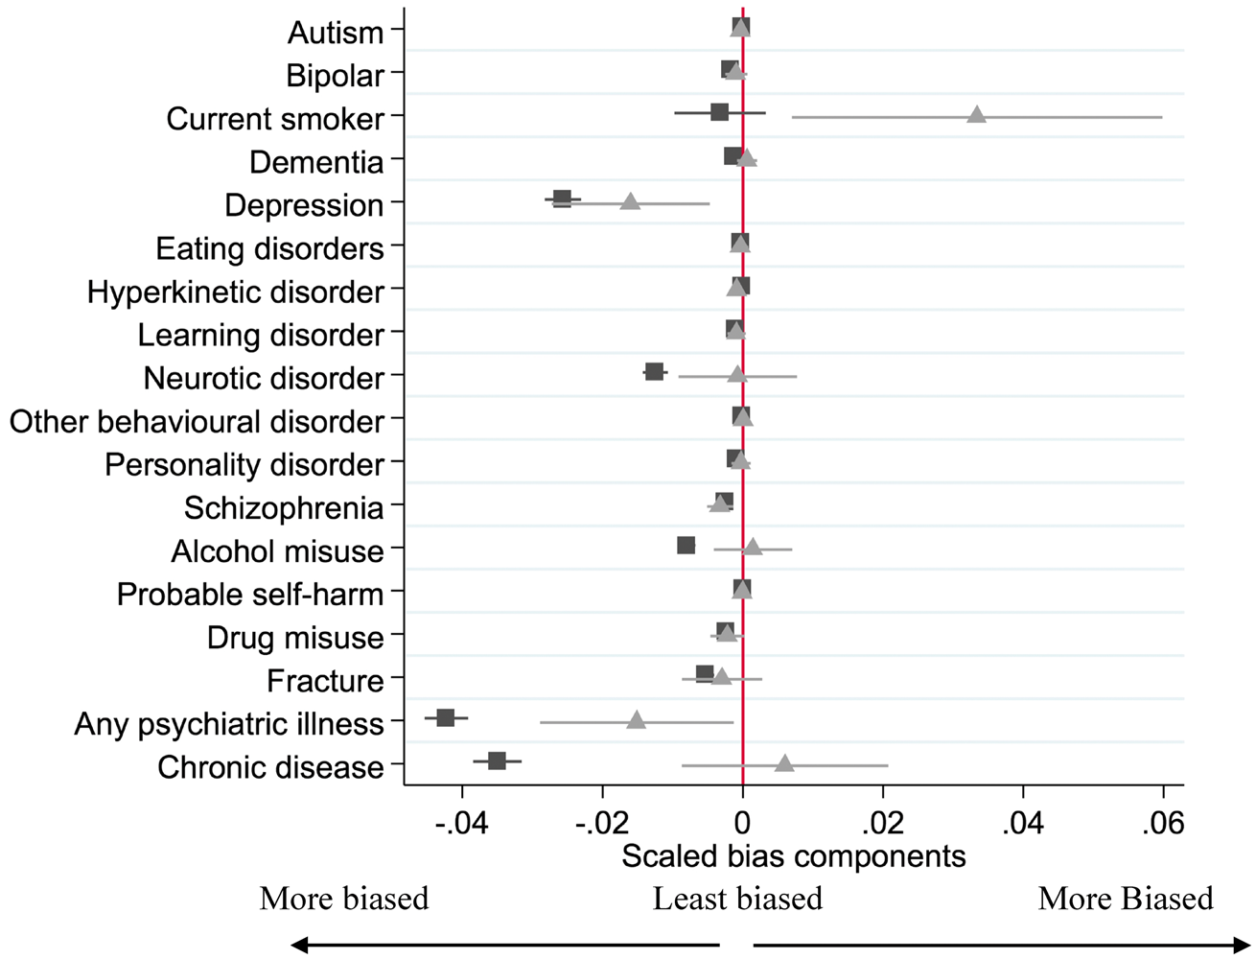
B. Is the instrument associated with potential confounders?
Covariate balance plots
Compare
Covariate-exposure association
Covariate-instrument association
Allowing for strength of instrument
Confidence intervals indicate uncertainty
Code and description available in Davies et al. 2017 IJE.
Davies, N.M., Thomas, K.H., Taylor, A.E., Taylor, G.M.J., Martin, R.M., Munafò, M.R., Windmeijer, F., 2017. How to compare instrumental variable and conventional regression analyses using negative controls and bias plots. Int J Epidemiol. https://doi.org/10.1093/ije/dyx014

Slide 25
C. Is the instrument associated with potential alternative mediating variables or mechanisms?
C
Z
X
Y
Assumption cannot be proved, only falsified
Estimate instrument-mediator associations
Estimate heterogeneity in effect across different instruments
Hausman test
Pleiotropy - MR-Egger, weighted median
Rarely evaluated in applied papers outside of Mendelian randomization

Slide 26
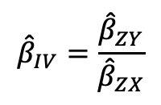
Section 3: Estimate causal effects with an instrumental variable
Instrumental variable estimators:
Instrument-outcome association: A valid test of the null hypothesis that the exposure does not cause the outcome.
Is the intention to treat estimate in an RCT with non-compliance
Wald type estimators: The ratio of the:
instrument-outcome and
Instrument-exposure associations, i.e.
Estimates of the size of the causal effect of the exposure on the outcome
The effect of taking the treatment in an RCT
Many different estimators – all with similar underlying logic
$${\hat{β}}_{IV}=\frac{{\hat{β}}_{ZY}}{{\hat{β}}_{ZX}}$$

Slide 27
Two-stage least squares: how to do it by hand
Regress exposure on instrument
Calculate fitted (predicted) values of the exposure
Regress outcome on the fitted values of the exposure
Fix the standard errors
This can be done manually, or using an existing command in Stata or R. For example, ivregress or ivreg2 or ivmodel in R.
Notes:
Motivation: use only the variation in X that is due to Z when estimating X-Y relationship.
Fitted values give variation in X due to Z.
Fix to standard errors is complex and only valid for large samples.

Slide 28
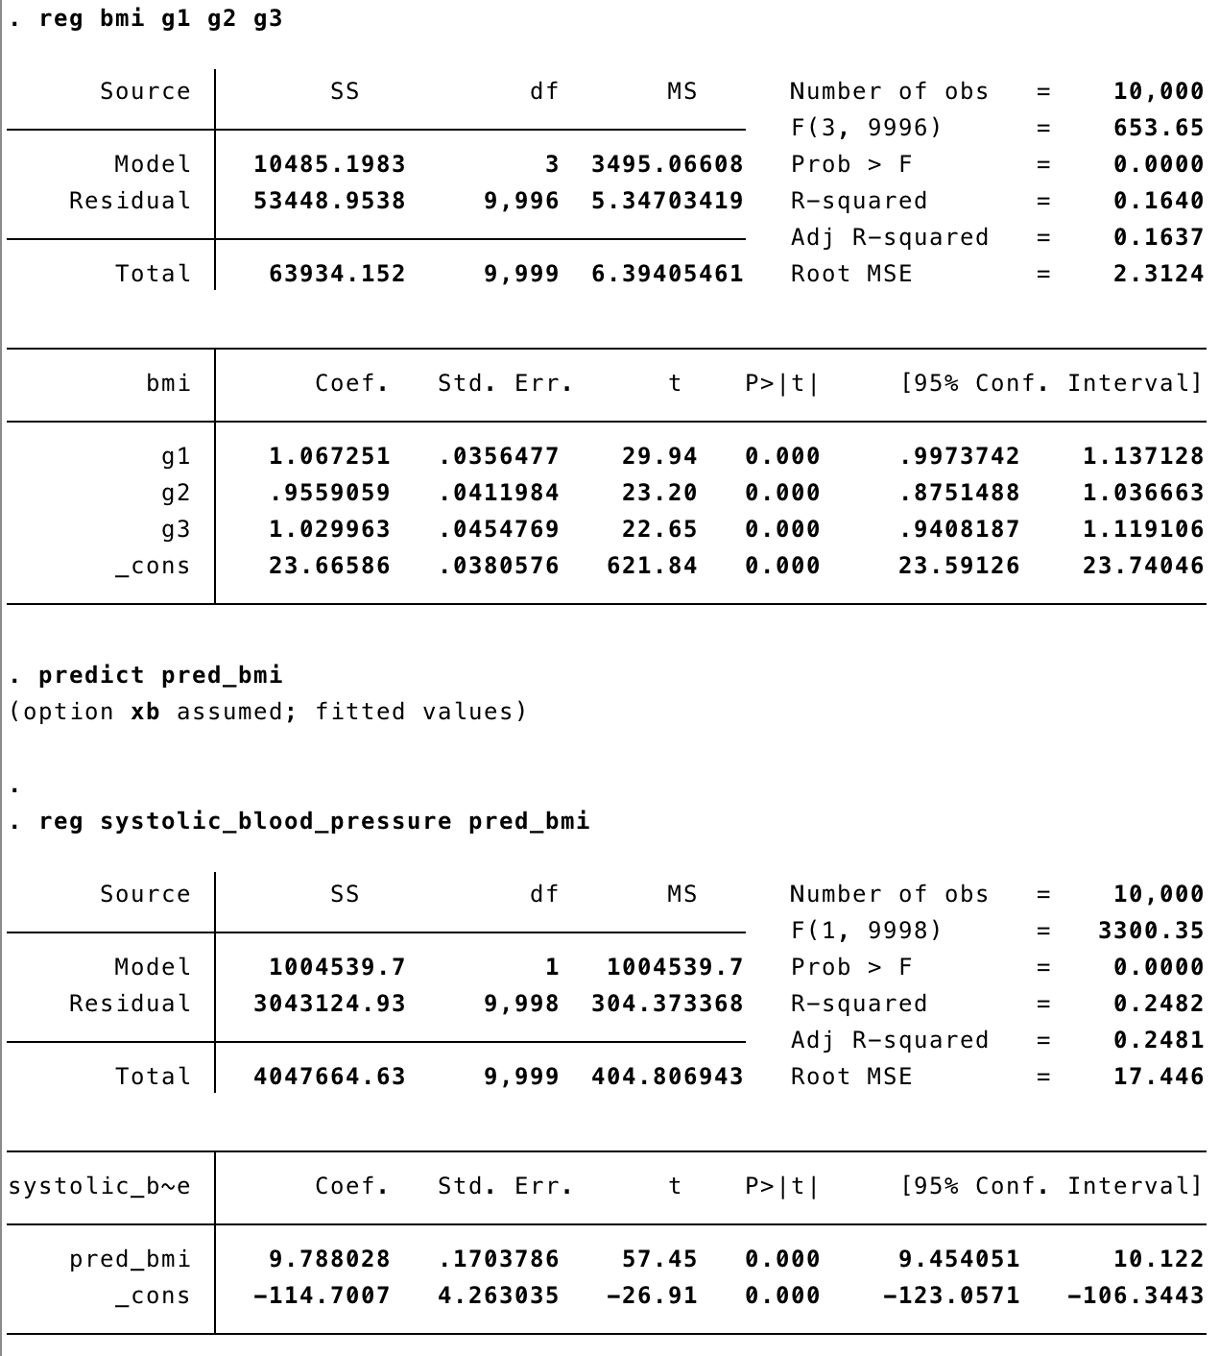
Stata output in an example dataset: effect of BMI on SBP. Manual TSLS

Slide 29
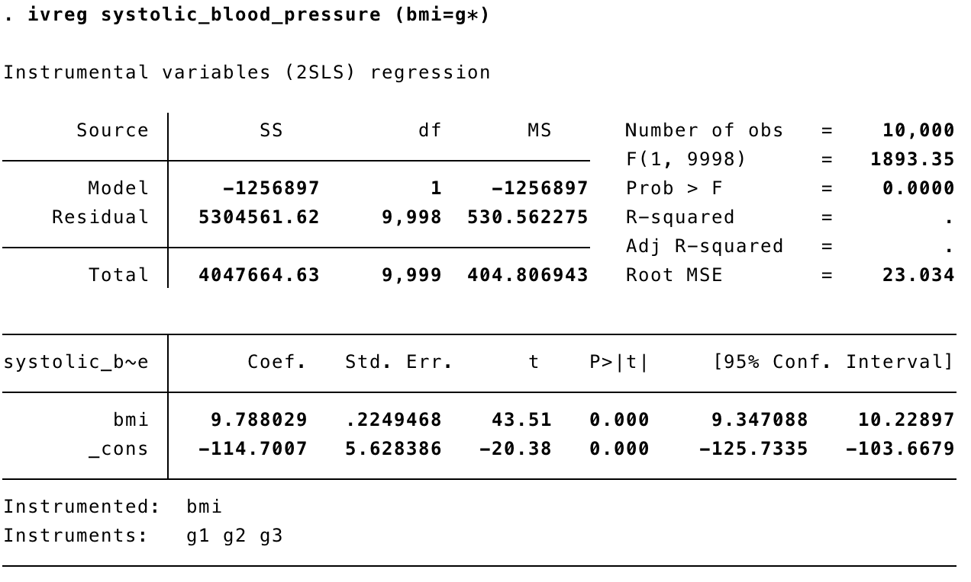
TSLS using ivregress
SE now bigger was 0.170

Slide 30
Using ivreg2 in Stata
ivreg2 outcome (exposure=instrument1 instrument2) , robust first endog(exposure)
Allows multiple instruments and exposures
robust = robust standard errors allowing for non-normality
first = report the “first stage” regression between the instrument and the exposure and tests of the instrument strength
endog(exposure) report the Hausman test for difference between the IV and OLS estimates
ivreg2 and other packages have lots of other useful functions – see the help file
Continuous outcomes are reported on the mean difference scale per unit change in the exposure
Binary outcomes are reported on the risk difference scale (robust SEs vital)

Slide 31
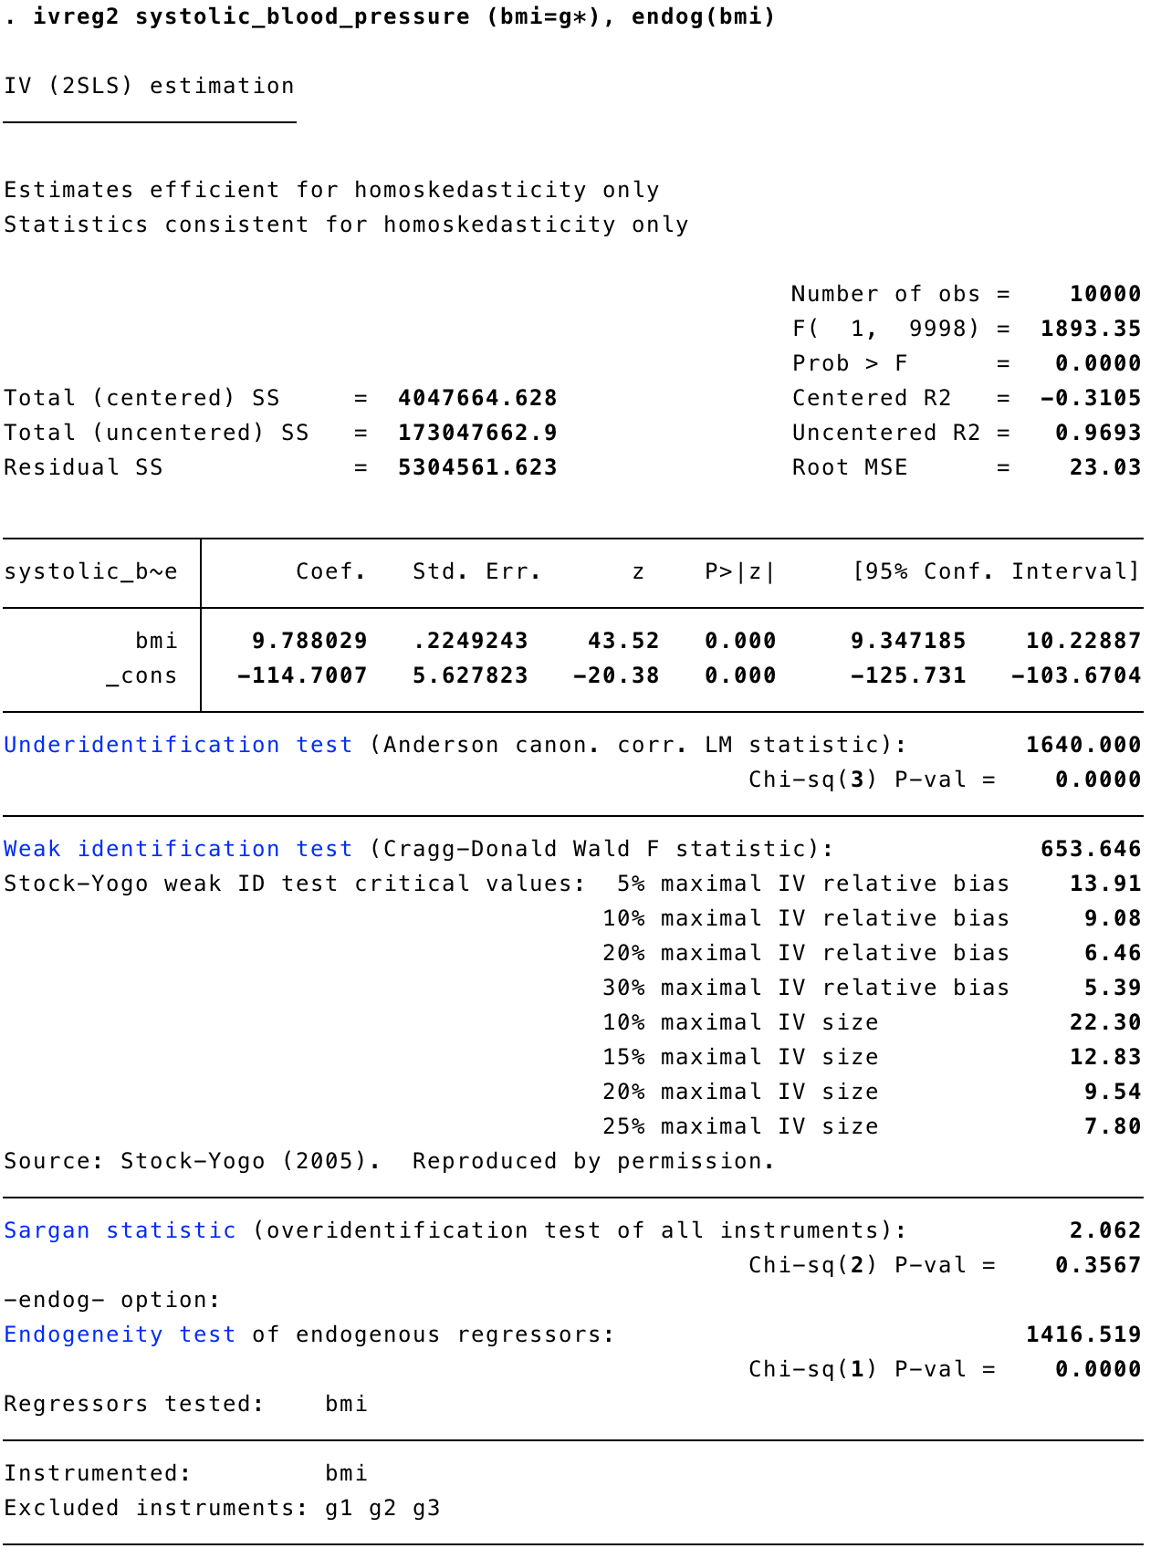
TSLS using ivreg2
F F-statistic=654
Endogeneity test

Slide 32
Limitations of two stage least squares
Assumes homoskedasticity
I.e. normally distributed error terms
Weak instrument bias
For a single instrument, the F statistic for its association with exposure should be at least 15.
Additional problems when you have multiple instruments each of which only explains a small proportion of the variation in the exposure
May not work well for binary or survival outcomes
Many outcomes in epidemiology are binary (e.g. disease or not)
Estimating odds and risk ratios
Which are standard for clinical journals

Slide 33
Other Useful Instrumental variable Estimators
Generalised Method of Moments (GMM)
robust to heteroscedasticity (non-normal outcomes)
Limited information maximum likelihood (LIML) and Continuously Updating Estimator (CUE)
Consistent even if instruments are weak
Control function
Useful for ratio outcomes (e.g. causal OR, RR)
Structural mean models (SMM)
Useful for ratio outcomes (e.g. causal OR, RR)
Detailed description and comparison of different IV methods - see Palmer et al., Am J Epi, 2011
Palmer, T.M., Sterne, J.A.C., Harbord, R.M., Lawlor, D.A., Sheehan, N.A., Meng, S., Granell, R., Smith, G.D., Didelez, V., 2011. Instrumental Variable Estimation of Causal Risk Ratios and Causal Odds Ratios in Mendelian Randomization Analyses. Am J Epidemiol 173, 1392–1403. https://doi.org/10.1093/aje/kwr026

Slide 34

Power calculators
Also see:
S. Burgess, International Journal of Epidemiology. 43, 922–929 (2014).

Slide 35
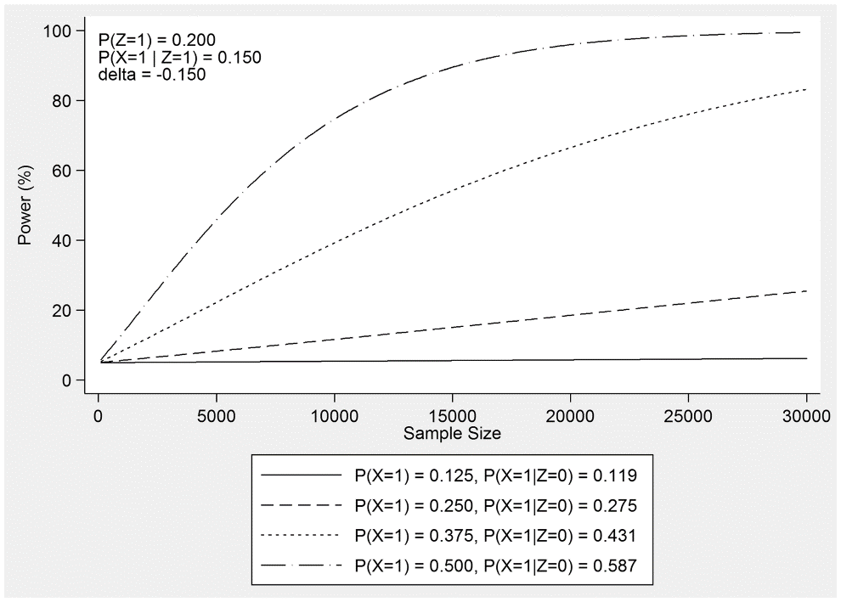
Power calculations for physicians prescribing preferences
Power calculator available for physicians' prescribing preferences
Power is higher with:
Evenly balanced treatments
Big differences in physician preferences
Larger samples
Larger causal effects
Online power calculator available here:
https://venexia.shinyapps.io/PharmIV/
Limitations
Continuous outcomes only
Walker, Davies, Windmeijer, Burgess, Martin, International Journal of Epidemiology (2017), doi:10.1093/ije/dyx090.

Slide 36
Online power calculator
http://glimmer.rstudio.com/kn3in/mRnd/
May work best in Internet Explorer
Power far lower for binary outcomes
Note there is currently no two-sample power calculator

Slide 37
Section 4: Interpreting instrumental variable estimates
The three assumptions define an instrumental variable
Without a further, fourth, ‘point identifying assumption’ instrumental variable analyses only estimate bounds on the causal effect of exposure
These bounds are imprecise but require relatively weak assumptions
The instrument-outcome association – tests whether exposure affects the outcome but not the direction of the causal effect
Possible point identifying assumptions
Constant causal effect
Monotonic effect of the instrument on the exposure
No effect modification of the instrument

Slide 38
What is point identification?
Point identification is estimation of a specific parameter for the effect of exposure (or treatment) on the outcome
i.e. a single number or point, e.g. the average effect of treatment
Without a fourth IV assumption the three core IV assumptions only bound the treatment effect
Bounds are easy to calculate (ivbounds command) in Stata
But bounds are typically very wide and imprecise
Thus the precision of and inference from IV estimates depends on the fourth assumption
Palmer, T.M., Ramsahai, R.R., Didelez, V., Sheehan, N.A., 2011. Nonparametric Bounds for the Causal Effect in a Binary Instrumental-Variable Model. The Stata Journal: Promoting communications on statistics and Stata 11, 345–367. https://doi.org/10.1177/1536867X1101100302
Swanson, S.A., Hernán, M.A., Miller, M., Robins, J.M., Richardson, T.S., 2018. Partial Identification of the Average Treatment Effect Using Instrumental Variables: Review of Methods for Binary Instruments, Treatments, and Outcomes. Journal of the American Statistical Association 113, 933–947. https://doi.org/10.1080/01621459.2018.1434530

Slide 39
Point identifying assumptions: the fourth IV assumption
Assumption | Target parameter | Relevant population | Notes
1. Constant effect of the exposure | Average treatment effect | Whole population | Implausible for binary outcomes.
2. No effect modification | Average effect of treatment in the treated | Those who are treated
3. Monotonicity | Local average treatment effect | People who exposure was affected by the instrument | Unidentified sub-group
Other 4th IV assumptions are available…

Slide 40
1. Constant effect of the exposure
This assumption requires that the exposure has the same effect on the outcome in everyone.
Target parameter: The average treatment effect
Relevant population: Everyone
Notes
Rarely plausible for continuous outcomes
Are the effects of a treatment likely to be identical for everyone?
Implausible for binary outcomes
Only plausible if treatment entirely determines outcome

Slide 41
2. No effect modification
This assumption assumes that the effects of the exposure are the same irrespective of the value of the instrument.
Target parameter: The average effect of treatment on the treated
Relevant population: Those who are treated
Notes
Plausible for binary and continuous outcomes
Can be used to identify causal risk-ratios and odds-ratios
Theory based on binary exposures, interpretation less clear for continuous exposures
Potentially not externally valid for those who were not treated

Slide 42
3. Monotonic effect of the exposure
This assumption assumes that the instrument affects the likelihood of exposure in the same direction in everyone. I.e. it always increases, or always decreases the likelihood of exposure
Target parameter: The local average treatment effect
Relevant population: Those whose treatment status is affected by the instrument
Notes
Plausible for binary and continuous outcomes
Easy to interpret for binary exposures, more complex for continuous exposures
Relates to poorly defined sub-group of the population

Slide 43

Limitations of instrumental variable analysis
Low statistical power
Solutions - increase explanatory power/R² of IV / increase sample size
Lack of robust instruments for studying modifiable exposures
More data, or modify the question
Point identifying assumptions untestable
Currently no solution: BUT conventional methods depend on strong untestable assumptions
Sample selection bias/collider bias
Use multiple samples, or statistically model selection process
Davies, N.M., Davey Smith, G., Windmeijer, F., Martin, R.M., 2013. Issues in the reporting and conduct of instrumental variable studies: a systematic review. Epidemiology 24, 363–369. https://doi.org/10.1097/EDE.0b013e31828abafb

Slide 44
Summary
Three steps for running an instrumental variable study:
Define an instrumental variable
Often, no plausible IV can be found
Assess the plausibility of an instrumental variable
Estimate causal effects with an instrumental variable

Slide 45
Useful packages and tools
IV estimation in R
ivmodel Jiang, Kang, Small, M. H. Kang, (2017).
IV estimation in Stata
ivreg2 Baum, Schaffer, Stillman, IVREG2: Stata module for extended instrumental variables/2SLS and GMM estimation (2013; http://EconPapers.repec.org/RePEc:boc:bocode:s425401).

Slide 46
References (1)
Excellent textbooks
Hernán MA, Robins JM (2018). Causal Inference. Boca Raton: Chapman & Hall/CRC, forthcoming.
Burgess S, Thompson SG. Mendelian randomization: methods for using genetic variants in causal estimation. Boca Raton: : CRC Press, Taylor & Francis Group 2015.
Angrist JD, Pischke J-S. Mastering ’metrics: the path from cause to effect. Princeton ; Oxford: : Princeton University Press 2015.
VanderWeele TJ. Explanation in causal inference: methods for mediation and interaction. New York: : Oxford University Press 2015.
Imbens G, Rubin DB. Causal inference for statistics, social, and biomedical sciences: an introduction. New York: : Cambridge University Press 2015.

Slide 47
References (2)
Instrumental variable methodology papers
Davies, N.M., Thomas, K.H., Taylor, A.E., Taylor, G.M.J., Martin, R.M., Munafò, M.R., Windmeijer, F., 2017. How to compare instrumental variable and conventional regression analyses using negative controls and bias plots. Int J Epidemiol. https://doi.org/10.1093/ije/dyx014
Jackson, J.W., Swanson, S.A., 2015. Toward a Clearer Portrayal of Confounding Bias in Instrumental Variable Applications. Epidemiology 26, 498–504. https://doi.org/10.1097/EDE.0000000000000287
N. M. Davies, G. Davey Smith, F. Windmeijer, R. M. Martin, Issues in the reporting and conduct of instrumental variable studies: a systematic review. Epidemiology. 24, 363–369 (2013).
P. S. Clarke, F. Windmeijer, Instrumental Variable Estimators for Binary Outcomes. Journal of the American Statistical Association. 107, 1638–1652 (2012).
Balke & Pearl, Bounds on treatment effects from studies with imperfect compliance. Am J Epidemiol, 1997, 92, 1172-1176
Jackson JW, Swanson SA. Toward a Clearer Portrayal of Confounding Bias in Instrumental Variable Applications. Epidemiology. 2015 Jul;26(4):498–504.
Swanson SA, Hernán MA. Think Globally, Act Globally: An Epidemiologist’s Perspective on Instrumental Variable Estimation. Statistical Science. 2014 Aug;29(3):371–4.
A. Inoue, G. Solon, Two-Sample Instrumental Variables Estimators. Review of Economics and Statistics. 92, 557–561 (2010).
M. A. Hernán, J. Robins, Instruments for causal inference: an epidemiologist’s dream? Epidemiology. 17, 360–372 (2006).

Slide 48
References (3)
Mendelian randomization methods papers
G. Davey Smith, G. Hemani, Mendelian randomization: genetic anchors for causal inference in epidemiological studies. Human Molecular Genetics. 23, R89–R98 (2014).
G. Davey Smith, Random Allocation in Observational Data: How Small But Robust Effects Could Facilitate Hypothesis-free Causal Inference. Epidemiology. 22, 460–463 (2011).
Taylor AE, Davies NM, Ware JJ, VanderWeele T, Smith GD, Munafò MR. Mendelian randomization in health research: Using appropriate genetic variants and avoiding biased estimates. Economics and Human Biology 2014;13(100):99-106. doi:10.1016/j.ehb.2013.12.002.
Davies, N.M., Holmes, M.V., Davey Smith, G., 2018. Reading Mendelian randomisation studies: a guide, glossary, and checklist for clinicians. BMJ k601. https://doi.org/10.1136/bmj.k601
S. Burgess, N. M. Davies, S. G. Thompson, Instrumental Variable Analysis with a Nonlinear Exposure–Outcome Relationship: Epidemiology. 25, 877–885 (2014).
T. M. Palmer et al., Instrumental Variable Estimation of Causal Risk Ratios and Causal Odds Ratios in Mendelian Randomization Analyses. Am J Epidemiol. 173, 1392–1403 (2011).
N. M. Davies et al., The many weak instruments problem and Mendelian randomization. Statistics in Medicine. 34, 454–468 (2015).

Slide 49
References (4)
Mendel randomisation ‘classics’ and other commentaries
Davey Smith G, Ebrahim S. 'Mendelian randomization': can genetic epidemiology contribute to understanding environmental determinants of disease? Int J Epidemiol. 2003 Feb;32(1):1-22.
Davey Smith G, Ebrahim S. What can mendelian randomisation tell us about modifiable behavioural and environmental exposures? BMJ. 2005 May 7;330(7499):1076-9.
Davey Smith G. Use of genetic markers and gene-diet interactions for interrogating population-level causal influences of diet on health. Genes and nutrition. 2011; 6 (1):27-43.
On independent assortment
Davey Smith G, Lawlor DA, Harbord R, et al. Clustered environments and randomized genes: a fundamental distinction between conventional and genetic epidemiology. PLoS Med. 2007 Dec;4(12):e352.

Slide 50
References (5)
More examples of Mendelian randomisation studies
Chen L, Davey Smith G, Harbord RM, Lewis SJ. Alcohol intake and blood pressure: a systematic review implementing a Mendelian randomization approach. PLoS Med. 2008 Mar 4;5(3):e52.
Trompet S, Jukema JW, Katan MB et al. Apolipoprotein e genotype, plasma cholesterol, and cancer: a Mendelian randomization study. Am J Epidemiol. 2009 Dec 1;170(11):1415-21.
Collin SM, Metcalfe C, Zuccolo L, et al. Association of folate-pathway gene polymorphisms with the risk of prostate cancer: a population-based nested case-control study, systematic review, and meta-analysis. Cancer Epidemiol Biomarkers Prev. 2009 Sep;18(9):2528-39.
C Reactive Protein Coronary Heart Disease Genetics Collaboration. Association between C reactive protein and coronary heart disease: mendelian randomisation analysis based on individual participant data. BMJ 2011; 342:d548.
L. Zuccolo et al., Prenatal alcohol exposure and offspring cognition and school performance. A “Mendelian randomization” natural experiment. International Journal of Epidemiology. 42, 1358–1370 (2013).
Chen et al. Alcohol Intake and Blood Pressure: A Systematic Review Implementing a Mendelian Randomization Approach. PLoS Med, March 2008, 5(3)e52
Lawlor DA, et al. Exploring causal associations between alcohol and coronary heart disease risk factors: findings from a Mendelian randomization study in the Copenhagen General Population Study. European Heart Journal 2013; doi:10.1093/eurheartj/eht081
Pritchett & Summers. Wealthier is Healthier. Journal of Human Resources 1996; 31,: 841-868

