Slide 1
An introduction to causal inference
Neil M Davies
University of Bristol
MRC Integrative Epidemiology Unit
2nd October 2020

Slide 2
Overview
Causal questions
The potential outcomes framework
Directed acyclic graphs (DAGs)
Sources of bias
Simulations

Slide 3
Questions in epidemiology
Descriptive
What is the incidence of a disease in the population?
Does the burden of disease differ within different groups?
Causal
Will vitamin E reduce the rate of cardiovascular disease?
Does hydroxychloroquine affect severity of COVID?

Slide 4
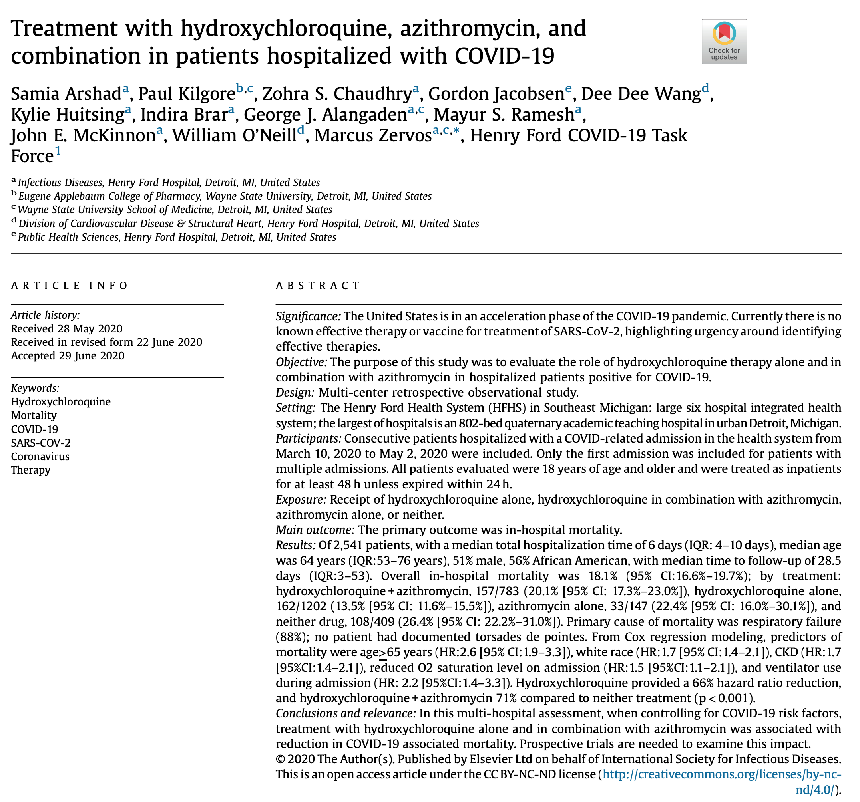
Causal questions
Does hydroxychloroquine reduce rates of mortality for patients admitted to hospital with COVID?

Slide 6
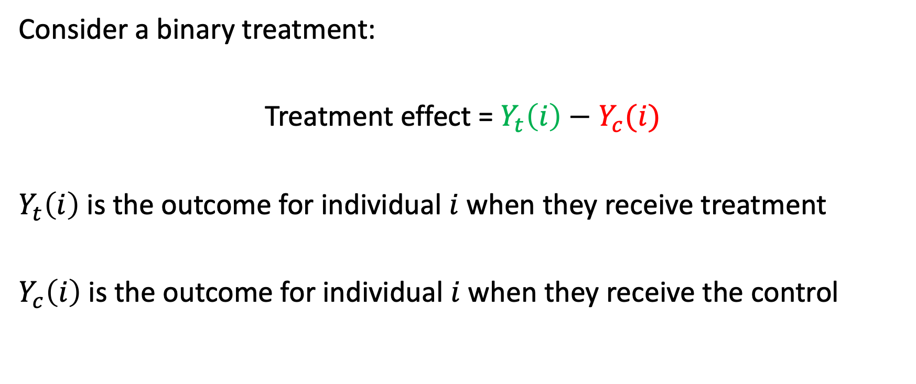
The potential outcomes framework
Consider a binary treatment:
Treatment effect = $Y_{t}\left(i\right)−Y_{c}(i)$
$Y_{t}\left(i\right)$ is the outcome for individual $i$ when they receive treatment
$Y_{c}\left(i\right)$ is the outcome for individual $i$ when they receive the control

Slide 8
The potential outcomes framework

Slide 20
References
Rubin, Donald B. 1974. “Estimating Causal Effects of Treatments in Randomized and Nonrandomized Studies.” Journal of Educational Psychology 66 (5): 688–701. https://doi.org/10.1037/h0037350.

