Slide 1
Analysis of the correlation between Housing Sales Prices and Venues in the city of Toronto
By Nathan Monteiro

Slide 2
Introduction
A real estate agency would like to know whether different venues surrounding the house affect the sale price so that they can effectively price their new developments.

Slide 3
Data Acquisition
To carry out the analysis a dataset on House Sales needs to be imported which is available here:
https://www.kaggle.com/mnabaee/ontarioproperties/downloads/ontarioproperties.zip/1
Calls to the Foursquare API will also need to be made to get access to the venues in a particular area which can be accessed by following the steps here:
https://foursquare.com/

Slide 4
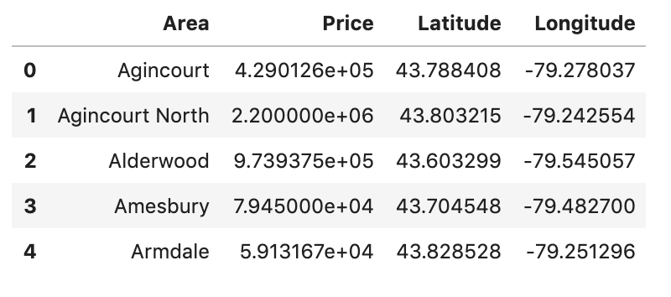
Data Cleaning
The House Sales dataframe is filtered out to only contain entries which are located in Toronto.
A new dataset is created which contains the mean price of houses in each area by grouping the previous dataframe by unique areas and getting the mean.

Slide 5
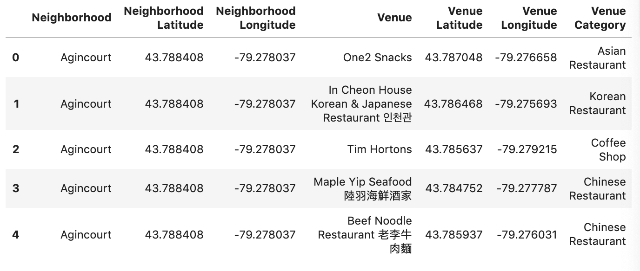
Foursquare API
A call is made to the Foursquare API to find the venues in the areas mentioned in the new dataset that we created. This information is used to create a new dataframe with all the surrounding venues in a particular area.

Slide 6
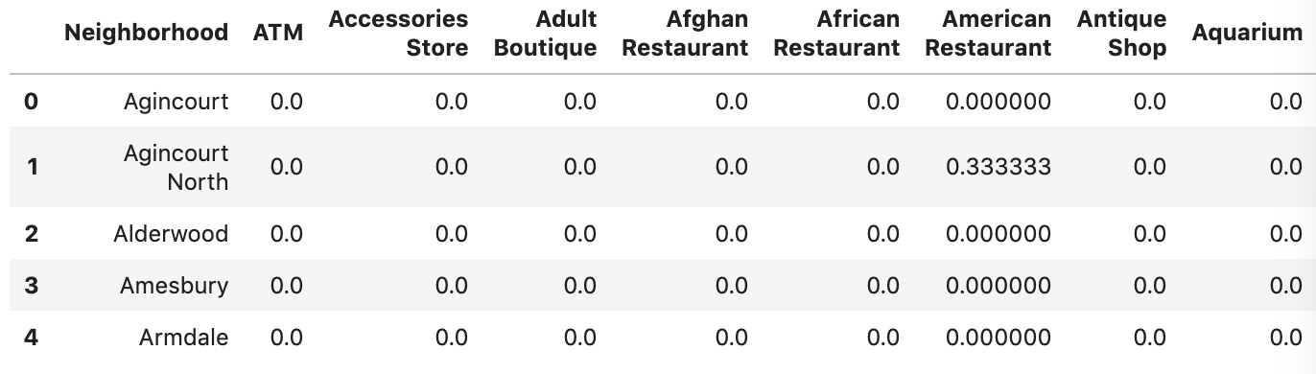
Encoding the data
In order to be able to fit the data using the k-means algorithm, it needs to encoded which is done using a one-hot encoder.
And the rows are grouped by neighborhood and by taking the mean of the frequency of occurrence of each category.

Slide 7
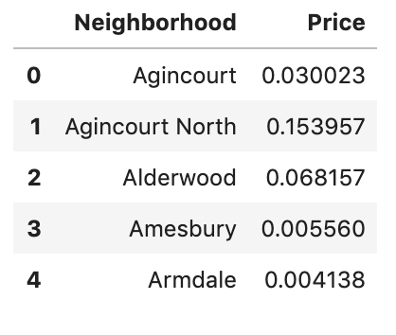
Adding the price variable
In order to be able to create clusters which take house sales price into consideration as well, the Price column needs to be added to the dataframe. However, it needs to be normalized first so that it does not overpower the other variables.

Slide 8
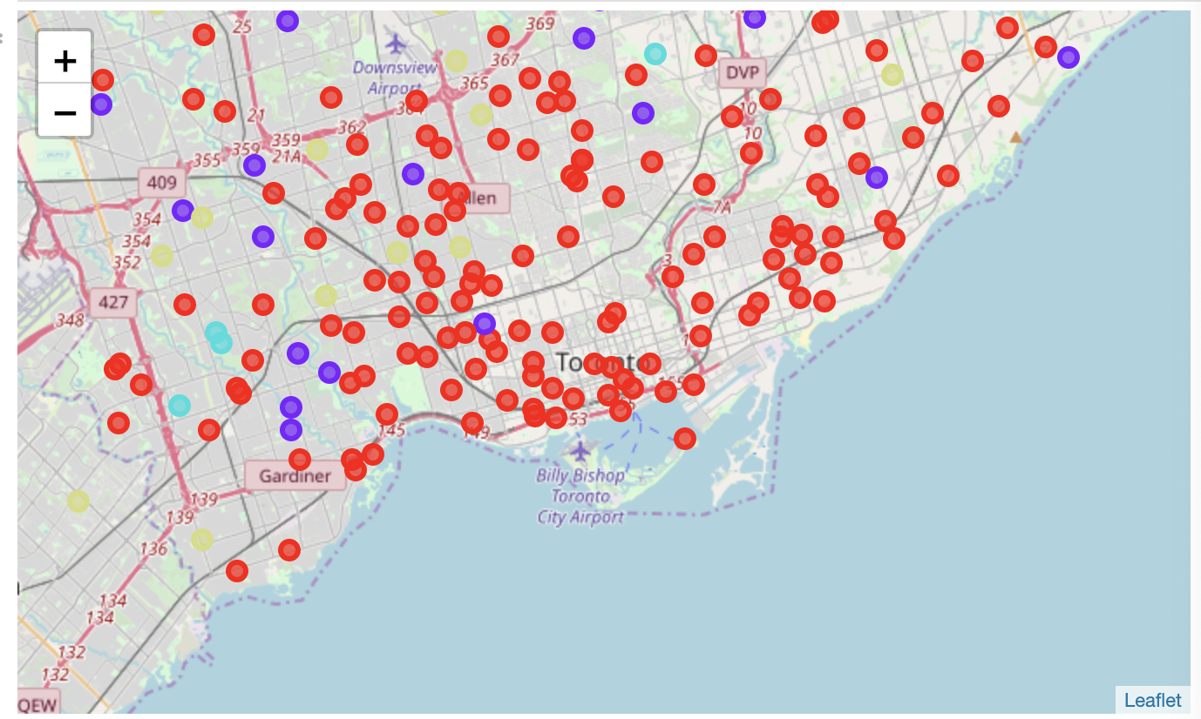
Clustering using k-means
The data is fitted to create four clusters

Slide 9
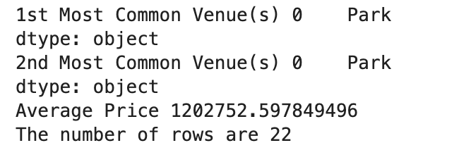
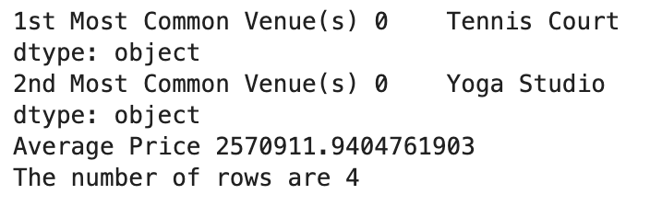
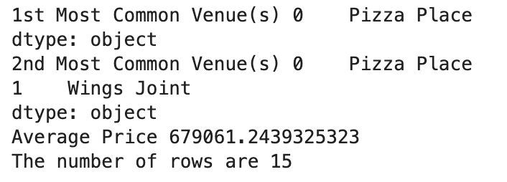
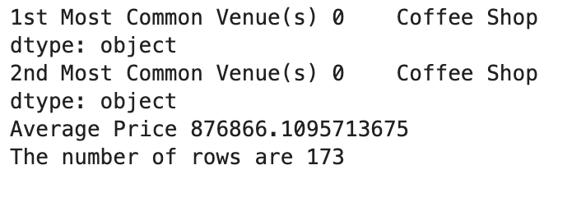
Results
Cluster 1
Cluster 2
Cluster 3
Cluster 4

Slide 10
Conclusion
It may be concluded that in the city of Toronto there may be a correlation between higher-priced houses and Tennis Courts, Yoga Studios and Parks in contrast with the relatively lower-priced houses which may be correlated with Pizza Places, Wings Joints, and Coffee Shops.

