Slide 1
Web Capacity Models
5 December 2017

Slide 2
Overview
Performance measures:
Response time, throughput, resource utilization, resource queue length
Analytic models are based on statistical formulas and computational algorithms
Simulation models mimic the behavior of system.
System level models does not consider internal details. System is considered as a “black box” and only average throughput is used.
Component level models takes into account different resources of the system: disk, CPU, network…

Slide 3
System level Models
System is abstract

Slide 4
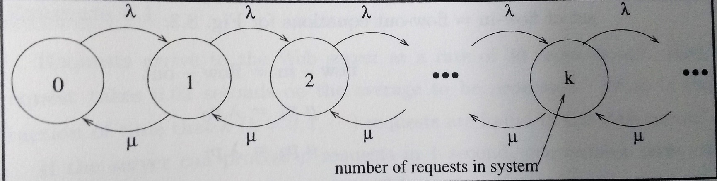
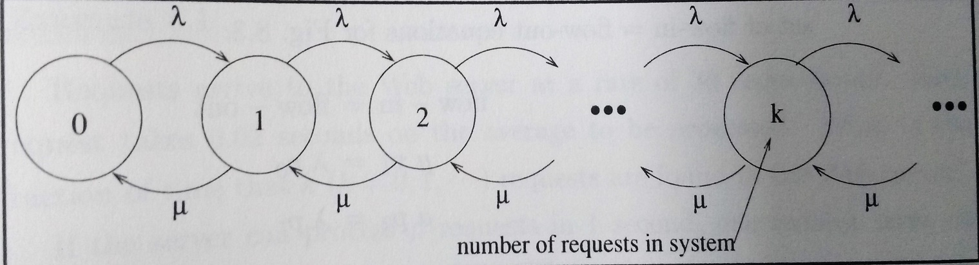
Infinite Queue
Infinite population: Arrival rate (λ) is not influenced by number of requests that arrived already.
Assumption:
No request is discarded.
Throughput (µ) is constant.
When the server is in k state and..
a new request comes, state k → k+1
a request completes, state k → k-1

Slide 5
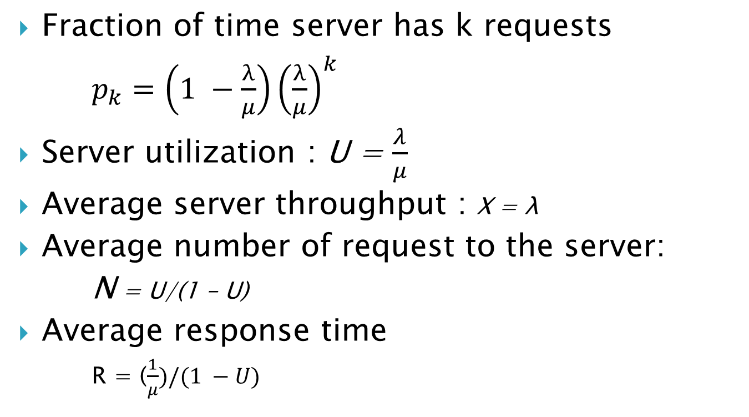
Formulas: Infinite queue
Fraction of time server has k requests
$p_{k}=\left(1 −\frac{λ}{μ}\right){\left(\frac{λ}{μ}\right)}^{k}$
Server utilization : U = $\frac{λ}{μ}$
Average server throughput : X = λ
Average number of request to the server:
N = U/(1 – U)
Average response time
R = ($\frac{1}{μ})/(1 −U)$

Slide 6
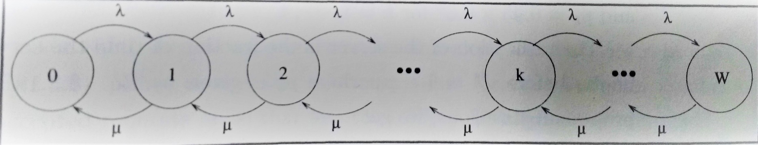
Finite Queue
Server can not queue all requests
Server rejects new requests coming after W requests are queued.
Up to W states are possible.

Slide 7
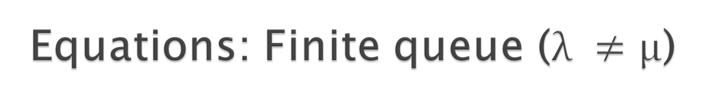
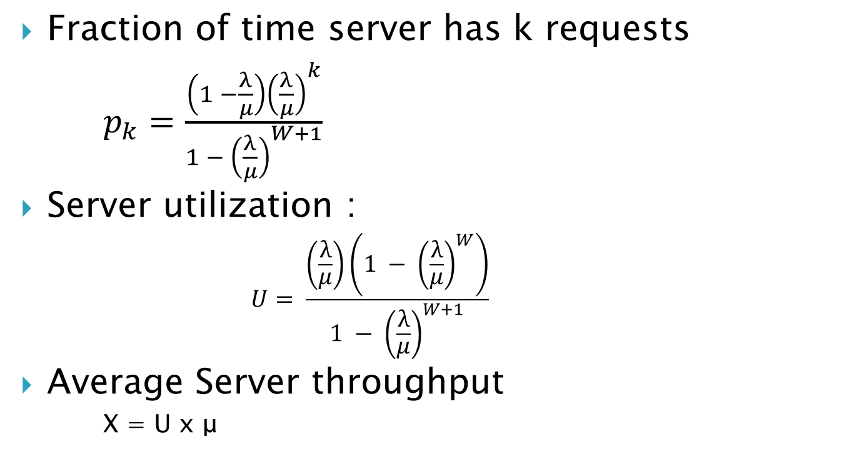
Equations: Finite queue ($λ ≠μ$)
Fraction of time server has k requests
$p_{k}=\frac{\left(1 −\frac{λ}{μ}\right){\left(\frac{λ}{μ}\right)}^{k}}{1 − {\left(\frac{λ}{μ}\right)}^{W+1}}$
Server utilization :
$$U= \frac{\left(\frac{λ}{μ}\right)\left(1 − {\left(\frac{λ}{μ}\right)}^{W}\right)}{1 − {\left(\frac{λ}{μ}\right)}^{W+1}}$$
Average Server throughput
X = U x μ

Slide 8
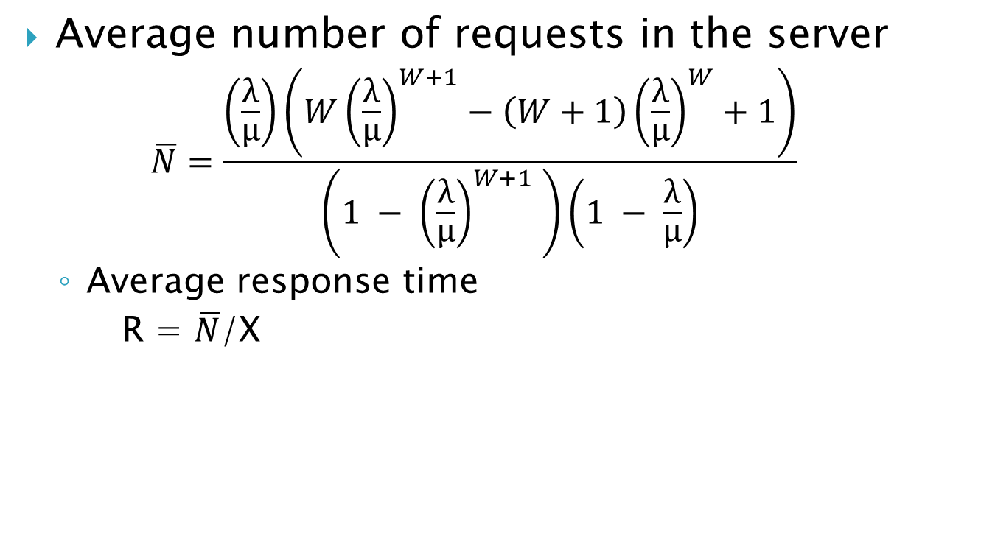
Formulas ..finite queue
Average number of requests in the server
$$\overline{N}=\frac{\left(\frac{λ}{μ}\right)\left(W{\left(\frac{λ}{μ}\right)}^{W+1}−\left(W+1\right){\left(\frac{λ}{μ}\right)}^{W}+1\right)}{\left(1 − {\left(\frac{λ}{μ}\right)}^{W+1} \right)\left(1 − \frac{λ}{μ}\right)}$$
Average response time
R = $\overline{N}$/X

Slide 9
Example
A search engine with N servers receives 500 requests/sec.
Arrival rate to each server is 500/N.
Throughput of each server is 20 request/sec.
W is 200 requests.
Plot Average response time vs number of servers.
To get rejection rate below 5% and maximum response time as 2 seconds, minimum 26 servers needed.

Slide 10
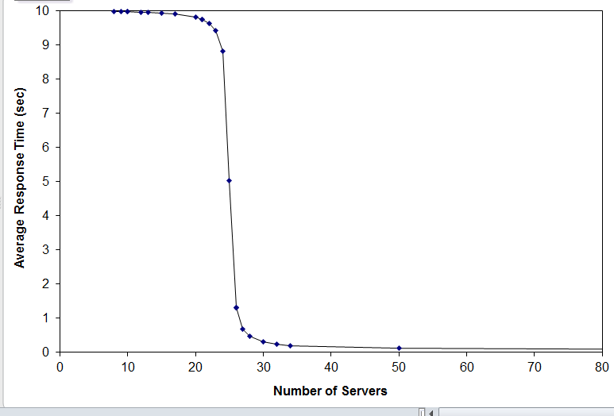
Plot

Slide 11
Component level models
(Inside the System)

Slide 12
Queuing Networks
Queuing Network = resource + queue of (CPU,disk) requests
Described as, S(n) : average service time per request when n request at queue.
Load independent resource: S(n) is constant
Load dependent resource: S(n) depends on load
Delay resource: No queuing

Slide 13
Class of QN
Open Class QN: Unbounded Requests
Close Class QN: Fixed number of requests
Closed class model is used for a system with maximum degree of multiprogramming under heavy load, e.g., A C/S
Network with limited number of clients sending requests to a multithreaded server.

Slide 14
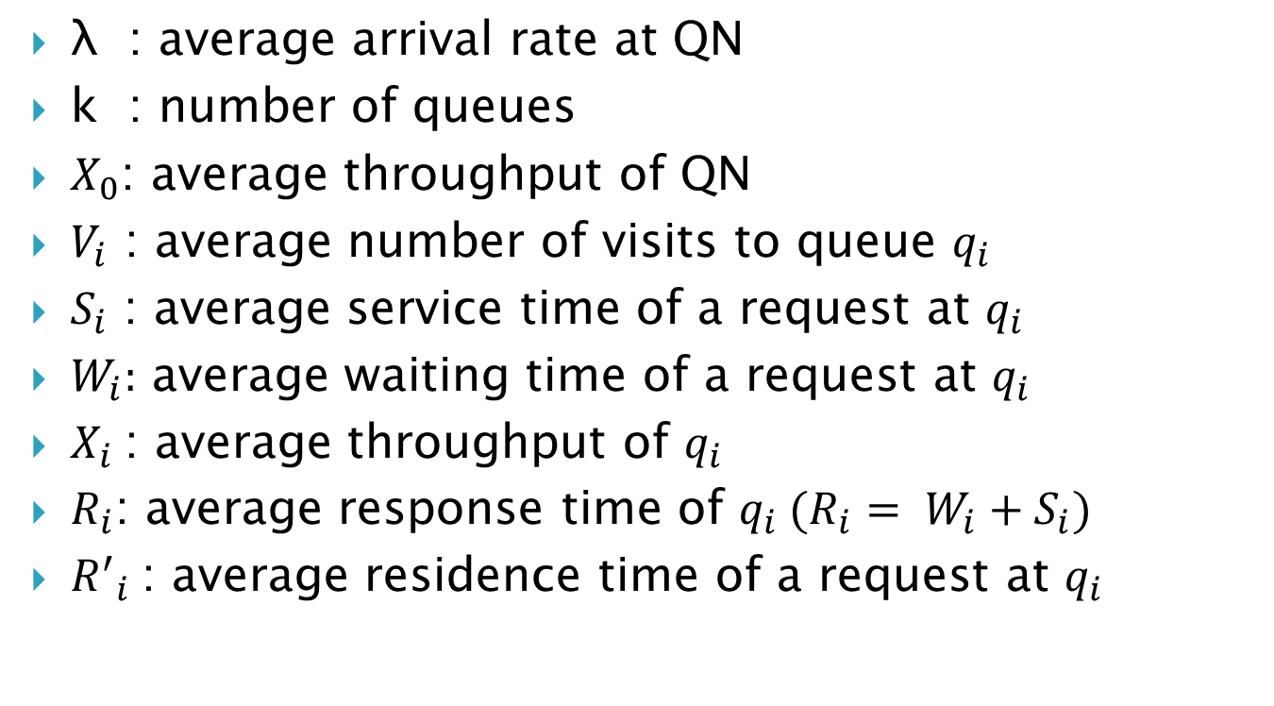
QN Parameters
λ : average arrival rate at QN
k : number of queues
$X_{0}$: average throughput of QN
$V_{i}$ : average number of visits to queue $q_{i}$
$S_{i}$ : average service time of a request at $q_{i}$
$W_{i}:$ average waiting time of a request at $q_{i}$
$X_{i}$: average throughput of $q_{i}$
$R_{i}$: average response time of $q_{i} (R_{i}= W_{i}+S_{i})$
${R^{′}}_{i}$: average residence time of a request at $q_{i}$

Slide 15
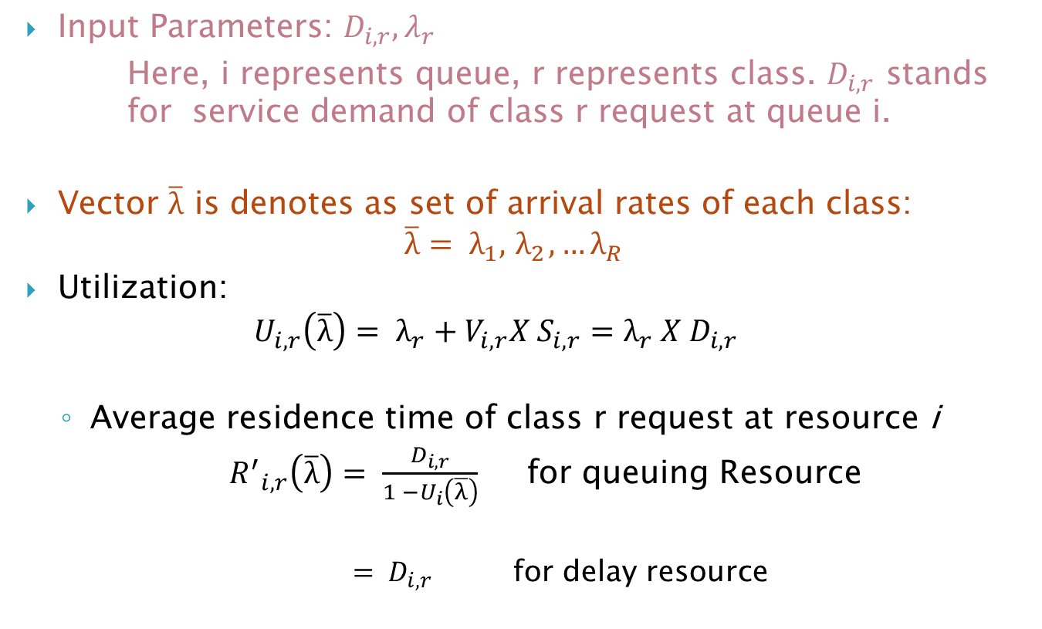
Equations : Open QN,multiclass
Input Parameters: $D_{i,r},λ_{r}$
Here, i represents queue, r represents class. $D_{i,r}$ stands for service demand of class r request at queue i.
Vector $\overline{λ}$ is denotes as set of arrival rates of each class:
$$\overline{λ}= λ_{1},{ λ}_{2},…λ_{R}$$
Utilization:
$$U_{i,r}\left(\overline{λ}\right)= λ_{r}+V_{i,r}X S_{i,r}=λ_{r} X D_{i,r}$$
Average residence time of class r request at resource i
${R^{′}}_{i,r}\left(\overline{λ}\right)= \frac{D_{i,r}}{1 −U_{i}\left(\overline{λ}\right)}$ for queuing Resource
${= D}_{i,r}$ for delay resource

Slide 16
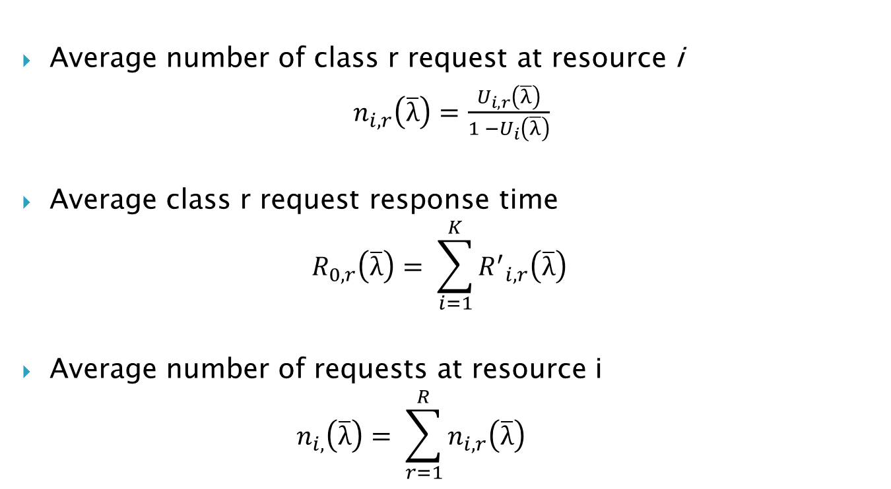
Equations .. Open QN,multiclass
Average number of class r request at resource i
$n_{i,r}\left(\overline{λ}\right)=$ $\frac{U_{i,r}\left(\overline{λ}\right)}{1 −U_{i}\left(\overline{λ}\right)}$
Average class r request response time
$$R_{0,r}\left(\overline{λ}\right)= \sum_{i=1}^{K}{{R^{′}}_{i,r}\left(\overline{λ}\right)}$$
Average number of requests at resource i
$$n_{i,}\left(\overline{λ}\right)= \sum_{r=1}^{R}{n_{i,r}\left(\overline{λ}\right)}$$

Slide 17
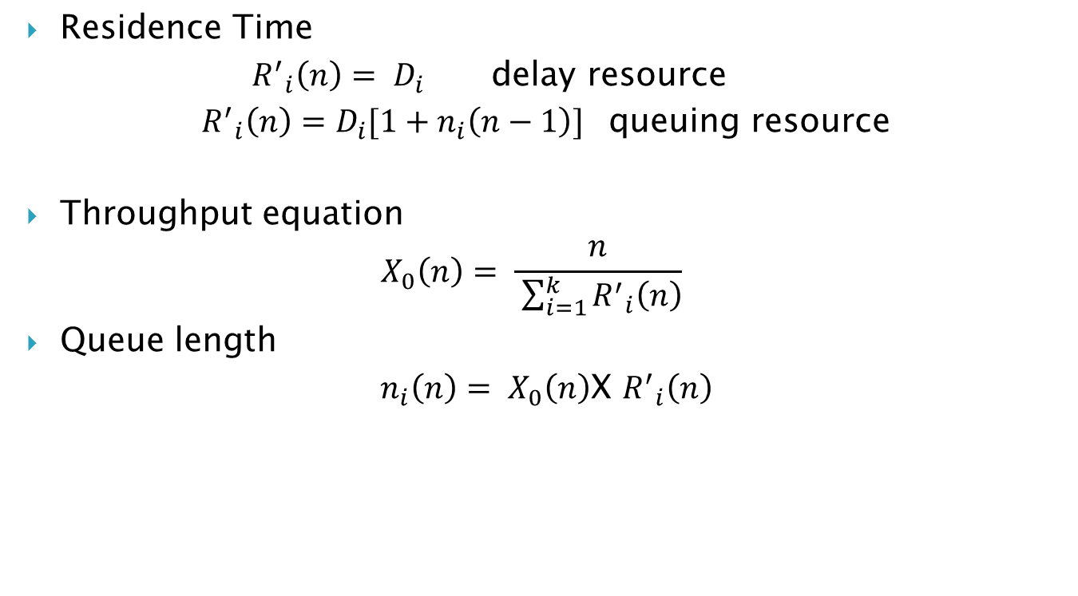
Equations: Closed QN, single class
Residence Time
${R^{′}}_{i}\left(n\right)= D_{i}$ delay resource
${R^{′}}_{i}\left(n\right)={D_{i}[1+n}_{i}\left(n−1\right)]$ queuing resource
Throughput equation
$$X_{0}\left(n\right)= \frac{n}{ \sum_{i=1}^{k}{{R^{′}}_{i}\left(n\right)}}$$
Queue length
$n_{i}\left(n\right)= X_{0}\left(n\right)$X ${R^{′}}_{i}\left(n\right)$

Slide 18
Example: Database Server
Requests from 50 clients.
Each request takes 15 ms CPU time.
Each request reads 5 records and takes 9 ms per record
What is throughput, average time at resources?
Service Demand at disk = 5x9 = 45 ms
Calculate parameters using MVA (Mean Value Analysis) equations for closed model.
As number of request increases, throughput saturates at 0.0222 transactions/msec.

Slide 19
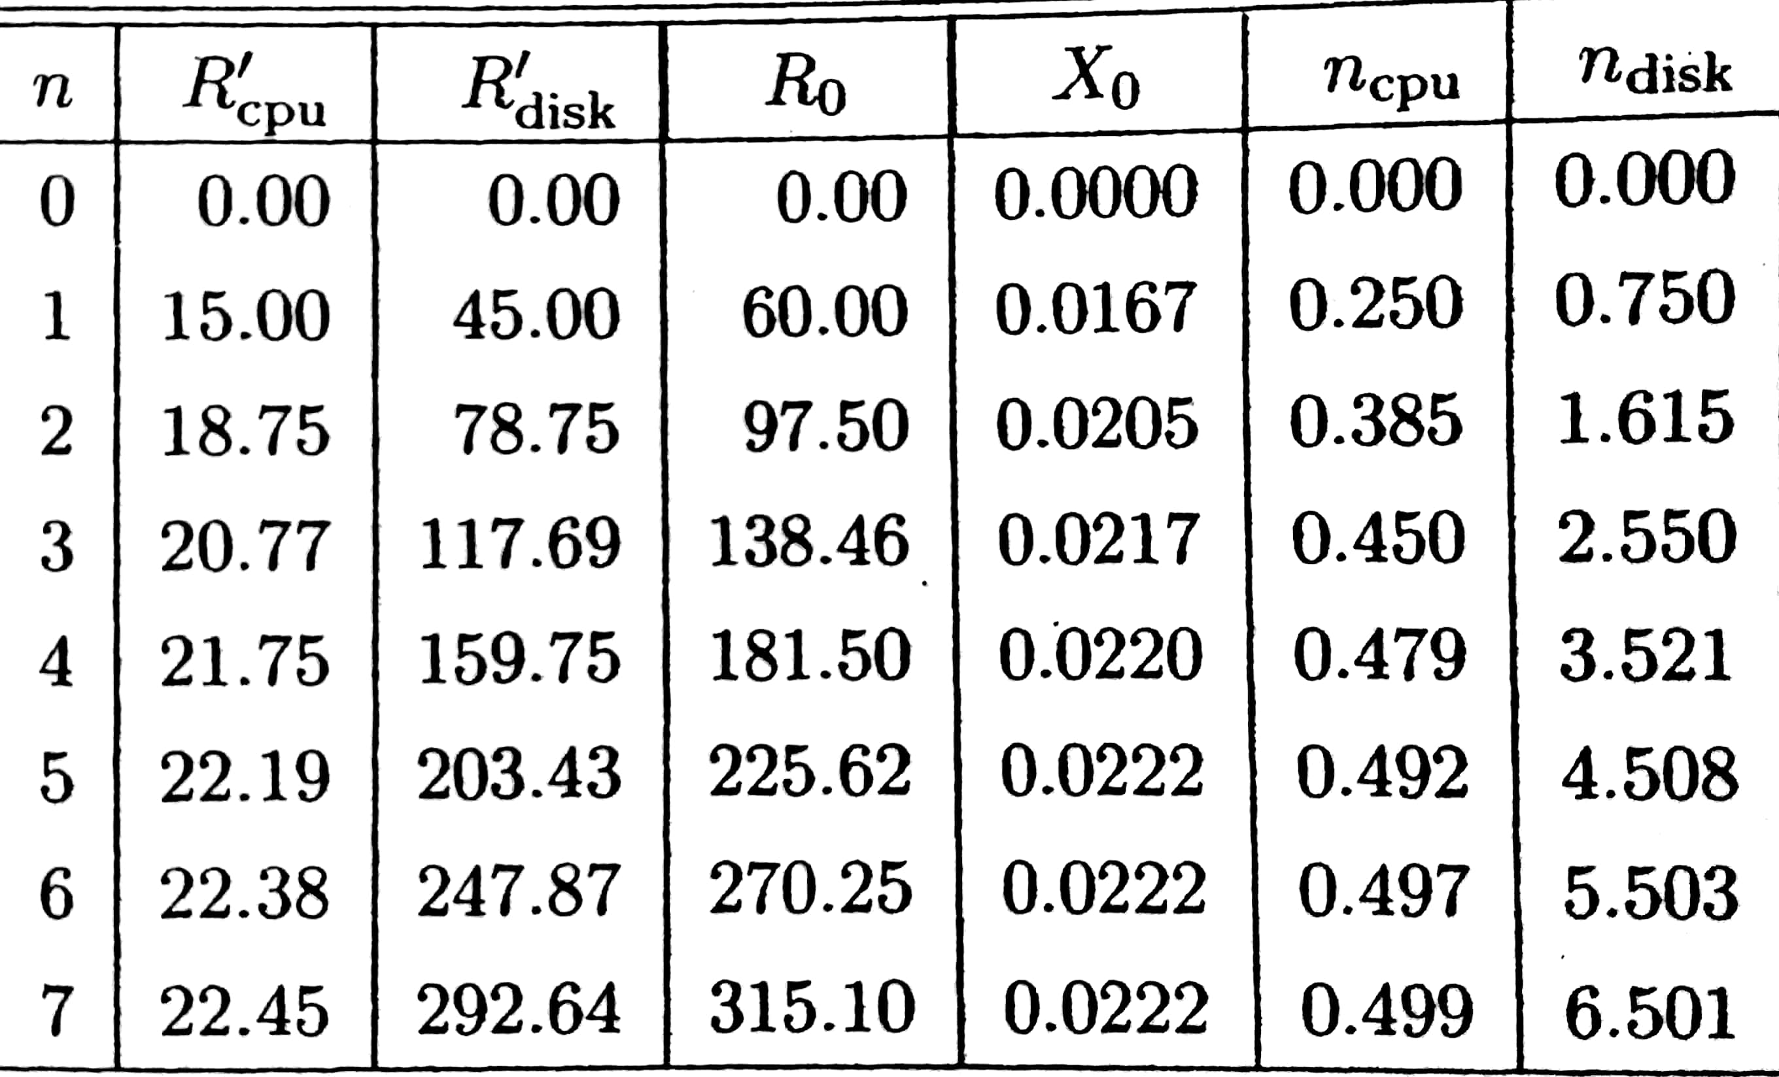
Calculations

Slide 20
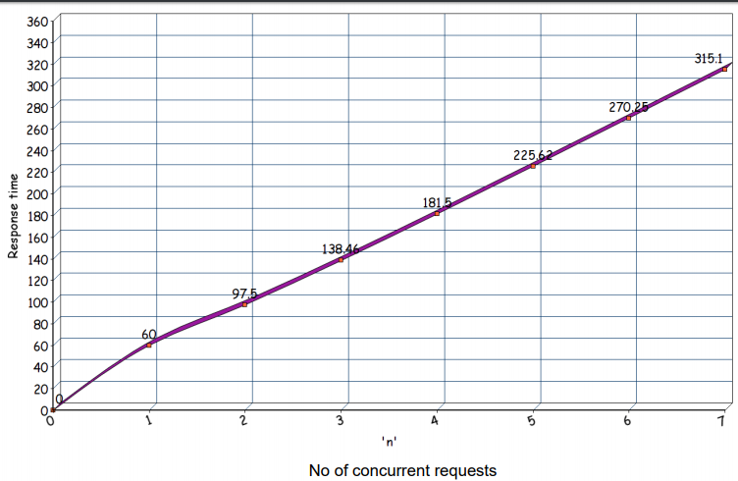
Results

Slide 21
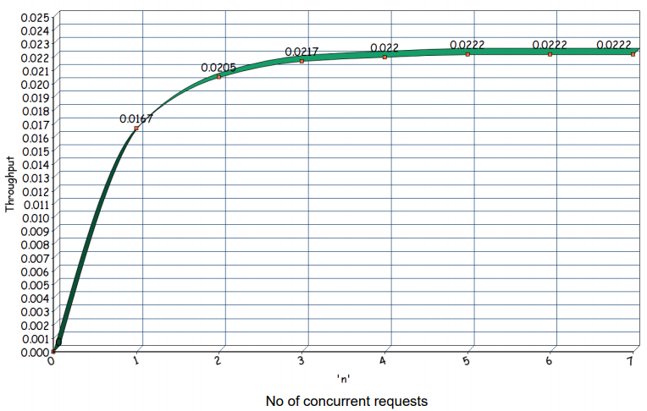
Results..

Slide 22
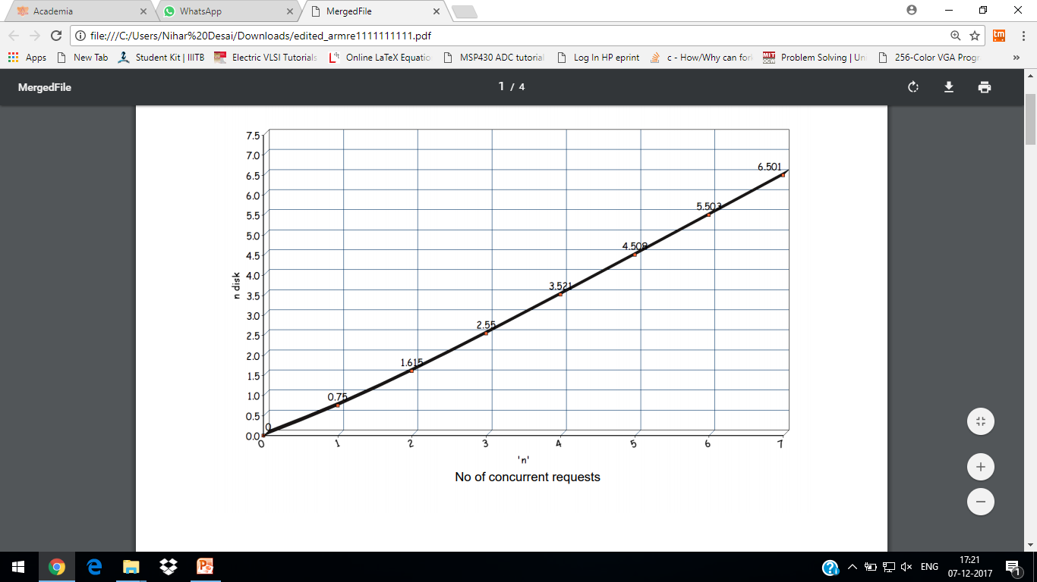
Results..

Slide 23
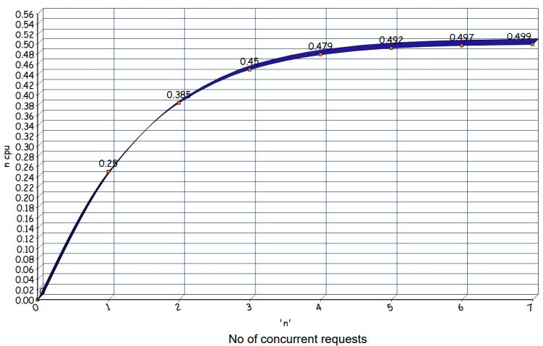
Results..

Slide 24
Conclusion
Performance of web servers can be analyzed at high level, system’s point of view or component’s point of view.
Analytic models use mathematical algorithms to estimate average throughput, response time, server utilization.
Server resources can be modelled as Queuing Networks. From Mean Value Analysis residence time in resource, queue length of a resource can be estimated.

Slide 25
Reference
Menasce A., Almedia A.F. , Capacity Planning for Web Services: Metrics, models and methods, Prentice Hall
To download chapter-wise excel sheets,
https://cs.gmu.edu/~menasce/webservices/efiles.html

