Slide 1
Web Services
10th October, 2017

Slide 2
Web Services
Web service is a service available to user via internet, that complete tasks or conduct transactions.
Examples: electronic payment, storage services, content distribution
Execution: Single site vs different sites
Problems: insufficient bandwidth, uneven server loads, failure of third-party service
SLA: Service Level Agreement ?

Slide 3
Performance
Metrics:
end-to-end response time
Site response time
Throughput in requests/sec
Throughput in Mbps
Errors per second
Visitors per day

Slide 4
Performance
Quality of Service
24X7 uninterruptible service
Small call drop index
Large coverage
Short repair time
cost

Slide 5
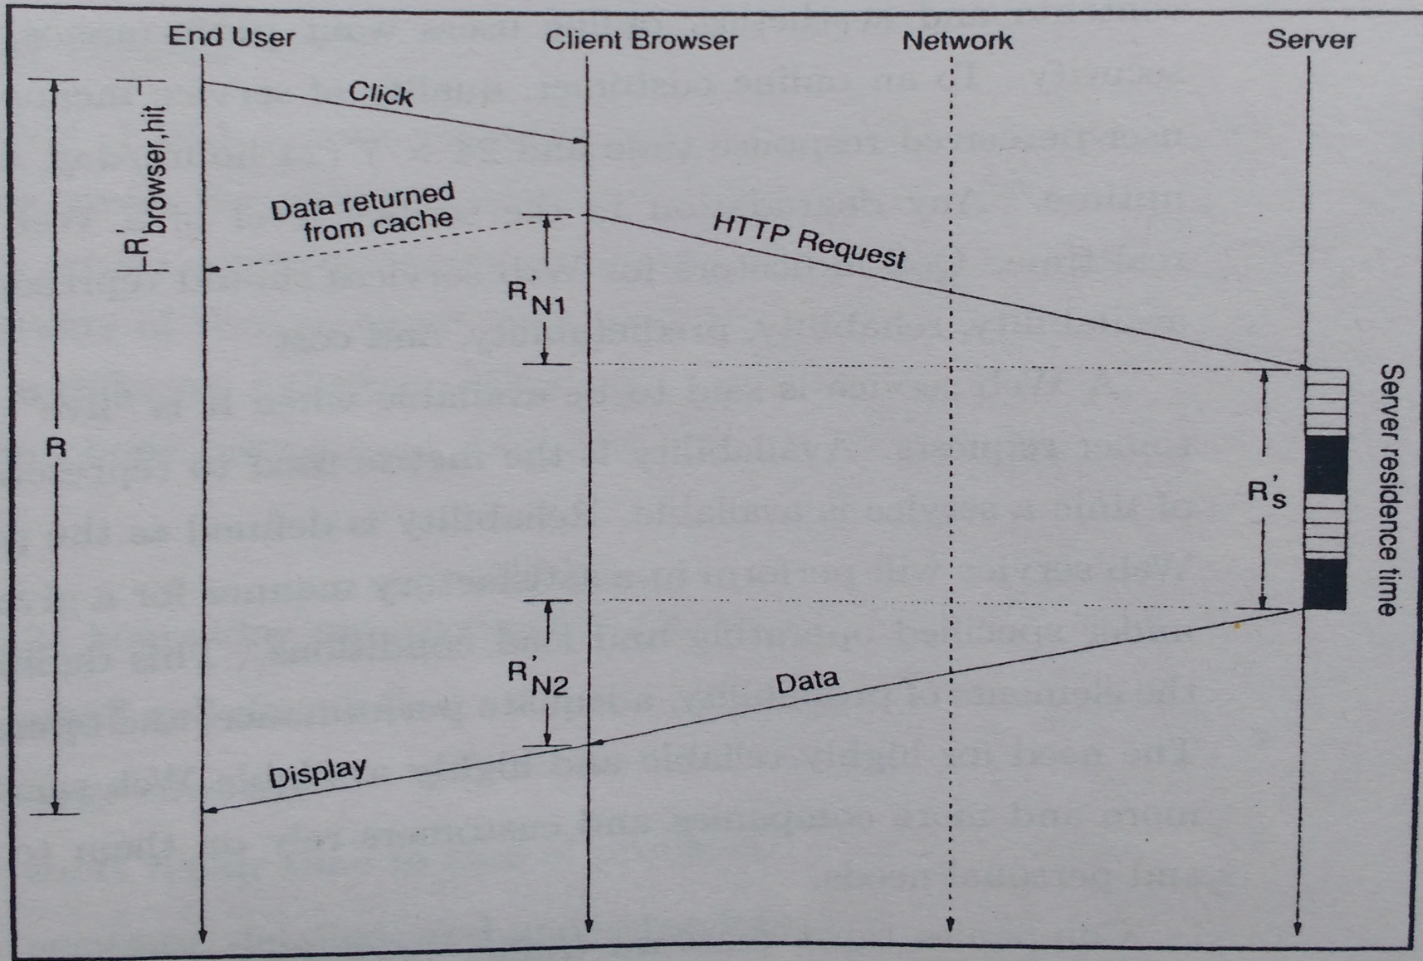
Delay

Slide 6
Server Architectures
Web servers:
Listens HTTP requests coming from client
Establishes client-server connection
Sends requested file, returns to listening
Multiple requests: fork, multithreading
Dynamic webpages : client-side programs
In-kernel services : speedup delivery,vulnerable

Slide 7
Server Architectures…
2. Application Servers:
- software that handles operations between customer and company’s back-end database
a. CGI scripts: new processes
b. FastCGI: scripts communicates with webserver through TCP or IPC
c. Applications within web-server context

Slide 8
Server Architectures…
Transaction & database servers
Transaction server integrates the components needed to execute transaction: database systems, OS, communication system.
Database systems are high-power server or mainframes which provides access to shared data.

Slide 9
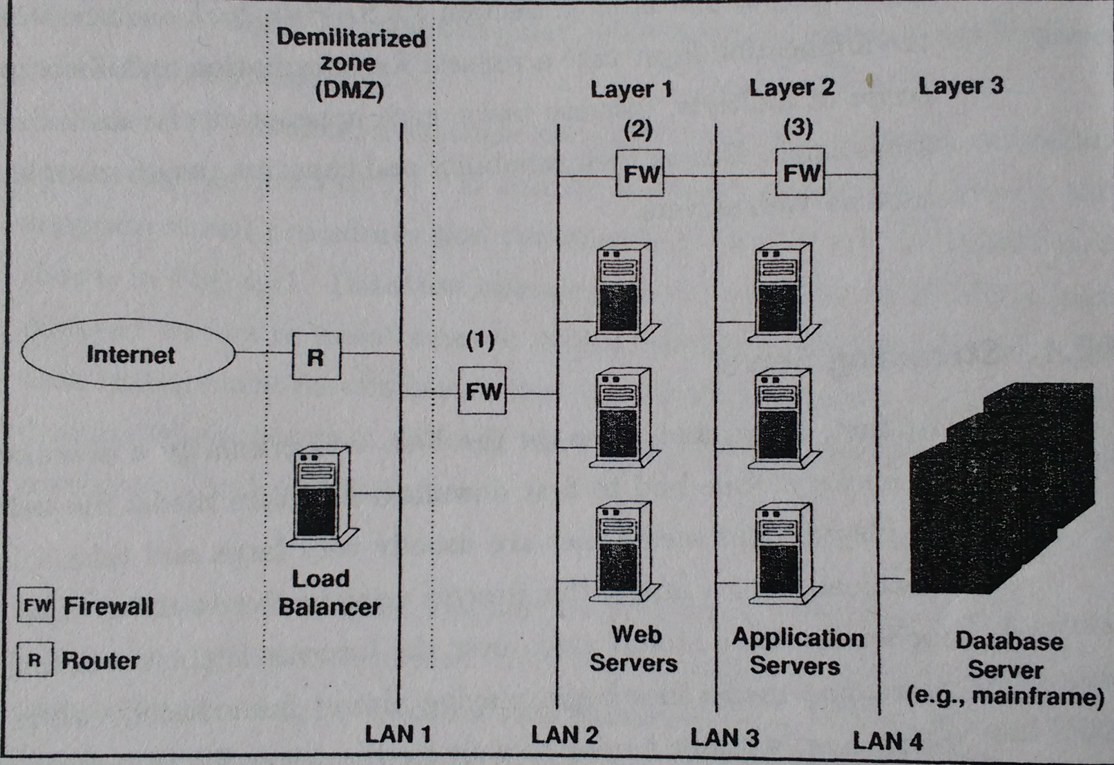
Multi-tier Architecture

Slide 10
Load Balancing
Add more servers to handle more traffic
Web cluster: an architecture consisting of multiple web servers & mechanisms to route incoming requests among sever nodes.
Web switch: maps virtual IP address to actual server address. (switch address = cluster address)
- Layer4, Layer7
Round-robin, DNS-based, server based

Slide 11
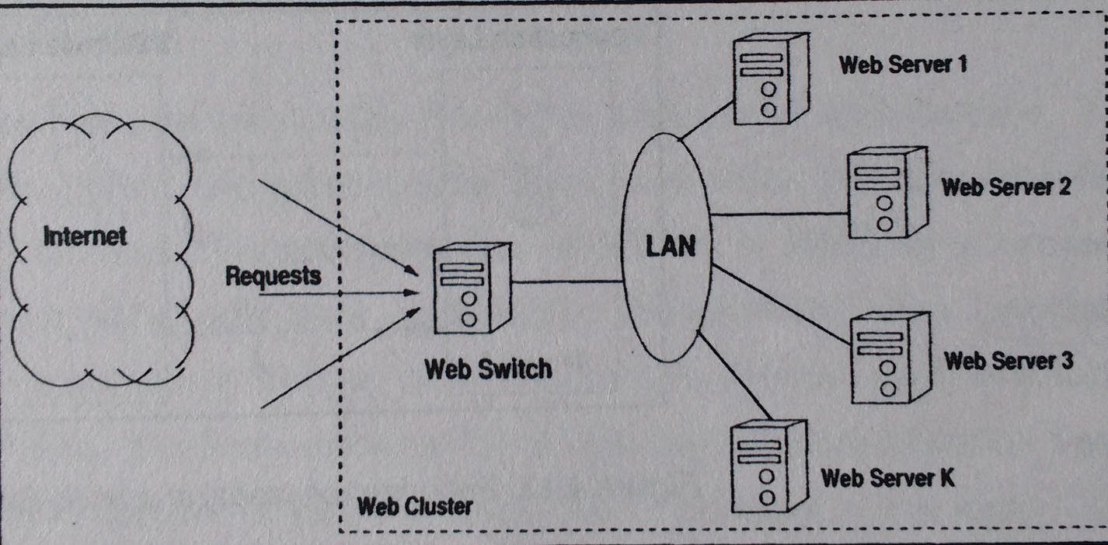
Load Balancing

Slide 12
Network
Bandwidth and latency
Latency: time needed for a bit to travel across network
Bandwidth: rate of data transfer
Traffic
bursty(random) behavior
difficulty in sizing server capacity and bandwidth
degradation during peak time

