Slide 1
Web Capacity Models
5 December 2017

Slide 2
Overview
Performance measures:
Response time, throughput, resource utilization, resource queue length
Analytic models are based on statistical formulas and computational algorithms
Simulation models mimic the behavior of system.
System level models does not consider internal details. System is considered as a “black box” and only average throughput is used.
Component level models takes into account different resources of the system: disk, CPU, network…

Slide 3
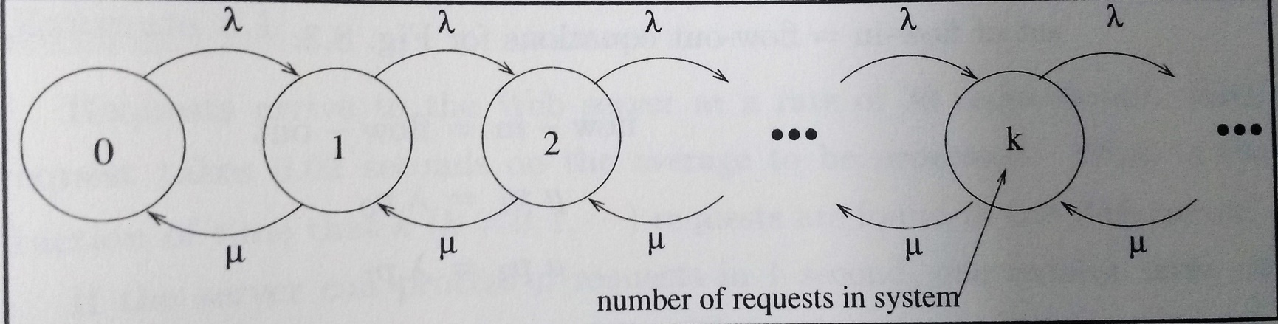
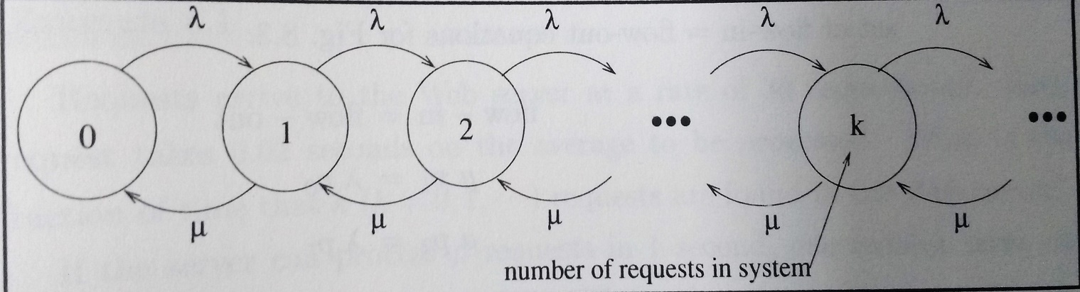
Infinite Queue
Infinite population: Arrival rate (λ) is not influenced by number of requests that arrived already.
Assumption:
No request is discarded.
Throughput (µ) is constant.
When the server is in k state and..
a new request comes, state k → k+1
a request completes, states k → k-1

Slide 4
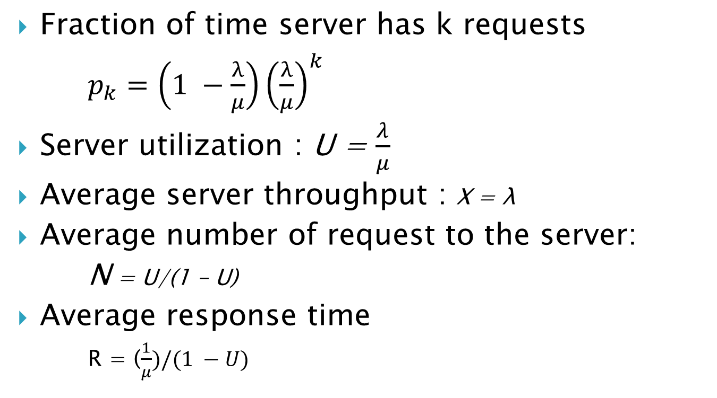
Formulas
Fraction of time server has k requests
$p_{k}=\left(1 −\frac{λ}{μ}\right){\left(\frac{λ}{μ}\right)}^{k}$
Server utilization : U = $\frac{λ}{μ}$
Average server throughput : X = λ
Average number of request to the server:
N = U/(1 – U)
Average response time
R = ($\frac{1}{μ})/(1 −U)$

Slide 5
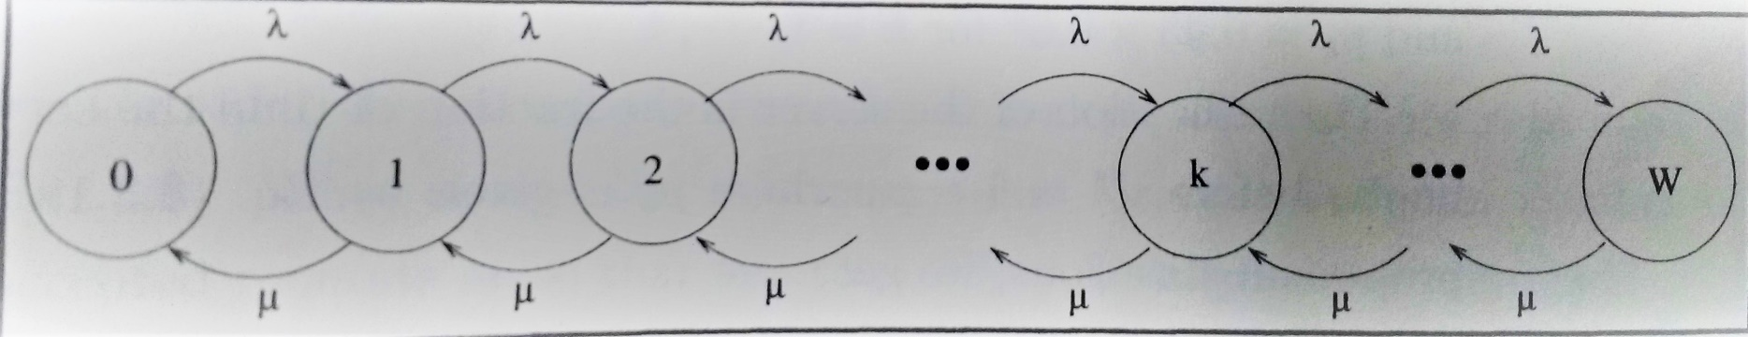
Finite Queue
Server can not queue all requests
Server rejects new requests coming after W requests are queued.
W states are possible.

Slide 6
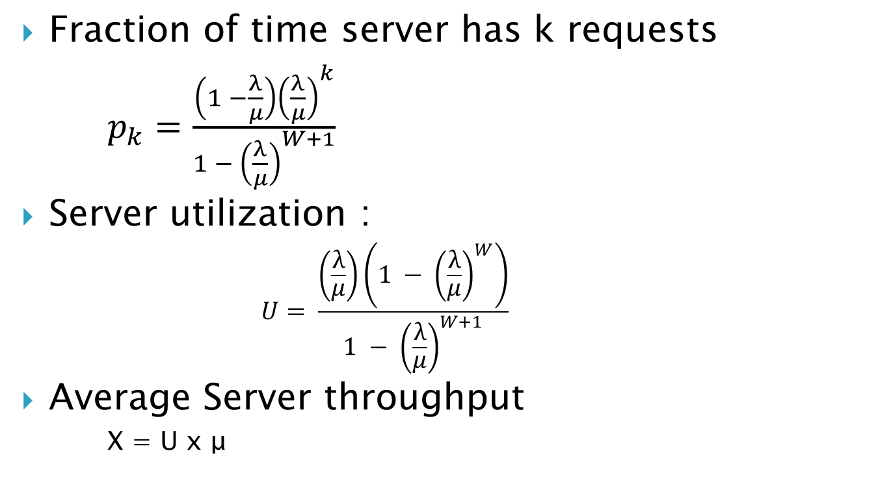
Formulas
Fraction of time server has k requests
$p_{k}=\frac{\left(1 −\frac{λ}{μ}\right){\left(\frac{λ}{μ}\right)}^{k}}{1 − {\left(\frac{λ}{μ}\right)}^{W+1}}$
Server utilization :
$$U= \frac{\left(\frac{λ}{μ}\right)\left(1 − {\left(\frac{λ}{μ}\right)}^{W}\right)}{1 − {\left(\frac{λ}{μ}\right)}^{W+1}}$$
Average Server throughput
X = U x μ

Slide 7
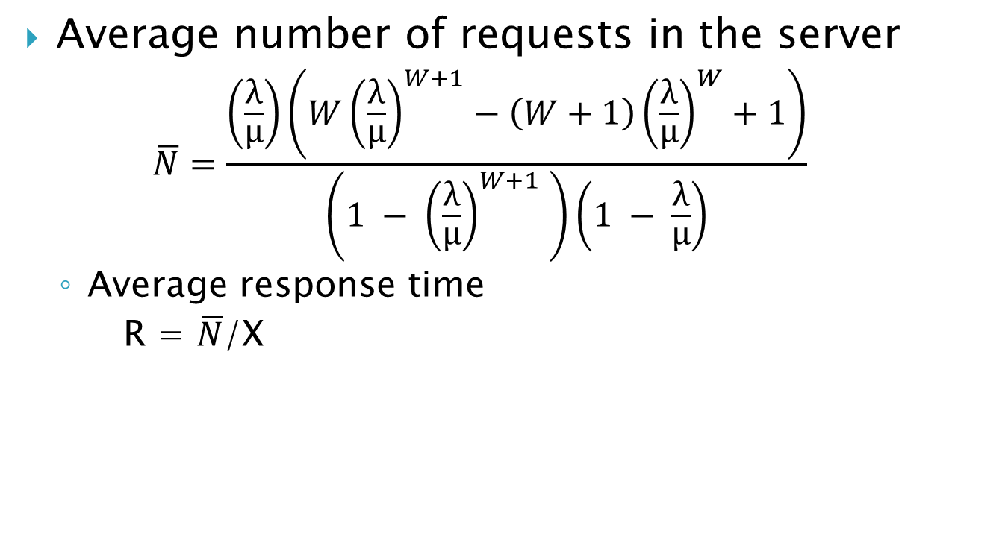
Formulas ..
Average number of requests in the server
$$\overline{N}=\frac{\left(\frac{λ}{μ}\right)\left(W{\left(\frac{λ}{μ}\right)}^{W+1}−\left(W+1\right){\left(\frac{λ}{μ}\right)}^{W}+1\right)}{\left(1 − {\left(\frac{λ}{μ}\right)}^{W+1} \right)\left(1 − \frac{λ}{μ}\right)}$$
Average response time
R = $\overline{N}$/X

Slide 8
Example
A search engine with N servers receives 500 requests/sec.
Arrival rate to each server is 500/N.
Throughput of each server is 20 request/sec.
W is 200 requests.
Plot Average response time vs number of servers.
To get rejection rate below 5% and maximum response time as 2 seconds, minimum 26 servers needed.

Slide 9
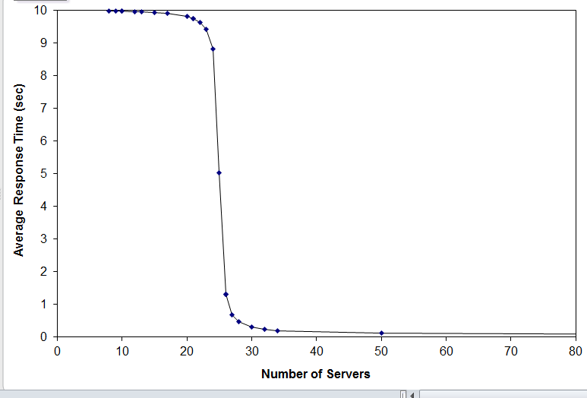
Plot

