Slide 1
HL7® FHIR® and
HLA Nomenclatures
A Formalized Framework for
Electronic Exchange of Coded HLA Data
Operated by the National Marrow Donor Program®

Slide 2
Goals
Introduce HL7, focusing on use of coded data
Examine types of coded HLA data found in the NMDP registry
See how registry HLA data could fit into a HL7 framework
Explore a prototype HL7 terminology service for coded HLA data
Identify potential advantages of adopting a HL7 framework for working with coded data
Facilitate thoughts and discussion about HL7 usage
Operated by the National Marrow Donor Program®

Slide 3
What is HL7?
ANSI accredited SDO
Prominent developer of standards for healthcare information exchange
Version 2
  Developed by implementers
  Widely used by hospital systems and medical devices
  Sometimes criticized for being an 80% solution, not a real standard
Version 3
  Developed using a model-driven methodology
  Reference Implementation Model (RIM), etc.
  Very low adoption after 10+ years
  Originally released under a proprietary IP license
Operated by the National Marrow Donor Program®

Slide 4
What is FHIR?
Successor to HL7 version 3
Focused on implementers
Open source license
RESTful web service APIs and resources
  Modern architecture, supports both JSON and XML data formats
Deliberately limited scope for core resources
  Avoid “boil the ocean” modeling efforts
Extension mechanism for handling special cases
  Creation of extensions is expected and normal
Operated by the National Marrow Donor Program®

Slide 5
HL7 and Coded Data
HL7 makes a distinction between a Code System and a Value Set.
Code System
A set of controlled strings (codes)
A source of codes which may be used in a value set
e.g. LOINC, SNOMED CT, ICD-10
Identified by a code system URI, e.g. http://hl7.org/fhir/allergy-intolerance-status
Value Set
A set of controlled strings (codes)
May specify the set of codes allowed for a particular data element (“binding”)
May be a mixed set of codes, originating from more than one code system
May include in-house codes, such as codes defined by an inline code system
Identified by a value set URI, e.g. http://hl7.org/fhir/ValueSet/allergy-intolerance-status
Operated by the National Marrow Donor Program®

Slide 6
Identifying a Coded Value
“Code Pair”
system
  The code system URI
  Identifies the code system (a namespace)
  e.g. http://www.genenames.org
code
  The coded value (a name)
  e.g. HLA-A
The system is always a code system URI, and never a value set URI. A value set URI identifies a set of code pairs, but is never used as the namespace in an actual code pair.
A code system defines a set of codes, but a value set only references codes defined elsewhere. Additionally, a value set may reference codes from more than one code system.
A value set is used when binding an element within a resource to a set of allowed values. In FHIR, usage is strictly element ➔ binding ➔ value set ➔ code system.
Operated by the National Marrow Donor Program®

Slide 7
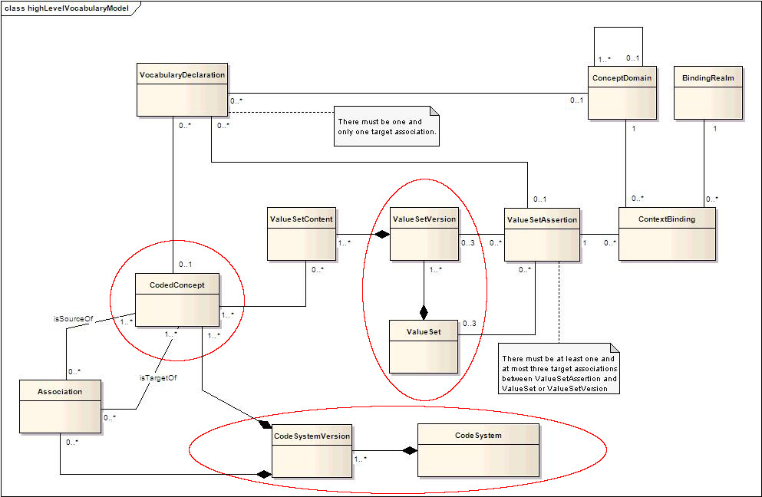
HL7 High Level Vocabulary Model
Operated by the National Marrow Donor Program®

Slide 8
Code System Versioning
Code systems evolve over time.
Where codes do not change meaning over time (or changes are sufficiently subtle), the version of the code system does not need to be noted.
To precisely reference a specific version of a code system, the coded value identifier may include a version in addition to the system and code.
Code systems use a variety of mechanisms to signify a version.
In some cases, an effective date may be used to identify a code system version.
Operated by the National Marrow Donor Program®

Slide 9
Post-Coordinated Expressions
“pre-coordinated”
A complex concept which has been assigned a unique concept identifier or code.
e.g. ‘left arm’
“post-coordinated”
A complex concept represented by a combination of two or more codes.
e.g. ‘arm’ with laterality ‘left’
“grammar for post-coordination”
The mechanism (syntax) that permits construction of new concept representations.
Post-coordinated expressions using nomenclature-level HLA data
Slash-delimited lists, e.g. HLA-A*01:01/HLA-A*01:02
GL Strings
Operated by the National Marrow Donor Program®

Slide 10
Example Code System: SNOMED CT
What is SNOMED CT?
A prominent system for encoding clinical data.
Cited by HL7 FHIR documentation as an important example of coded data.
Well documented and widely adopted.
Maintained by IHTSDO, a not-for-profit organization owned and governed by 28 international members.
Requires a license for deployment; usable free of charge in IHTSDO member countries.
Operated by the National Marrow Donor Program®

Slide 11
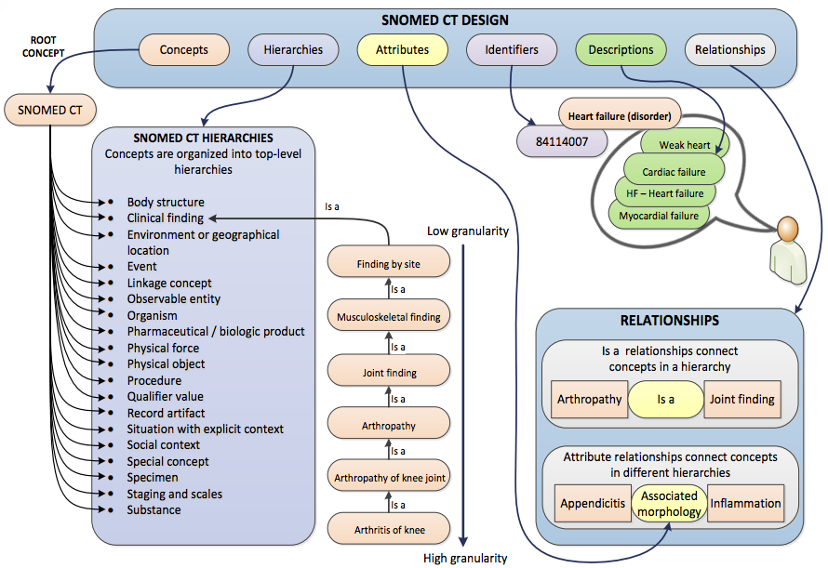
SNOMED CT: Concept Hierarchies, etc.
Operated by the National Marrow Donor Program®

Slide 12
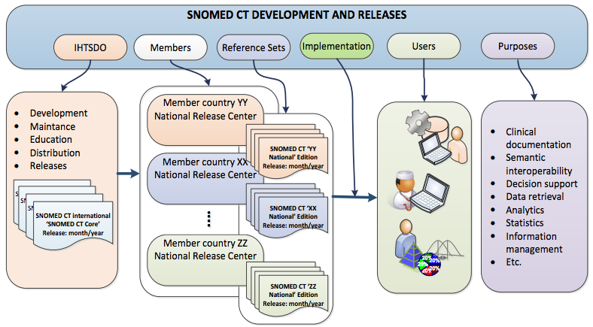
SNOMED CT: Development and Releases
Operated by the National Marrow Donor Program®

Slide 13
SNOMED CT: Post-coordinated Expressions
An example …
Pre-coordinated expression
A single SNOMED CT concept identifier
Optionally followed by a term associated with that concept, enclosed in pipe characters
174041007|laparoscopic emergency appendectomy|
Post-coordinated expression
Contains two or more concept identifiers
Adds refinement to a concept
80146002|appendectomy|:260870009|priority|=25876001|emergency|,425391005|using access device|=86174004|laparoscope|
Post-coordination allows a clinical phrase to be represented even when the precise concept is not present in SNOMED CT.
Operated by the National Marrow Donor Program®

Slide 14
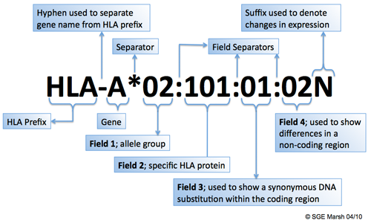
Nomenclature of HLA Alleles
Operated by the National Marrow Donor Program®

Slide 15
_x0010_HL7 Code Systems & HLA Nomenclature
Two hypothetical HL7 code systems for HLA data, geared toward HLA data transmission (HML or form 22).
hla-multiple-allele-code
  Alphabetic code, e.g. HLA-A*01:AB
  Represents a set of amino acid (protein level) alleles
hla-who-nomenclature
  Long name, e.g. HLA-A*01:01:01:01, HLA-A*01:01:01:02N
  An unambiguous IMGT/HLA allele name
These code systems have been implemented in a prototype HL7 FHIR Terminology Service. For now, their code system and value set URIs are (temporarily) tied to b12x.org.
Operated by the National Marrow Donor Program®

Slide 16
Code System: hla-multiple-allele-code
Each multiple allele code represents a list of two or more amino acid alleles
e.g. AB = 01/02, etc.
Expected usage is at protein level (amino acid)
Coming soon: multiple allele code (MAC) service
Automate creation of new multiple allele codes
Enable higher level of automation with typing labs
hla-multiple-allele-code namespace (in prototype FHIR terminology service)
Always presents multiple allele codes in the contest of a locus, e.g. HLA-A*01:AB
These are values which could be used in a typing report such as HML or form 22
Operated by the National Marrow Donor Program®

Slide 17
Code System: hla-amino-acid-allele
Each amino acid allele represents one or more genomic alleles which encode the same protein.
Indicated by first 2 fields of IMGT/HLA nomenclature
E.g. HLA-A*01:01
HLA Expression Suffixes
Protein expression is important for matching
e.g. null alleles such as HLA-A*01:01:01:02N
Transposing expression suffix to protein-level name, e.g. HLA-A*01:01N
Consequences of transposing the expression suffix
Deviation from IMGT/HLA standard
Protein-level names which describe both expression and encoding
Operated by the National Marrow Donor Program®

Slide 18
Code System: hla-genomic-allele
Each genomic allele represents a distinct allele characterized by the IMGT/HLA database.
Indicated by all 4 fields of IMGT/HLA nomenclature
  e.g. HLA-A*01:01:01:01
Caveat: 4-field names are only assigned when a 3-field name becomes ambiguous, etc.
Some genomic allele names have only 2 or 3 fields
  e.g. HLA-A*01:02, HLA-A*01:01:02
  2-field name may be both genomic and protein-level
Full-length allele name may vary from one IMGT/HLA release to the next
  e.g. the name HLA-A*01:02 would no longer be genomic if HLA-A*01:02:02 were discovered
TBD: Should we customize the genomic allele namespace too?
e.g. recognize HLA-A*01:02:01:01 as a synonym for HLA-A*01:02
Achieve naming stability at 4-field level across IMGT/HLA releases
Operated by the National Marrow Donor Program®

Slide 19
HLA vs. World
Some stumbling points in translating HLA-isms to a wider genomics audience.
Locus vs. Gene
  We say “locus”, they say “gene”.
Shorthand Gene Names
  E.g. A for HLA-A, DR or DRB1 for HLA-DRB1, etc.
  Unrecognized in some contexts
    e.g. www.genenames.org search results for “A” vs. search results for “HLA-A”
  May be confusing to clinicians who aren’t HLA geeks
    e.g. there is more than one gene named “A”
Presently, the prototype HL7 FHIR Terminology Service accepts shorthand gene names as input, but generates output using the full HLA gene names.
Operated by the National Marrow Donor Program®

Slide 20
Wait, There’s More
Other possible HL7 code systems for nomenclature-level HLA data.
hla-amino-acid-allele
  IMGT/HLA names, but limited to 2 or fewer fields, e.g. HLA-A*01:01
hla-exomic-allele
  IMGT/HLA names, but limited to 3 or fewer fields, e.g. HLA-A*01:01:01
hla-serology
  Serology types, e.g. HLA-A2
hla-wmda-special-code
  Special WMDA codes, e.g. HLA-DRB3*NNNN, HLA-DRB3*XXXX
hla-sequence-feature-enumeration
  Colon-delimited lists of sequence features, based on some feature model
Operated by the National Marrow Donor Program®

Slide 21
HL7 FHIR Terminology Service
An HL7 FHIR terminology service implements a set of operations for lookup, validation, retrieval, and translation of coded data.
General pattern for HL7 FHIR web service APIs
Parameters structure = a set of name/value pairs
Request = IN Parameters
Response = OUT Parameters
Error Response = OperationOutcome
Data format can be either JSON or XML
Terminology service operations are bound to the ValueSet and ConceptMap resources.
ValueSet Operations: $expand, $lookup, $validate-code
ConceptMap Operation: $translate
Operated by the National Marrow Donor Program®

Slide 22
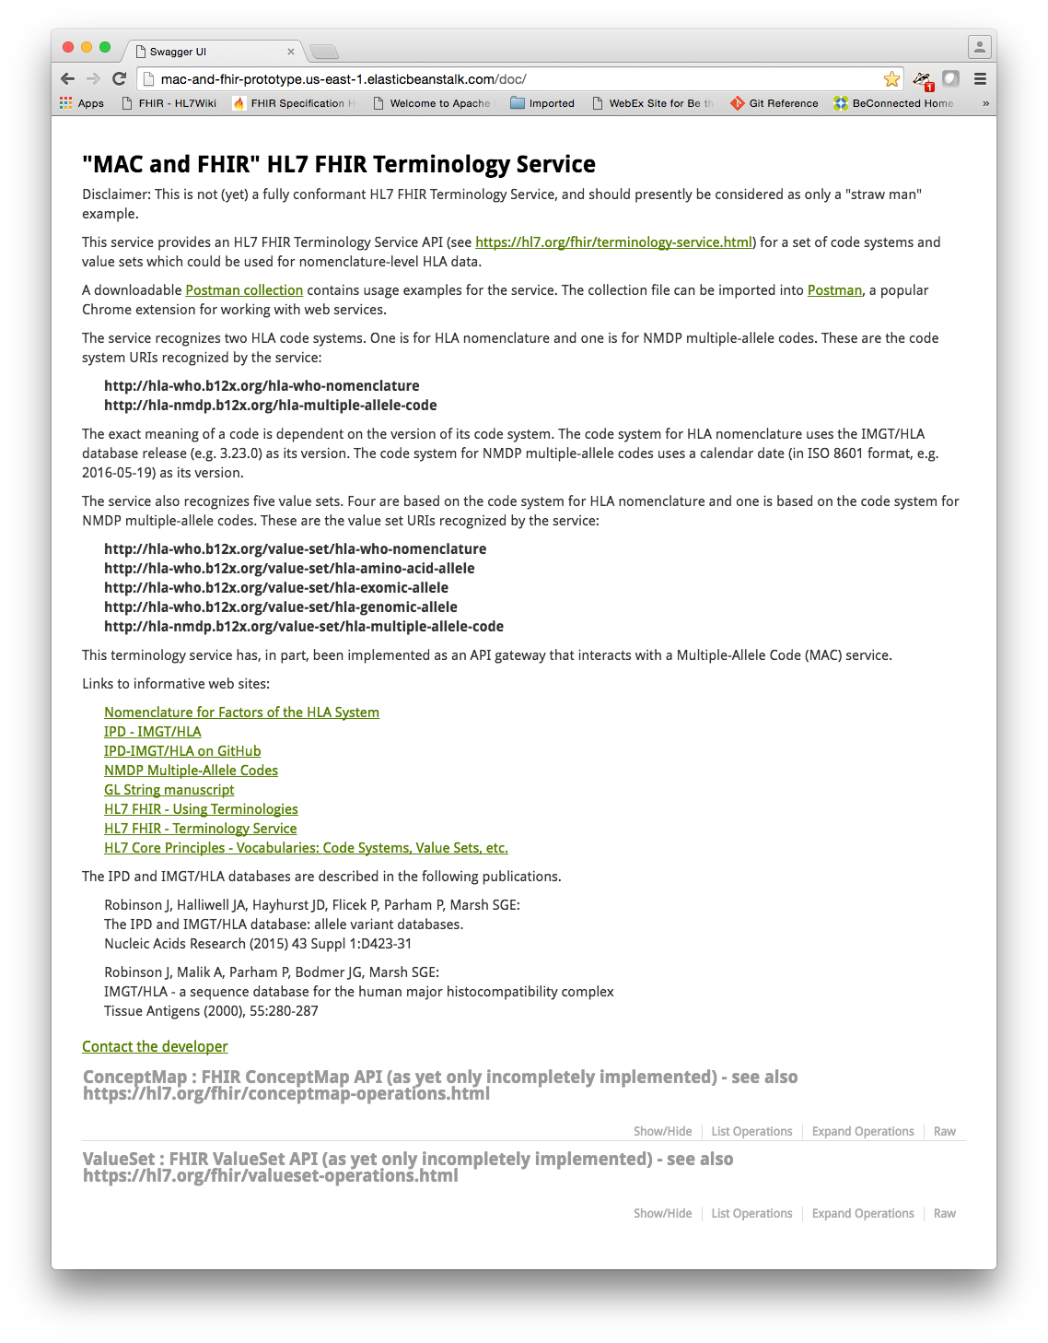
Prototype HL7 FHIR Terminology Service
Operated by the National Marrow Donor Program®

Slide 23
ValueSet/$expand operation
Produces a simple collection of codes suitable for use for data entry or validation.
Able to retrieve all codes in a value set.
Allows for queries to retrieve a subset of a value set’s codes.
e.g. populate drop-down list in data-collection system
Not yet implemented in prototype terminology service.
Always returns “too costly” error
Operated by the National Marrow Donor Program®

Slide 24
ValueSet/$expand request
{
"resourceType" : "Parameters",
"parameter" : [
{
"name" : "identifier",
"valueUri" : "http://hla-nmdp.b12x.org/value-set/hla-multiple-allele-code"
}
]
}
Operated by the National Marrow Donor Program®

Slide 25
ValueSet/$expand response
HTTP status: 501 Not Implemented
{
"resourceType": "OperationOutcome",
"issue": [
{
"severity": "fatal",
"code": "too-costly"
}
]
}
Operated by the National Marrow Donor Program®

Slide 26
ValueSet/$lookup operation
Retrieves additional details about a concept.
FHIR API specification allows for retrieval of information which was applicable at some past date.
Not fully implemented in prototype terminology service.
Operated by the National Marrow Donor Program®

Slide 27
ValueSet/$lookup request
{
"resourceType" : "Parameters",
"parameter" : [
{
"name" : "code",
"valueString" : "HLA-A*01:AB"
},
{
"name" : "system",
"valueUri" : "http://hla-nmdp.b12x.org/hla-multiple-allele-code"
}
]
}
Operated by the National Marrow Donor Program®

Slide 28
ValueSet/$lookup response
HTTP status: 200 OK
{
"resourceType": "Parameters",
"parameter": [
{
"name": "name",
"valueString": "hla-multiple-allele-code"
},
{
"name": "version",
"valueString": "2016-04-01"
},
{
"name": "display",
"valueString": "HLA-A*01:AB"
},
{
"name": "abstract",
"valueBoolean": false
}
]
}
Operated by the National Marrow Donor Program®

Slide 29
ValueSet/$validate-code operation
Validates that a coded value is in the set of codes allowed by a value set.
FHIR API specifications allow for validation to be performed using information applicable at a past date, or within a specific context.
Not fully implemented in prototype terminology service.
Operated by the National Marrow Donor Program®

Slide 30
ValueSet/$validate-code request
{
"resourceType" : "Parameters",
"parameter" : [
{
"name" : "code",
"valueString" : "HLA-A*01:AB"
},
{
"name" : "system",
"valueUri" : "http://hla-nmdp.b12x.org/hla-multiple-allele-code"
}
]
}
Operated by the National Marrow Donor Program®

Slide 31
ValueSet/$validate-code response
HTTP status: 200 OK
{
"resourceType": "Parameters",
"parameter": [
{
"name": "result",
"valueBoolean": true
},
{
"name": "display",
"valueString": "HLA-A*01:AB"
}
]
}
Operated by the National Marrow Donor Program®

Slide 32
ConceptMap/$translate operation
Translates a code from one value set to another.
FHIR API specification allows for additional parameters to aid the translation.
Not fully implemented in prototype terminology service.
Operated by the National Marrow Donor Program®

Slide 33
ConceptMap/$translate request
{
"resourceType" : "Parameters",
"parameter" : [
{
"name" : "code",
"valueString" : "HLA-A*01:AB"
},
{
"name" : "system",
"valueUri" : "http://hla-nmdp.b12x.org/hla-multiple-allele-code"
},
{
"name" : "target",
"valueUri" : "http://hla-who.b12x.org/value-set/hla-amino-acid-allele"
}
]
}
Operated by the National Marrow Donor Program®

Slide 34
ConceptMap/$translate response
HTTP status: 200 OK
{
"resourceType": "Parameters",
"parameter": [
{
"name": "result",
"valueBoolean": true
},
{
"name": "message",
"valueString": "ambiguity list for: HLA-A*01:AB"
},
{
"name": "match",
"part": [
{
"name": "equivalence",
"valueCode": "narrower"
},
{
"name": "concept",
"valueCoding": {
"system": "http://hla-who.b12x.org/hla-who-nomenclature",
"version": "3.23.0",
"code": "HLA-A*01:01",
"display": "HLA-A*01:01",
"userSelected": false
}
}
]
},
{
"name": "match",
"part": [
{
"name": "equivalence",
"valueCode": "narrower"
},
{
"name": "concept",
"valueCoding": {
"system": "http://hla-who.b12x.org/hla-who-nomenclature",
"version": "3.23.0",
"code": "HLA-A*01:02",
"display": "HLA-A*01:02",
"userSelected": false
}
}
]
}
]
}
Operated by the National Marrow Donor Program®

Slide 35
HLA Post-Coordinated Expressions
Multiple-Allele Codes (MAC)
Translate slash-delimited allele lists to MACs
  e.g. HLA-A*01:01/HLA-A*01:02
Supported by prototype HL7 FHIR Terminology Service
  Terminology service calls MAC service to perform translation
GL String
Future translation possibilities
Operated by the National Marrow Donor Program®

Slide 36
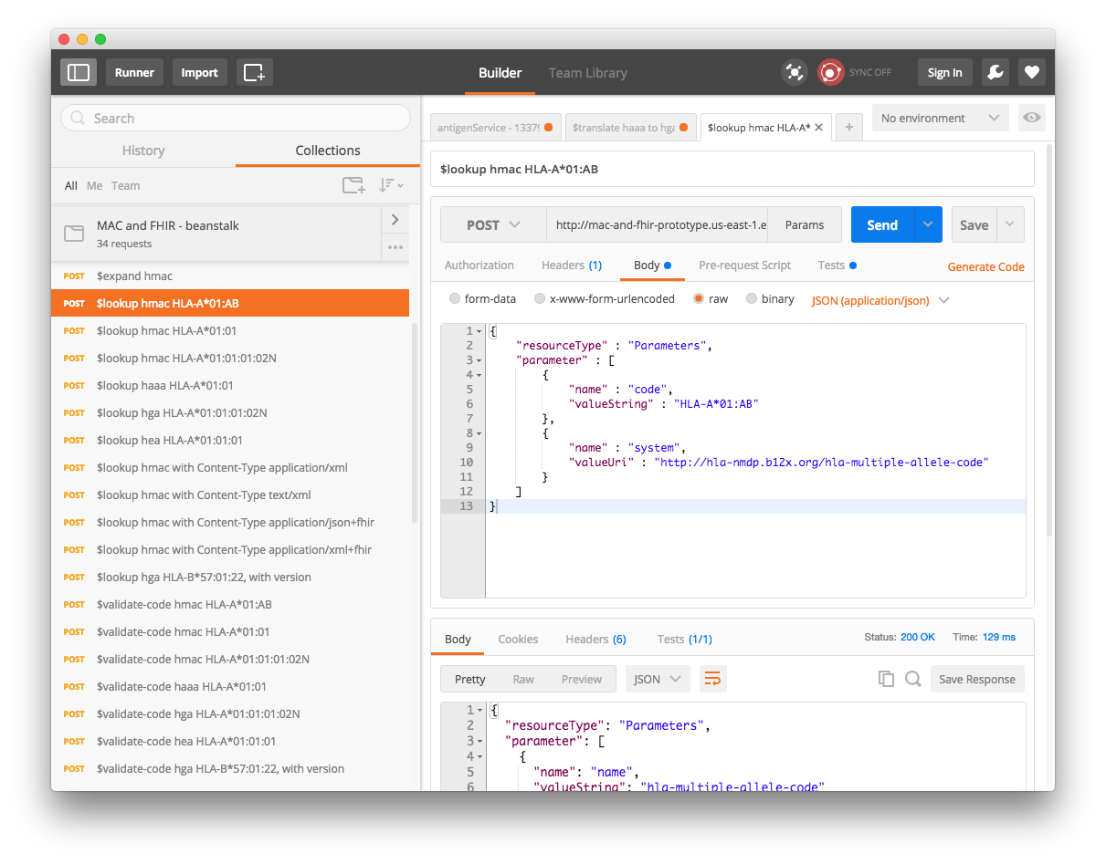
Exercising the Service with Postman (Demo)
Operated by the National Marrow Donor Program®

Slide 37
Recap
HL7 and Coded Data
Code System, Value Set
SNOMED CT example
HLA Nomenclature
Hypothetical HL7 code systems for HLA data
hla-multiple-allele-code, hla-amino-acid-allele, hla-genomic-allele
HL7 FHIR Terminology Service
Operations: expand, lookup, validate-code, translate
Demo (with Postman)
Operated by the National Marrow Donor Program®

Slide 38
Opportunities
Systematic framework for coded data
  Usable for HLA data
  Applicable to other data such as infectious disease markers (IDMs)
  Pattern could simplify adoption of new coding systems, both internally and with external partners
Reduce barriers to interoperability
  Electronic form 22
  HL7 FHIR alternative to HML
  Adopt standard HL7 FHIR communication protocols
    Simplify communications with external EMR and lab systems
Operated by the National Marrow Donor Program®

Slide 39
Challenges
Maintenance & governance of terminology systems
  An ongoing commitment
  More critical if/when we make terminologies available externally
  Official code system and value set URIs, versioning policies, etc.
Modifications & Adjustments to official IMGT/HLA nomenclature
  Transposition of expression suffixes onto protein-level names
  Expansion of genomic names to 4-field level (?)
Technology Issues
  Stand-alone Dropwizard vs. HAPI-FHIR server
  Coordinate with MAC service efforts
  Implementing a fully conformant HL7 FHIR Terminology Service
Operated by the National Marrow Donor Program®

Slide 40
Resources
Prototype HL7 FHIR Terminology Service
http://mac-and-fhir-prototype.us-east-1.elasticbeanstalk.com/
Postman collection downloadable from landing page
Wiki Page
https://wiki.nmdp.org/display/BIO/HL7+FHIR+and+HLA+Nomenclature%3A+IMGT%2C+MAC%2C+and+GL+String#HL7FHIRandHLANomenclature:IMGT,MAC,andGLString-%22MACandFHIR%22HL7FHIRTerminologyService
HL7 FHIR
https://hl7.org/fhir/
https://hl7.org/fhir/terminologies.html
https://hl7.org/fhir/terminology-service.html
Operated by the National Marrow Donor Program®

Slide 41

Questions / Discussion ?
Operated by the National Marrow Donor Program®

