Slide 1


HML and FHIR Conversion
Andrew S. Brown, Ph.D.
abrown3@nmdp.org

Slide 2
Guided User Input
HML and FHIR Converter
JSON
Database
service-hml-fhir-converter
Queue
process-kafka-fhir-hml-conversion-consumer
JSON
XML
Batch
FHIR Submission
Status
File Upload
process-kafka-fhir-submission-consumer
process-kafka-hml-fhir-conversion-consumer
service-hml-fhir-converter-api
FHIR -> HML
Kafka
message producer
FHIR Bundles
(FHIR -> HML)
HML -> FHIR
Kafka
message producer
HML
(HML -> FHIR)
Kafka Server

Slide 3
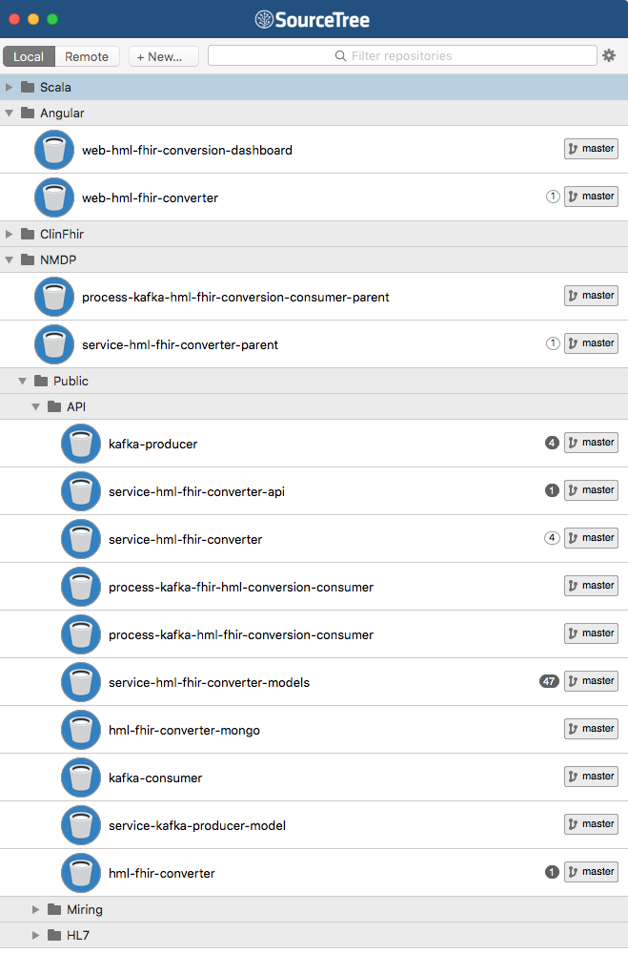
GUI to build HML or FHIR

Slide 4
GUI to submit files (xml, Json, batch)

Slide 5
Module components to build
service-hml-fhir-converter-api

Slide 6
Module components to build
service-hml-fhir-converter

Slide 7
Module components to build
process-kafka-hml-fhir-conversion-consumer
and
process-kafka-fhir-hml-conversion-consumer

Slide 8
Kafka consumers and rest APIs require the building and installation of submodules (org.nmdp.*). We have included ‘parent’ projects that will handle submodule composition, building, and installing to a local maven repository.
To execute build:
python Setup.py [ -b ‘branch’, -p ‘packages’ , -r ‘run’ ]
To run:
sh run.sh
*Requires: maven 3+, java 8, and python 2.7+

Slide 9
Environment
Kafka
Dockerization of each environment component. This will allow for easy deployment to cloud based or proprietary based hardware.
These components are completely open source and designed to run in a Linux / Unix environment. For development and testing purposes, these can be easily adapted to run on MS Windows, or any other OS that supports JVM.
MongoDb
REST APIs
Kafka Consumer Processes

Slide 10
Questions?
Contact:
Andrew S. Brown, Ph.D. <abrown3@nmdp.org>

