Slide 1

Governance of HLA Haplotype Frequency Data and Software
Draft

Slide 2
Definitions
Governance ensures that stakeholder needs, conditions and options are evaluated to determine balanced, agreed-on enterprise objectives to be achieved; setting direction through prioritisation and decision making; and monitoring performance and compliance against agreed-on direction and objectives.
Management plans, builds, runs and monitors activities in alignment with the direction set by the governance body to achieve the enterprise objectives.

Slide 3
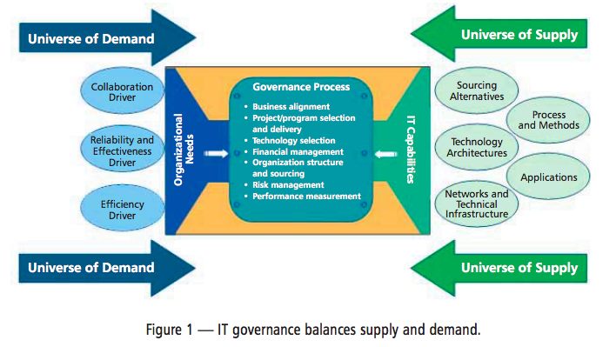
IT governance

Slide 4
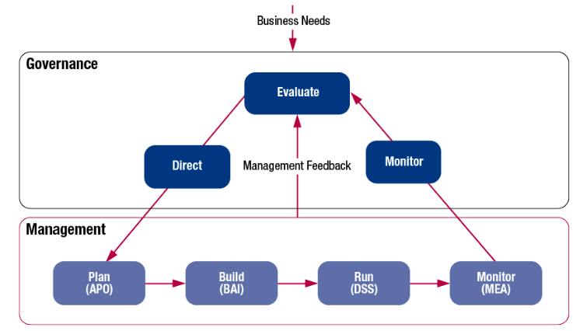
IT governance and management

Slide 5
Service Oriented Architecture
Service oriented architecture (SOA) governance is an extension of IT governance, which is an extension of corporate governance. (http://www-01.ibm.com/software/solutions/soa/gov/, http://en.wikipedia.org/wiki/SOA_governance)

Slide 6
Conclusions
Governance should mirror the philosophy of the methods employed to deliver the product
There is no clear distinction between IT governance and IT (service) management

Slide 7
Options
Using a framework
Homegrown/Common Sense
Open source IT governance model

Slide 8
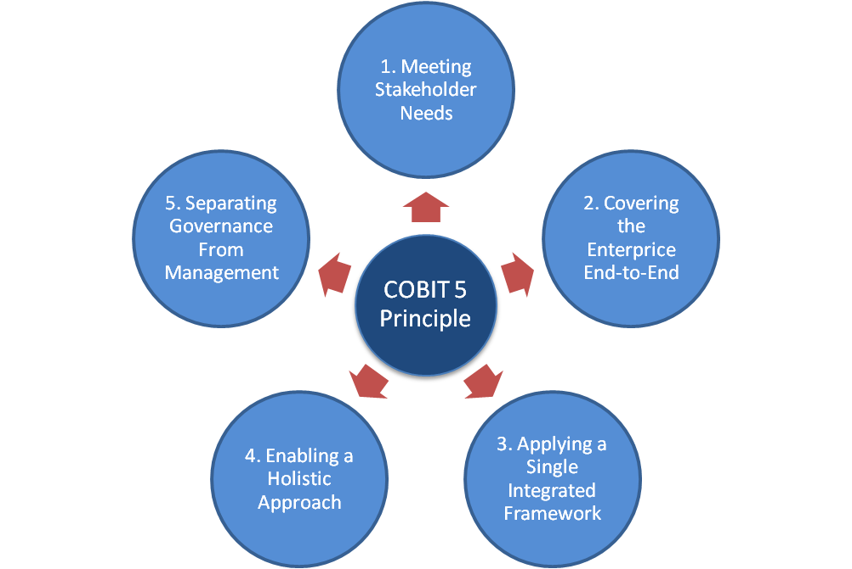
Using a framework: Cobit 5

Slide 9
Homegrown/Common Sense
E.g. from the EMDIS house rules:
It is the responsibility of the Technical Group to:
protect the integrity of the EMDIS system, technology and infrastructure.
define technical requirements for the participation in EMDIS, define interfacing rules and prepare the necessary documentation.
review proposals for new developments emanating from the User Group.
prepare specifications and timetables for implementation by national development teams.
liaise with the User Group and the national development teams of the member registries.
provide technical information to members, particularly newly participating registries and those interested in becoming members.
prepare meetings, produce minutes and communicate with the representatives.

Slide 10
Open source IT governance model
Charismatic leadership, e.g. Linux, Python
Enlightened dictatorship, e.g. KDE
Delegated governance, e.g. Ubuntu

Slide 11
Management: Specification and Standardization
Specifications are needed to avoid errors due to lack of compatibility, for instance, in interoperability issues.
A specification is a type of a standard which is often referenced by a contract or procurement document. It provides the necessary details about the specific requirements.
Standardization can help to maximize compatibility, interoperability, safety, repeatability or quality.
Definition of a framework, which ensures compliance with a minimal level of quality, technological or management processes, system management, interface provision, etc.
Notes:
Common vocabulary

