Slide 1

Practical Data Science Group 2
Tran Viet Anh
Pham Nguyen Vu
Le Duc Nguyen
Nguyen Minh Duong

Slide 2
Problem
The data set for this project is a 10 years collection of daily weather information in Australia.
The goal is to use this data to predict rain probability for the following day.

Slide 3
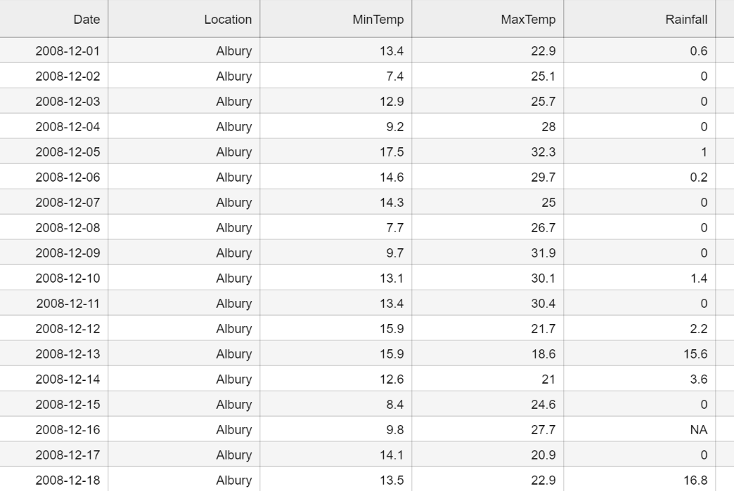
Dataset

Slide 4
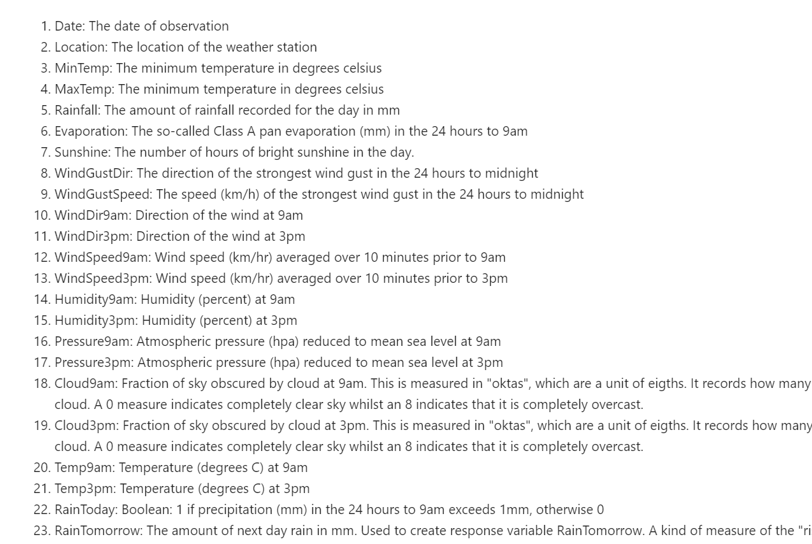
Dataset

Slide 5


Data preparation: Issues
EXTRA WHITESPACES.
MISSING VALUES.

Slide 6
Data preparation: Solution
Drop columns with high percentage of missing values and not contributed to the result of the analysis.
drop(['Evaporation','Sunshine','Cloud9am','Cloud3pm']
Object columns filled with "Unknown".
Numerical columns filled with median to fix the skewness of the set.

Slide 7





Hypothesis
People tends to have their own judgement
Temperature
Humidity
Wind
Has it rain today?

Slide 8
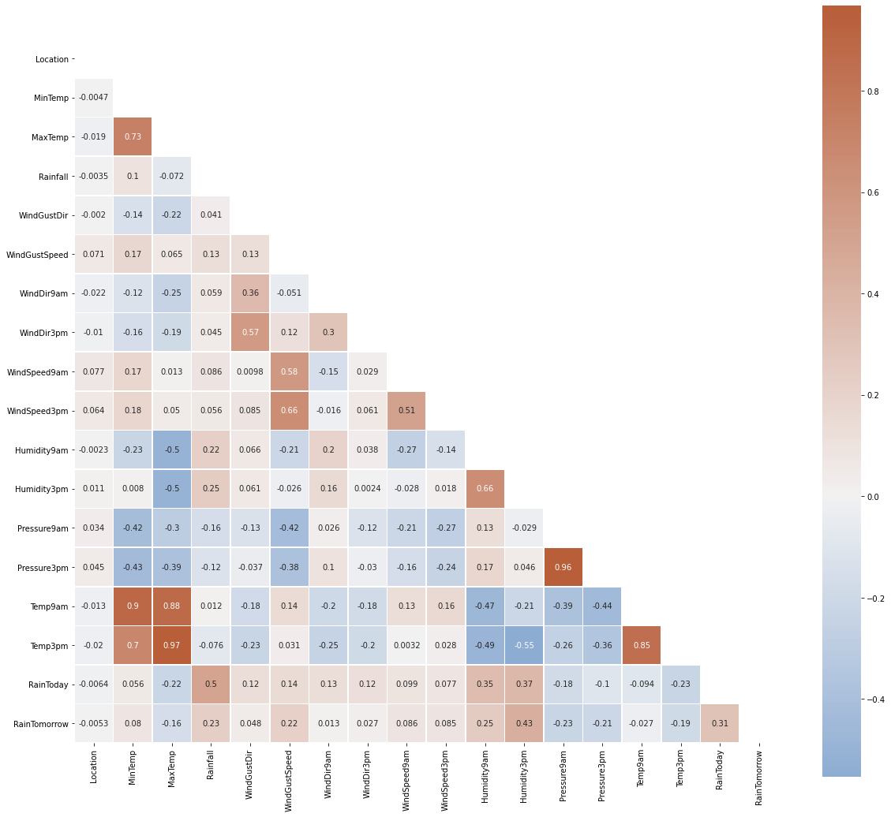
Modelling: Feature engineering
Correlation analysis
The following pairs of features are having high correlation between them:
MaxTemp and MinTemp
Pressure9am and Pressure3pm
Temp9am and Temp3pm
MaxTemp and Temp3pm
But there is no case that the correlation value is equal to a perfect "1". As a result, we will not discard any feature.

Slide 9
Modelling: Result
Model | Accuracy | ROC - AUC | Cohen’s Kappa | Time Taken
Model 1 - Logistic Regression | 0.8406 | 0.7016 | 0.4629 | 0.7379
Model 2 - Neural Network | 0.8524 | 0.7296 | 0.5147 | 227.006
Model 3 - Random Forest | 0.8514 | 0.7180 | 0.5000 | 13.3136
Model 4 - Catboost | 0.8493 | 0.7310 | 0.5110 | 94.5475
Model 5 - XGBoost | 0.8554 | 0.7446 | 0.5356 | 32.2469

Slide 10
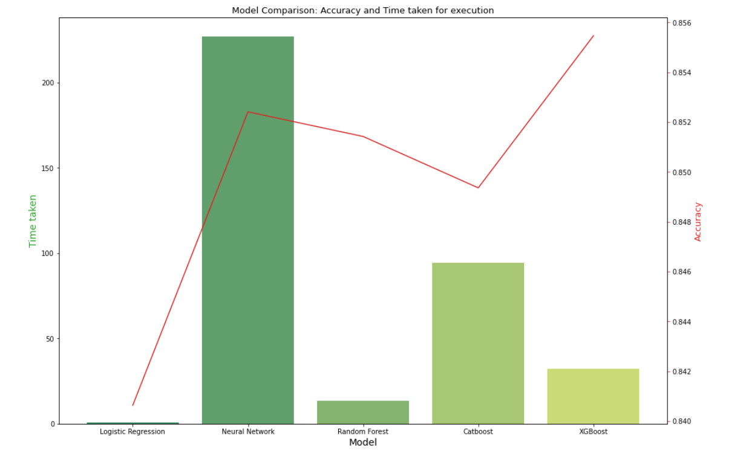
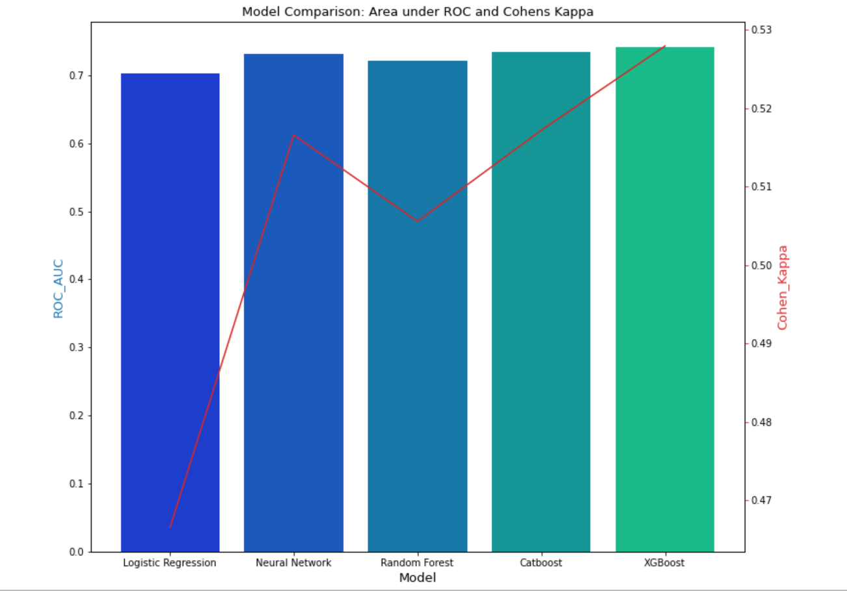
Modelling: Algorithm

Slide 11
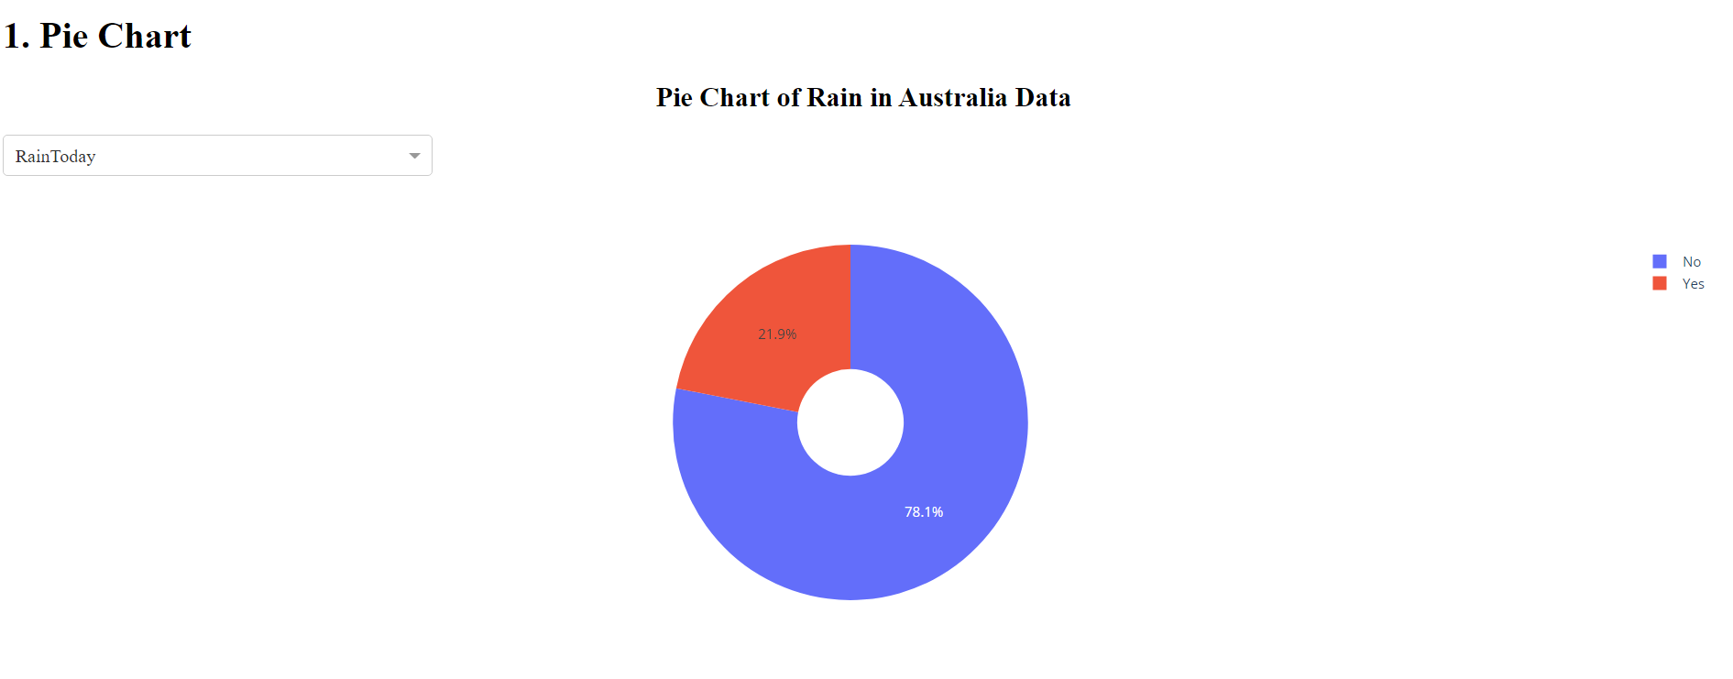
Dashboard

Slide 12
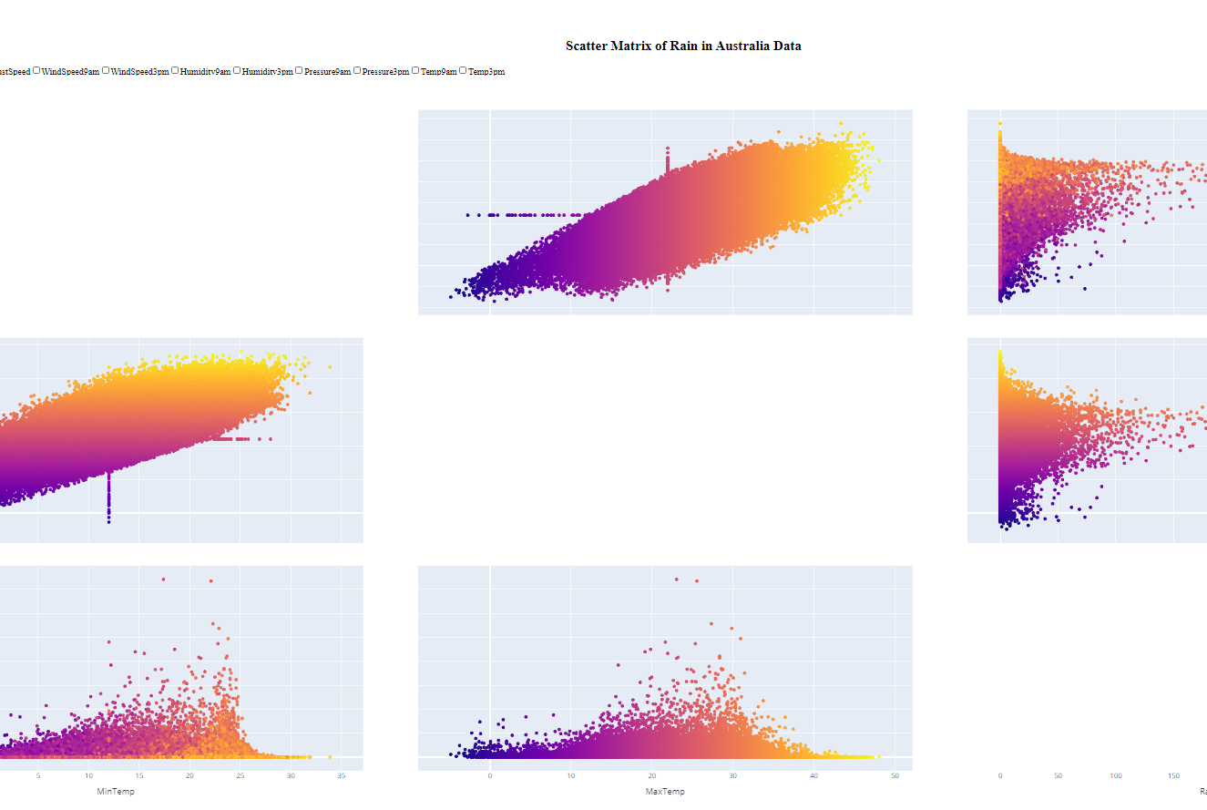
Dashboard

Slide 13
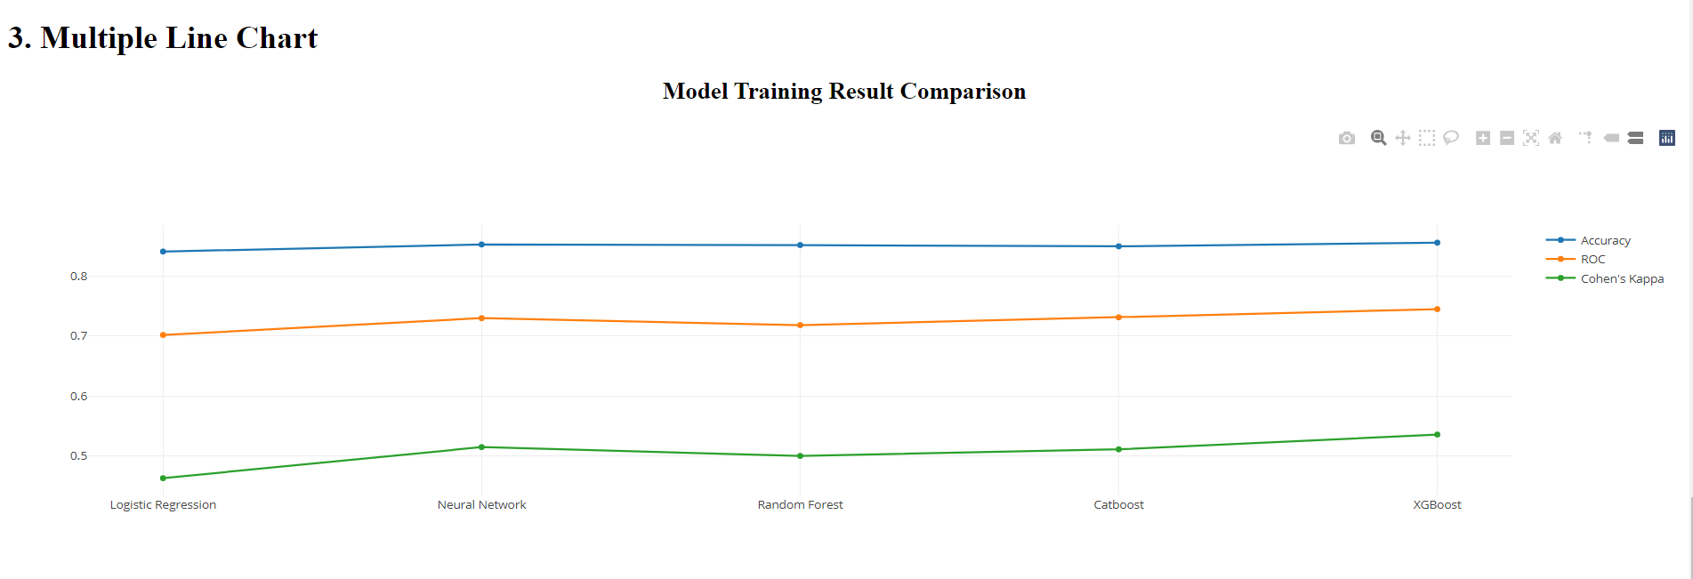
Dashboard

Slide 14


Conclusion
The result supports initial hypothesis
The possibility of rain according to data analysis relies on humidity, temperature, wind speed and wind direction

