Slide 1
Applied Data Science Capstone Project
An Analysis of Healthcare
In the City of Seattle, Washington
Jeffrey Guest
June 27, 2020

Slide 2
Applied Data Science Capstone Project Overview
For the first week, the final deliverables of the project will be:
A description of the problem and a discussion of the background. (15 marks)
A description of the data and how it will be used to solve the problem. (15 marks)
For the second week, the final deliverables of the project will be:
A link to your Notebook on your Github repository, showing your code. (15 marks)
A full report consisting of all of the following components (15 marks):
Introduction where you discuss the business problem and who would be interested in this project.
Data where you describe the data that will be used to solve the problem and the source of the data.
Methodology section which represents the main component of the report where you discuss and describe any exploratory data analysis that you did, any inferential statistical testing that you performed, if any, and what machine learnings were used and why.
Results section where you discuss the results.
Discussion section where you discuss any observations you noted and any recommendations you can make based on the results.
Conclusion section where you conclude the report
Your choice of a presentation or blogpost. (10 marks)

Slide 3
Framing the problem: Background Information
A Changing Healthcare Landscape:
Healthcare delivery models are undergoing substantial changes
Patients increasingly responsible for making financial decisions about their own health care
Individuals responsible for larger portions of healthcare costs
Those seeking health services are acting more and more like consumers of other types of goods and services

Slide 4
Intended Audience and Potential Impact
Healthcare Thought Leadership:
Serves as a data science exercise that demonstrates insight and understanding about health resources in a major metropolitan area:
More informed decisions about resource distribution and payment methodologies
Healthcare accessibility
Audience targets:
Healthcare provider administrators
Government health policy leaders
Health payors (health insurers)
Healthcare consumers

Slide 5
Problem Statement
Major Project Aims:
Understand some key elements about health service locations.
Visualize data around healthcare Length of Stay and Charge data from a State-level Department of Health.
Demonstrate data science comprehension
Use of Python
Associated Libraries
Data visualization
Clustering techniques

Slide 6
Data Background
High-level description of project data:
Using Foursquare, the data for this project used a very high-level keyword description of “healthcare”.
Folium package used to provide a mapping, visual representations of similar clusters of healthcare venues using a k-means algorithm approach.
Washington Department of Health Data and Descriptive Statistics related to:
Hospital Volume Data
Length of Stay
Payor charge behavior

Slide 7
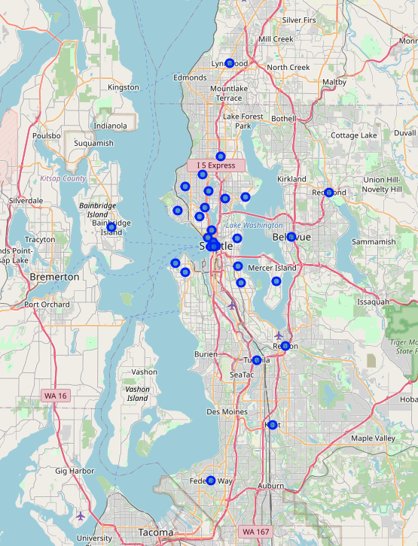
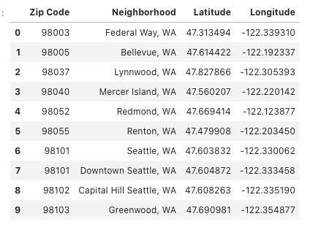
Project Methodology
Folium mapping by neighborhood of Seattle, WA:

Slide 8
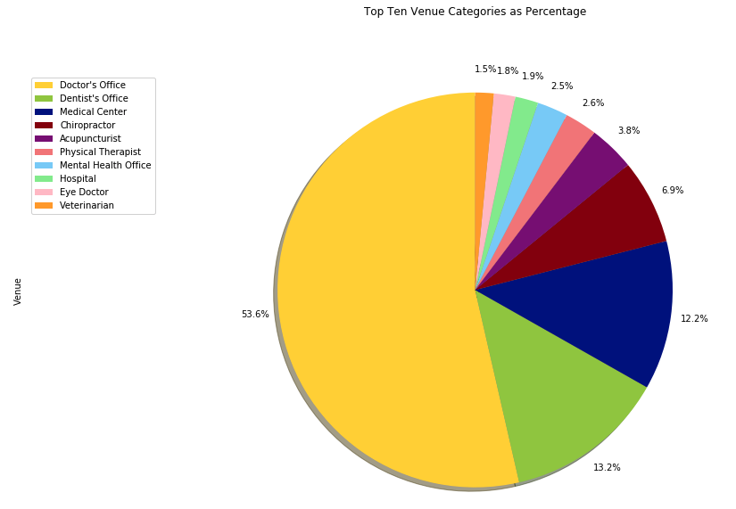
Project Methodology
Healthcare venue analysis:
Top 10 healthcare venue categories considered using pie-chart
Doctor’s and Dentist offices vastly most common
29 total categories in all:
Many with only 1 or 2 instances

Slide 9
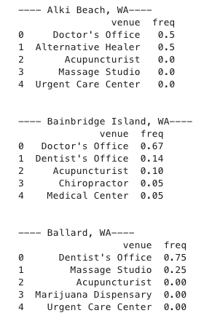
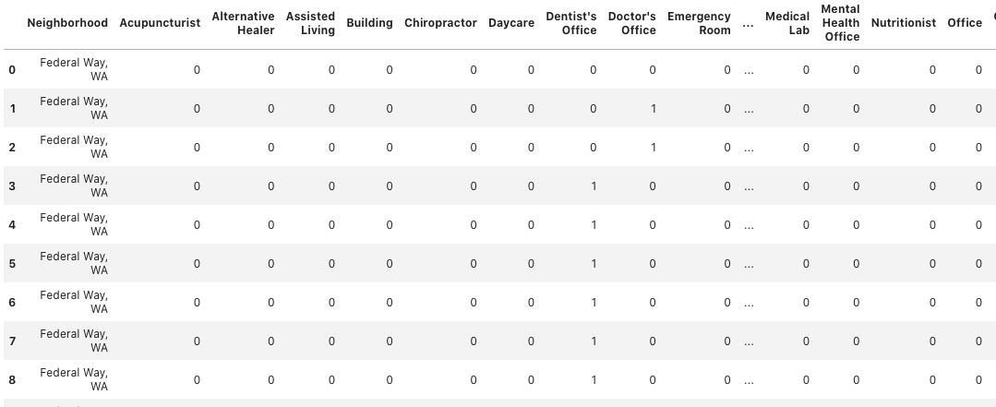
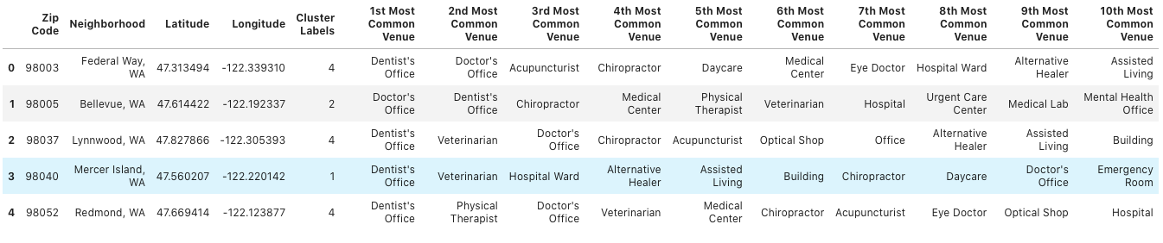
Project Methodology
K-Means venue analysis:
One hot encoding with Top 5 Analysis by neighborhood:
Utilize K = 5 for clusters:

Slide 10
Project Methodology
Washington State - Department of Health Data:
Discharges by Payor and key census data
2019 Calendar year
Fields Name | Description
Hospital_name | Name of the facility
Type | Type of facility – Includes Acute care, urgent care, skilled nursing facility, etc.
Lic | State Healthcare License Number
Payername
Discharges | Total number of discharged patients for period
Total_days | Pateint days in hospital as defined under the two midnight rule
Total_charges | Total amount charged for the care received
Mean_LOS | Length of stay, rounded to nearest integer value. The Length of stay is the total number of days divided by the total number of discharges
Mean_charge_per_discharge | Total charges divided by the number of discharges
Mean_Charge_per_Day | Total charges divided the number of patient days
Casemix_index | An adjustment factor based on the relative population sickness being treated at the facility. Charge metrics are divided by this factor. If the factor is less than one the Charge metric will increase, if the factor is greater than one the metric will decrease.
Casemix_adjusted Charge per Disch | Calculated charge based on casemix index as described above.

Slide 11
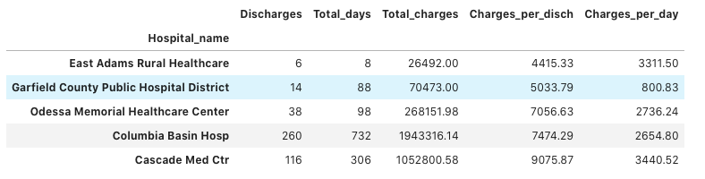
Primary Data Analysis Results
Census Dataframe:
Recalculation by facility using “groupby” method and “value_counts().
Sorting by Charges per Discharge or Charges per Day to determine lowest Charge facilities results in list of facilities with very few overall Discharges.
Updated methodology to make comparison by largest volume by discharge.

Slide 12
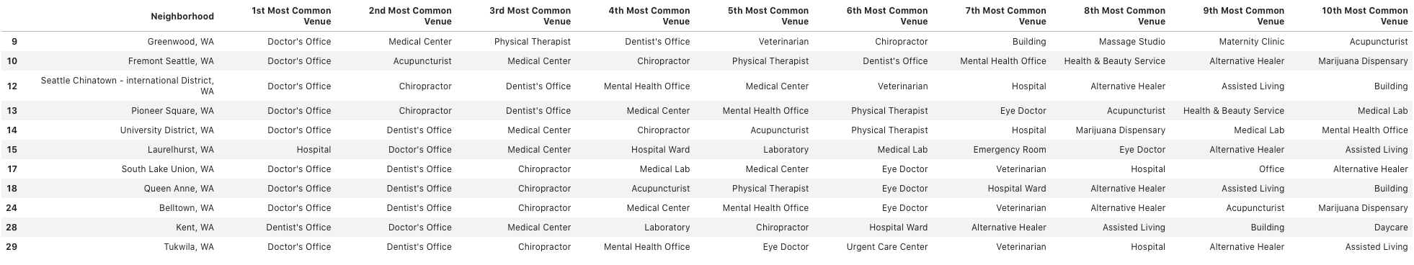
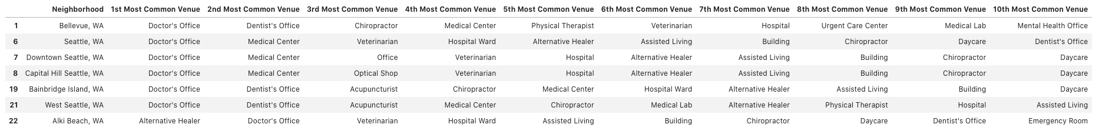
Primary Data Analysis Results
K-Means Cluster Results:
Cluster 1:
Cluster 2:
Cluster 3:

Slide 13
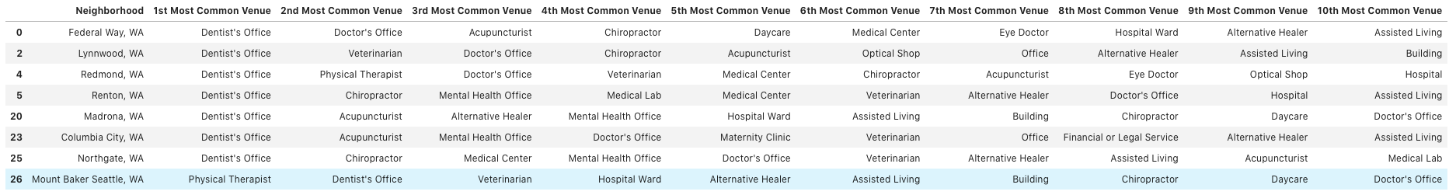
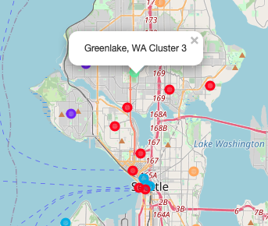
Primary Data Analysis Results
K-Means Cluster Results:
Cluster 4:
Cluster 5:
Key Differences in Clustering based on ”lower-level” Most Common Venues
Foursquare venue criteria unspecific and potentially duplicative

Slide 14
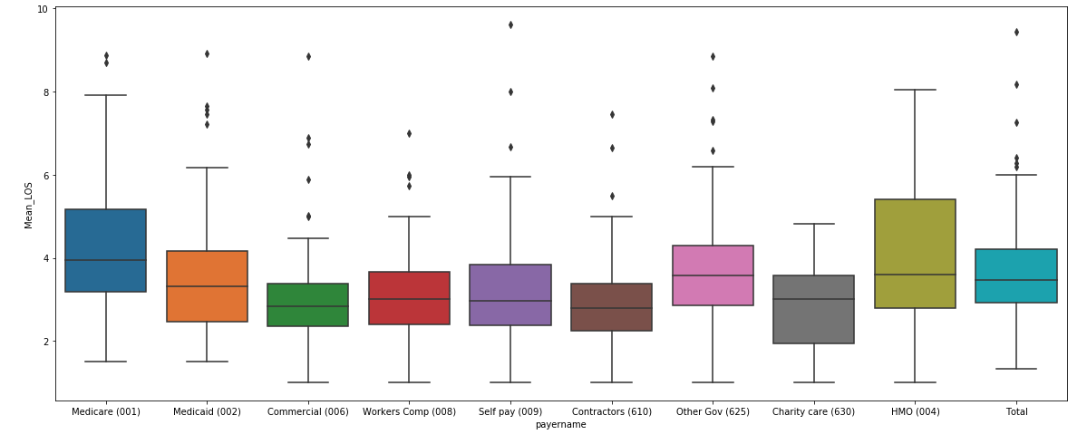
Primary Data Analysis Results
Length of Stay Analysis:
Comparison metrics by payor
Commercial boxplot interquartile range significantly tighter than for government payer.

Slide 15
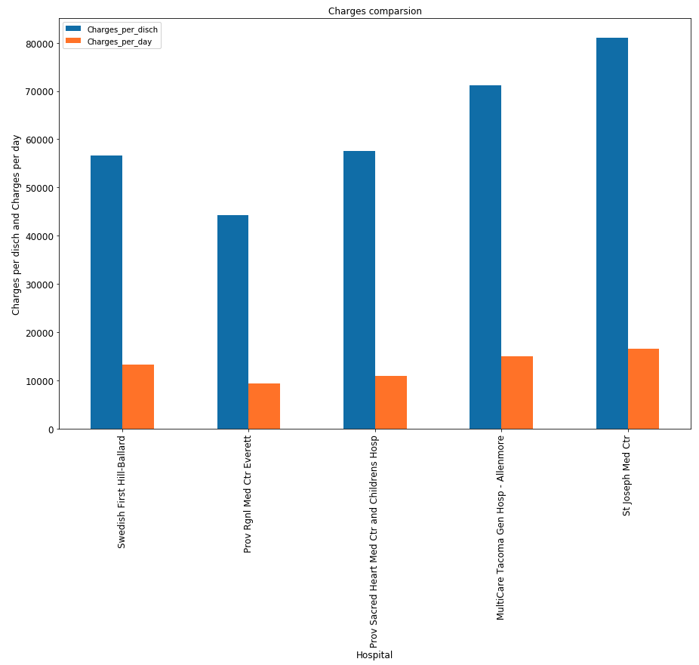
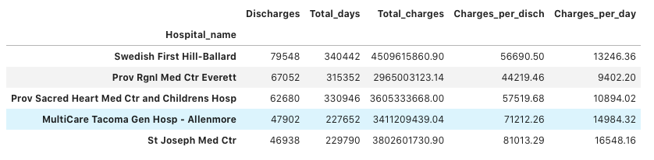
Primary Data Analysis Results
Largest Volume Discharge
Acute-care Facility Comparison:
Overall, it appears that Providence Sacred Heart balances charges per discharge and charges per day the best of these top 5 hospitals by discharge volume

