Slide 1
Understanding the Technology Value Stream in DevOps

Slide 2

01
Definition: Converts customer request to delivered product/service
02
Importance: Enables faster delivery and fewer errors
What Is a Technology Value Stream?
03
Product Management: Aligns value with customer needs
04
QA, IT Ops, Security: Ensure quality, stability, and compliance
05
Collaboration: Cross-team visibility improves flow
Source: IT Revolution, Kim et al. (2021)

Slide 3

Ticket Lead vs Processing
Lead Time
Processing Time
The total time from when a request (ticket) is created to when the work is completed and delivered.
Includes both waiting time and active work time.
The actual time spent actively working on the request.
Does not include time spent waiting in queues.
Example:
- Ticket created: Monday
- Work starts: Friday
- Completed: next Monday
→ Lead Time = 7 days
→ Processing Time = 2 days

Slide 4
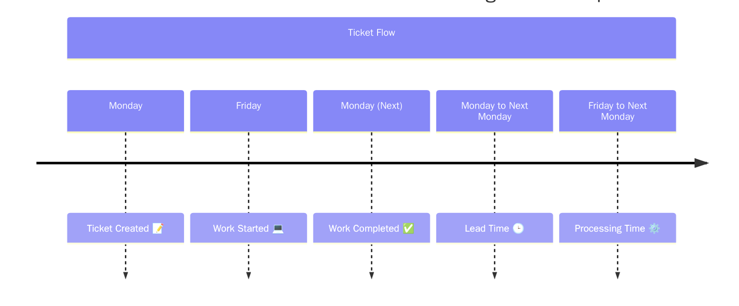
Ticket Lead vs Processing Time Diagram (w/ Source)

Slide 5

The Problem — Deployment Lead Times of Months
Traditional IT Challenges
Legacy delivery models often include manual approvals, limited test environments, and integration issues that arise late in the cycle.
Consequences of Delay
Extended lead times (3+ months) result in late bugs, costly hotfixes, and significant stress on teams under pressure to deliver.
Visualizing the Pain
Bottlenecks across departments and delayed feedback loops complicate fast, reliable delivery, making change slow and risky.
Source: DevOps Handbook, p. 10

Slide 6

The DevOps Ideal — Lead Times of Minutes
Vision for High-Performing Teams
Modern DevOps teams aim for small, frequent releases using CI/CD pipelines, automated testing, and continuous feedback.
Business Impact
These practices enable faster time-to-market, higher reliability, and safer deployments—even during business hours.
Key Enablers
Automation, cross-functional collaboration, and a culture of experimentation drive sustainable improvements in lead time and service quality.
Source: DevOps Handbook, p. 10; Atlassian (2025)

Slide 7
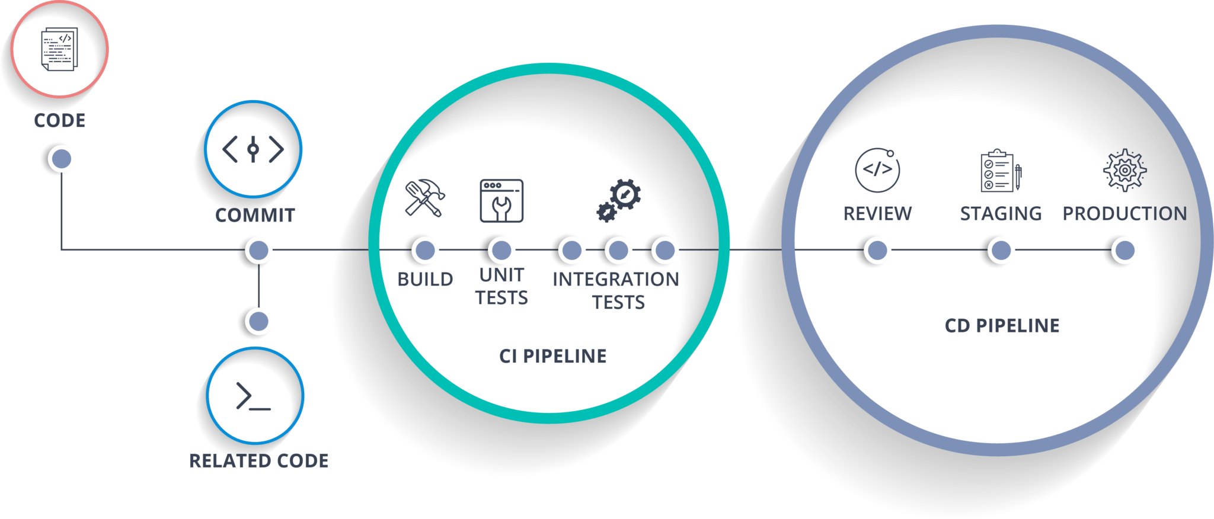
CI/CD Pipeline Diagram

Slide 8
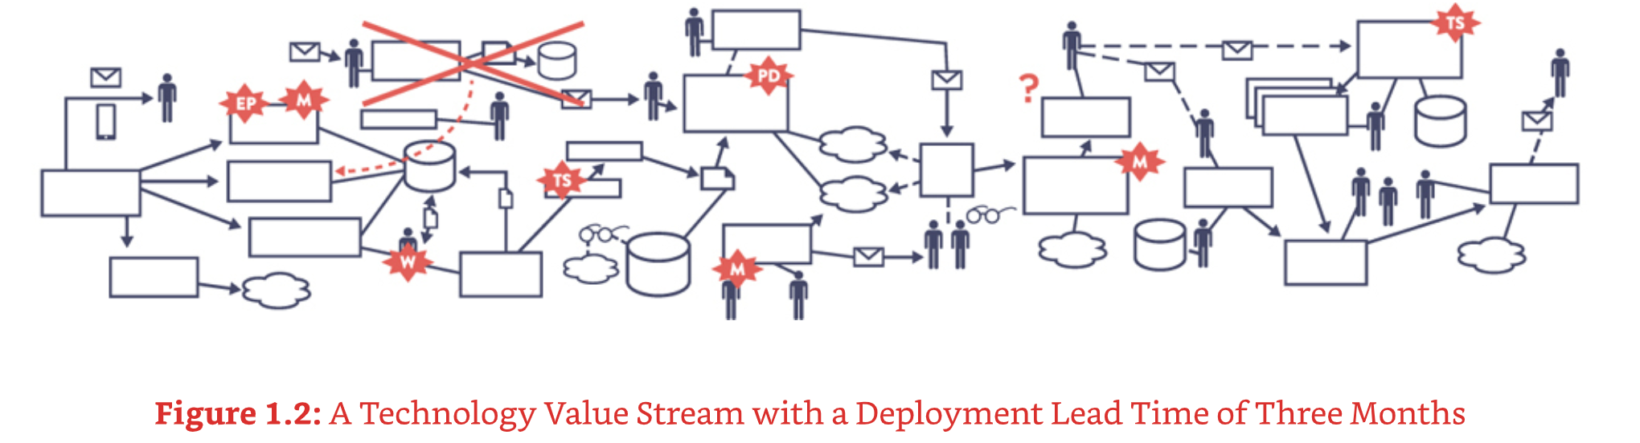
Mapping the Value Stream
Why Map It?
Mapping visualizes every step in the delivery process, helping uncover bottlenecks, reduce delays, and align stakeholders.
Typical Process Steps
A typical stream map includes planning, coding, testing, reviewing, and releasing phases—each contributing to overall lead time.
Collaborative Improvement
Cross-functional input ensures accurate insights and effective, lasting process improvements.
Source: IT Revolution, Kim et al. (2021)

Slide 9
Creating the Future State
Strategic Approach
Design a future-state map with reduced lead times, then use targeted experiments and metrics to guide process changes.
Actionable Steps
Assign owners to improvement initiatives, define success criteria, and iterate based on feedback.
Sustaining Momentum
Transformation teams should start small, share wins, and foster a culture of continuous learning and iteration.
Source: IT Revolution, Kim et al. (2021)

Slide 10

Tools to Reinforce Behavior
DevOps Tools That Enable Flow
Platforms like JIRA and ServiceNow centralize work tracking, while dashboards increase visibility and alignment.
Bottleneck Detection
Azure DevOps’ Lead Time Widgets highlight delays and guide interventions with visualized data.
Building a Shared Culture
By adopting shared metrics and backlogs, teams can align efforts, reduce handoffs, and foster a culture of improvement.
Source: Microsoft Azure Docs (2025); IT Revolution (2021)

Slide 11
Measuring Success with DORA Metrics
The 4 Key Metrics
DORA tracks Lead Time for Changes, Deployment Frequency, Time to Restore Service, and Change Failure Rate to evaluate DevOps performance.
Why They Matter
These metrics reveal the strengths and weaknesses in your delivery process and help guide targeted improvements.
Visualizing Progress
Dashboards showing month-over-month changes across these metrics can motivate teams and highlight impact areas.
Source: Atlassian (2025)

Slide 12
Final Thoughts
What should we remember about Technology Value Streams in DevOps?
Summary and Key Takeaways
✔ Lead time includes all delivery steps; processing time focuses on active work.
✔ Traditional delivery models cause delays due to manual steps and silos.
✔ DevOps practices cut lead times drastically via automation and collaboration.
✔ Mapping helps diagnose delays; metrics guide improvement.
✔ DORA metrics offer a clear lens to assess and evolve delivery capabilities.
Sources: DevOps Handbook; Atlassian; IT Revolution

Slide 13
Kim, G., Humble, J., Debois, P., & Willis, J. (2021). The DevOps Handbook: How to Create World-Class Agility, Reliability, & Security in Technology Organizations (2nd ed.). IT Revolution Press.
Kim, G., Humble, J., Debois, P., & Willis, J. (2021). Understanding the Work in Our Value Stream and Improving Flow. IT Revolution. Retrieved from: https://itrevolution.com/articles/improve-flow-devops-value-stream/
Microsoft. (2025). Lead Time and Cycle Time widgets in Azure DevOps. Microsoft Learn. Retrieved from: https://learn.microsoft.com/en-us/azure/devops/report/dashboards/cycle-time-and-lead-time
Atlassian. (2025). DevOps Metrics: DORA Metrics Overview. Retrieved from: https://www.atlassian.com/devops/frameworks/devops-metrics
Kim, G., Humble, J., Debois, P., & Willis, J. (2021). The DevOps Handbook: How to Create World-Class Agility, Reliability, & Security in Technology Organizations (2nd ed.). IT Revolution Press.
Kim, G., Humble, J., Debois, P., & Willis, J. (2021). Understanding the Work in Our Value Stream and Improving Flow. IT Revolution. Retrieved from: https://itrevolution.com/articles/improve-flow-devops-value-stream/
Microsoft. (2025). Lead Time and Cycle Time widgets in Azure DevOps. Microsoft Learn. Retrieved from: https://learn.microsoft.com/en-us/azure/devops/report/dashboards/cycle-time-and-lead-time
Atlassian. (2025). DevOps Metrics: DORA Metrics Overview. Retrieved from: https://www.atlassian.com/devops/frameworks/devops-metrics
References
References

