Slide 1
Establishing a Just, Learning Culture: Barriers and Challenges

Slide 2

What is a Just Culture?
Definition and Origin
A Just Culture promotes fairness and accountability, aiming to learn from mistakes rather than punish them. It originated in high-risk industries such as aviation and healthcare.
Encouraging Open Reporting
It encourages employees to report errors openly, which helps improve safety and systemic learning without fear of blame.
Key Philosophy
The approach values restorative over retributive justice, recognizing that people make rational decisions based on their knowledge and context.
Sources: Shorrock, 2023; Geraghty, 2025; Boskeljon-Horst et al., 2024

Slide 3

Why Just Culture Matters
Importance in Complex Systems
Errors are inevitable in complex systems, and a Just Culture ensures that mistakes become learning opportunities rather than hidden failures.
Impact on Psychological Safety
Without psychological safety, employees conceal errors. Just Culture fosters trust and supports individuals involved in incidents.
Core Principles
It relies on local rationality, forward-looking accountability, and strong psychological safety to promote continuous improvement.
Sources: Geraghty, 2025; Shorrock, 2023; Boskeljon-Horst et al., 2024

Slide 4
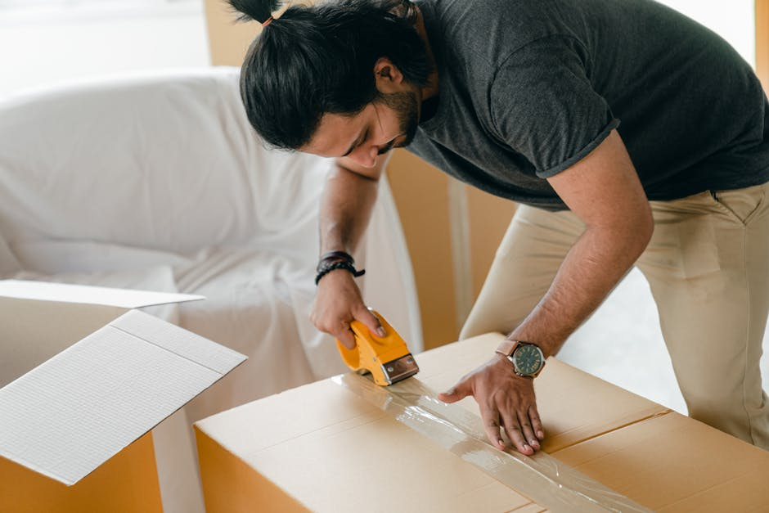
Conceptual & Cultural Barriers
Misconceptions About Culture
Just Culture is not a separate culture but a way to express values like fairness. It’s a lens through which organizational behavior is interpreted.
Challenges of Change
Cultural transformation is bottom-up, slow, and adaptive. Top-down mandates often fail to achieve real change.
Legacy and Subcultures
Conflicting professional values and past scapegoating incidents create distrust and resistance to change.
Sources: Shorrock, 2023; Geraghty, 2025

Slide 5

Organizational & Leadership Barriers
Inconsistent Leadership
Leaders may promote Just Culture verbally but resort to punitive actions in crises, undermining credibility and trust.
Resistance and Misalignment
Middle managers fear losing authority or being seen as weak. HR, Legal, and Safety departments often work in silos.
Training Gaps
Insufficient or rushed training fails to prepare leaders and staff to apply Just Culture principles effectively.
Sources: Essen et al., 2024; Boskeljon-Horst et al., 2024

Slide 6

Fear and Shame
Psychological and Social Barriers
Many employees hesitate to speak up due to fear of judgment, punishment, or isolation — especially in hierarchical environments.
Power Gradients
Junior staff often stay silent when authority figures dominate. This imbalance erodes openness and stalls improvement.
Trust and Blame
Trust takes time to build but can collapse quickly. The human tendency to assign blame is deeply rooted and counterproductive.
Sources: Geraghty, 2025; Shorrock, 2023

Slide 7
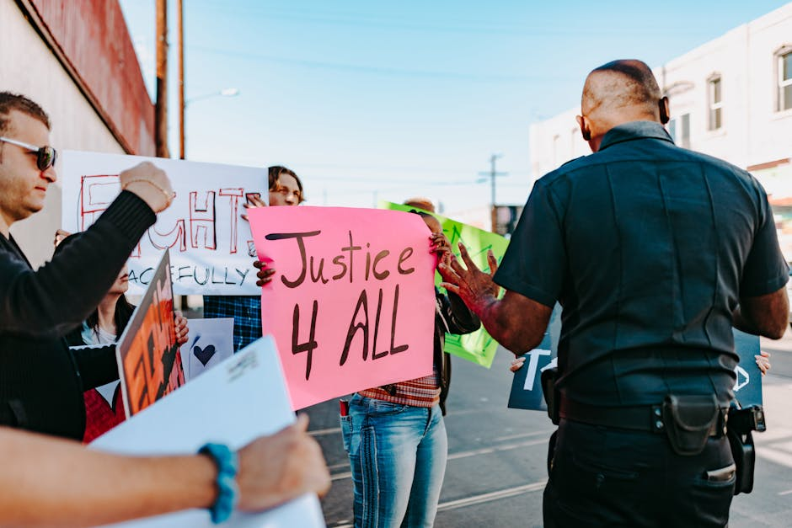
Structural, Legal, and Societal Barriers
Legal Complexity
Laws may require prosecution of gross negligence, even when internal processes support a Just Culture, creating fear of liability.
Media and Public Pressure
Media framing and societal demand for punishment can push organizations toward scapegoating rather than accountability.
Cultural Misalignment
Deep-seated beliefs in retributive justice conflict with Just Culture values, making the concept counterintuitive for many.
Sources: Shorrock, 2023; Geraghty, 2025; Essen et al., 2024

Slide 8

Why Just Culture Efforts Fail
Superficial Implementation
Organizations often adopt tools like incident reporting or decision trees without addressing the underlying culture, rendering efforts ineffective.
Missing Psychological Safety
Without trust and safety, employees won’t engage with Just Culture initiatives, regardless of policies or frameworks in place.
Systemic Alignment Needed
Success requires consistent values, behaviors, and systems that reinforce restorative, learning-oriented responses to error.
Sources: Geraghty, 2025; Essen et al., 2024; Boskeljon-Horst et al., 2024

Slide 9
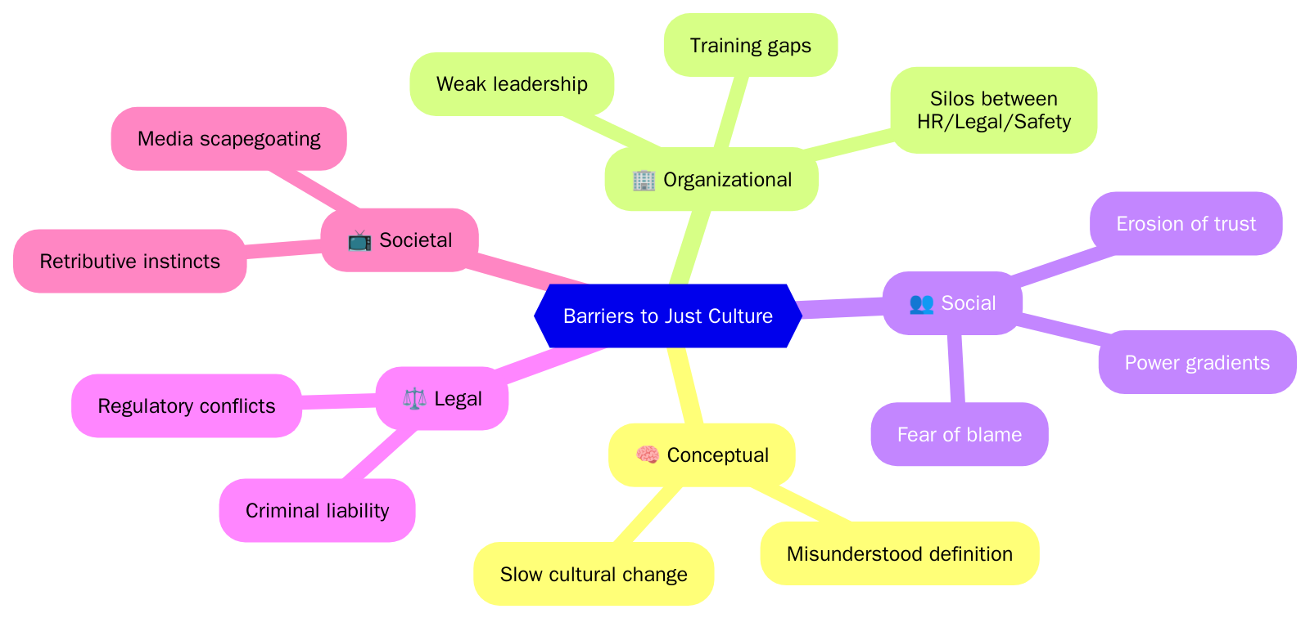
Barriers to Just Culture Implementation

Slide 10

Moving Forward
Building a Supportive Foundation
Psychological safety must be prioritized to allow individuals to report and reflect without fear. It's the foundation for any successful Just Culture.
Leadership and Learning
All leadership levels must consistently model Just Culture principles, shifting focus from individual blame to collective learning.
Restorative Integration
Organizations should integrate restorative justice in investigations, shifting from 'who failed' to 'what can be learned and repaired.'
Sources: Boskeljon-Horst et al., 2024; Geraghty, 2025; Shorrock, 2023

Slide 11
Final Takeaway
How can organizations truly embrace a Just Culture?
Conclusion
True adoption of a Just Culture requires a shift in mindset—away from blame and toward learning, empathy, and systemic accountability. With psychological safety, aligned leadership, and restorative values at its core, Just Culture becomes a sustainable path to resilience and improvement.

Slide 12

Shorrock, S. (2023). *Why Is It Just So Difficult?* Barriers to Just Culture in the Real World. Humanistic Systems.
🔗 https://humanisticsystems.com/2023/07/17/just-culture-barriers
Boskeljon-Horst, S., Steinmetz, B., & Dekker, S. (2024). *Restorative Just Culture: An Exploration of the Enabling Conditions*.
🔗 https://www.sciencedirect.com/science/article/abs/pii/S0925753524000031
Essen, A. et al. (2024). *Establishing a Just Culture: VHA Journey to High Reliability*.
🔗 https://www.ncbi.nlm.nih.gov/pmc/articles/PMC10834736
Geraghty, T. (2025). *Just Culture*. PsychSafety.com.
🔗 https://psychsafety.com/just-culture
📚 References
Sources Cited Throughout This Presentation

