Slide 1





SQUIDZ
“Squids with gunz”
Team 3
Minh Khoi Phan
Shane Duffney
Naomi Mendoza
Raziel Mendoza
Angelica Cuadrado

Slide 2
TABLE OF CONTENTS
₀₁ ₀₂ ₀₃ ₀₄ ₀₅
Feedback Collection and Suggested Additional Features
Analysis of Suggestions
Features of the Beta Build
Identified bugs.
Gameplay Demonstration

Slide 3
01
Feedback Collection and Suggested Additional Features

Slide 4

Feeback Received
Add Tutorial Screen
Make Font More Visible

Slide 5
02
Analysis of Suggestions

Slide 6
Evaluation of Suggestions
01
02
Add Tutorial
Make Font More Visable
Feasibility: High
Reasoning: Needed for player to understand gameplay
Feasibility: High
Reasoning: Enhances user accessibility

Slide 7
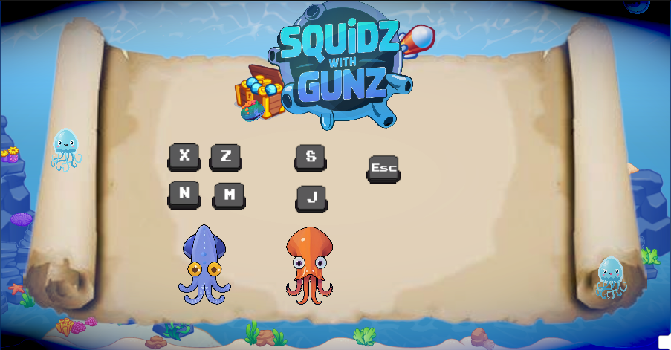


Slide 8
03
Features of the Beta Build

Slide 9

Features
Rounds Display Properly
Improved End Screen

Slide 10
04
Identified bugs

Slide 11
BUGS
01
02
Ui display is not consistent at different aspect ratios
Ui elements not displaying when needed

Slide 12
05
Gameplay Demonstration
THANK YOU

Slide 13
05
Conclusion and Planned Improvements

Slide 14
Conclusions
1.Improved Stability
2.Enhanced Player Experience
3.Performance Optimizations
4.Responsive Feedback Loop
5.Future Updates

Slide 15
Planned Improvements
1.Optimize collision detection for smoother player-enemy interactions.
2.Improve audio management to prevent overlapping and cutting-off sounds.
3.Enhance texture rendering to eliminate flickering on specific platforms.
4.Redesign the health bar UI for better alignment across various screen resolutions.
5.Implement further performance optimizations to reduce frame rate drops in high-action scenes.

Slide 16
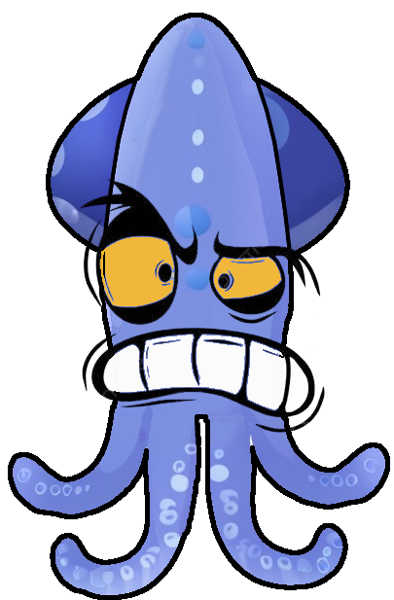
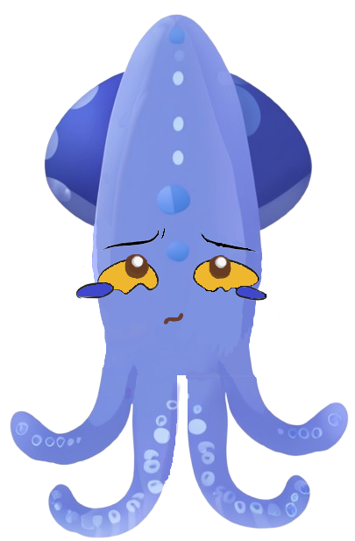
Animations
PLAYER MOVEMENT
New animation states:
Idle
Movement
Lose
Win
Make Damage
Take Damage

Slide 17
UI Assets
MENU Screen
Button1: Exits the Application
Button2: Starts the Game
ASSET INCLUDE:
Game Title Logo
Back Ground Art
Button Art Style

Slide 18
Audio Assets
Menu SFX:
Adding more audio effects to menus:
Main Menu
Round End
Congratulatory Message
ASSET INCLUDE:
Non-copyright songs
Battle Phase SFX:
During the duel, the game play experience is enriched with audio and sound effects for better player immersion and enjoyment.
ASSET INCLUDE:
Gunshots
Players Getting Hit
BG Music
Wall-bump

