Slide 1

Notes:
Hello everyone. My name is Niccolò Meneghetti.
Today, I will present our paper: "Variational Inference for De Finetti Logic"
This is joint work with my PhD students Sami Hadouaj and Ouael Ben Amara, who unfortunately could not be here today.

Slide 2
Notes:
First of all, what is De Finetti Logic?
De Finetti Logic is a simple probabilistic programming language that we can use to express probabilistic models in the form of sets of symbolic relational constraints.
Why would we want to do so?
As it was pointed out in the PODS keynote, it is really time for database systems to start treating probabilistic models as first-class citizens; that is, objects that can be queried, analyzed, and manipulated directly.
Since Database systems already understand relational constraints really well, it makes sense to use this language to express probabilistic models.

Slide 3
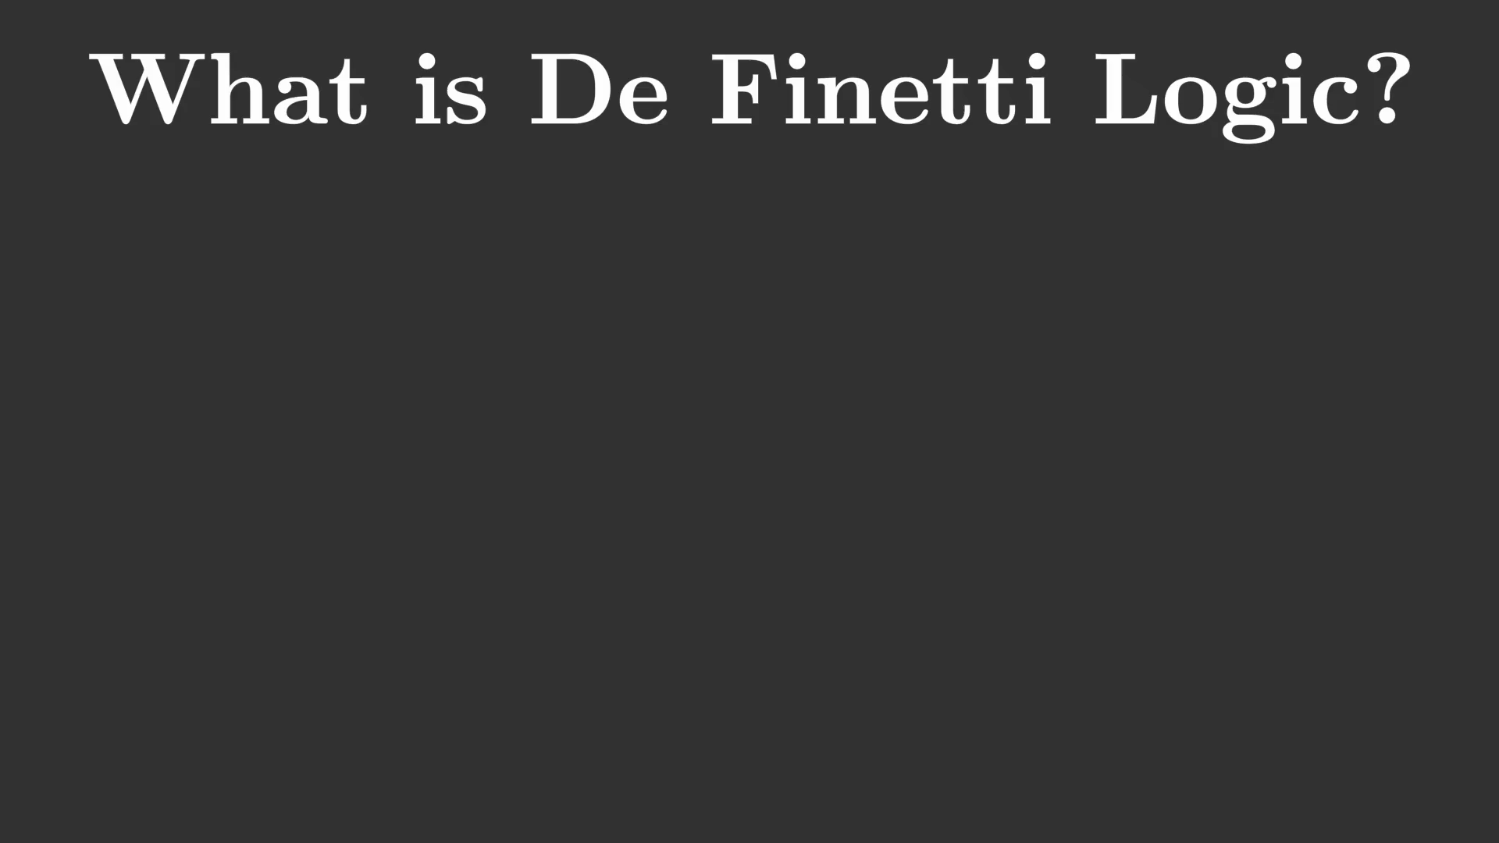
Notes:
First of all, what is De Finetti Logic?
De Finetti Logic is a simple probabilistic programming language that we can use to express probabilistic models in the form of sets of symbolic relational constraints.
Why would we want to do so?
As it was pointed out in the PODS keynote, it is really time for database systems to start treating probabilistic models as first-class citizens; that is, objects that can be queried, analyzed, and manipulated directly.
Since Database systems already understand relational constraints really well, it makes sense to use this language to express probabilistic models.

Slide 4
Notes:
The basic building block of a De Finetti Logic program is a simple statistical model called a Pólya urn. You can think of it as a physical urn containing balls of different colors — say, green and red — from which we repeatedly draw at random.
What makes a Pólya urn special is its reinsertion rule: Whenever we draw a ball of some color, we must put it back together with an additional ball of the same color.
Therefore, the number of balls in the urn keeps increasing: if we draw a green ball, the urn gains another green ball. If we draw a red ball, the urn gains another red ball.
This rule captures self-reinforcing dynamics: the more often we have drawn a certain color in the past, the more likely we are to draw it again in the future.
To make this concrete, we will use the Pólya urn to model the behavior of Ada, a fictional aircraft pilot. Ada can be in one of two states: VIGILANT, represented by a green ball or DISTRACTED, represented by a red ball.
Imagine that we observe Ada over a sequence of flights.
Whenever Ada is VIGILANT, we add a green ball to the urn. Whenever she is DISTRACTED, we add a red ball.
After observing some flights, we can use the resulting urn to predict Ada’s future behavior.

Slide 5
Notes:
A Pólya urn defines a probability distribution over sequences of observations of arbitrary length.
An interesting property of this distribution is that the probability of a sequence does not change if we permute the observations.
In other words, the probability of a sequence depends only on how many green and red balls appear in it, and not on their specific arrangement.
This property is called exchangeability. Please keep this term in mind, because it will become important later.
For now, let me restate that by construction the observations generated by a Pólya urn are not pariwise independent. Threfore, exchangeability does not imply pairwise independence.

Slide 6
Notes:
In general, we can use as many Polya urns as we want. Suppose we have two pilots, Ada and Bob, and we want to track the attention level of both.
We can do this with a parallel Pólya urn, which consists of two independent Pólya urns, one urn for Ada and one urn for Bob.
At each extraction round, we draw one ball from each urn, and then update each urn according to the usual reinsertion rule.
So each round produces a joint observation about both pilots, with four possible oucomes:
both pilots are vigilant,
both pilots are sleepy,
Ada is vigilant and Bob is sleepy,
Ada is sleepy and Bob is vigilant.

Slide 7
Notes:
A De Finetti Logic theory is a collection of logical constraints over the outcomes of multiple draws from a parallel Pólya urn.
There are only two restrictions: (1) all the constraints must be satisfiable, and (2) no two constraints may refer to the same extraction round.
In this example, for simplicity, we identify each extraction round with a day of the week.
We impose the following constraints:
On Monday, exactly one pilot was vigilant.
The same was true on Tuesday.
The same was true on Wednesday.
On Thursday, if Bob was vigilant, then Ada was vigilant as well.
So the theory specifies partial logical information about several independent extraction rounds from the parallel Pólya urn.
Note that these constraints do not need to be logically consistent with each other.
For example, we can state that Ada is vigilant on Monday, and sleepy on Tuesday, without creating a contradiction.

Slide 8
Notes:
Our research question is: Assuming that the information encoded by the De Finetti Logic constraints is correct, how should we revise our expectations about the future behavior of Ada and Bob?

Slide 9
Notes:
One approach is to compute the posterior distribution of the urns, conditioned on the De Finetti Logic constraints.
If we do this, then the posterior turns out to be a mixture of parallel Pólya urns.
To see why, consider any sequence of draws that satisfies all the constraints. We can construct such a sequence by choosing, for each day, one outcome that satisfies the corresponding constraint.
We call such a sequence of outcomes a POSSIBLE WORLD.
For example, one possible world satisfying the constraints is the following: on Monday and Wednesday, Ada was vigilant and Bob was distracted; on Tuesday, Bob was vigilant and Ada was distracted; and on Thursday, both Ada and Bob were distracted.
Of course, there may be many possible worlds. In this example, there are 16.
For each possible world, we can compute its likelihood under the prior distribution of the initial parallel Pólya urn model, as well as the resulting urn configuration after observing that world, for instance on Friday.
Therefore, the posterior distribution can be written as a mixture of parallel Pólya urns, with one mixture component for each possible world.
This is great. However, it is still not clear what information is actually encoded in this posterior distribution?

Slide 10
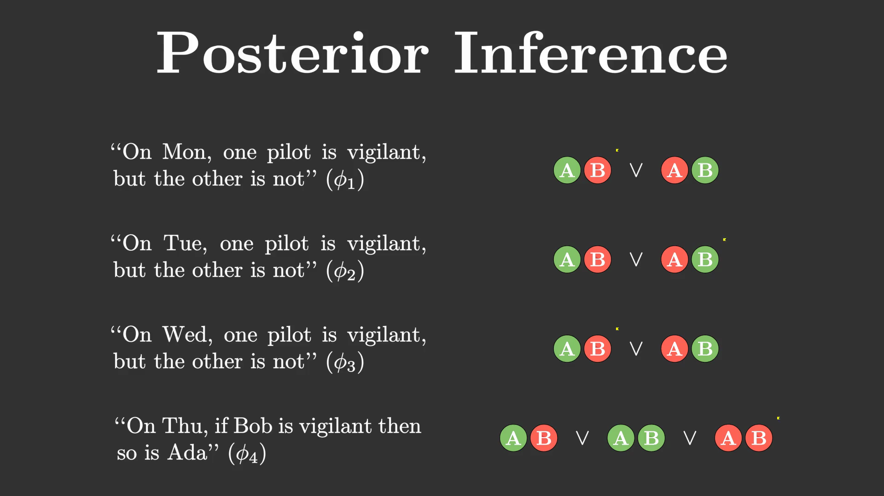
Notes:
One approach is to compute the posterior distribution of the urns, conditioned on the De Finetti Logic constraints.
If we do this, then the posterior turns out to be a mixture of parallel Pólya urns.
To see why, consider any sequence of draws that satisfies all the constraints. We can construct such a sequence by choosing, for each day, one outcome that satisfies the corresponding constraint.
We call such a sequence of outcomes a POSSIBLE WORLD.
For example, one possible world satisfying the constraints is the following: on Monday and Wednesday, Ada was vigilant and Bob was distracted; on Tuesday, Bob was vigilant and Ada was distracted; and on Thursday, both Ada and Bob were distracted.
Of course, there may be many possible worlds. In this example, there are 16.
For each possible world, we can compute its likelihood under the prior distribution of the initial parallel Pólya urn model, as well as the resulting urn configuration after observing that world, for instance on Friday.
Therefore, the posterior distribution can be written as a mixture of parallel Pólya urns, with one mixture component for each possible world.
This is great. However, it is still not clear what information is actually encoded in this posterior distribution?

Slide 11
Notes:
To understand this better, we need to introduce a bit of notation.
Suppose we keep drawing balls from a standard Pólya urn, and we track the empirical fraction of green and red balls among all the draws observed so far.
On the slide, we denote these two quantities by theta_g and theta_r.
A classical property of the Pólya urn is that, in the limit, these fractions converge to a random vector distributed according to a Dirichlet distribution, that uses as concentration parameter the initial number of green and red balls present in the urn.
So we can view a Pólya urn as implicitly defining a distribution over the long-run frequencies of its possible outcomes. Equivalently, we can view it as implicitly defining a Dirichlet distribution.
Now let us combine the two observations we have made so far.
First, the posterior distribution of a De Finetti Logic theory is a mixture of parallel Pólya urns.
Second, each Pólya urn corresponds to a Dirichlet distribution over long-run outcome frequencies.
It follows that the posterior distribution induced by a De Finetti Logic theory can be represented as a mixture of products of Dirichlet distributions.
In this representation, each mixture component corresponds to one possible world, and each product contains one Dirichlet distribution for each urn in the parallel Pólya urn.

Slide 12
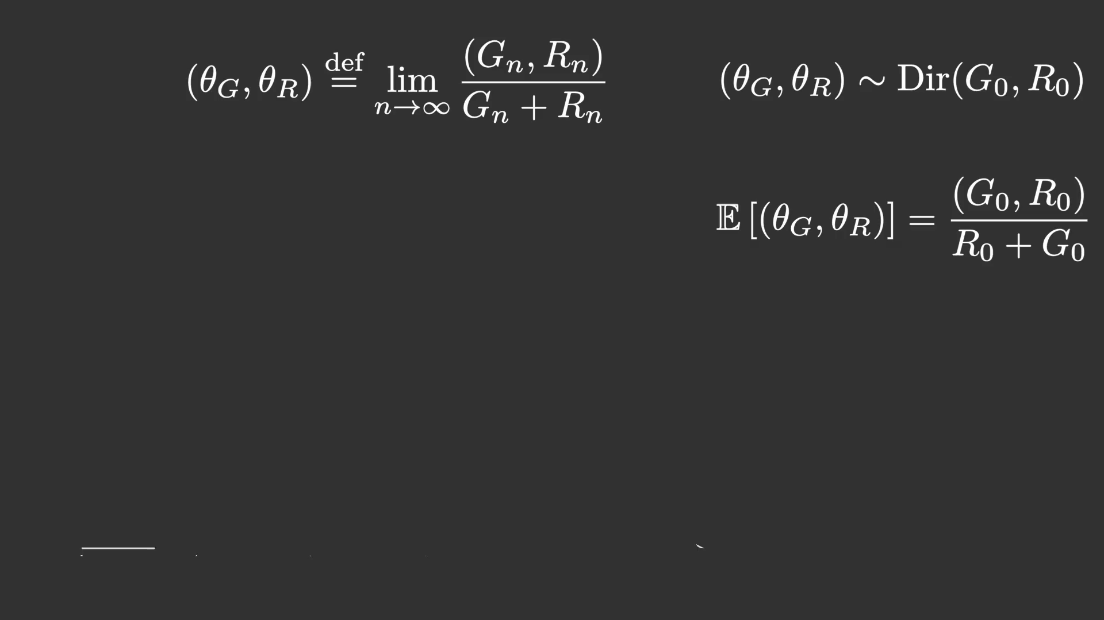
Notes:
To understand this better, we need to introduce a bit of notation.
Suppose we keep drawing balls from a standard Pólya urn, and we track the empirical fraction of green and red balls among all the draws observed so far.
On the slide, we denote these two quantities by theta_g and theta_r.
A classical property of the Pólya urn is that, in the limit, these fractions converge to a random vector distributed according to a Dirichlet distribution, that uses as concentration parameter the initial number of green and red balls present in the urn.
So we can view a Pólya urn as implicitly defining a distribution over the long-run frequencies of its possible outcomes. Equivalently, we can view it as implicitly defining a Dirichlet distribution.
Now let us combine the two observations we have made so far.
First, the posterior distribution of a De Finetti Logic theory is a mixture of parallel Pólya urns.
Second, each Pólya urn corresponds to a Dirichlet distribution over long-run outcome frequencies.
It follows that the posterior distribution induced by a De Finetti Logic theory can be represented as a mixture of products of Dirichlet distributions.
In this representation, each mixture component corresponds to one possible world, and each product contains one Dirichlet distribution for each urn in the parallel Pólya urn.

Slide 13
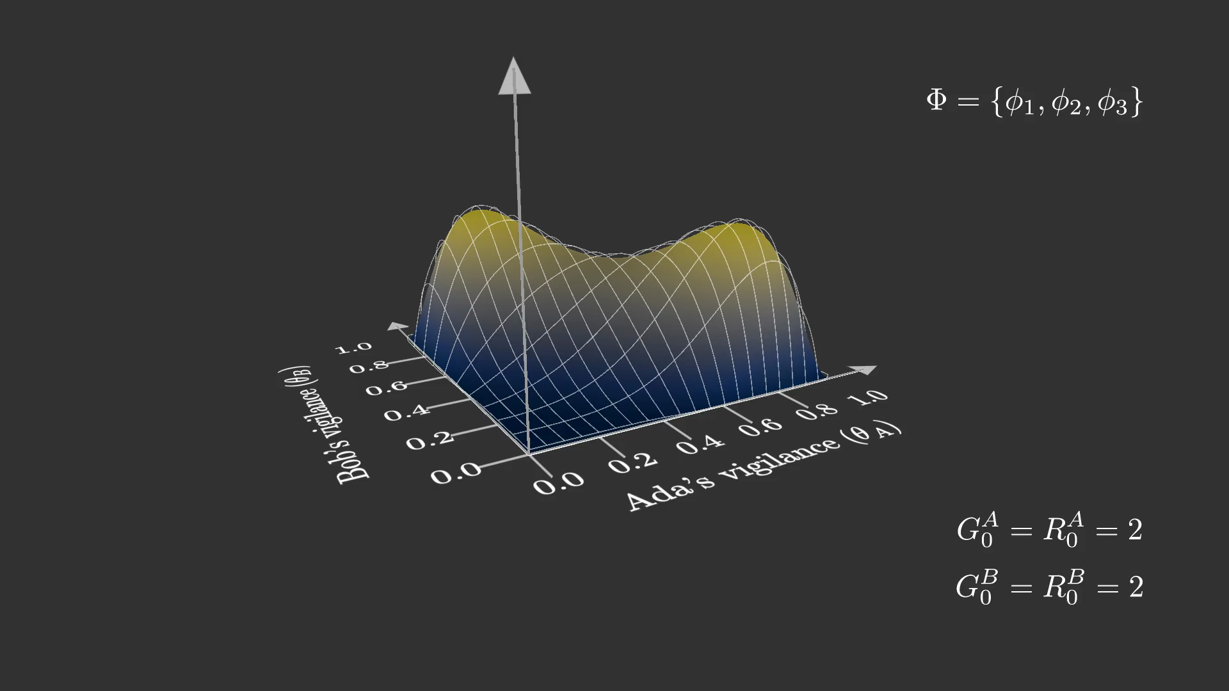
Notes:
Let us see what this posterior looks like.
This plot shows the posterior distribution induced by the first three constraints in our De Finetti Logic theory: the constraints stating that, in each of the first three rounds, exactly one pilot is vigilant and the other is not.
There are three important takeaways from this plot.
First, we learn the ability to encode a set of Boolean constraints into a smooth continuous differentiable density surface
Second, even though the two Pólya urns are independent in the prior distribution, they are clearly not independent in the posterior distribution. Conditioning on shared logical constraints introduces statistical dependence between them.
Third, a De Finetti Logic theory can naturally encode a multimodal posterior distribution.
This is important because it means that the posterior may contain several distinct explanations of the observed constraints, rather than concentrating around a single mode.

Slide 14
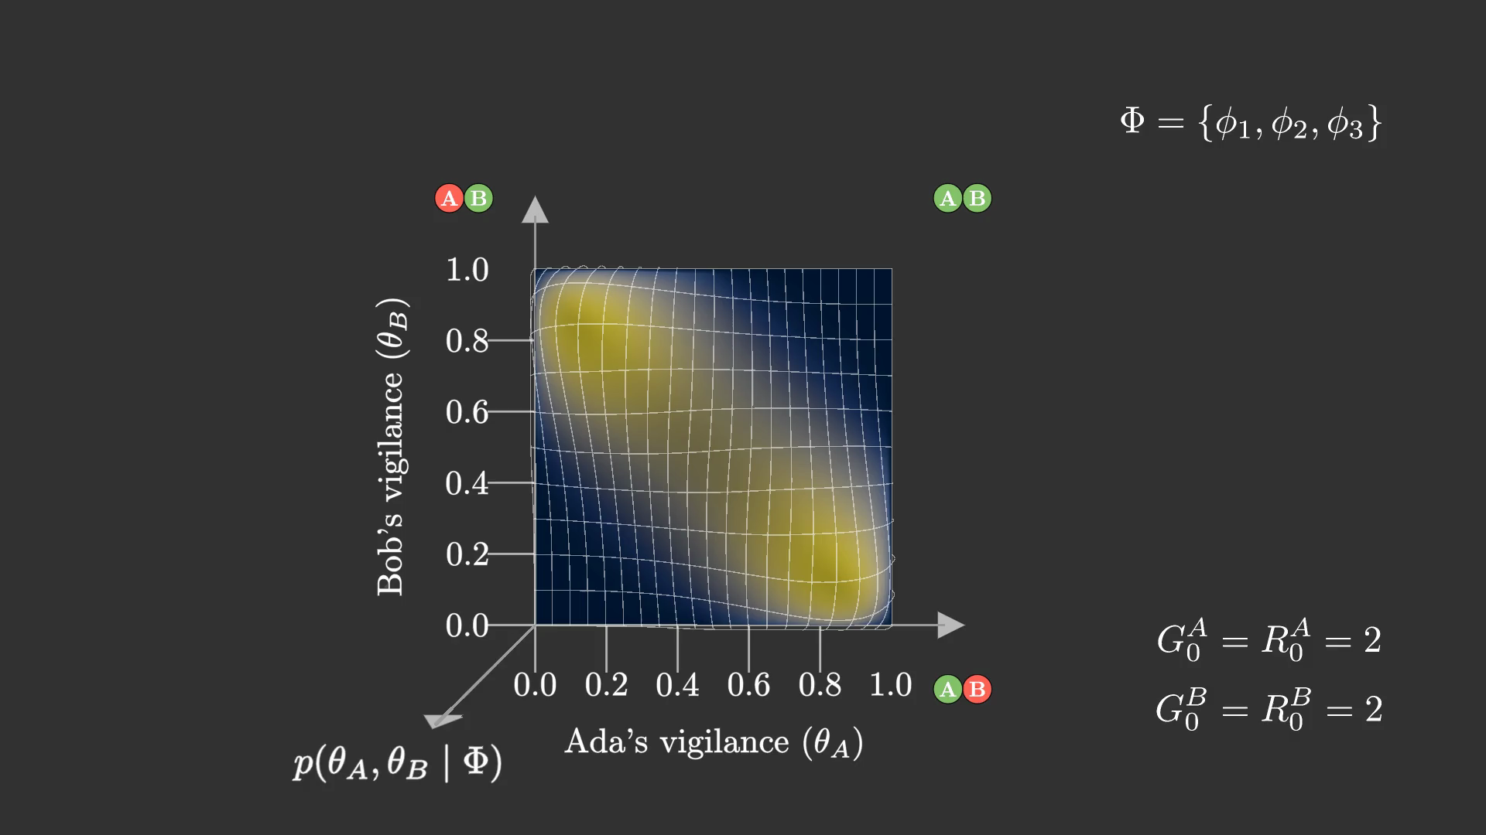
Notes:
Now let us add the last constraint: the one stating that, on Thursday, Ada is as vigilant as Bob.
As you can see, this changes the posterior distribution quite substantially. The distribution collapses to a single dominant mode: the one in which Ada is likely to be vigilant and Bob is likely to be sleepy.
This happens because the last constraint changes how we interpret the first three constraints. Earlier, we only knew that exactly one of the two pilots was vigilant, but we did not know which one. The Thursday constraint provides additional evidence that makes one explanation more plausible than the others.
The key takeaway is that De Finetti Logic theories support a form of probabilistic modus ponens: logical constraints can propagate information and revise our beliefs about the latent behavior of the urns.

Slide 15
Notes:
Beyond toy examples, in the paper we show that this language can represent complex NLP models, including latent Dirichlet allocation, or LDA.
LDA is a topic model that decomposes a large text corpus into a mixture of latent topics.
The De Finetti Logic representation of LDA is extremely large: it contains millions of urns and billions of constraints.
As a result, the number of possible worlds is astronomically large, making exact inference impractical.

Slide 16
Notes:
The main contribution of the paper is a general-purpose variational inference method for De Finetti Logic.
This method enables approximate inference over very large-scale DFL theories, where exact inference is computationally infeasible.

Slide 17
Notes:
For any De Finetti Logic theory, our framework constructs a tailored family of candidate variational distributions, which we denote by Q, to approximate the true posterior.
A specific approximation is then selected by tuning the parameters of Q to minimize the KL divergence between the variational distribution and the true posterior. As in standard variational inference, this is done by maximizing the evidence lower bound, or ELBO.
The variational family Q is designed to factorize more efficiently than the true posterior distribution. This comes at the cost of reduced expressivity, which we compensate for by introducing a larger number of variational parameters.

