Slide 1

Online Electronic Payment System Using PREDICT II Protocol
Final Project Presentation
3rd October, 2001
By
Nishanth Menon
98m11, S₆ MCA

Slide 2

Contents
Problem statement
Design
Implementation
Testing
Security Issues Addressed
Future Work

Slide 3
Problem Statement
The objective of this project is to create a scalable model of an online electronic payment system, allowing authorized users to access and utilize their wealth from anywhere in the Internet using the PRotocol Enhancement of DIgital Cash Transaction- II protocol.

Slide 4
Problem Statement .Contd..
Inputs.
User Information – name, Pass Phrase etc.
Amount of Cash to be transacted.
The IP of the Zone Server.
The IP and optionally the port of the Server socket of the remote client software.
The Key Generation information (including no: bits RSA Key, Hashing algorithm for the password storage and other configuration information).
Outputs.
Transaction Result–Whether completed or aborted etc.
Passbook format Transaction information.
Complete transaction information.
Personal information of authorized client.

Slide 5
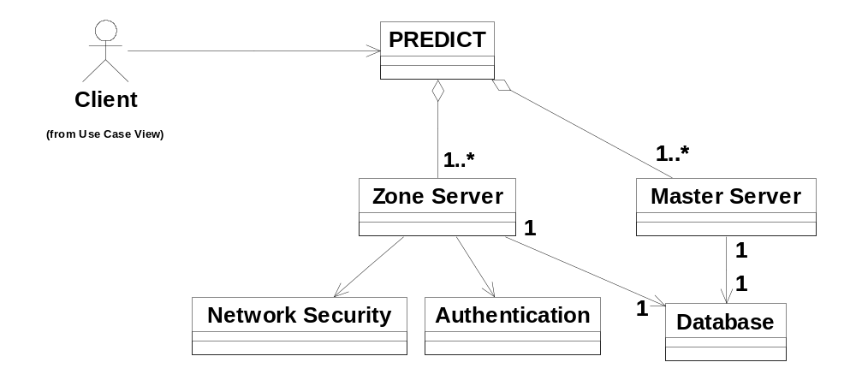
Conceptual Class Diagram

Slide 6
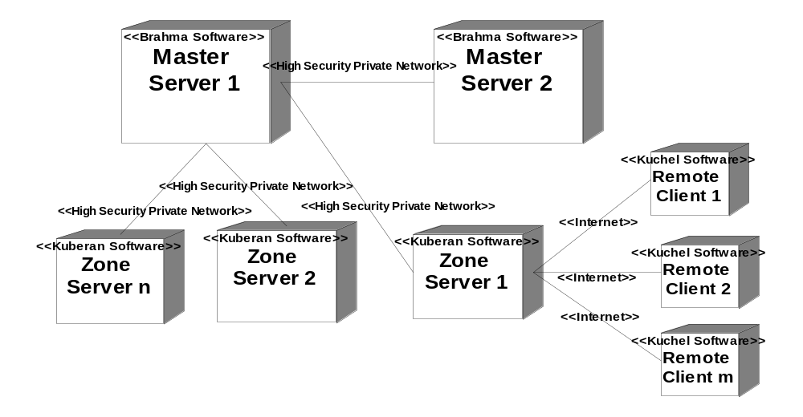
Deployment Diagram

Slide 7
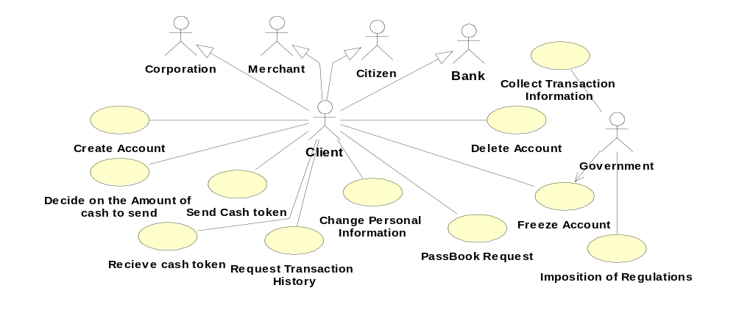
Entire System Use Case Diagram

Slide 8
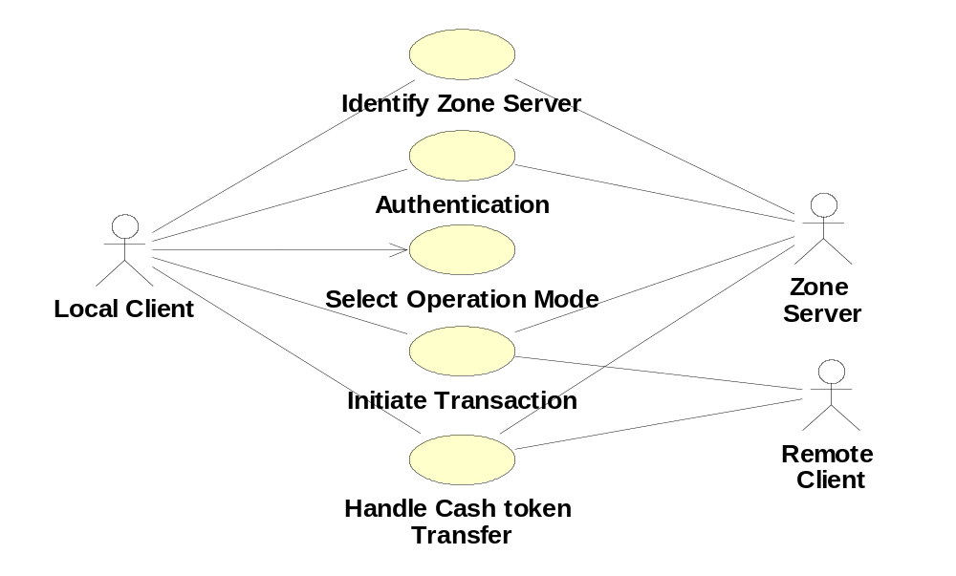
Client Use Case Diagram

Slide 9
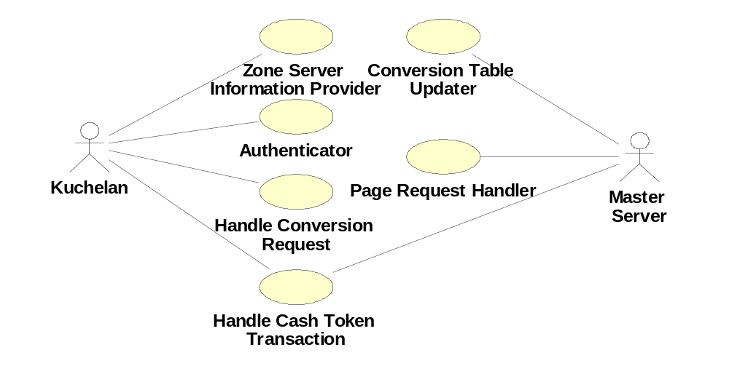
Zone Server Use Case Diagram

Slide 10
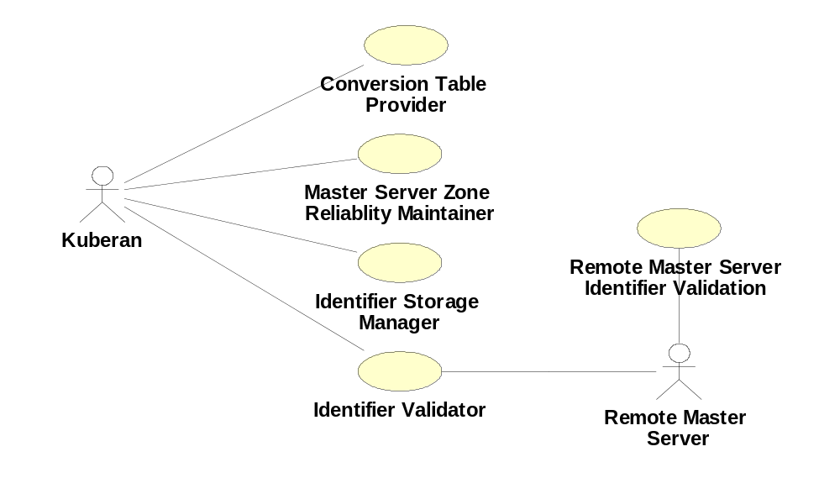
Master Server Use Case

Slide 11
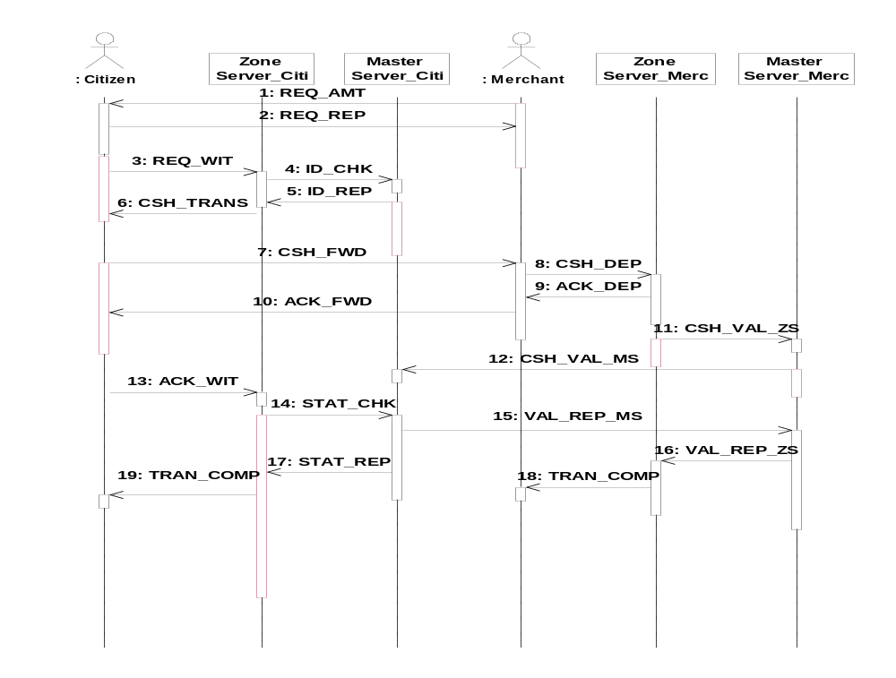
Sequence Diagram

Slide 12
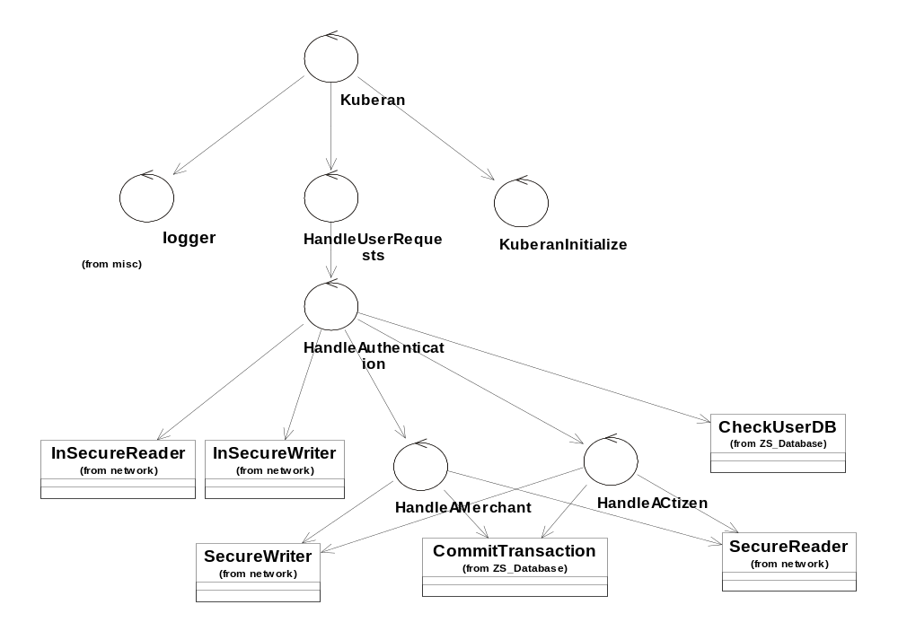
Zone Server Software

Slide 13
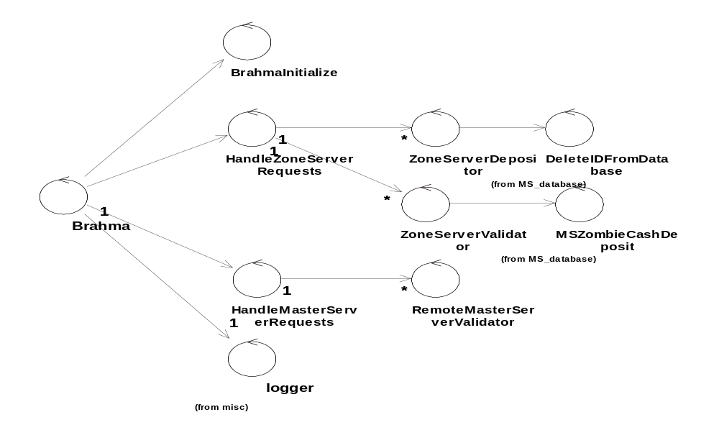
Master Server Software

Slide 14
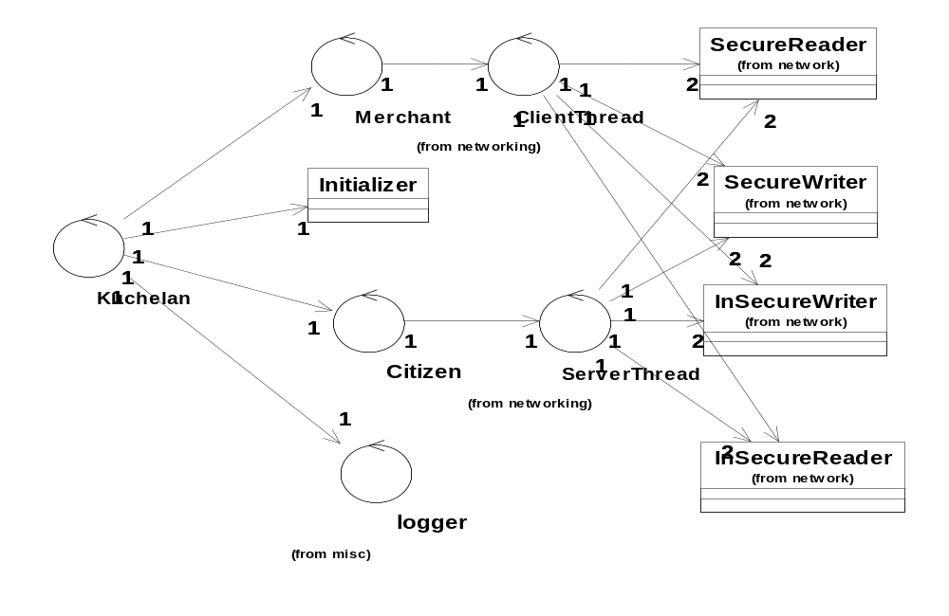
Client Software

Slide 15
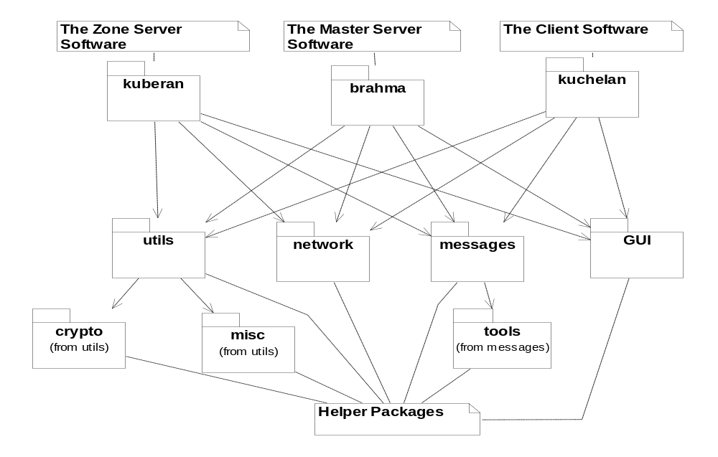
Package Layout

Slide 16
Security Issues Addressed
User authentication & security of User Pass Phrase.
Cash token and acknowledgement integrity- modification/corruption.
Double spending.
Security of the Database Server.
Internet based attacks on the Web Server (DMZ created).
Secure transmissions. (Session Key based RSA transmissions-initial Key Exchange with DH key exchange)

Slide 17
Future Work
The time estimation needs to be improved.
Full scale testing in a network with loss and performance estimation.
Implementation of the master server and zone server software to be done in C++.
Testing of the system for vulnerabilities against different forms of attacks to be tested.
Improving the cryptographic implementation for time-wise complexity.

