Slide 1
This is an overview of extensive work by many people

Slide 2
Attention, memory & symmetry
Nick Fisher
@NickFisherAU
19 June 2018

Slide 3
Free internet points to anyone who knows what the following is…

Slide 4
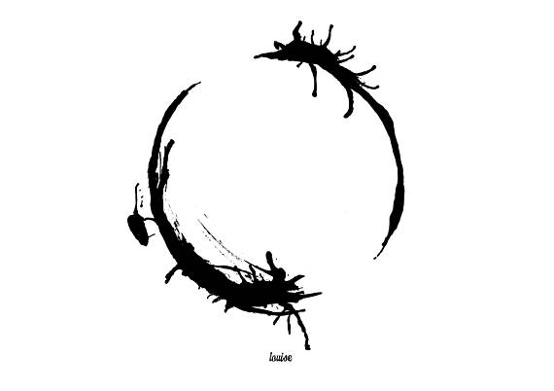

Slide 5
Language isn’t necessarily sequential!

Slide 6
Example
If you don’t know the last word, how do you know what “it” refers to in this sentence?
The trophy could not fit in the suitcase because it was too
?
?

Slide 7
Notwithstanding, deep sequential models have been very successful
Language modelling – given a sequence of n tokens, predict the (n+1)th token
The cat sat on the _____

Slide 8
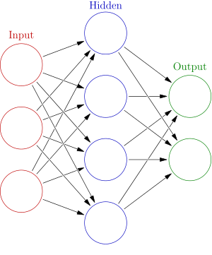
Vanilla recurrent neural network applied at each timestep in the sequence
The
cat
sat
on
Backpropagation through time
Repeated chained sigmoids are numerically unstable – gradients vanish or explode

Slide 9
Solution?
Ensure constant error flow by gating!

