Slide 1
Machine Learning
Approach based on Decision Trees

Slide 2
Decision Tree Learning
  Practical inductive inference method
  Same goal as Candidate-Elimination algorithm
    Find Boolean function of attributes
    Decision trees can be extended to functions with more than two output values.
  Widely used
  Robust to noise
  Can handle disjunctive (OR’s) expressions
  Completely expressive hypothesis space
  Easily interpretable (tree structure, if-then rules)

Slide 3
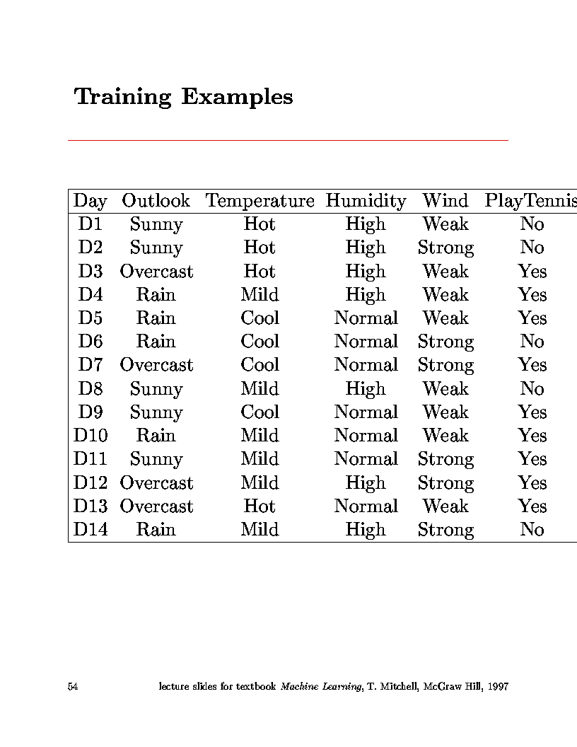
Training Examples
Attribute, variable, property
Object, sample, example
Shall we play tennis today? (Tennis 1)
decision

Slide 4
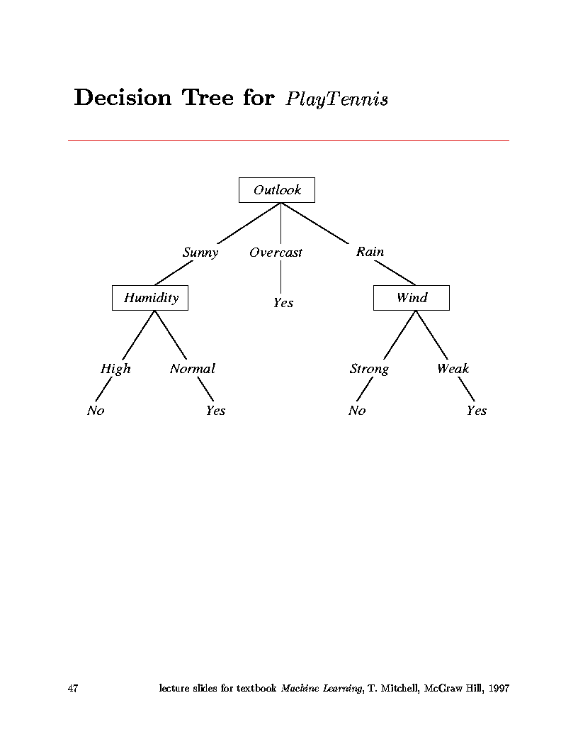
Decision trees do classification
  Classifies instances into one of a discrete set of possible categories
  Learned function represented by tree
  Each node in tree is test on some attribute of an instance
  Branches represent values of attributes
  Follow the tree from root to leaves to find the output value.
Shall we play tennis today?

Slide 5
The tree itself forms hypothesis
  Disjunction (OR’s) of conjunctions (AND’s)
  Each path from root to leaf forms conjunction of constraints on attributes
  Separate branches are disjunctions
Example from PlayTennis decision tree:
  (Outlook=Sunny ∧ Humidity=Normal)
  ∨
  (Outlook=Overcast)
  ∨ 
  (Outlook=Rain ∧ Wind=Weak)

Slide 6
Types of problems decision tree learning is good for:
  Instances represented by attribute-value pairs
    For algorithm in book, attributes take on a small number of discrete values
    Can be extended to real-valued attributes
      (numerical data)
    Target function has discrete output values
    Algorithm in book assumes Boolean functions
    Can be extended to multiple output values

Slide 7
  Hypothesis space can include disjunctive expressions.
    In fact, hypothesis space is complete space of finite discrete-valued functions
  Robust to imperfect training data
    classification errors
    errors in attribute values
    missing attribute values
Examples:
  Equipment diagnosis
  Medical diagnosis
  Credit card risk analysis
  Robot movement
  Pattern Recognition
    face recognition
    hexapod walking gates

Slide 8
ID3 Algorithm
  Top-down, greedy search through space of possible decision trees
    Remember, decision trees represent hypotheses, so this is a search through hypothesis space.
  What is top-down?
    How to start tree?
      What attribute should represent the root?
    As you proceed down tree, choose attribute for each successive node.
    No backtracking:
      So, algorithm proceeds from top to bottom

Slide 9
The ID3 algorithm is used to build a decision tree, given a set of non-categorical attributes C1, C2, .., Cn, the categorical attribute C, and a training set T of records.
function ID3 (R: a set of non-categorical attributes,
C: the categorical attribute,
S: a training set) returns a decision tree;
begin
If S is empty, return a single node with value Failure;
If every example in S has the same value for categorical
attribute, return single node with that value;
If R is empty, then return a single node with most
frequent of the values of the categorical attribute found in
examples S; [note: there will be errors, i.e., improperly
classified records];
Let D be attribute with largest Gain(D,S) among R’s attributes;
Let {dj| j=1,2, .., m} be the values of attribute D;
Let {Sj| j=1,2, .., m} be the subsets of S consisting
respectively of records with value dj for attribute D;
Return a tree with root labeled D and arcs labeled
d1, d2, .., dm going respectively to the trees
ID3(R-{D},C,S1), ID3(R-{D},C,S2) ,.., ID3(R-{D},C,Sm);
end ID3;

Slide 10
  What is a greedy search?
    At each step, make decision which makes greatest improvement in whatever you are trying optimize.
    Do not backtrack (unless you hit a dead end)
    This type of search is likely not to be a globally optimum solution, but generally works well.
  What are we really doing here?
    At each node of tree, make decision on which attribute best classifies training data at that point.
    Never backtrack (in ID3)
    Do this for each branch of tree.
    End result will be tree structure representing a hypothesis which works best for the training data.

Slide 11
Information Theory Background
If there are n equally probable possible messages, then the probability p of each is 1/n
Information conveyed by a message is -log(p) = log(n)
Eg, if there are 16 messages, then log(16) = 4 and we need 4 bits to identify/send each message.
In general, if we are given a probability distribution
  P = (p1, p2, .., pn)
the information conveyed by distribution (aka Entropy of P) is:
  I(P) = -(p1*log(p1) + p2*log(p2) + .. + pn*log(pn))

Slide 12
Question?
How do you determine which attribute best classifies data?
Answer: Entropy!
Information gain:
  Statistical quantity measuring how well an attribute classifies the data.
    Calculate the information gain for each attribute.
    Choose attribute with greatest information gain.

Slide 13
But how do you measure information?
  Claude Shannon in 1948 at Bell Labs established the field of information theory.
  Mathematical function, Entropy, measures information content of random process:
    Takes on largest value when events are equiprobable.
    Takes on smallest value when only one event has
    non-zero probability.
  For two states:
    Positive examples and Negative examples from set S:
    H(S) = -p₊log₂(p₊) - p₋log₂(p₋)
Entropy of set S denoted by H(S)

Slide 14
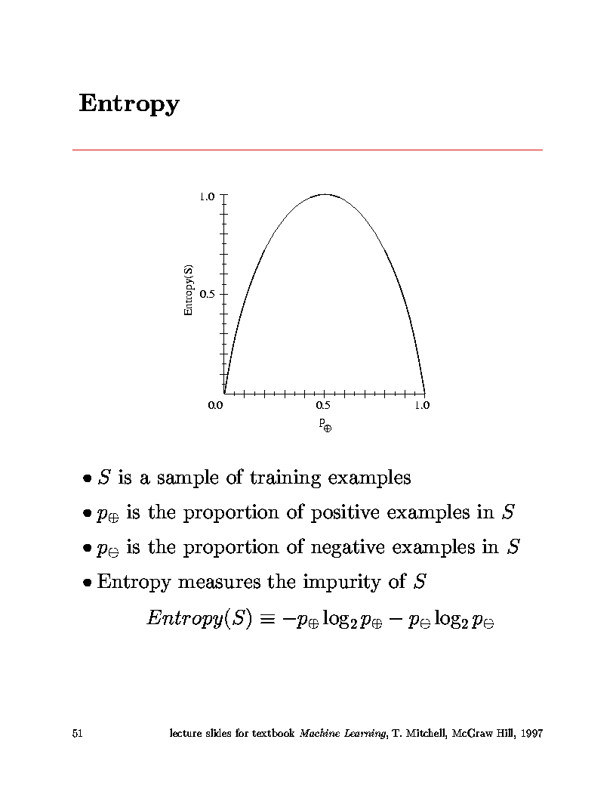
Largest entropy
Entropy
Boolean functions with the same number of ones and zeros have largest entropy

Slide 15
But how do you measure information?
  Claude Shannon in 1948 at Bell Labs established the field of information theory.
  Mathematical function, Entropy, measures information content of random process:
    Takes on largest value when events are equiprobable.
    Takes on smallest value when only one event has
    non-zero probability.
  For two states:
    Positive examples and Negative examples from set S:
    H(S) = - p₊log₂(p₊) - p₋ log₂(p₋)
Entropy
= Measure of order in set S

Slide 16
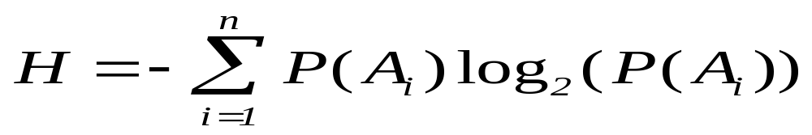
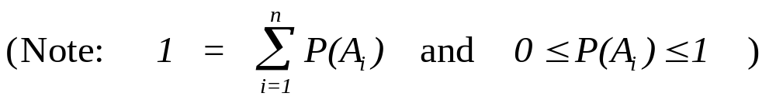
In general:
  For an ensemble of random events: {A₁,A₂,...,A_{n}},
  occurring with probabilities: z ={P(A₁),P(A₂),...,P(A_{n})}
If you consider the self-information of event, i, to be: -log₂(P(A_{i}))
Entropy is weighted average of information carried by each event.
Does this make sense?

Slide 17
  Does this make sense?
  If an event conveys information, that means it’s a surprise.
  If an event always occurs, P(A_{i})=1, then it carries no information. -log₂(1) = 0
  If an event rarely occurs (e.g. P(A_{i})=0.001), it carries a lot of info. -log₂(0.001) = 9.97
  The less likely the event, the more the information it carries since, for 0 ≤ P(A_{i}) ≤ 1,
  -log₂(P(A_{i})) increases as P(A_{i}) goes from 1 to 0.
    (Note: ignore events with P(A_{i})=0 since they never occur.)

Slide 18
What about entropy?
  Is it a good measure of the information carried by an ensemble of events?
  If the events are equally probable, the entropy is maximum.
  1) For N events, each occurring with probability 1/N.
  H = -∑(1/N)log₂(1/N) = -log₂(1/N)
  This is the maximum value.
  (e.g. For N=256 (ascii characters) -log₂(1/256) = 8
  number of bits needed for characters.
  Base 2 logs measure information in bits.)
  This is a good thing since an ensemble of equally probable events is as uncertain as it gets.
(Remember, information corresponds to surprise - uncertainty.)

Slide 19
  2) H is a continuous function of the probabilities.
    That is always a good thing.
  3) If you sub-group events into compound events, the entropy calculated for these compound groups is the same.
    That is good since the uncertainty is the same.
It is a remarkable fact that the equation for entropy shown above (up to a multiplicative constant) is the only function which satisfies these three conditions.

Slide 20
Choice of base 2 log corresponds to choosing units of information.(BIT’s)
Another remarkable thing:
  This is the same definition of entropy used in statistical mechanics for the measure of disorder.
  Corresponds to macroscopic thermodynamic quantity of Second Law of Thermodynamics.

Slide 21
The concept of a quantitative measure for information content plays an important role in many areas:
For example,
  Data communications (channel capacity)
  Data compression (limits on error-free encoding)
Entropy in a message corresponds to minimum number of bits needed to encode that message.
In our case, for a set of training data, the entropy measures the number of bits needed to encode classification for an instance.
  Use probabilities found from entire set of training data.
  Prob(Class=Pos) = Num. of positive cases / Total case
  Prob(Class=Neg) = Num. of negative cases / Total cases

Slide 22
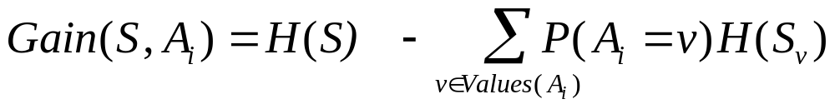
(Back to the story of ID3)
Information gain is our metric for how well one attribute A ^{i} classifies the training data.
Information gain for a particular attribute =
  Information about target function,
  given the value of that attribute.
  (conditional entropy)
Mathematical expression for information gain:
entropy
Entropy for value v

Slide 23
ID3 algorithm (for boolean-valued function)
  Calculate the entropy for all training examples
    positive and negative cases
    p₊ = #pos/Tot p₋ = #neg/Tot
    H(S) = -p₊log₂(p₊) - p₋log₂(p₋)
  Determine which single attribute best classifies the training examples using information gain.
    For each attribute find:
    Use attribute with greatest information gain as a root

Slide 24
Using Gain Ratios
The notion of Gain introduced earlier favors attributes that have a large number of values.
  If we have an attribute D that has a distinct value for each record, then Info(D,T) is 0, thus Gain(D,T) is maximal.
To compensate for this Quinlan suggests using the following ratio instead of Gain:
  GainRatio(D,T) = Gain(D,T) / SplitInfo(D,T)
SplitInfo(D,T) is the information due to the split of T on the basis of value of categorical attribute D.
  SplitInfo(D,T) = I(|T1|/|T|, |T2|/|T|, .., |Tm|/|T|)
where {T1, T2, .. Tm} is the partition of T induced by value of D.

Slide 25
Example: PlayTennis
  Four attributes used for classification:
    Outlook = {Sunny,Overcast,Rain}
    Temperature = {Hot, Mild, Cool}
    Humidity = {High, Normal}
    Wind = {Weak, Strong}
  One predicted (target) attribute (binary)
    PlayTennis = {Yes,No}
  Given 14 Training examples
    9 positive
    5 negative

Slide 26
Examples, minterms, cases, objects, test cases,
Training Examples

Slide 27
14 cases
9 positive cases
Step 1: Calculate entropy for all cases:
      N_{Pos} = 9 N_{Neg} = 5 N_{Tot} = 14
      H(S) = -(9/14)*log₂(9/14) - (5/14)*log₂(5/14) = 0.940
entropy

Slide 28
Step 2: Loop over all attributes, calculate gain:
  Attribute = Outlook
    Loop over values of Outlook
      Outlook = Sunny
      N_{Pos} = 2 N_{Neg} = 3 N_{Tot} = 5
      H(Sunny) = -(2/5)*log₂(2/5) - (3/5)*log₂(3/5) = 0.971
      Outlook = Overcast
      N_{Pos} = 4 N_{Neg} = 0 N_{Tot} = 4
      H(Sunny) = -(4/4)*log₂4/4) - (0/4)*log₂(0/4) = 0.00

Slide 29
      Outlook = Rain
      N_{Pos} = 3 N_{Neg} = 2 N_{Tot} = 5
      H(Sunny) = -(3/5)*log₂(3/5) - (2/5)*log₂(2/5) = 0.971
    Calculate Information Gain for attribute Outlook
    Gain(S,Outlook) = H(S) - N_{Sunny}/N_{Tot}*H(Sunny)
    - N_{Over}/N_{Tot}*H(Overcast)
    - N_{Rain}/N_{Tot}*H(Rainy)
    Gain(S,Outlook) = 9.40 - (5/14)*0.971 - (4/14)*0 - (5/14)*0.971 Gain(S,Outlook) = 0.246
  Attribute = Temperature
    (Repeat process looping over {Hot, Mild, Cool})
    Gain(S,Temperature) = 0.029

Slide 30
  Attribute = Humidity
    (Repeat process looping over {High, Normal})
    Gain(S,Humidity) = 0.029
  Attribute = Wind
    (Repeat process looping over {Weak, Strong})
    Gain(S,Wind) = 0.048
  Find attribute with greatest information gain:
  Gain(S,Outlook) = 0.246, Gain(S,Temperature) = 0.029
  Gain(S,Humidity) = 0.029, Gain(S,Wind) = 0.048
  ∴ Outlook is root node of tree

Slide 31
  Iterate algorithm to find attributes which best classify training examples under the values of the root node
  Example continued
    Take three subsets:
      Outlook = Sunny (N_{Tot} = 5)
      Outlook = Overcast (N_{Tot} = 4)
      Outlook = Rainy (N_{Tot} = 5)
    For each subset, repeat the above calculation looping over all attributes other than Outlook

Slide 32
  For example:
    Outlook = Sunny (N_{Pos} = 2, N_{Neg}=3, N_{Tot} = 5) H=0.971
      Temp = Hot (N_{Pos} = 0, N_{Neg}=2, N_{Tot} = 2) H = 0.0
      Temp = Mild (N_{Pos} = 1, N_{Neg}=1, N_{Tot} = 2) H = 1.0
      Temp = Cool (N_{Pos} = 1, N_{Neg}=0, N_{Tot} = 1) H = 0.0
      Gain(S_{Sunny},Temperature) = 0.971 - (2/5)*0 - (2/5)*1 - (1/5)*0
      Gain(S_{Sunny},Temperature) = 0.571
    Similarly:
    Gain(S_{Sunny},Humidity) = 0.971
    Gain(S_{Sunny},Wind) = 0.020
    ∴ Humidity classifies Outlook=Sunny
    instances best and is placed as the node under
    Sunny outcome.
  Repeat this process for Outlook = Overcast &Rainy

Slide 33
  Important:
    Attributes are excluded from consideration if they appear higher in the tree
  Process continues for each new leaf node until:
    Every attribute has already been included along path through the tree
    or
    Training examples associated with this leaf all have same target attribute value.

Slide 34
  End up with tree:

Slide 35
  Note: In this example data were perfect.
    No contradictions
    Branches led to unambiguous Yes, No decisions
    If there are contradictions take the majority vote
      This handles noisy data.
  Another note:
    Attributes are eliminated when they are assigned to a node and never reconsidered.
      e.g. You would not go back and reconsider Outlook under Humidity
  ID3 uses all of the training data at once
    Contrast to Candidate-Elimination
    Can handle noisy data.

Slide 36
Another Example: Russell’s and Norvig’s Restaurant Domain
Develop a decision tree to model the decision a patron makes when deciding whether or not to wait for a table at a restaurant.
Two classes: wait, leave
Ten attributes: alternative restaurant available?, bar in restaurant?, is it Friday?, are we hungry?, how full is the restaurant?, how expensive?, is it raining?,do we have a reservation?, what type of restaurant is it?, what's the purported waiting time?
Training set of 12 examples
~ 7000 possible cases

Slide 37
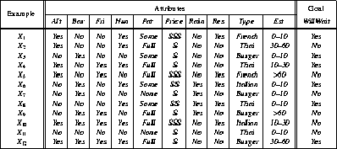
A Training Set

Slide 38
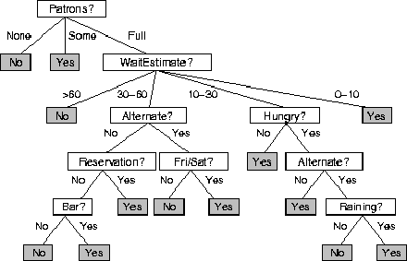
A decision Tree from Introspection

Slide 39
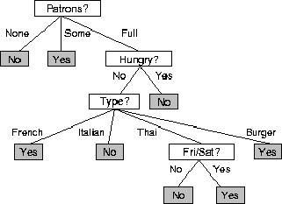
ID3 Induced
Decision Tree

Slide 40
ID3
A greedy algorithm for Decision Tree Construction developed by Ross Quinlan, 1987
Consider a smaller tree a better tree
Top-down construction of the decision tree by recursively selecting the "best attribute" to use at the current node in the tree, based on the examples belonging to this node.
  Once the attribute is selected for the current node, generate children nodes, one for each possible value of the selected attribute.
  Partition the examples of this node using the possible values of this attribute, and assign these subsets of the examples to the appropriate child node.
  Repeat for each child node until all examples associated with a node are either all positive or all negative.

Slide 41
Choosing the Best Attribute
The key problem is choosing which attribute to split a given set of examples.
Some possibilities are:
  Random: Select any attribute at random
  Least-Values: Choose the attribute with the smallest number of possible values (fewer branches)
  Most-Values: Choose the attribute with the largest number of possible values (smaller subsets)
  Max-Gain: Choose the attribute that has the largest expected information gain, i.e. select attribute that will result in the smallest expected size of the subtrees rooted at its children.
The ID3 algorithm uses the Max-Gain method of selecting the best attribute.

Slide 42
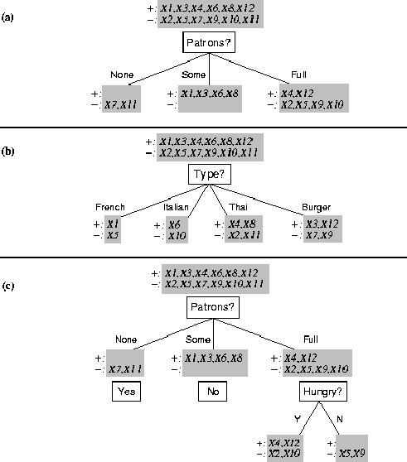
Splitting Examples by Testing Attributes

Slide 43
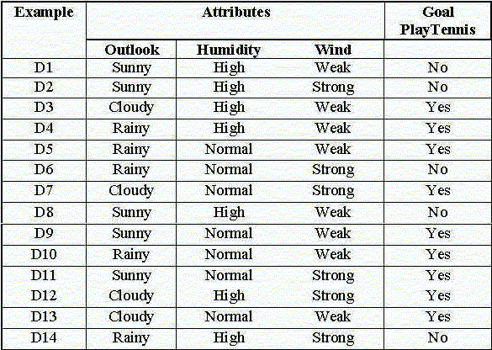
Another example: Tennis 2 (simplified former example)

Slide 44
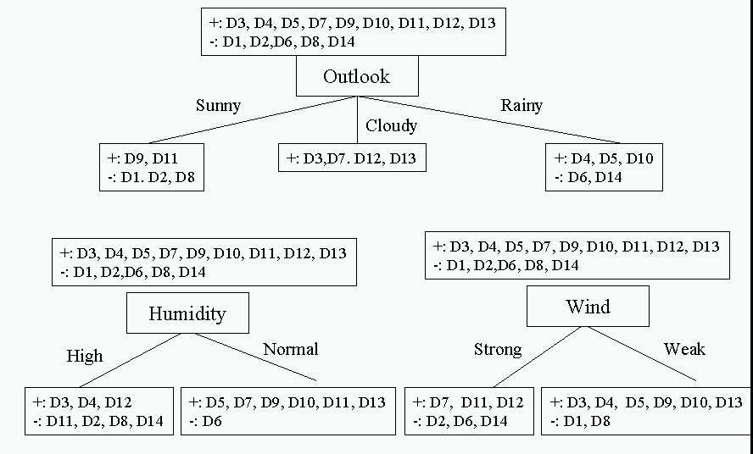
Choosing the first split

Slide 45
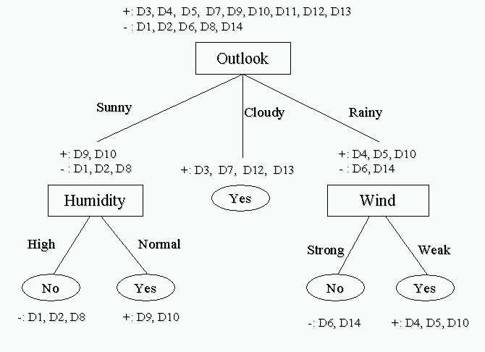
Resulting Decision Tree

Slide 46
The entropy is the average number of bits/message needed to represent a stream of messages.
Examples:
  if P is (0.5, 0.5) then I(P) is 1
  if P is (0.67, 0.33) then I(P) is 0.92,
  if P is (1, 0) then I(P) is 0.
The more uniform is the probability distribution, the greater is its information gain/entropy.

Slide 47
What is the hypothesis space for decision tree learning?
  Search through space of all possible decision trees
    from simple to more complex guided by a heuristic: information gain
  The space searched is complete space of finite, discrete-valued functions.
    Includes disjunctive and conjunctive expressions
  Method only maintains one current hypothesis
    In contrast to Candidate-Elimination
  Not necessarily global optimum
    attributes eliminated when assigned to a node
    No backtracking
    Different trees are possible

Slide 48
Inductive Bias: (restriction vs. preference)
  ID3
    searches complete hypothesis space
    But, incomplete search through this space looking for simplest tree
    This is called a preference (or search) bias
  Candidate-Elimination
    Searches an incomplete hypothesis space
    But, does a complete search finding all valid hypotheses
    This is called a restriction (or language) bias
  Typically, preference bias is better since you do not limit your search up-front by restricting hypothesis space considered.

Slide 49
How well does it work?
Many case studies have shown that decision trees are at least as accurate as human experts.
  A study for diagnosing breast cancer:
    humans correctly classifying the examples 65% of the time,
    the decision tree classified 72% correct.
  British Petroleum designed a decision tree for gas-oil separation for offshore oil platforms/
    It replaced an earlier rule-based expert system.
  Cessna designed an airplane flight controller using 90,000 examples and 20 attributes per example.

Slide 50
Extensions of the Decision Tree Learning Algorithm
Using gain ratios
Real-valued data
Noisy data and Overfitting
Generation of rules
Setting Parameters
Cross-Validation for Experimental Validation of Performance
Incremental learning

Slide 51
Algorithms used:
  ID3 Quinlan (1986)
  C4.5 Quinlan(1993)
  C5.0 Quinlan
  Cubist Quinlan
  CART Classification and regression trees Breiman (1984)
  ASSISTANT Kononenco (1984) & Cestnik (1987)
ID3 is algorithm discussed in textbook
  Simple, but representative
  Source code publicly available
Entropy first time was used
C4.5 (and C5.0) is an extension of ID3 that accounts for unavailable values, continuous attribute value ranges, pruning of decision trees, rule derivation, and so on.

Slide 52
Real-valued data
Select a set of thresholds defining intervals;
  each interval becomes a discrete value of the attribute
We can use some simple heuristics
  always divide into quartiles
We can use domain knowledge
  divide age into infant (0-2), toddler (3 - 5), and school aged (5-8)
or treat this as another learning problem
  try a range of ways to discretize the continuous variable
  Find out which yield “better results” with respect to some metric.

Slide 53
Noisy data and Overfitting
Many kinds of "noise" that could occur in the examples:
  Two examples have same attribute/value pairs, but different classifications
  Some values of attributes are incorrect because of:
    Errors in the data acquisition process
    Errors in the preprocessing phase
  The classification is wrong (e.g., + instead of -) because of some error
Some attributes are irrelevant to the decision-making process,
  e.g., color of a die is irrelevant to its outcome.
  Irrelevant attributes can result in overfitting the training data.

Slide 54
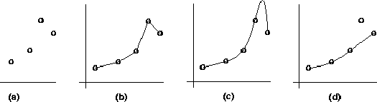
Overfitting:
  learning result fits data (training examples) well but does not hold for unseen data
    This means, the algorithm has poor generalization
  Often need to compromise fitness to data and generalization power
  Overfitting is a problem common to all methods that learn from data
(b and (c): better fit for data, poor generalization
(d): not fit for the outlier (possibly due to noise), but better generalization
Fix overfitting/overlearning problem
  By cross validation (see later)
  By pruning lower nodes in the decision tree.
  For example, if Gain of the best attribute at a node is below a threshold, stop and make this node a leaf rather than generating children nodes.

Slide 55
Pruning Decision Trees
Pruning of the decision tree is done by replacing a whole subtree by a leaf node.
The replacement takes place if a decision rule establishes that the expected error rate in the subtree is greater than in the single leaf. E.g.,
  Training: eg, one training red success and one training blue Failures
  Test: three red failures and one blue success
  Consider replacing this subtree by a single Failure node.
After replacement we will have only two errors instead of five failures.
Color
Color
FAILURE
red
blue
red
blue
2 success
4 failure
1 success
0 failure
0 success
1 failure
1 success
3 failure
1 success
1 failure

Slide 56
Incremental Learning
Incremental learning
  Change can be made with each training example
  Non-incremental learning is also called batch learning
  Good for
    adaptive system (learning while experiencing)
    when environment undergoes changes
  Often with
    Higher computational cost
    Lower quality of learning results
  ITI (by U. Mass): incremental DT learning package

Slide 57
Evaluation Methodology
Standard methodology: cross validation
  1. Collect a large set of examples (all with correct classifications!).
  2. Randomly divide collection into two disjoint sets: training and test.
  3. Apply learning algorithm to training set giving hypothesis H
  4. Measure performance of H w.r.t. test set
Important: keep the training and test sets disjoint!
Learning is not to minimize training error (wrt data) but the error for test/cross-validation: a way to fix overfitting
To study the efficiency and robustness of an algorithm, repeat steps 2-4 for different training sets and sizes of training sets.
If you improve your algorithm, start again with step 1 to avoid evolving the algorithm to work well on just this collection.

Slide 58
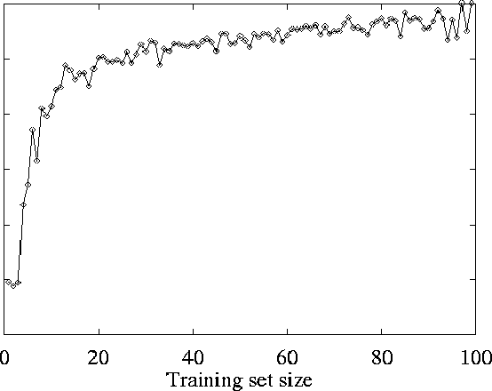
Restaurant Example
Learning Curve

Slide 59
Decision Trees to Rules
It is easy to derive a rule set from a decision tree: write a rule for each path in the decision tree from the root to a leaf.
In that rule the left-hand side is easily built from the label of the nodes and the labels of the arcs.
The resulting rules set can be simplified:
  Let LHS be the left hand side of a rule.
  Let LHS' be obtained from LHS by eliminating some conditions.
  We can certainly replace LHS by LHS' in this rule if the subsets of the training set that satisfy respectively LHS and LHS' are equal.
  A rule may be eliminated by using metaconditions such as "if no other rule applies".

Slide 60

C4.5
C4.5 is an extension of ID3 that accounts for unavailable values, continuous attribute value ranges, pruning of decision trees, rule derivation, and so on.
C4.5: Programs for Machine Learning
J. Ross Quinlan, The Morgan Kaufmann Series in Machine Learning, Pat Langley,
Series Editor. 1993. 302 pages. paperback book & 3.5" Sun disk. $77.95. ISBN 1-55860-240-2

Slide 61
Summary of DT Learning
Inducing decision trees is one of the most widely used learning methods in practice
Can out-perform human experts in many problems
Strengths include
  Fast
  simple to implement
  can convert result to a set of easily interpretable rules
  empirically valid in many commercial products
  handles noisy data
Weaknesses include:
  "Univariate" splits/partitioning using only one attribute at a time so limits types of possible trees
  large decision trees may be hard to understand
  requires fixed-length feature vectors

Slide 62
Summary of ID3 Inductive Bias
  Short trees are preferred over long trees
    It accepts the first tree it finds
  Information gain heuristic
    Places high information gain attributes near root
    Greedy search method is an approximation to finding the shortest tree
  Why would short trees be preferred?
    Example of Occam’s Razor:
    Prefer simplest hypothesis consistent with the data.
    (Like Copernican vs. Ptolemic view of Earth’s motion)

Slide 63
  Homework Assignment
    Tom Mitchell’s software
    See:
    http://www.cs.cmu.edu/afs/cs.cmu.edu/project/theo-3/www/ml.html
    Assignment #2 (on decision trees)
    Software is at: http://www.cs.cmu.edu/afs/cs/project/theo-3/mlc/hw2/
      Compiles with gcc compiler
      Unfortunately, README is not there, but it’s easy to figure out:
        After compiling, to run:
        dt [-s <random seed> ] <train %> <prune %> <test %> <SSV-format data file>
        %train, %prune, & %test are percent of data to be used for training, pruning & testing. These are given as decimal fractions. To train on all data, use 1.0 0.0 0.0
      Data sets for PlayTennis and Vote are include with code.
      Also try the Restaurant example from Russell & Norvig
      Also look at www.kdnuggets.com/ (Data Sets)
      Machine Learning Database Repository at UC Irvine - (try “zoo” for fun)

Slide 64
Questions and Problems
1. Think how the method of finding best variable order for decision trees that we discussed here be adopted for:
    ordering variables in binary and multi-valued decision diagrams
    finding the bound set of variables for Ashenhurst and other functional decompositions
2. Find a more precise method for variable ordering in trees, that takes into account special function patterns recognized in data
3. Write a Lisp program for creating decision trees with entropy based variable selection.

Slide 65
  Sources
    Tom Mitchell
      Machine Learning, Mc Graw Hill 1997
    Allan Moser
    Tim Finin,
    Marie desJardins
    Chuck Dyer

