Slide 1
Restaurant mangement system

Slide 2

Hello!
We are group 10 including :
Dao Hai Long BA9-041
Doan Van Chuong BA9-008
Dang Thai Son BA9-053
Nguyen Minh Hieu BA9-020
Do Cong Hoa BA9-022

Slide 3
Let’s preview some concepts
INTRODUCTION ABOUT OUR PROJECT
STUCTURE OF THE PROJECT
DEMO OF SOME FEATURES
CONCLUSION

Slide 4
INTRO
1
What ?
Why ?
How ?

Slide 5
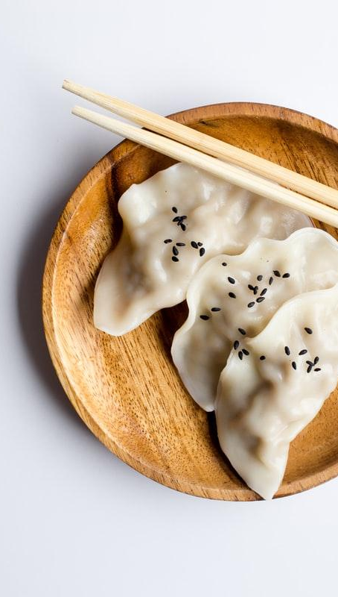
WHAT?
Management tool for restaurant business.
Fundamental and primitive kind of python application.

Slide 6
WHY?
For a big and crowded restaurant, it’s hard to handle all the things by hand.
Help the manager to make their work more efficient.

Slide 7
HOW?
CUSTOMER
DISHES
ORDER
Manage customer: arrive time, number,..etc
Manage menu: price, information…
Order management: quantity, total price

Slide 8
Structure
2
Database
Interface

Slide 9

Database
Contain data set that can be applied for interface

Slide 10
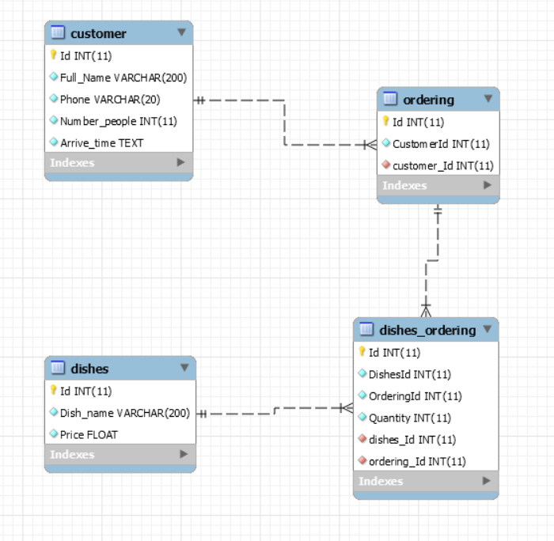
Database diagram

Slide 11
Relationship
Customer-Ordering | One to many: one customer can have many orders.
Dishes-Ordering | Many to many: one dishes can belong to many orders and vice versa

Slide 12
Table’s function.
Customer: key information of a customer.
Dishes: information of all dishes in the menu.
Ordering: Contains customers’ ID which implement which order belongs to which customer.
Dishes-ordering: intermediary table between dishes and ordering table

Slide 13
Interface
Friendly for users.

Slide 14
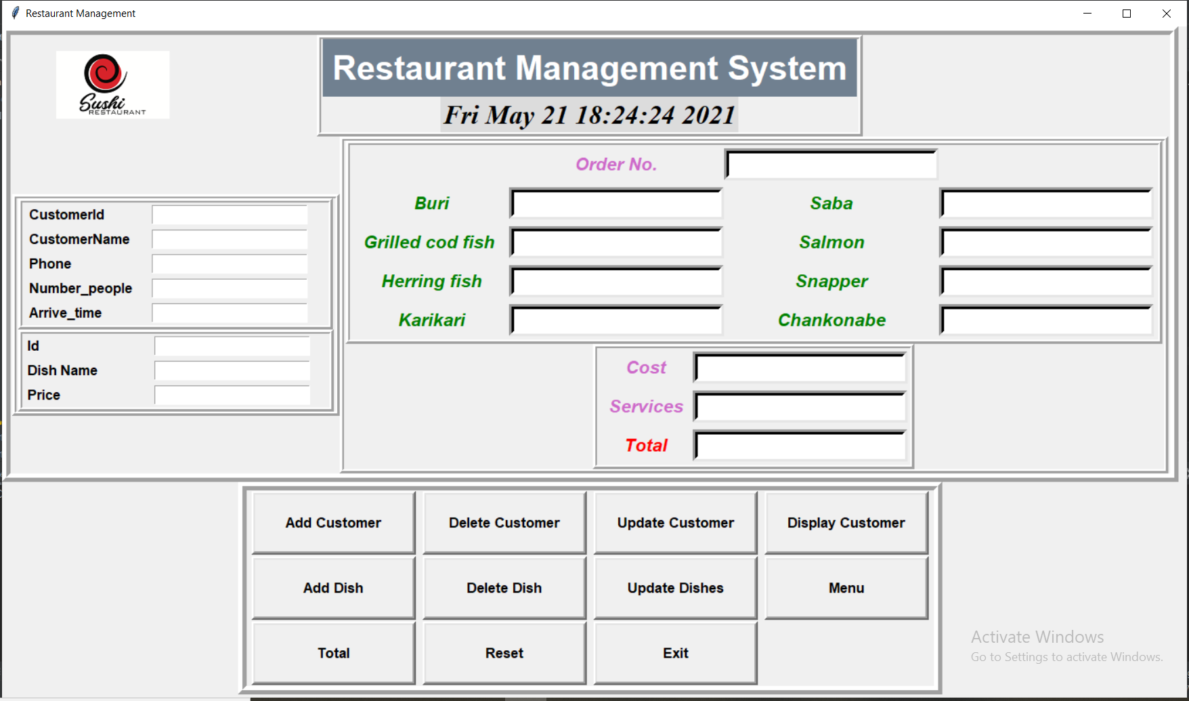
UI design

Slide 15
Three main parts of UI
Adding
Add information of customers and dishes and store it into database
Receipt calculating
Calculate cost of each dish then sum it up to provide receipt to customers
Feature buttons
Provide some others tasks to improve the efficency

Slide 16
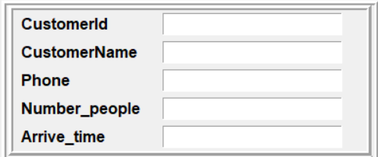
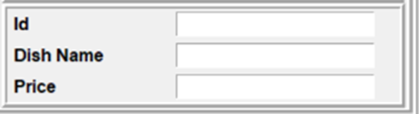
Adding function

Slide 17
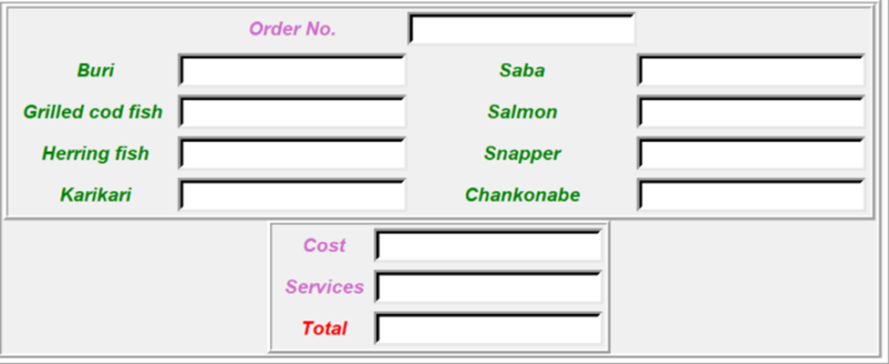
Receipt calculating

Slide 18
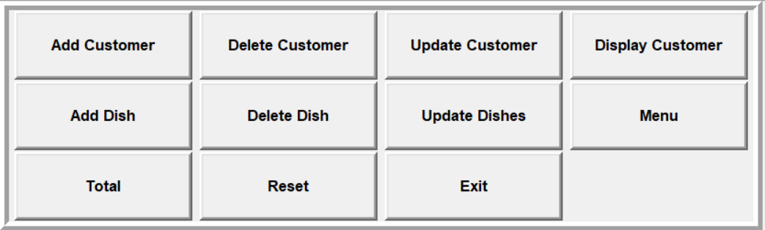
Feature buttons

Slide 19
Demo
3
Menu
Customer displaying
Receipt calculating

Slide 20
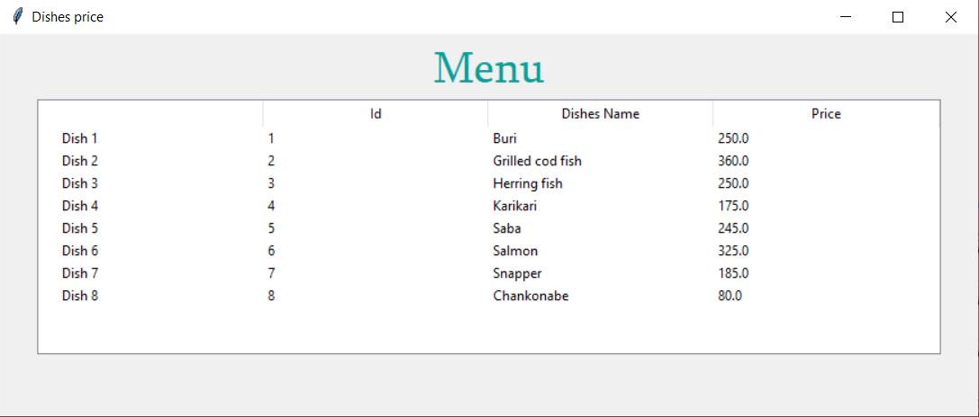
Menu Displaying

Slide 21
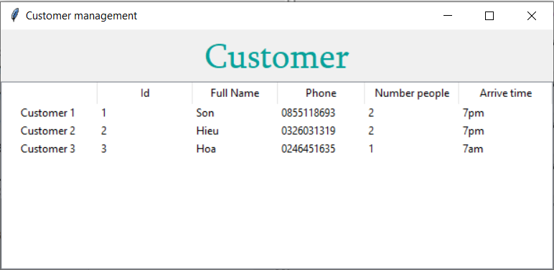
Customer displaying

Slide 22
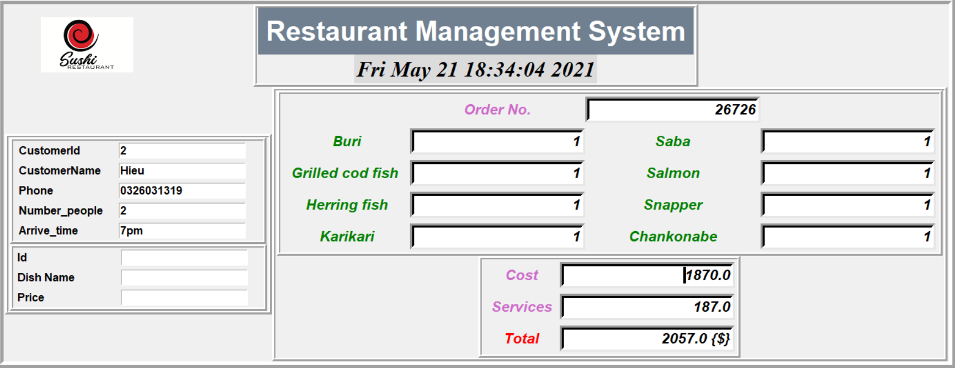
Customer displaying

Slide 23
Conclusion
4
Done
Not done

Slide 24
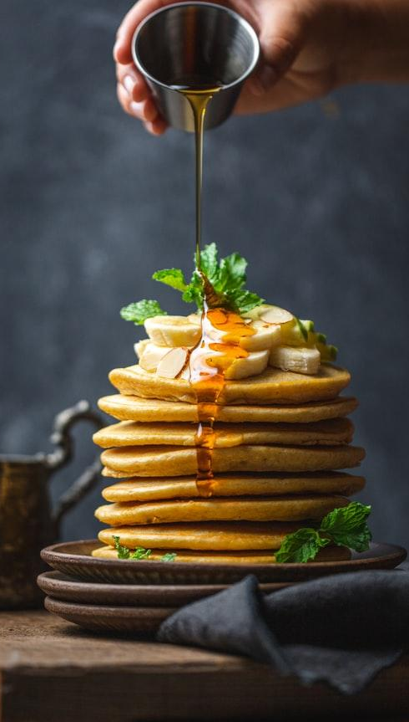
DONE
CRUD of Dishes, Customer table.
Calculate total price.

Slide 25
NOT DONE
Only can add or delete 1 customer or dish at a time.
For receipt calculating feature, we cannot set default every dishes to 0 in the interface
The calculating receipt feature can deal with only a given number of dishes

Slide 26
Thanks!
Any questions?
You can find me at:
@username
user@mail.me

