Slide 1
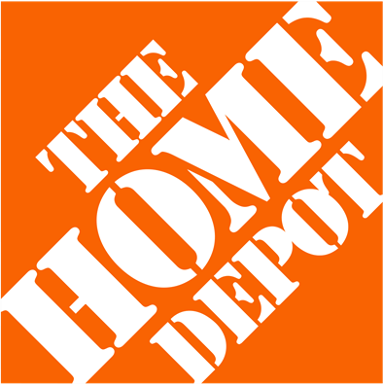
Mock Search Performance Review
Home Depot
Kepler Summer 2025
Intern Portfolio Project
May 2025

Slide 2

01 Campaign Objectives & KPIs
Insights & Key Takeaways
02
Agenda
03 Recommendations & Next Steps
04 Q&A

Slide 3


01
Campaign
Objective & KPIs

Slide 4
Executive
Summary
Client Overview
Home Depot is one of the largest Home Improvement Retail Corporations with focus on these categories:
DIY, Appliances, Brand, Kitchen & Kitchenware, and Lawn & Garden
Client Goals
Increase orders in all of the listed categories above based on data from the dates of March 24, 2025 - April 23, 2025
KPIs
Focus on “maximizing conversions,” with emphasis on conversions, cost per conversion, conversion rate, and
conversion value over cost
Our Findings
The campaign generated strong conversions in brand, lawn & gardening, and kitchen & kitchenware, but had a low performance in searches for general
Our Approach
Compare performance across each ad group, looking at the highest performing keywords with the highest conversions and cost-efficiency

Slide 5


Key Performance Indicator
Terminology
Impressions:
The number of times an ad is displayed to users
Clicks:
The number of times users have interacted with an ad
CTR:
Click through rate; the number of times a user clicked on an ad versus just viewing it
Avg CPC:
Average cost per click = total cost/total clicks
Conversions:
Orders placed by users
Cost/Conv:
Cost per conversion; total cost spent to receive a sale from a user
Conv. Value/Cost:
Return on ads spend (ROAS)

Slide 6
02
Insights &
Key Takeaways

Slide 7
Overall
Ad Group Performance Snapshot
Ad Group | Impr. | Clicks | CTR | Avg. CPC | Spend | Conversions | Cost / Conv | CVR
Appliances | 86,874 | 1,320 | 1.52% | $2.93 | $3,788.03 | 15 | $256.55 | 1.12%
Brand | 175,915 | 6,221 | 3.54% | $0.41 | $5,647.10 | 216 | $26.18 | 3.47%
DIY | 43,934 | 1,078 | 2.45% | $2.84 | $2,996.26 | 13 | $235.60 | 1.18%
General | 45,107 | 1,025 | 2.27% | $1.67 | $1,683.85 | 11 | $157.66 | 1.04%
Kitchen & Kitchenware | 36,080 | 467 | 1.29% | $4.85 | $2,235.21 | 21 | $106.32 | 4.50%
Lawn & Garden | 63,154 | 1,278 | 2.02% | $3.89 | $4,275.11 | 27 | $159.99 | 2.09%
Account Total | 451,064 | 11,388 | 2.52% | $2.77 | $20,625.55 | 303 | $68.38 | 2.65%
Performance Insight: “Brand” is the top performer, it has the highest conversions, second highest CVR(3.47%), and lowest cost/ conversion($26.18). It also had the highest CTR and clicks with lowest average CPC at only ($0.42)
Performance Insight: Lowest performer is “General”, it only has (11) conversions and a CVR of (1.04%).
Impressions, clicks, and CTR, were also low, however, it had a low spend and the second-lowest CPC at ($1.67)

Slide 8
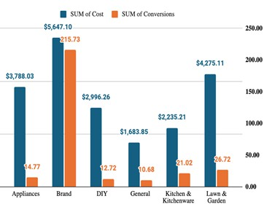
Ad Group
Trend Analysis
Total Spend vs Conversions
Ad Group | Sum of Cost | Sum of Conversions
Appliances | $3,788.03 | 15
Brand | $5,647.10 | 216
DIY | $2,996.26 | 13
General | $1,683.85 | 11
Kitchen and Kitchenware | $2,235.21 | 21
Lawn and Garden | $4,274.11 | 27
Grand Total | $20,625.55 | 303
8
Insights:
1. The table indicates high spending but low conversions across ad groups.
1. Despite its high spending, the Brand ad group delivered the highest number of conversions, indicating a stronger resonance with the target audience.

Slide 9
Keyword
Performance
Ad Group | Keyword | Impr. | Clicks | Avg. CPC | Spend | Conversions | (CPA) Cost / Conv | CVR
Brand | Home Depot Savings | 52,775 | 2,177 | $0.88 | $1,915.76 | 80 | $23.90 | 3.68%
Brand | [Kitchen Appliances] | 43,979 | 1,555 | $0.89 | $1,383.95 | 55 | $25.28 | 3.52%
Brand | [Garden Center] | 35,183 | 1,244 | $0.92 | $1,144.48 | 43 | $26.67 | 3.45%
Brand | Home Improvement | 26,387 | 932 | $0.91 | $848.12 | 33 | $25.64 | 3.55%
Brand | Home Services | 17,591 | 313 | $1.13 | $354.79 | 9 | $39.33 | 2.88%
 | Account Total | 175,915 | 6,221 | $0.91 | $5,647.10 | 220 | $25.67 | 3.54%
Keyword Insight: The highest performing keyword among the top 5 is Home Depot Savings — keyword has highest conversions (80), lowest CPA ($23.90), highest CVR (3.68%), and lowest CPC ($0.88).
Keyword Insight: Home Services is the lowest performing among the top 5 — keyword has lowest conversions (9), highest CPA ($39.33), lowest CVR (2.88%), and highest CPC ($1.13).
9

Slide 10
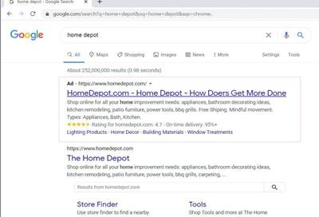
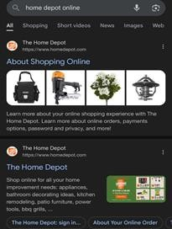
Search Creative
Performance
Search Creative Insight: Keyword “Home Depot” ranks highest in the search engine results page (SERP) for strong brand recognition and directs traffic to home improvement appliances and space.
Search Creative Insight: Keyword “Home Depot online” ranks second highest and has a 2.99 conversion
rate, indicating a strong interest to purchase from the weekly ad.

Slide 11

Demographic
Performance by Conversions
 |  | Age |  | Household Income
 |  | 18-24: 13% |  | Top 10%: 24%
Gender |  | 25-34: 22% |  | 11-20%: 8%
Female: 48% Male: 34% |  | 35-44: 22% 45-54: 17% |  | 21-30%: 14% 31-40%: 19%
Unknown: 18% |  | 55-64: 13% 65+: 8% |  | 41-50%: 17% Lower 50%: 12%
 |  | Unknown: 5% |  | Unknown: 6%
Gender: Female holds the highest conversion at 48% while male holds the lowest at 34%
Age: Groups 25-44 holds the highest conversion at 22% while 65+ holds the lowest at 8%
Household Income: Top 10% of household income holds the highest conversion at 24% while 11-20% holds the lowest at 8%

Slide 12
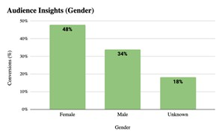
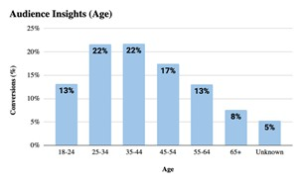
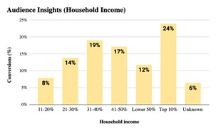

Demographic
Performance by Conversions
Gender: Females have the highest conversions at 48%
Age: 25-34 and 35-44 age groups have the highest conversions at 22%
Household Income: Top 10% of household income has the highest conversion at 24%

Slide 13


Ad Groups
Takeaways
The "Brand" ad group is significantly more efficient at driving conversions than other groups, achieving the highest number of conversions despite having the highest spend.
“Kitchen & Kitchenware” showed strong purchase intent among clickers, presenting an opportunity to boost performance by improving ad engagement and reducing cost per click.
Ad groups show a pattern of high spend but low conversions, indicating inefficient use of budget and an opportunity to improve ROI through better ad targeting and messaging.
13

Slide 14

Keyword
Takeaways
Average CPC consistently remained <$1 across top converting
keywords, highlighting efficiency at lowering ad spend.
Home Depot Savings is the highest-performing keyword across all
relevant metrics (conversions, CPA, conversion value, CVR, etc.).
The 5 keywords with the most conversions account for >71% of all conversions. They are also the most cost-efficient at converting in the entire campaign, according to their CPAs and ROASs.
Home Services has room for improvement — it’s in the top 5 for conversions and CPA, and has the best ROAS, but impressions, clicks, spend, and conversions remain low while CPC and CPA remains high.
62 keywords having 0 clicks and 9 keywords having <1 ROAS, highlighting optimization opportunities.
14

Slide 15

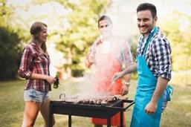
Demographics
Takeaways
Females, individuals aged 25–44, and those in the top 10% of household income brackets have the highest conversion rates. Spring time (March/April) motivates this group to refresh kitchens and gardens, often driven by holiday hosting and seasonal home improvement.
Recommend targeting these demographics in the garden and kitchen ad groups to maximize conversions.
Since seasonality seems to be a huge motivator, we recommend extending these discounts and sales for the upcoming holidays.
15

Slide 16
03
Recommendations
& Next Steps

Slide 17
Recommendations &
Next Steps
Considerations for recommendations & next steps:
Ad Groups: Continue to allocate budget towards “Brand” ad group and consider removing “General” as an ad group to allocate more money towards other better-performing as groups such as “Kitchen & Kitchenware” and “Lawn & Garden”
Keywords:
Pause low performing keywords (all with 0 clicks or <1 ROAS) and test out different keywords that are similar to keywords that are receiving high conversion.
Increase spend for top performing keywords to drive more conversions and ROAS.
Increase bids especially for Garden Center, since summer is coming up, and Home Improvement, since more houses are bought/sold in warmer months*.
Home Services has strong metrics that proves potential. Increase bid and change ad copy to improve impressions, CTR, CPC, and CVR.
Demographics: Continue targeting females, ages 25-44, and top 10% of household incomes.
Search Ad Creative: A/B test recommendations for new search ad headlines/descriptions.
*the National Association of Realtors Fidelis Mortgage, Rocket Mortgage, Bank Rate, Investopedia

Slide 18
04
Q&A

