Slide 1
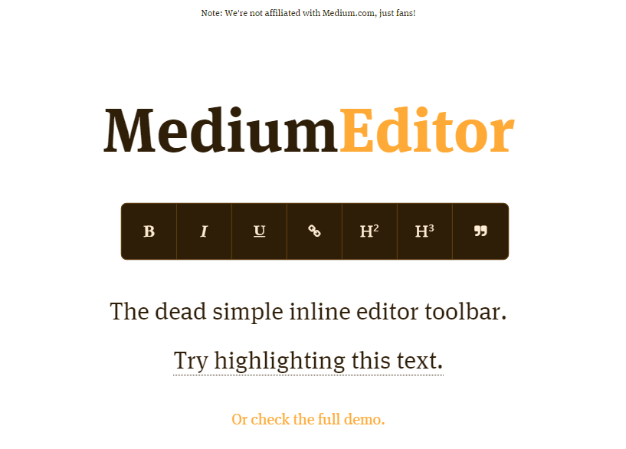
medium-editor the #1 WYSIWYG editor on GitHub

Slide 2
About:
medium-editor is a WYSIWYG editor for the browser.
Used as the core text editor for new sitebuilder (code named 'Tower') being built by Digital team.
WYSIWYG editing in browsers sucks
medium-editor makes it suck a lot less.

Slide 3
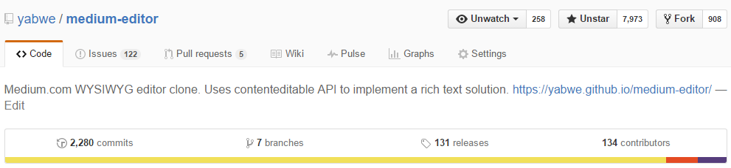
The Numbers:
7,973+ stars
900+ forks
490+ pull requests
258 watchers
134 contributors

Slide 4
The Story
Needed a rich-text editor for new sitebuilder project
Experimented with a few (including quill, scribe, and ArteJS)
Went with medium-editor because of full browser support and very active community
December 2014: Starting finding exisiting issues, fixed bugs, opened a bunch of pull requests
Were maintaining our own fork

Slide 5
Taking Over
01/27/2015: Myself and Noah Chase became collaborators
Now we can do whatever we want including:
Cut releases (not maintaining fork)
Control features and code quality
Get the attention of lots of developers

Slide 6
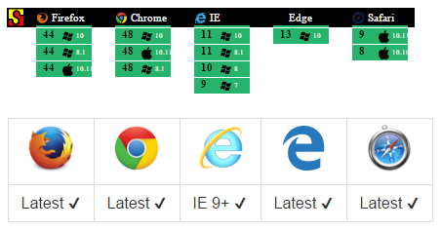
Quality
527 tests (and growing)
Tests run against 13 OS + Browser combinations on each code change (SauceLabs)
94% Code Coverage in our tests

Slide 7
Famous Folks
Peter Higgins, ex-Dojo project lead reaches out to contribute to medium-editor (5th most contributions)
Dave Winer, creator of Scripting News
Used medium-editor for a project, opened issues, and wrote a nice post about his experience
John David-Dalton, creator of lo-dash, maintainer of jsPerf and Benchmark.js
Helped Us support Edge and opened 3 bugs internally for Edge, hoping to be fixed in upcoming Edge releases!
Tim Berners-Lee, creator of World Wide Web, is using medium-editor in his Dokieli project

Slide 8
Lots of Attention
Featured on the front page of ProductHunt (437+ upvotes)
Smashing Magazine (nearly 1M followers) Tweeted about Medium-Editor
Endless Tweets if you search for medium-editor in twitter
Creators of Medium.com asked us to change the name!

Slide 9
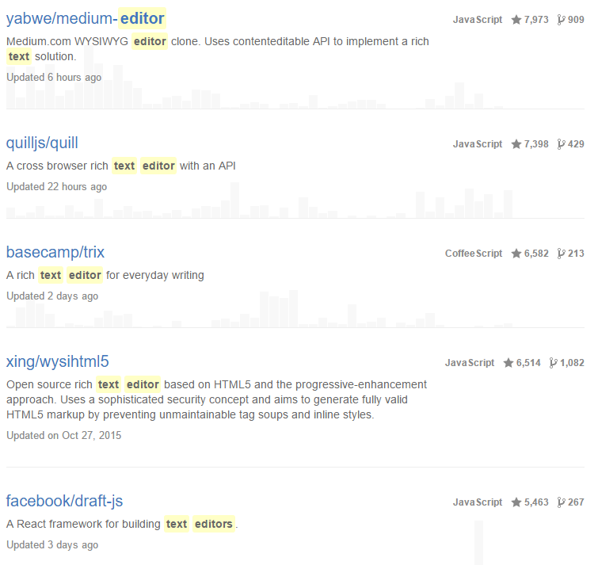
#1 Editor on Github!

Slide 10
We Need Maintainers!
A lot of projects in Vistaprint need WYSIWYG editors, why not the one with a huge active developer community?
Need to keep responding to issues, merging PRs, cutting releases, keep the community alive!
Need to keep evolving the editor (JSON Backed data model?)

Slide 11
Interested?
We have called out Easy First Bugs
Use it in your next project, we can let you be maintainers and cut releases whenever you need.
Demo: https://github.com/yabwe/medium-editor
Repo: https://github.com/yabwe/medium-editor
Contact me (Nate Mielnik) if you have questions or want to get involved nate@webs.com | http://github.com/nmielnik
Notes Posted here

