Slide 1
An LLM-powered Application for Detecting Academic Stress Levels in Vietnamese University Students
A layered screening system: validated instruments, a fine-tuned encoder, and a grounded language model behind a deterministic safety rule
Pre-thesis defence · School of Computer Science and Engineering
International University — VNU-HCM
A screening and self-reflection aid. Not a diagnostic instrument.

Slide 2
THE PROBLEM
Two kinds of tool exist, and each is missing something
Validated questionnaires — DASS-21, PSS-10
• Trusted and psychometrically sound.
– The student receives a number and nothing else: no explanation, no next step.
General-purpose chatbots
• Conversational, and willing to give advice.
– Anchored to no instrument, and they invent advice that has no source.
The gap this project addresses
• Keep the validated instrument as the authority; let the model explain and suggest, grounded in a curated corpus rather than its own parameters.
! In this domain a wrong answer is not a poor user experience. It is potential harm — which is why the architecture is ordered the way the next slide shows.

Slide 3
SCOPE
Five objectives, and where each one actually stands
# | Objective | Status
O1 | Psychometric scoring, exact to the manual | Met
O2 | Fine-tune a Vietnamese encoder, compare against baselines | Partly met
O3 | Retrieval-augmented advice + component ablation | Partly met
O4 | Crisis detection, quantitatively evaluated | Met
O5 | Reproducible evaluation — no number without a script | Met
O2 and O3 are only partly met, and this slide says so before the results do. Slides 12 and 17 give the reasons: a provider quota limit, and an ablation that has not run.

Slide 4
ARCHITECTURE
Deterministic core, generative periphery
Classifier + scoring (pure) → Crisis gate → Persist → Retrieval → Generation
• The ordering is a safety property, not an engineering convenience.
– Everything before the gate is a pure function: it cannot store, send or show anything.
– Nothing is written to disk and no external service is called until the gate has cleared.
– Scoring is arithmetic and always produces a result; the classifier degrades to the lexicon.
– Retrieval and generation are last precisely because they can fail unpredictably.
✓ Read left to right as decreasing reliability AND decreasing authority. The gate is the only component that can pre-empt everything after it — and it costs 0.05 ms.
If generation fails the system returns its deterministic results and says why. It does not return an error, and it does not guess.
The figure on the next slide draws this order exactly as the code executes it.

Slide 5
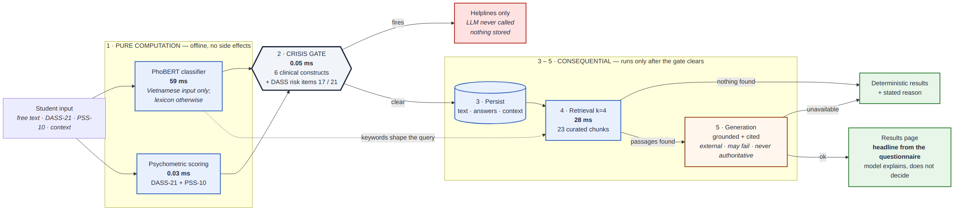
ARCHITECTURE · FIGURE
System architecture
Left of the gate: pure functions that cannot store, send or show anything. Right of the gate: persistence, retrieval and generation — none of which run until the gate has cleared. Generation is the only external, non-authoritative stage.

Slide 6
DATA
Ground truth: a conservative composite of two validated instruments
• 466 records · frozen split 326 / 70 / 70 · seed 42
How the four-class label is defined
• The more severe of the DASS-21 stress subscale band and the PSS-10 category, mapped onto Low / Moderate / High / Severe.
– Chosen for screening asymmetry: a false alarm costs a student a helpline they did not need; a miss costs a student support they did.
• Both source instruments are published and validated — DASS-21 (Lovibond & Lovibond, 1995) and PSS-10 (Cohen et al., 1983), deployed as the original English items.
! Stated limitation: the composite itself has not been separately validated as a psychometric scale. It is an operational outcome measure defined for this study, and §5.4 treats it as a construct-validity threat.
The split is frozen and reused everywhere, because the classifier was fine-tuned on its training portion — redrawing it would leak training data into the test set.
Test distribution — Low 16 · Moderate 23 · High 22 · Severe 9 (Figure 4.2: label distribution)

Slide 7
MODEL
The classifier: PhoBERT, fine-tuned and fully offline
• PhoBERT-base · AdamW, lr 2e-5, 4 epochs, best-epoch selection
✓ Validation macro-F1 0.8403 at epoch 2, then a complete plateau — epochs 3 and 4 add nothing, so epoch 2 is what ships.
✓ Held-out test: accuracy 0.800 / macro-F1 0.8013 on the three-class task.
Two honest notes
• It is a three-class model. In the unified four-class comparison its F1 on Severe is zero BY CONSTRUCTION, not by failure.
• It runs entirely offline — no network, no third party. That matters for an application handling private writing about mental health.
Figure 4.3: training and validation curves

Slide 8
SAFETY
The safety rule: what it used to do, and what it does now
Held-out set (60 bilingual items) | Before | After
Precision | 0.600 | 1.000
Recall | 0.200 | 0.867
F1 | 0.300 | 0.929
Explicit ideation | 6 / 12 | 12 / 12
Indirect ideation | 0 / 14 | 11 / 14
False positives (20 lethal-sounding idioms) | 4 | 0
The old rule matched fixed phrases. On phrasing it had never seen it scored recall 0.200 — not the 0.500 previously published, which came partly from the test set sharing wording with the lexicon.

Slide 9
METHOD
Fixing it honestly was harder than fixing it
✗ The twelve failures were already published. Adding them to the phrase list would have meant tuning against the test set.
The order is what makes the number mean something
• 1. Wrote a NEW 60-item bilingual set and froze it, SHA-256 recorded, before the new rule existed.
• 2. Rebuilt the rule around six constructs from suicide-risk assessment, written from that taxonomy rather than from failing items.
• 3. Measured once. The first measurement is the one reported.
• 4. Demoted the two older sets to DEVELOPMENT sets.
✓ Re-measuring the held-out set afterwards gave IDENTICAL numbers — the development work had no detectable effect on it.
! Limitation: the patterns and the held-out set share a single author. Independent annotation would strengthen the result.
Vietnamese perfect score (1.000/1.000) is a DEVELOPMENT number and is deliberately not the headline.

Slide 10
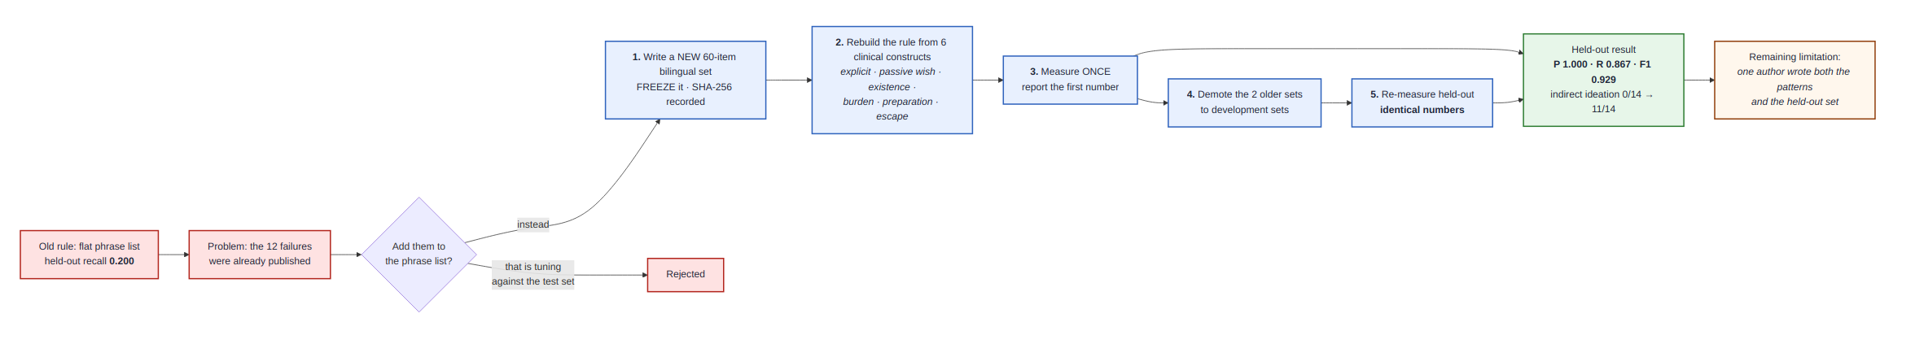
SAFETY · FIGURE
How the safety rule was rebuilt — the order, made visible
Held-out set written and frozen (SHA-256 recorded) before the new rule existed; patterns derived from six clinical constructs, not from failing items; measured once; the older sets demoted to development sets. Re-measuring afterwards gave identical numbers.

Slide 11
RAG
What stops the model inventing mental-health advice
Three mechanisms, in increasing order of strength
• The prompt rule is absolute: the model may rephrase the retrieved material, but may not add advice, techniques, services or phone numbers that are not in it — even if it believes them true.
• Every suggestion cites the chunk it came from, by id. The service checks those citations against what was actually retrieved and DISCARDS any the model invented.
✓ If retrieval returns nothing, the generator is not called at all. The system says advice is unavailable rather than filling the gap from its own parameters.
That last one is the difference between a grounded system and a system that merely prefers to be grounded.
Corpus: 23 curated chunks, multilingual embeddings, k = 4.

Slide 12
RESULTS
Main results — one frozen split, unified four-class label
System | Accuracy | Macro-F1
Majority class (floor) | 0.3286 | 0.1237
TF-IDF + Logistic Regression | 0.6857 | 0.6816
TF-IDF + SVM | 0.6571 | 0.6524
PhoBERT, fine-tuned | 0.6571 | 0.5329
LLM zero-shot | 0.5286 | 0.5238
Proposed (full pipeline) | — | not run
n = 70 · single seed · synthetic data · openai/gpt-oss-120b via Groq. The classical baseline wins, and slide 16 explains why that is a statement about the DATA rather than about transformers.

Slide 13
RAG EVALUATION
The measurement that changed the system
Query construction | MRR | Recall@1
Matched lexicon keywords only (original) | 0.509 | 0.344
The student's own sentence | 0.778 | 0.656
Sentence + keywords (current) | 0.839 | 0.719
57 hand-labelled queries · overall MRR 0.787, Recall@5 0.903. The original code threw the student's sentence away and searched on matched keywords; appending the questionnaire label hurt every variant tested. The shape was chosen by running six candidates through the harness, not by intuition.

Slide 14
PERFORMANCE
Latency: the safety check is effectively free
• DASS-21 + PSS-10 scoring 0.03 ms (p50)
• Crisis rule 0.05 ms
• Lexicon keyword match 0.07 ms
• RAG retrieval, k = 4 28.0 ms
• PhoBERT inference 59.3 ms
✓ The entire deterministic pipeline costs under 90 ms at the median.
✓ Running the safety gate before any side effect — before persistence and before the external call — costs 0.05 ms. There is no performance argument against that ordering.
Cold start is ≈ 21 s for both models, paid once per process, which is why the API loads them lazily rather than in the startup hook. Generation latency and token cost are not measured: each sample is a billable request.
Thirty runs per stage, CPU only. Figure 4.9: per-stage latency, p50 to p95.

Slide 15
REPRODUCIBILITY
Why these numbers can be trusted
✓ 337 tests, all passing · 94 % coverage on the application code (70 % once the offline evaluation scripts are included) · CI runs lint and the full suite.
✓ Frozen split · seeded generation · model responses cached by input hash, so a repeated evaluation makes zero API calls and returns identical results.
What matters for a research artefact
• No number in the report exists without a script that produced it.
• Where nothing was measured, the tooling writes an explicit "NOT RUN" marker rather than letting a gap look like a zero.
That discipline paying for itself, twice
• Failed model responses used to be counted and discarded; they are now kept and classified. The next run recorded 32 failures — 31 rate-limit refusals and ONE malformed JSON. The report's earlier "seven invalid JSON" claim was never evidence-based and has been corrected.
• All five flagged references were checked against publisher and ACL Anthology records; eight now carry a DOI. Two were wrong and are corrected — the third author of [4], the author list of [12].

Slide 16
LIMITATIONS
The limitation that matters most
• All text is generated from 41 Vietnamese sentence templates.
✓ The standard leakage control passes perfectly: 466 distinct texts, ZERO duplicates across splits.
✗ That control is the wrong instrument here. Nearest-neighbour similarity of each test item to its closest training item: median 0.799, and 34 of 70 test items exceed 0.80 — under three different similarity measures.
So the model is not being asked to detect stress
• It is being asked to recognise templates it has already seen in a slightly different arrangement. Every text-classification figure in this project is a pipeline demonstration, not evidence of stress-detection ability.
It is also the honest explanation for why TF-IDF wins on slide 12: a bag of n-grams is exceptionally good at recognising recurring surface forms.
Reproduce with: python scripts/check_leakage.py — it prints the closest train/test pairs verbatim so the measure can be judged rather than trusted.

Slide 17
CONCLUSION
Contributions, and what comes next
What this work contributes
✓ A layered screening system in which the deterministic, trustworthy components run first and can pre-empt the generative ones.
✓ Crisis-detection evaluation sets in both languages, measured without tuning against them, with every error published verbatim.
✓ A demonstration that exact-duplicate checking is inadequate for template-generated corpora, with the measurement to prove it.
✓ A harness in which a missing measurement LOOKS missing.
What it does not yet have
✗ Real participants — zero. The ablation, blocked on provider quota rather than on code. Faithfulness judging. Confidence intervals.
That gap is the difference between demonstrating a pipeline and demonstrating stress detection. It is where the thesis goes next.
Thank you — questions welcome.

Slide 18
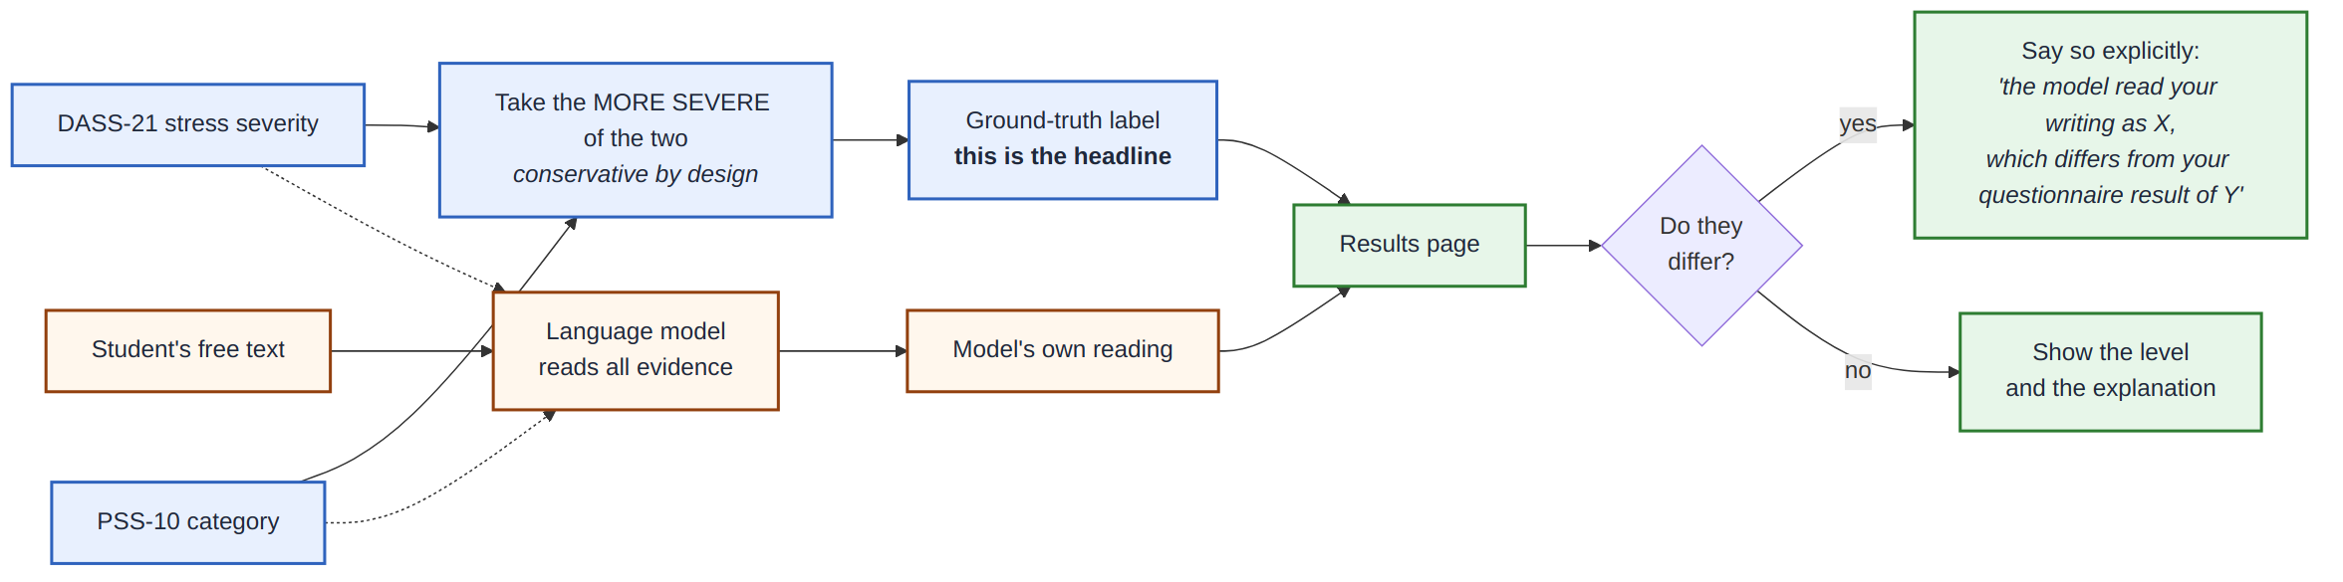
FUSION · FIGURE
Where the headline label comes from
The validated instrument owns the headline: the more severe of the DASS-21 stress band and the PSS-10 category. The model reads the same evidence and gives its own reading; where the two differ, the student is told so explicitly rather than the difference being hidden.
BACKUP — for Q&A, not part of the timed talk

Slide 19
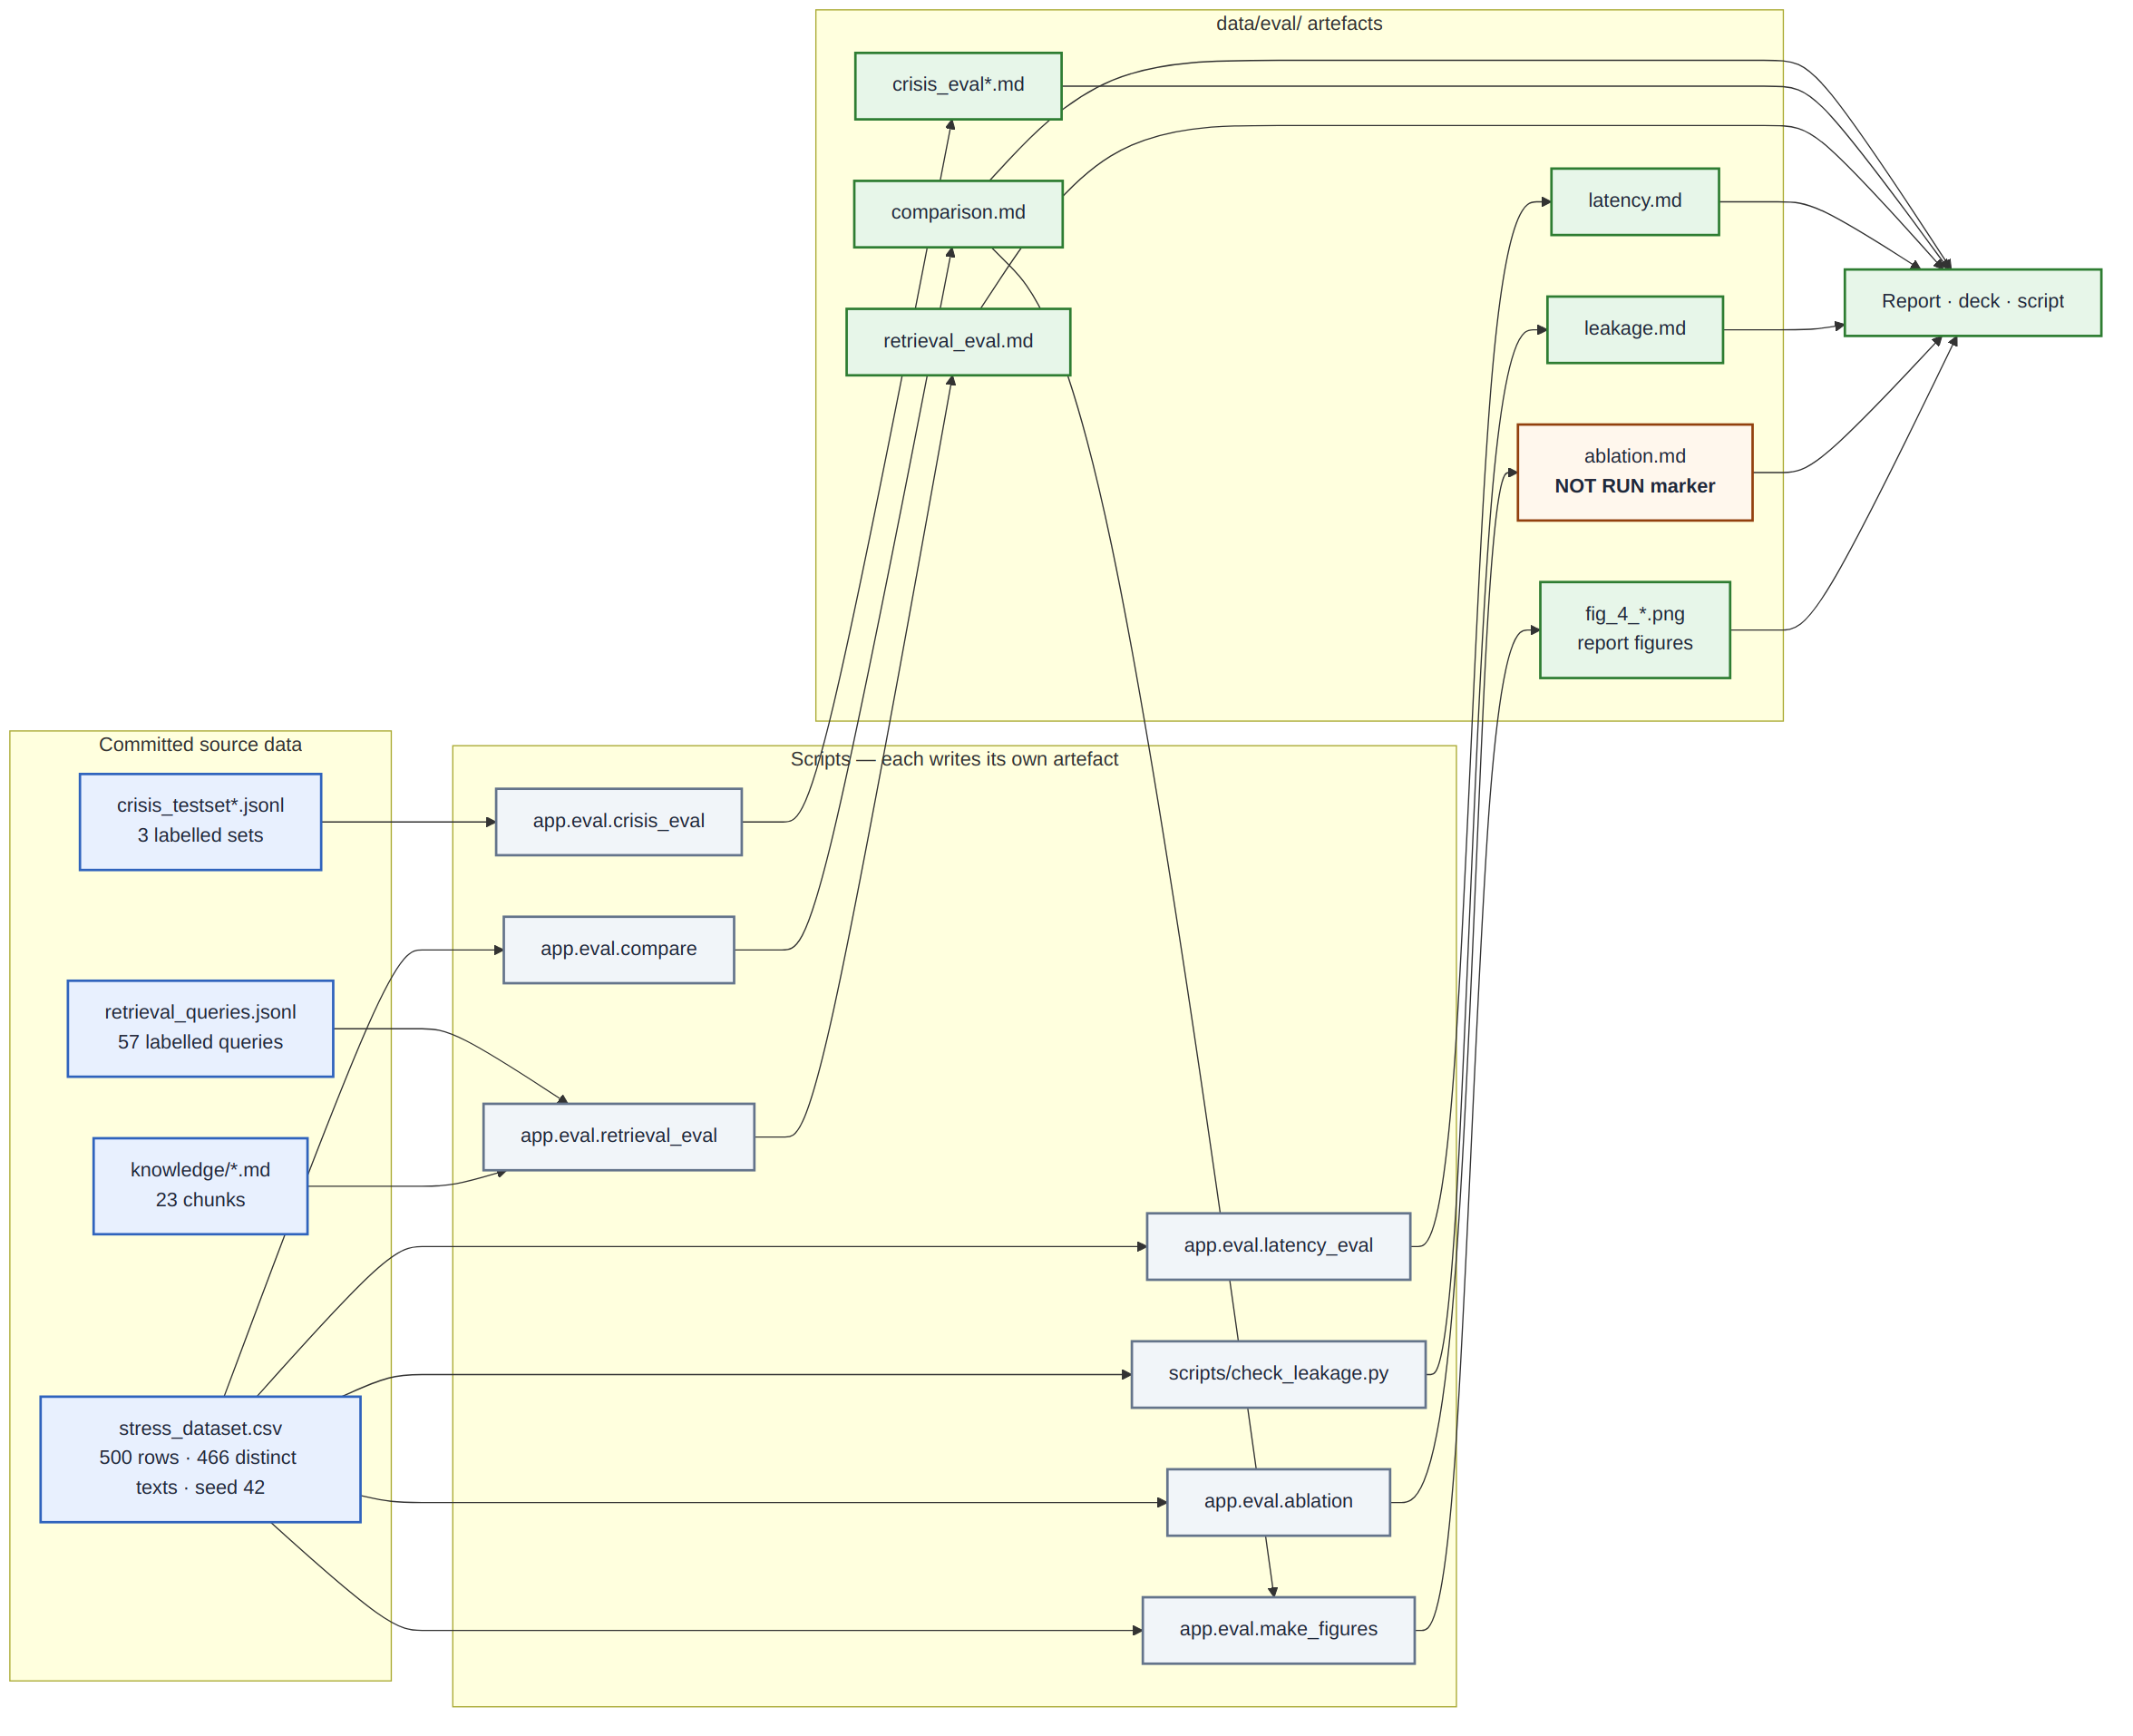
REPRODUCIBILITY · FIGURE
Evidence provenance
Every number on a slide traces to a committed source file, the script that consumed it, and the artefact it wrote. Where a measurement has not been made, the artefact is an explicit NOT RUN marker rather than an empty cell that could be mistaken for a zero.
BACKUP — for Q&A, not part of the timed talk

