Slide 1
Rotations and Gimbal Lock
Literature Review

Slide 2
“Why are quaternions not used in Maya?”
Notes:
Why are quaternions not used in Maya?
It all started as a curiosity while I was learning the basics of rigging in maya and I asked to question to Prof.

Slide 3
Rude Awakening: They are!

Slide 4
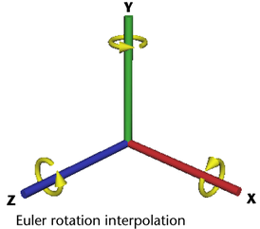
Quaternions in Maya
In Maya, there are two methods of rotation interpolation: Euler and Quaternion
Euler rotations are calculated using three separate angles representing rotations about the X, Y, and Z axes, and an order of rotation.
Notes:
Euler angles
Euler rotations are calculated using three separate angles representing rotations about the X, Y, and Z axes, and an order of rotation.
When Euler angles are used to interpolate the animated rotations of an object, the object’s orientation about its individual axes is evaluated one axis at a time.
This is why Euler-angled rotation is prone to artifacts such as gimbal lock and flipping.
Gimbal lock occurs when rotations about a single axis cause unwanted rotations about complementary axes or when axes become coincident. Flipping occurs when angles unexpectedly wrap around positive or negative 180 degrees during Euler-angled rotation interpolation between keyframes.

Slide 5
Quaternions in Maya
Quaternions provide smooth interpolation of animated rotations.
Quaternions store the overall orientation of an object rather than a series of individual rotations.
Quaternions store only orientation values.
Notes:
Quaternions provide smooth interpolation of animated rotations and always produce the most efficient path between keyframes in comparison to Euler angles.
Quaternions store the overall orientation of an object rather than a series of individual rotations.
This means that a single Quaternion stores the same amount of rotation data as three Euler angles.
Since Quaternions store only orientation values, they can be used to calculate the shortest rotation from one orientation to another.

Slide 6
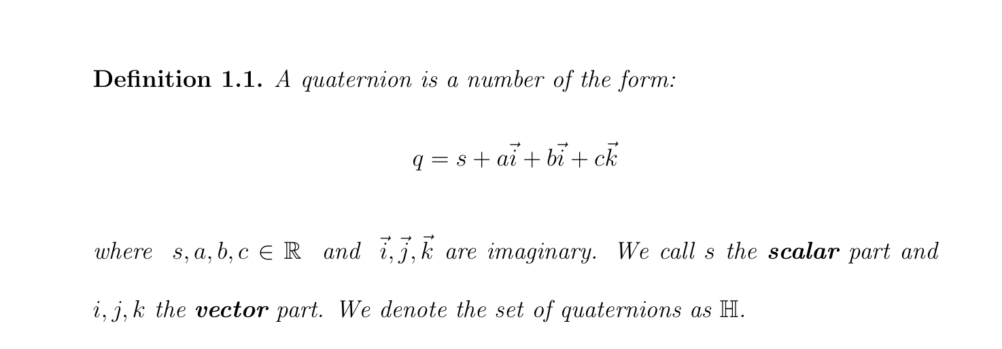
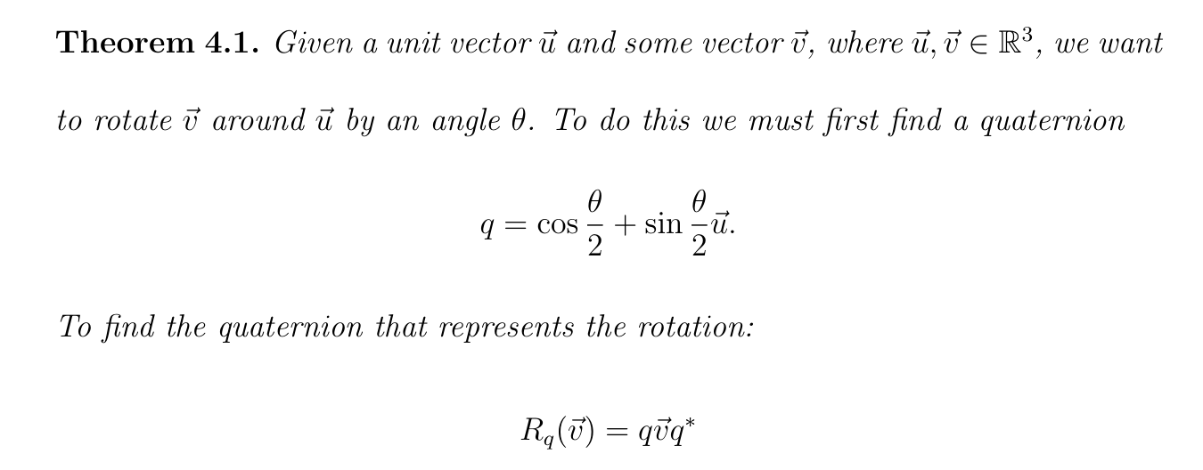
Notes:
Yup! For the enthusiasts!

Slide 7
Why should I use Quaternions?
Notes:
We use Quaternions when we want smooth interpolation between two keys. Quaternions produce the most efficient paths of interpolation and they do not generate artifacts such as gimbal lock and flipping.

Slide 8
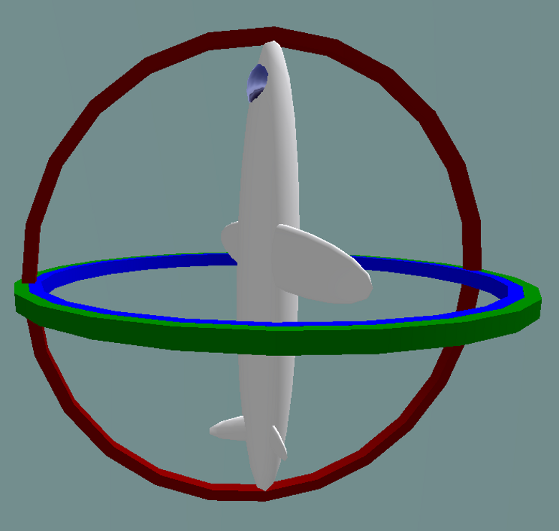
What is a Gimbal Lock?
Notes:
When looking at something in three-dimensions there are three axes each of which we are free to move around without necessarily affecting the others.
Each axis is a degree, and being able to move around the axis means that it has a degree of freedom. Essentially this means that each axis is an independent parameter, so a 3D object can have up to three degrees of freedom. Gimbal lock happens in very specific cases when the angles of rotation on each axis causes two of them to become parallel and lock.
Once this happens we cannot unlock the axes and one degree of freedom is lost, so instead of having three degrees of freedom we only have two.

Slide 9
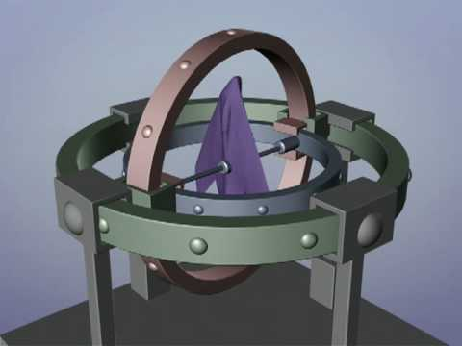
Gimbal Lock in Maya

Slide 10
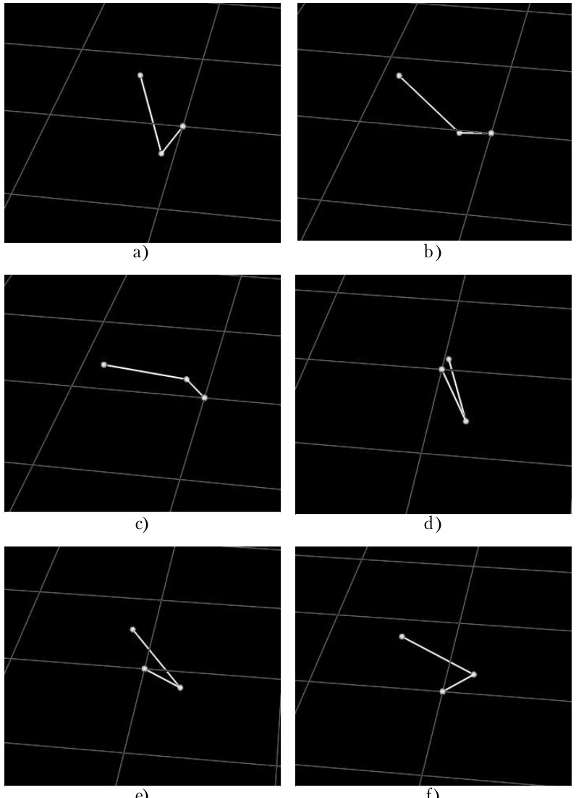
Why quaternions better?
[Skublewska-Paszkowska] Comparison of Arm Animation (2013)
The main aim of the research was to check what rotation interpolation method used in animating an arm resulted in an efficient rotation, economically.
This article presents two computer animations representing various arm moves. The animation with Euler angles uses linear interpolation while with quaternions spherical linear interpolation (slerp).
The animation using quaternion interpolation is smooth, natural and not disturbed.
Although using quaternions is a more complex method, it is more effective and reliable. It provides smooth and natural arm movements in comparison to using Euler angles.
Notes:
No video reference found sadly.

Slide 11
Why quaternions better?
[Ariel] Visualising Orientation using Quaternions (2012)
The advantages of quaternions visually demonstrated by showing them “in action” in examples of real-time key frame animations.
Key takeaways:
Interpolation is difficult to achieve when rotation matrices are used for representing orientations.
Since rotation matrices can represent transformations other than rotations (like shear), special conditions must be enforced to ensure that these matrices only represent orientation (like orthogonality conditions, and a determinant of +1).
Quaternion multiplication or “division” is computationally inexpensive and allows for fast and smooth interpolation of orientations.

Slide 12
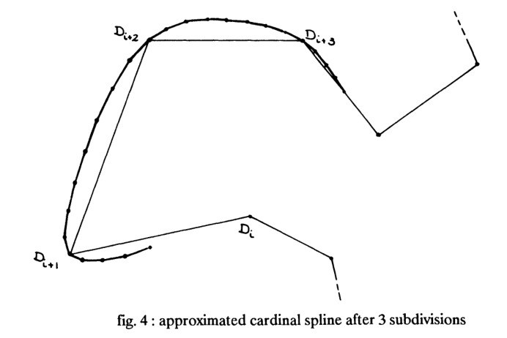
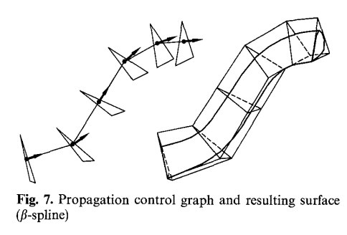
How are problems solved using quaternions?
[D. Pletincks] The Use of Quaternions for Animation, Modelling and Rendering (1988)
[D.Pletincks] Quaternion calculus as a basic tool in computer graphics (1989)
The paper describes a new method for splining quaternions so that they can be used with keyframe animation.
Starts by listing the advantages of Quaternions over Euler angles and reviewing basics of Interpolation and Spline subdivision.
They use a different approach to create splines known as the Cardinal splines.
Cardinal splines pass through the control points, they don't need additional control points which are not associated with keyframes. Therefore they are most suited for interpolating quaternions in a keyframe animation system.
The papers also discuss the advantages of using quaternions in rendering and modelling.

Slide 13
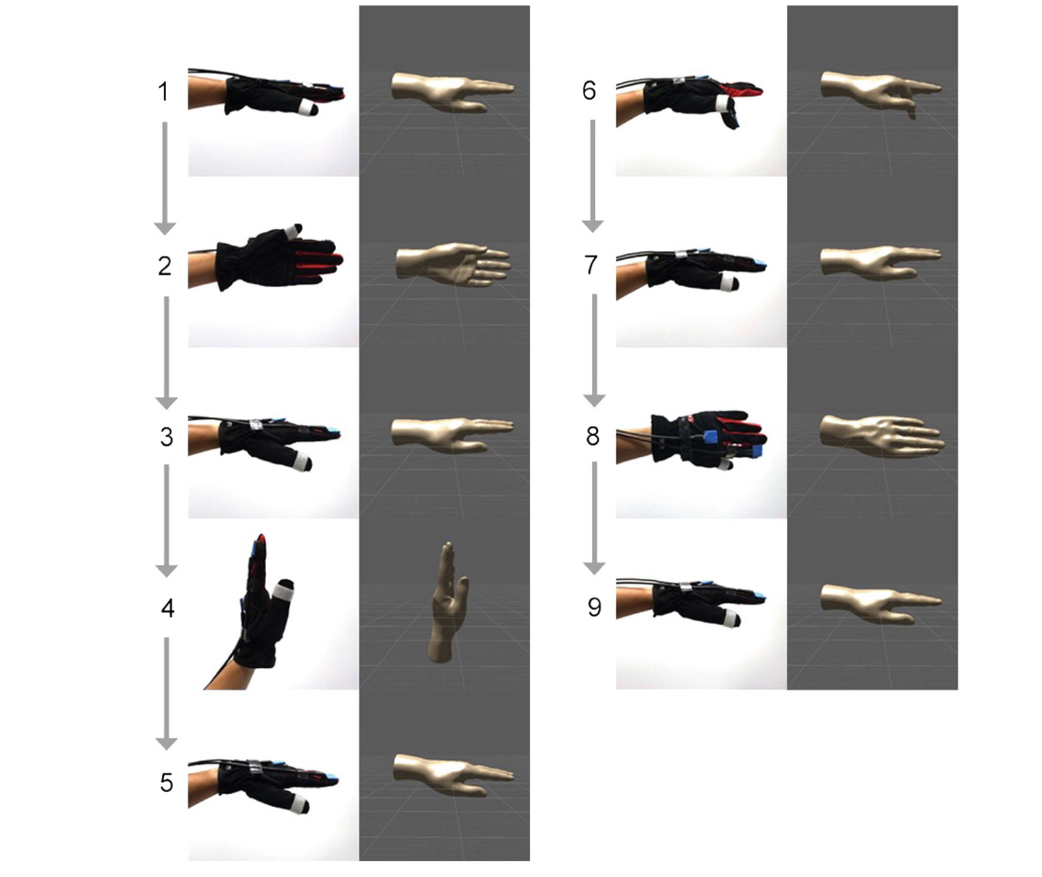
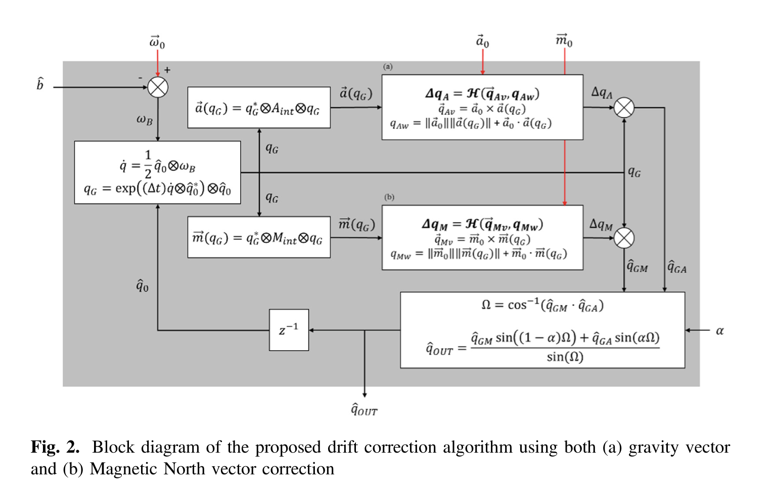
How are problems solved using quaternions?
[O-Larnnithipong] Orientation Correction for a 3D Hand Motion Tracking Interface Using Inertial Measurement Units (2018)
Orientation correction algorithm for a miniature commercial-grade Inertial Measurement Unit to improve orientation tracking of human hand motion and also to improve 3D User Interfaces experience to become more realistic.
This paper outlines the use of this algorithm to improve orientation tracking of human hand motion by using the combination of gyroscope, accelerometer and magnetometer measurements.
The algorithm consists of three parts, which are:
(1) bias offset estimation,
(2) quaternion correction using gravity vector and magnetic North vector
(3) quaternion interpolation
This could lead to 3D user interfaces to become more realistic

Slide 14
Other alternatives solving gimbal and other rotation problems?
[Jieyun] Application Research of Clifford Geometric Algebra in Keyframe Skeletal Animation (2011)
This paper presents an idea of the establishment of skeletal animation based on Clifford algebra.
Clifford algebra can provide a homogeneous representation to calculate the relationships among geometric objects in a space which is coordinate-free, and easily extended to the higher dimensional space.
Through experiments, the authors use Clifford algebra to establish the skeletal animation instead of the original Euler angles, so as to solve the issue of uneven rotation.

Slide 15
Some more… in other industries
Aerospace - [Mansur] Deploying Complementary filter to avert gimbal lock in drones using Quaternion angles (2020)
Chemistry - [Skone] Doing a Good Turn The Use of Quaternions for Rotation in Molecular Docking (2013)
Notes:
[Mansur] This paper presents the implementation of complementary filter using quaternion angles to mitigate the gimbal lock occurrence in drones.
[Skone] The relative superiority of the quaternion method when applied to molecular docking is demonstrated by practical experiment, as is the crucial importance of proper adjustment calculations in search methods.

Slide 16
Questions?
Even I have them a lot!

Slide 17
Thank you for your time!

