Slide 1
Getting Sassy with Sass

Slide 2
Learning Goals
Understand what Sass stands for and its purpose
Identify and use attributes for appropriate elements
Understand how to set up the correct file structure and Sass compiler

Slide 3
What is Sass?
Sass, or “Syntactically Awesome StyleSheets”, is a language extension of CSS that adds power and elegance to the basic language. Another syntax that you may see is SCSS, or “Sassy CSS”.

Slide 4
Why use Sass?
Sass lets you use features that do not exist in CSS, like variables, nested rules, mixins, loops, and other neat stuff!
Not to mention it reduces repetition of CSS and therefore saves time.

Slide 5
How does it work?
A browser doesn’t understand Sass code. Therefore, you will need a Sass compiler to convert Sass code into standard CSS.
This process is called transpiling. Which just means taking a source code written in one language and translating it into another.

Slide 6
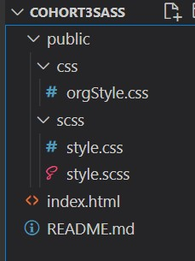
File Structure

Slide 7
What again is Sass?
Lets come back to the “how it works” for a moment and take a look at a few things we can do using Sass.

Slide 8
Variables in Sass
I mentioned earlier that we can use variables in Sass. These begin with a $, followed by a name, and are set like css properties.
Now that our variable has been declared , we can now use it over and over whenever you want.

Slide 9
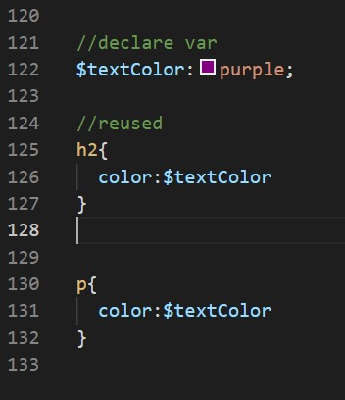
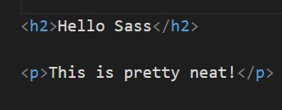
Variables in Sass

Slide 10

Variables in Sass

Slide 11
How about nesting
Sass lets you nest CSS selectors in the same way as HTML. Lets check out what we could do with a nav bar in Sass.

Slide 12
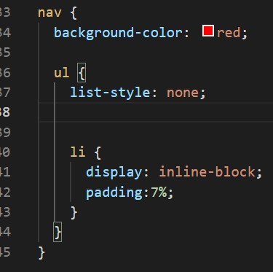
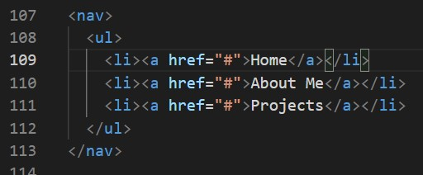
nesting

Slide 13

nesting

Slide 14
What is a mixin?
Another feature that you will find using Sass is called a mixin. One way to look at this is that is that mixins are like functions in css, or in this case Sass. Instead of using the word “function”, you would use @mixin, give it a name and (optionally arguments), followed by { }, that contains the contents. Mixins allow you to define styles that can be reused throughout the stylesheet. Lets take a look.

Slide 15

mixins

Slide 16
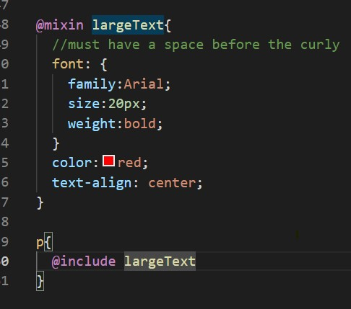
mixins

Slide 17

Expected output

Slide 18
Mixin with args
As mentioned, we can include arguments within our mixins. When defining a mixin, the arguments are written as variable names, separated by a comma. Then when including the mixin, the values can be passes in the same manner. Sounds busy, but hang with me.

Slide 19
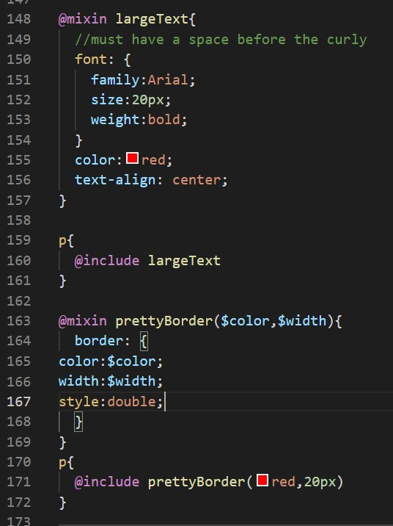

Slide 20

Expected output

Slide 21
Loops??
Did you ever think you could create loops in CSS? Well, of course you can! (using Sass that is). We will take a look at @for. This directive uses a starting and ending value to loop a certain number of times. We have special syntax needed...lets take a look at it.

Slide 22
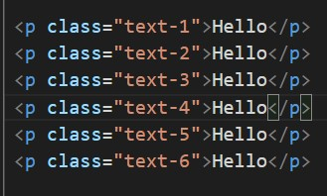
Loops??

Slide 23
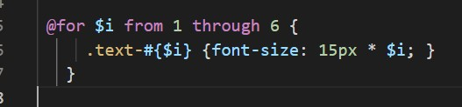
Loops??

Slide 24
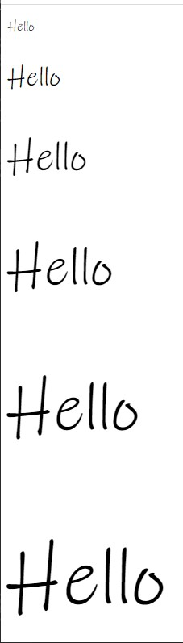

Slide 25
Activity time!
Create a new folder named SassPractice
Include public,assets,css,scss,js,index.html,and a README for good practice
Lets create some text using Sass and make it change sizes. Make 5 p tags with the class of “text-1”-”text-5” and in our SCSS, lets write some code to change the font sizes!!

