Slide 1


Slide 2
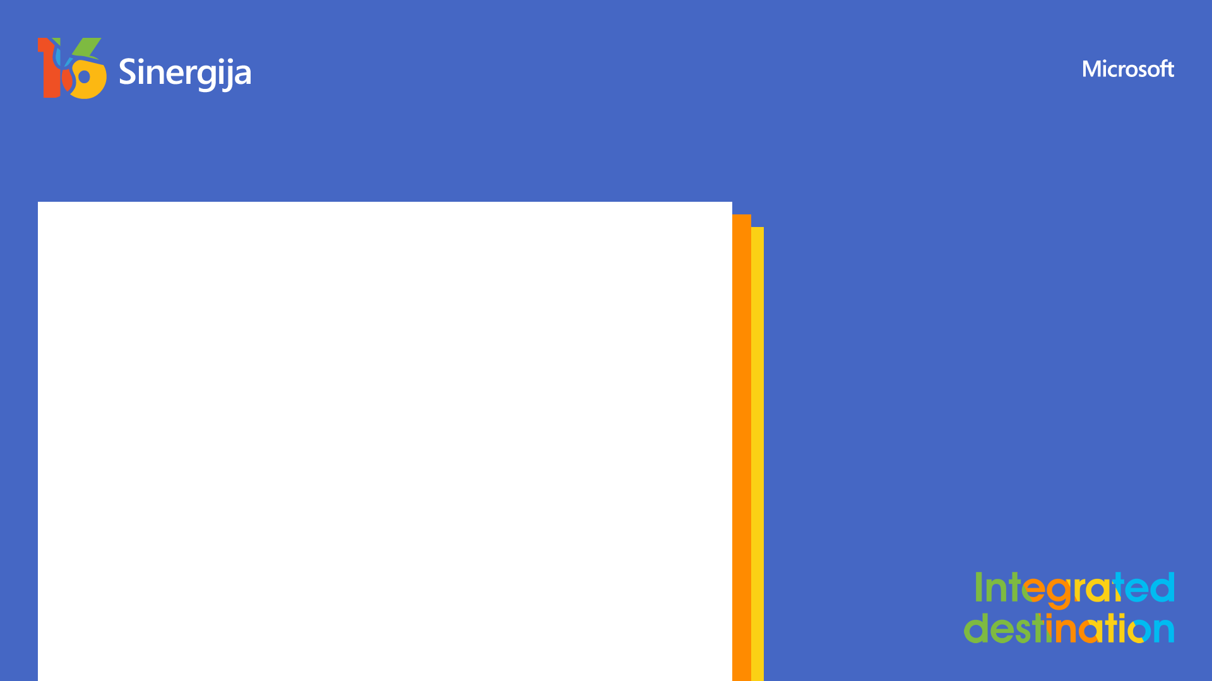
Top 10 open-source .NET libraries you have to try
Nemanja Milošević

Slide 3



Hi! I‘m Nemanja!
Teaching assistant & PhD Student – Computer Science
Faculty of Sciences, University of Novi Sad
.NET Developer
Alfasoft, Ruma
Ambassador & dotnet SIG member
Fedora Project

Slide 4
Agenda for today
Why FOSS?
What are these licenses and why should I care?
Top 10 .NET open-source libraries/projects/tools
Finding great projects is easy!

Slide 5

Why FOSS (Free Open Source Software)?

Slide 6
Why FOSS?
Ability to modify, distribute, inspect software
Open standards
Audited code is more secure
Free as in beer & Free as in freedom
Works for enterprises
Everyone can contribute! up-for-grabs.net

Slide 7
Licenses?

Slide 8
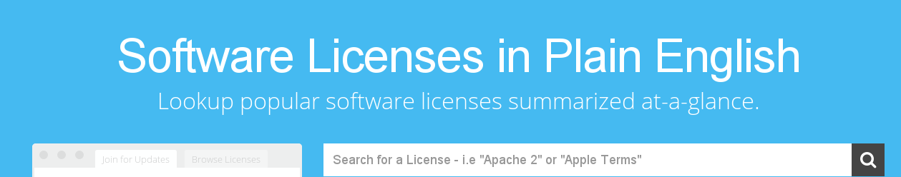
Next, next, next, I accept, Install
Check your NuGet prompt! Licenses are important!
Few enforce opening your code which isn‘t always possible
Human readable! Written by developers, not lawyers
tl;dr legal

Slide 9
Top 10 open-source .NET libraries you have to try

Slide 10
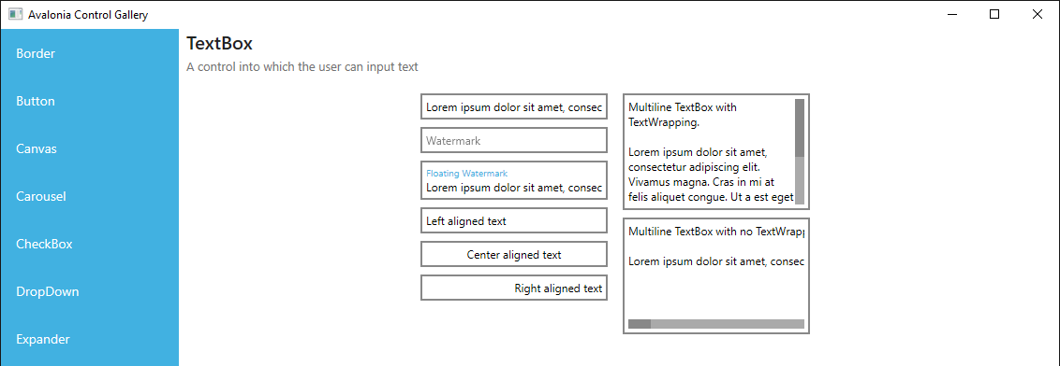
AvaloniaUI (MIT)

Slide 11
AvaloniaUI (cont‘d)
Cross-platform UI kit which runs Windows, UWP, Linux, macOS, iOS and Android
Uses XAML, has Data Binding, Data Templates, Resource Management...
Easy to make MVVM applications
Friendly APIs, similar to WPF

Slide 12

MVVMLight (MIT)
One of the most popular MVVM libraries
Even has a simple IoC container built in
And NavigationService!
Very easy to use
Great documentation
PCL means it works almost everywhere

Slide 13

Fody (MIT)
Code weaving utility
More than 50 extensions
You can develop extensions very easily
...
Wait. What is code weaving?

Slide 14
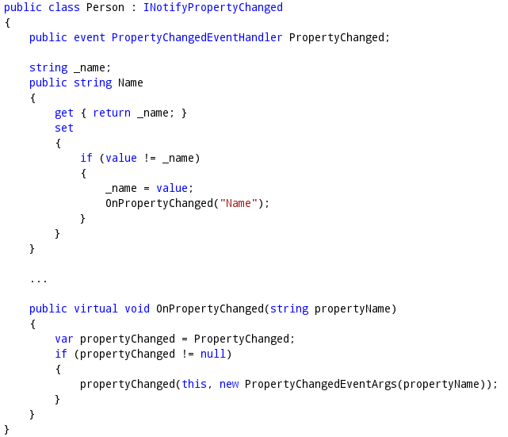
Fody.PropertyChanged example
Don‘t we all love INotifyPropertyChanged? :)

Slide 15
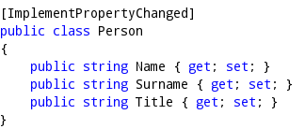
Fody.PropertyChanged example

Slide 16
Fody (cont‘d)
Some other extensions:
  Fody.Caseless – make all string comparisons case insensitive
  Fody.CryptStr – encrypt all string literals to protect against decompilation/reflection
  Fody.ToString – beautiful automatic ToString methods
  ...

Slide 17
LiteDB (MIT)
Awesome small one-file document based NoSQL database
Everything is really stored in one file
Support for complex relationships and mappings
Has its own shell!
Fast
Simple to use
Great for small applications
SQLite replacement

Slide 18
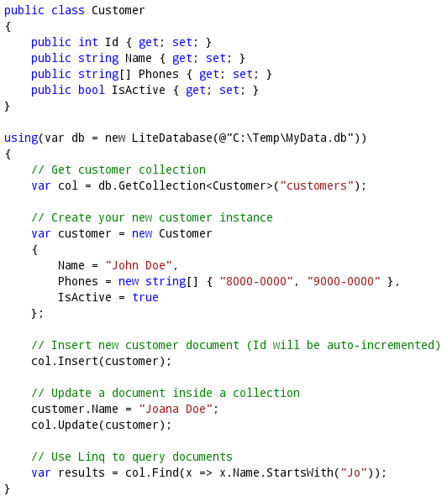
LiteDB example

Slide 19

TopShelf (Apache 2.0)
Building and testing Windows services is hard
Make a Console app and convert it to a service
Works on Linux too!
Very easy to use
Great documentation

Slide 20
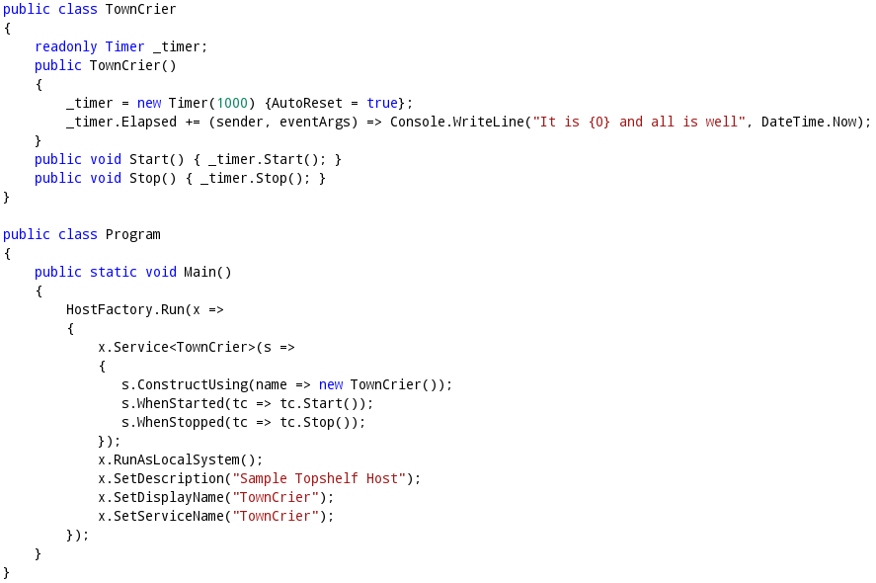
TopShelf example

Slide 21
Humanizer (MIT)
All you need for humanizing or dehumanizing strings, enums, dates...
Very easy to use API

Slide 22
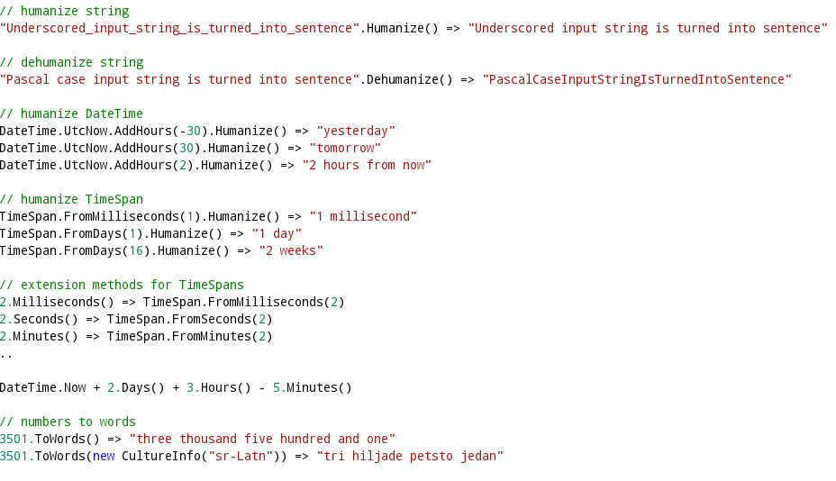
Humanizer examples

Slide 23
RazorEngine (Apache 2.0)
Use Razor templating engine for regular strings
Absolutely same syntax
Works not just for Web apps but for everything else
Simple to use

Slide 24
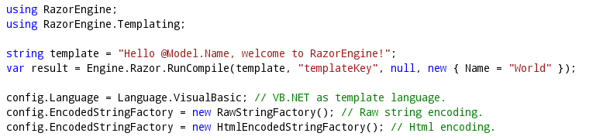
RazorEngine example

Slide 25
FluentScheduler (BSD3)
Scheduler with beautiful fluent API
Very powerful
Works for .NET Core!

Slide 26
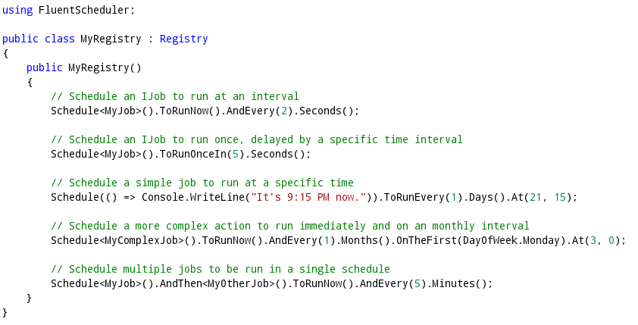
FluentScheduler example

Slide 27
NetMQ (LGPLv3)
A 100% native C# implementation of ZeroMQ for .NET
Popular messaging library
Fast!
Very simple to integrate and use
Hides complicated stuff from developers

Slide 28
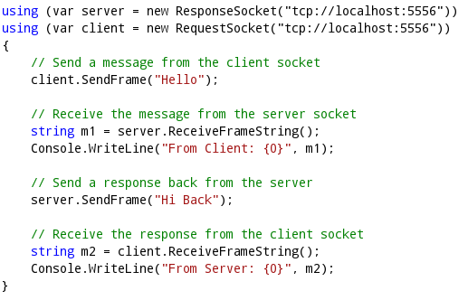
NetMQ example

Slide 29
OpenShift Origin (Apache 2.0)
PaaS - Platform as a Service which supports .NET Core
Runs on your servers
Extremely easy to get started
Continuous deployment, slots, reports, source control...
Pre-built cartridges for storage and infrastructure
Built by RedHat with Docker and Kubernates
Host your own cloud with .NET Core!

Slide 30
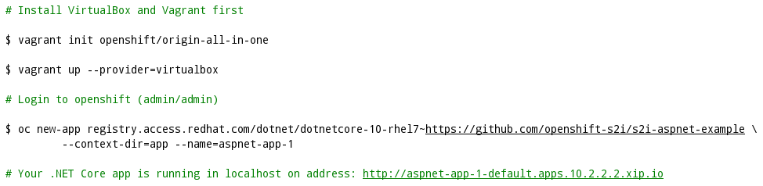
OpenShift Origin ASP.NET Core setup

Slide 31
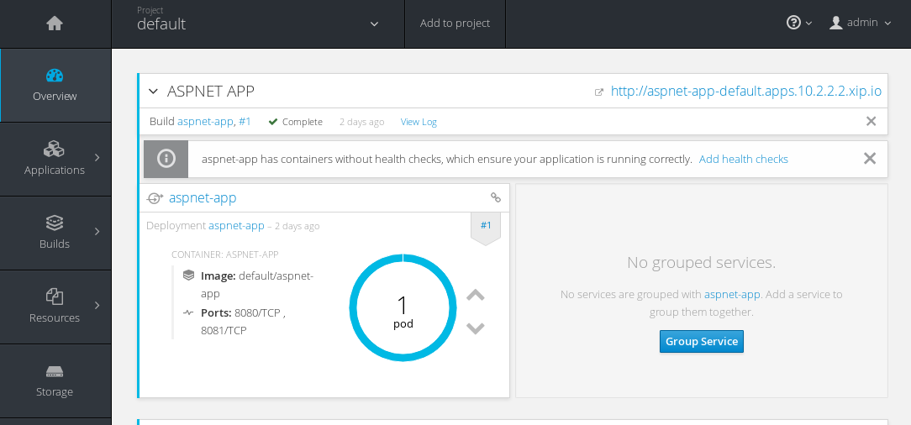
OpenShift Origin Web Console

Slide 32
There is more...

Slide 33
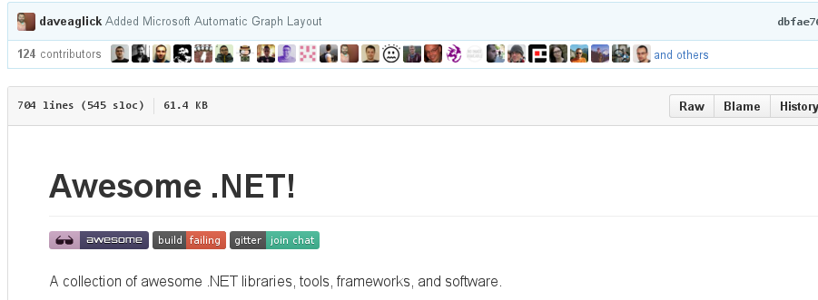
Awesome .NET

Slide 34
Awesome .NET (cont‘d)
github.com/quozd/awesome-dotnet
GitHub page with awesome .NET libraries and projects
Almost everything is FOSS, and available on NuGet
Not just for Plain-Old-.NET! awesome-xamarin, awesome-windows

Slide 35
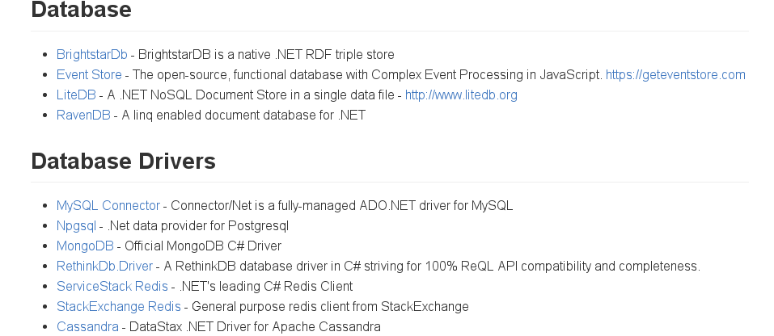

Slide 36
Other sources
nugetmusthaves.com
Blogs:
  hanselman.com
  alvinashcraft.com (Morning dew)
  blog.cwa.me.uk (Morning brew)
  ... tons of others

Slide 37
Contact me!
@nmilosev
nmilosev@live.com
nmilosev@fedoraproject.org
nmilosev@alfasoft.rs
nmilosev@dmi.uns.ac.rs
nmilosev.svbtle.com

Slide 38

Questions?

