Slide 3
.NET Development Toolchain on Linux
Nemanja Milošević
nmilosev@live.com

Slide 4
Hello!
Nemanja Milošević
  MSc Student – Software Engineering
    Faculty of Science, Novi Sad
  Full stack .NET Developer
    Alfasoft, Ruma
  Ambassador & Contributor
    Fedora Project

Slide 5
Agenda
Overview of available tools for .NET developers on Linux
  Supported text editors
  OmniSharp
  Full IDEs
  Other Tools
Open-source in your projects
  Free Open Source Software principles
  Libraries
Demos

Slide 6
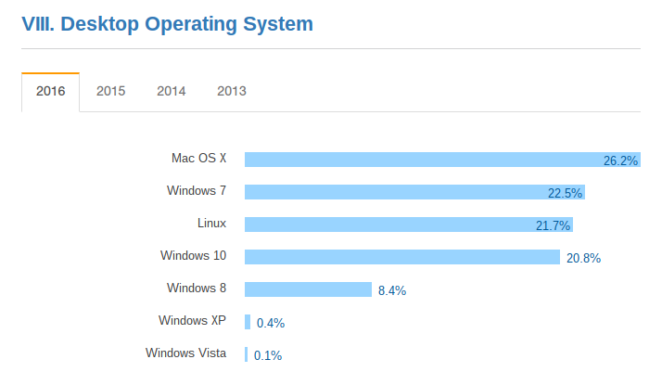
* Source: Stack Overflow Developer Survey 2016

Slide 7
The tools
Basic text editors
“Intelligent” text editors
IDEs
Other tools

Slide 8
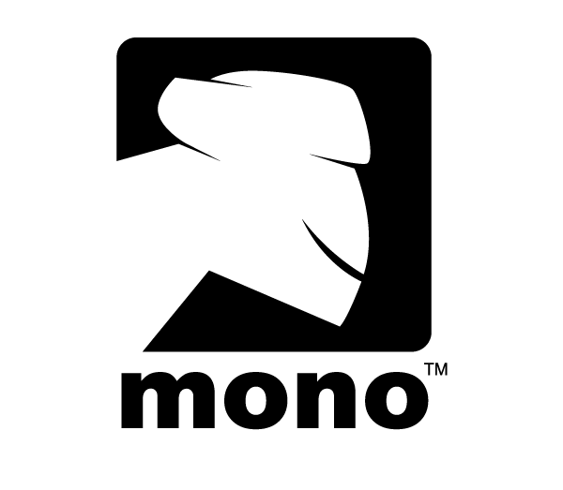
Mono Project
Cross Platform (Windows/Linux/OSX...)
Open source implementation of .NET framework
Runs .NET everywhere on anything
Owned by Xamarin/Microsoft

Slide 9
Basic text editors
Graphical
  gedit
  kate
  geany
  …
Text based (CLI)
  nano
  vim
  Emacs
  ...
All have syntax highlighting
Some have more features like code folding, spell checking, etc...

Slide 10

OmniSharp – What is it?
A tool for code analysis
Features in editors w/ OmniSharp
  IntelliSense
  Documentation peek
  Error/Warning markings
  etc.
Integration
  Atom, Sublime Text, Vim, Emacs, Brackets…
  Anything that supports plugins

Slide 11
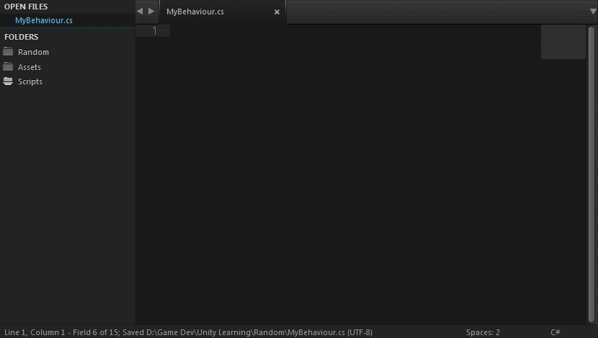
OmniSharp – Sublime Text 3

Slide 12
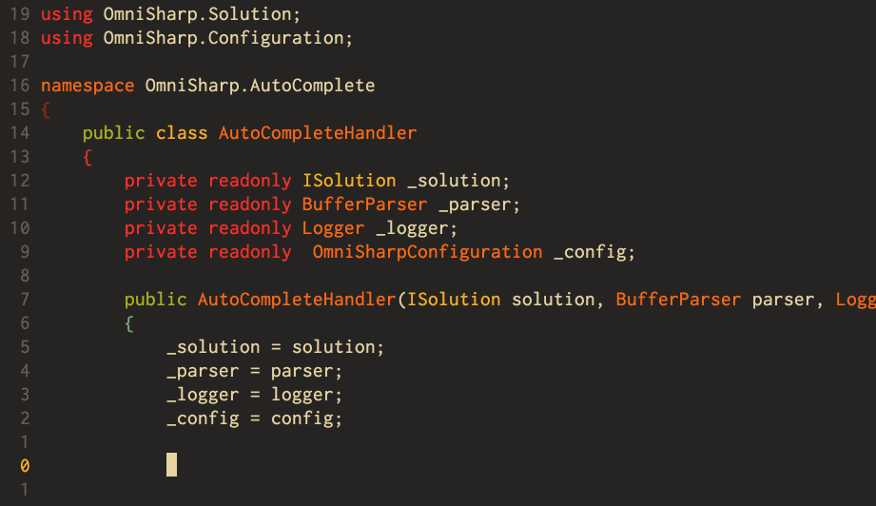
OmniSharp – Vim

Slide 13
Full-blown IDEs for .NET on Linux
Full debugging capabilities
Smart refactorings/code completion
NuGet Integration
…
Three good options:
  MonoDevelop (Xamarin Studio)
  IntelliJ Project Rider
  Microsoft Visual Studio Code

Slide 14
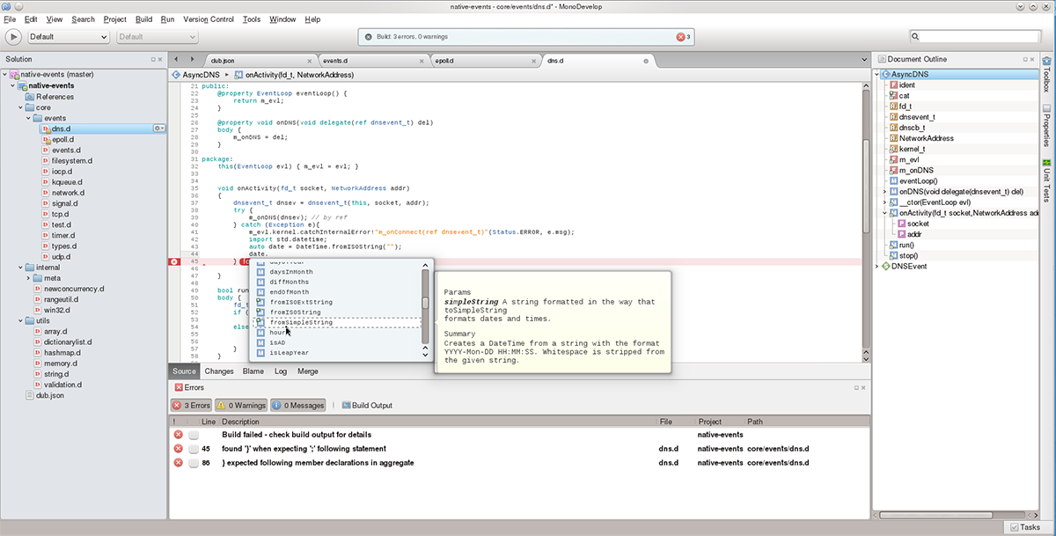
MonoDevelop
Cross-Platform
Also known as Xamarin Studio on Windows and OSX
Can work with .NET 4.6 and .NET Core
Recommended IDE by Mono Project
Similar feel to Visual Studio

Slide 15
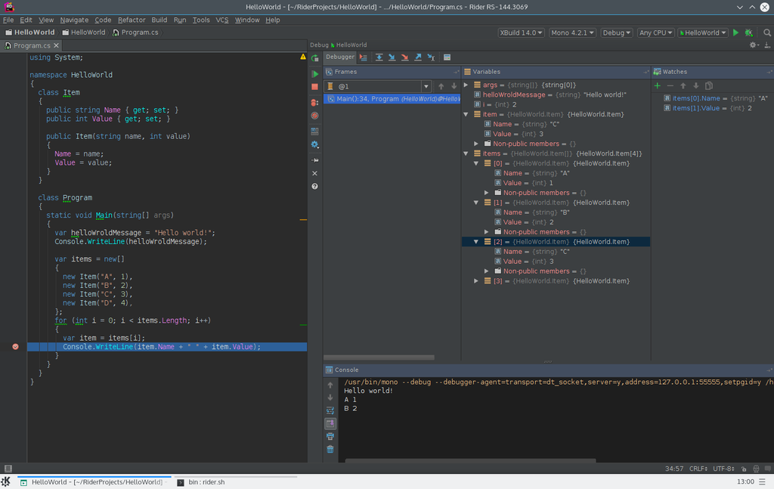
IntelliJ Project Rider
Cross-platform
Still in early development
Private alpha
Supports .NET Core applications
Built by IntelliJ, makers of Resharper
Resharper included out of the box

Slide 16
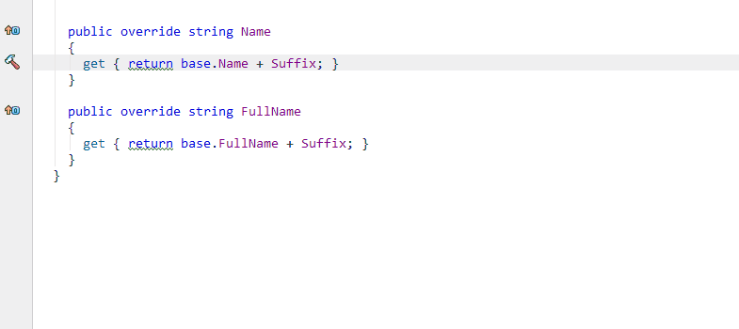
IntelliJ Project Rider – Resharper

Slide 17
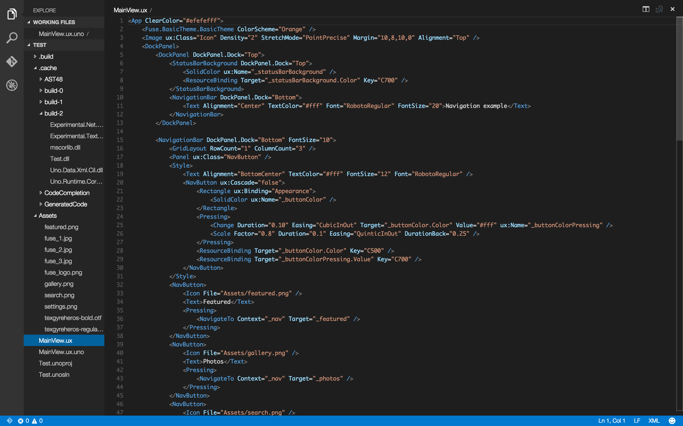
Visual Studio Code
Open source – Cross platform
The best and most polished tool for .NET development on Linux
Built on Electron Engine (JavaScript)
Version 1.0 is here
Powered by OmniSharp
More than a text editor

Slide 18
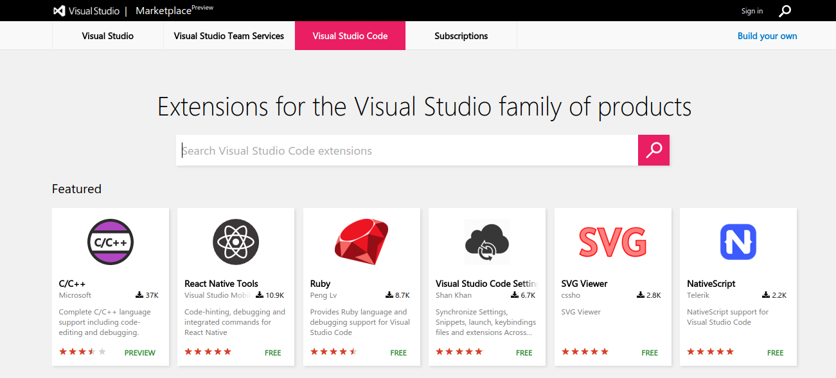
Visual Studio Code - features
Language support
  C#, C++, Python, Go, Scala…

Slide 19
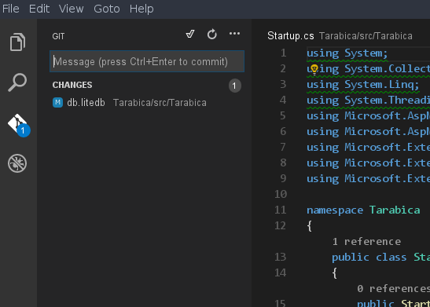
Git integration out of the box

Slide 20
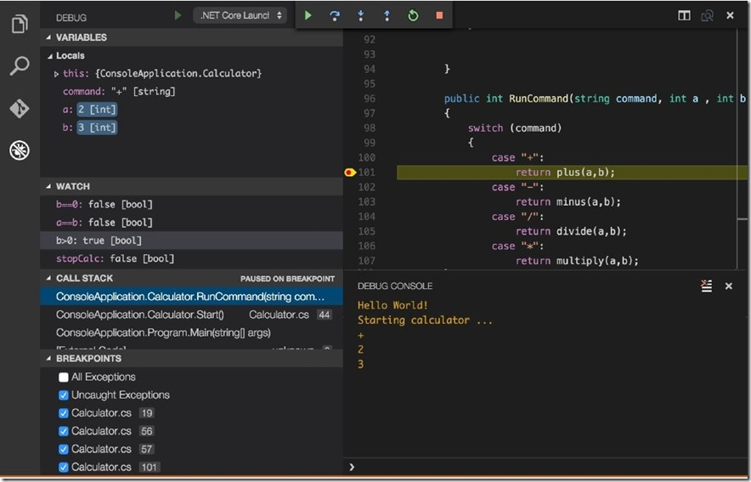
Built-in debugger

Slide 21
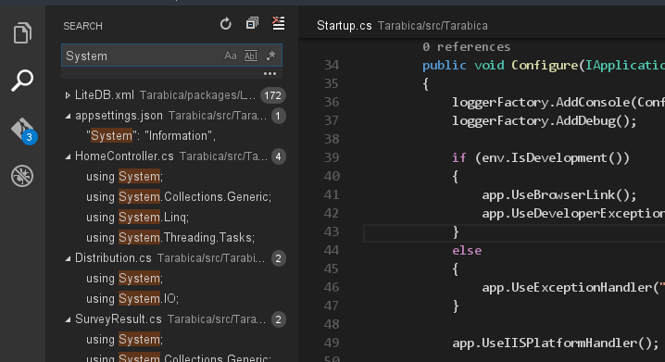
Excellent navigation

Slide 22
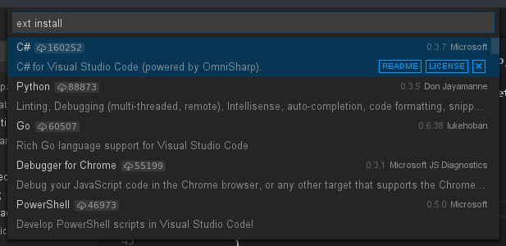
Extendable with many plugins

Slide 23
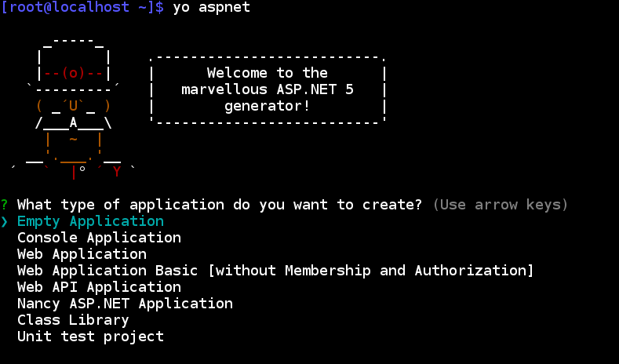
Other tools
Yeoman Project Generator
  The preferred way to generate .NET Core applications
  .NET Core 1.0 RC2 will have generators inside

Slide 24
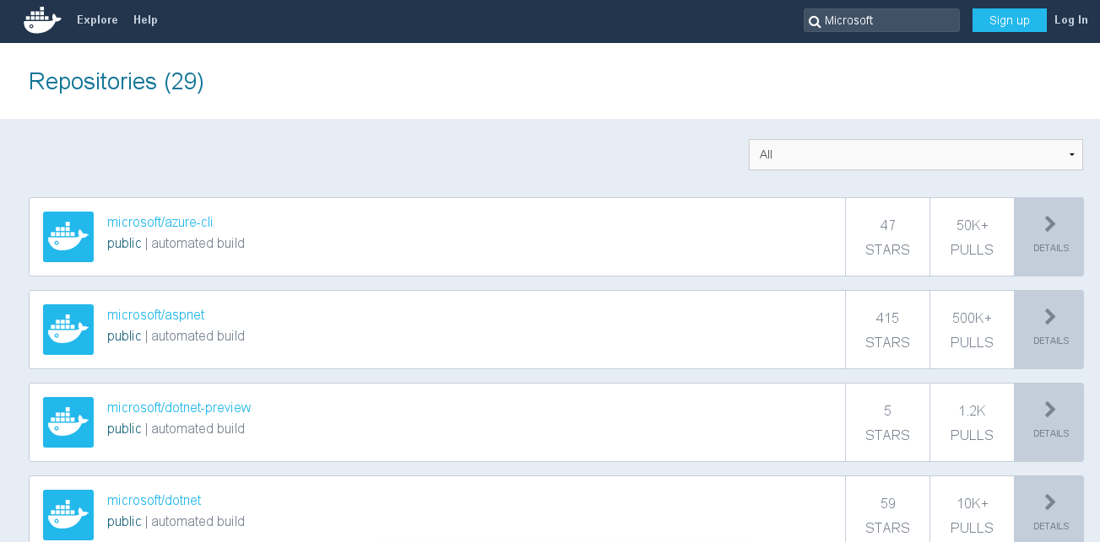

Other tools
Docker
  Containter service for packaging applications
  Can be used on Azure
  Microsoft tools (Azure-CLI, .NET Core RC2 preview…) are packed as Docker containers

Slide 25
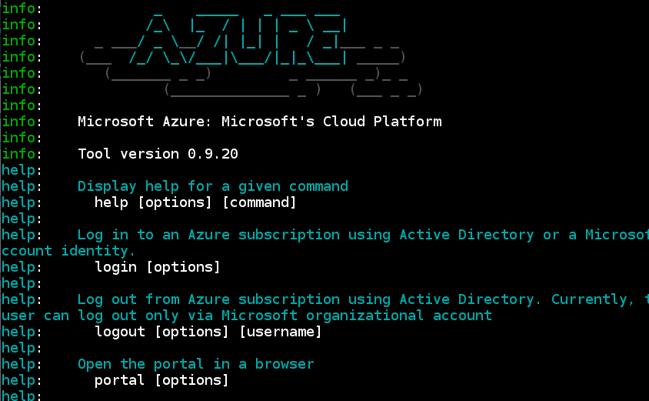
Azure-CLI
Cross-platform, open source
Manipulate everything on Azure from the command line

Slide 26
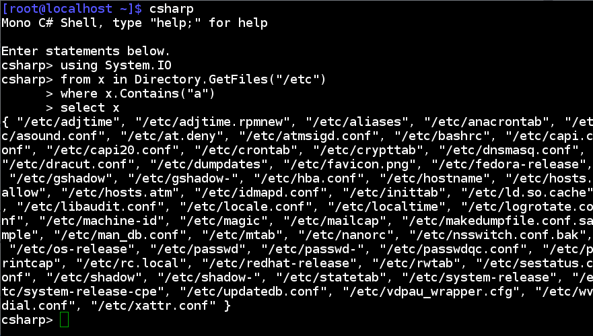
Mono C# REPL
Read-Eval-Print Loop
  very useful for quick checks
SQL REPL also available

Slide 27
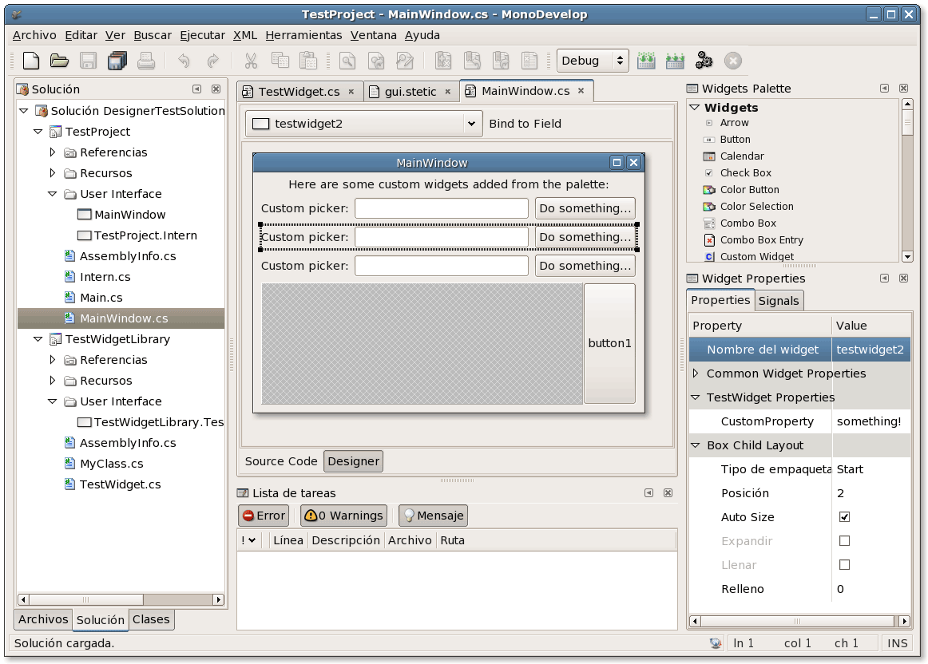
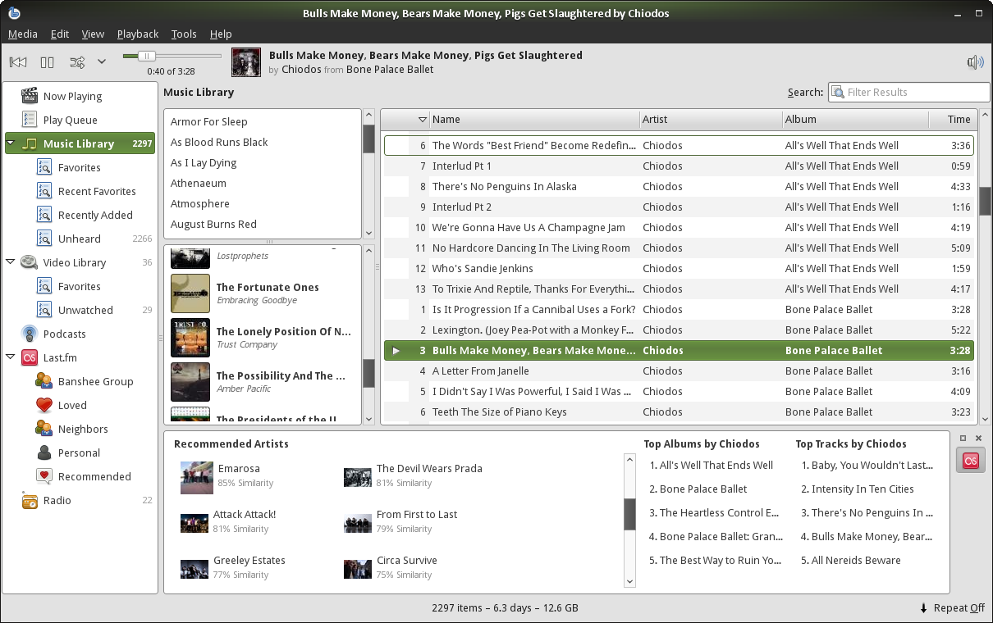
GTK#
Preffered way of developing desktop applications
  Designer available in MonoDevelop
QtSharp exists, but it still in development

Slide 28
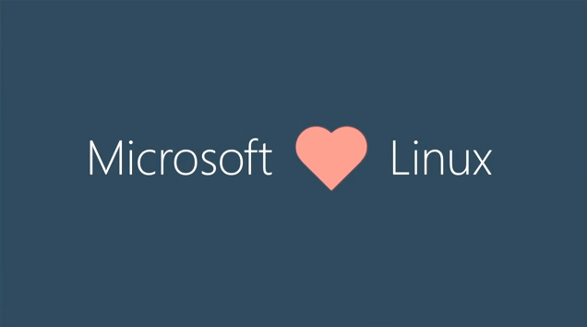

Slide 29
Open source
.NET Core is open source
ASP.NET Core is open source
Xamarin / Mono is open source
Visual Studio Code is open source
20% of Azure is hosted on Linux*
* http://www.zdnet.com/article/why-microsoft-loves-linux/

Slide 30
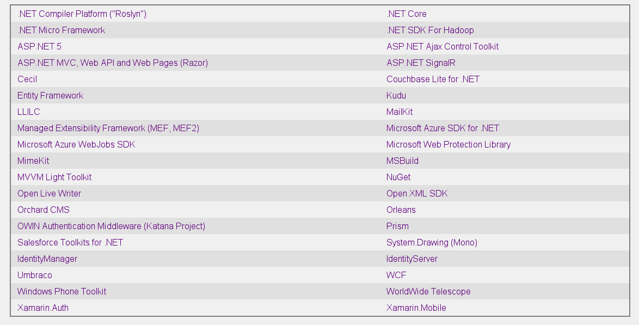
* www.dotnetfoundation.org

Slide 31
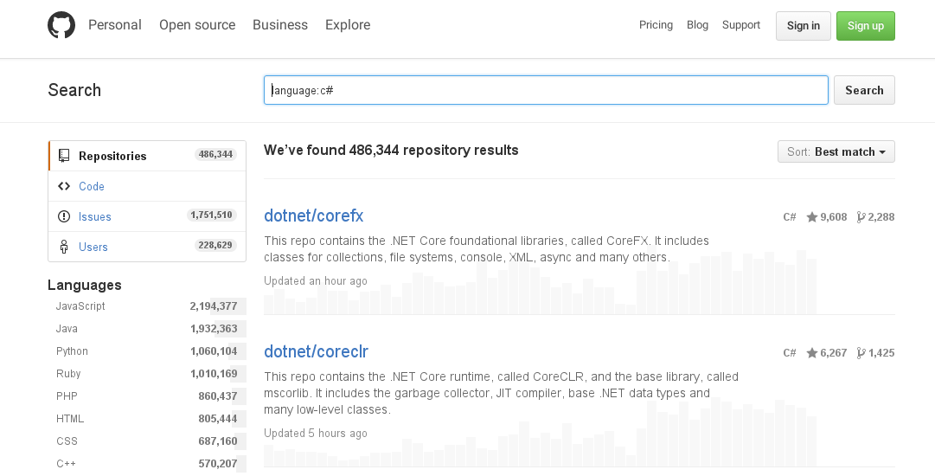
* github.com

Slide 32
Why FOSS?
Free Open Source Software initiative
  Ability to modify
  Ability to distribute
  Ability to inspect
  Open standards everywhere – makes developing easier
  More secure
FOSS is everywhere
Not only software
You can help! http://up-for-grabs.net/
Works for enterprises too

Slide 33
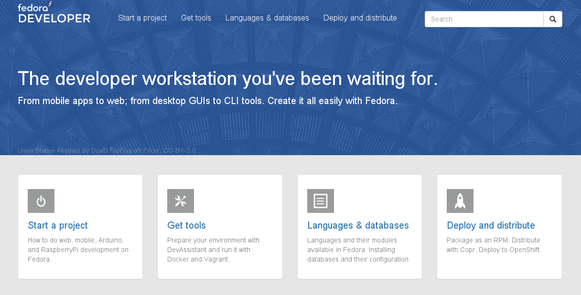

Fedora Project
A distribution of Linux
Very developer friendly
Mono available out of the box
Sponsored by Red Hat

Slide 34
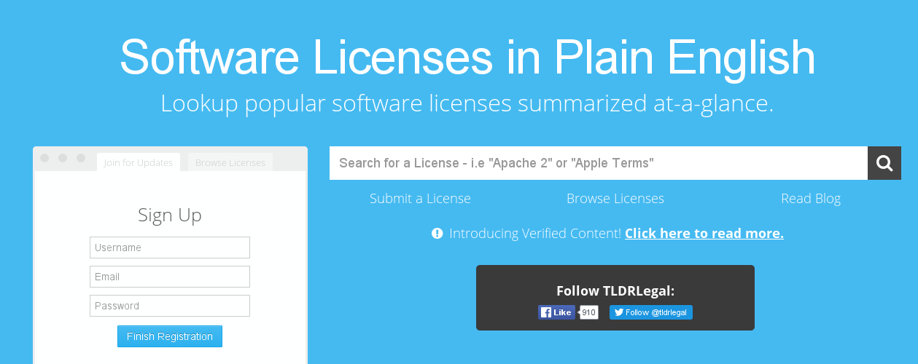
Open-source .NET libraries
Licensing
  TL;DR Legal
  Licenses are human readable!

Slide 35
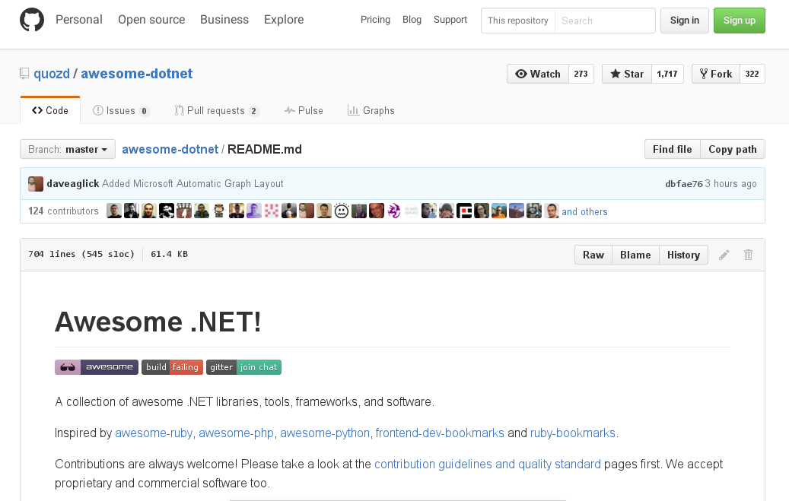
Awesome .NET!

Slide 36
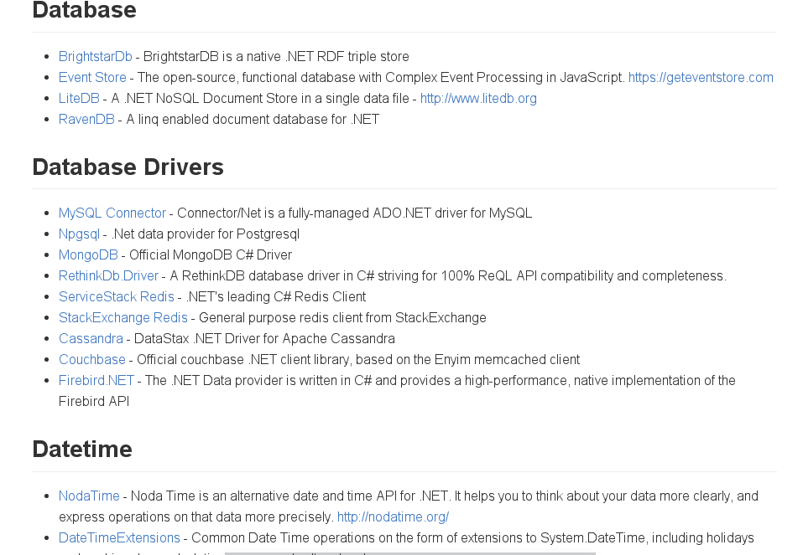
Awesome .NET!

Slide 37
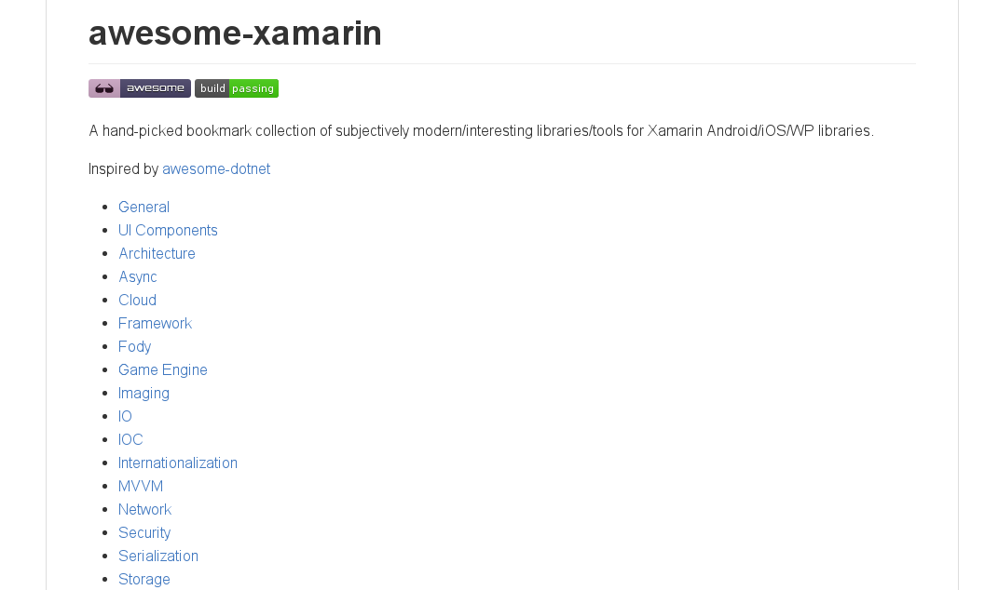
Awesome .NET!
Not everything free/open source, but most are
Almost everything available on NuGet
Not only for “plain” .NET

Slide 38
DEMO 1:
ASP.NET Core application in production

Slide 39
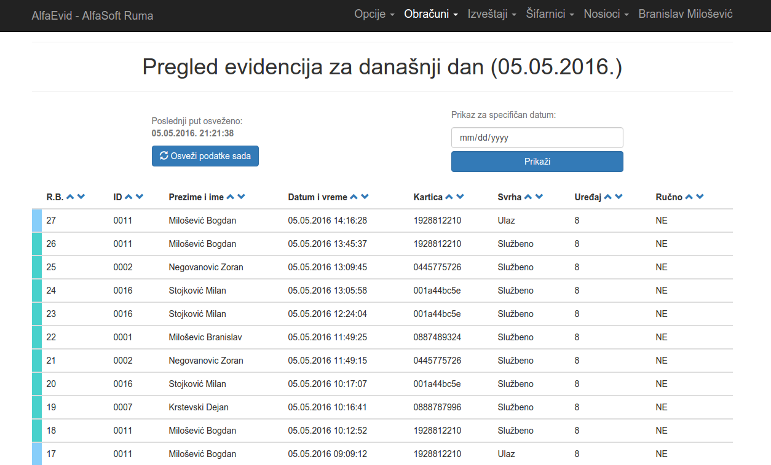
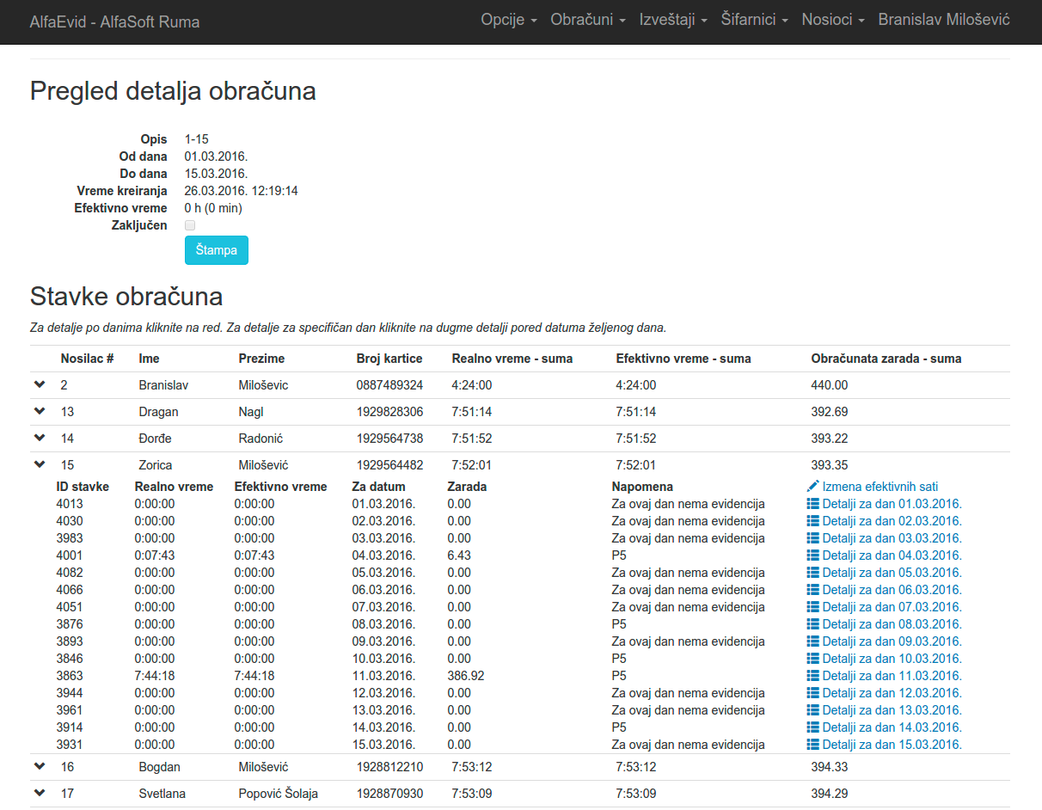
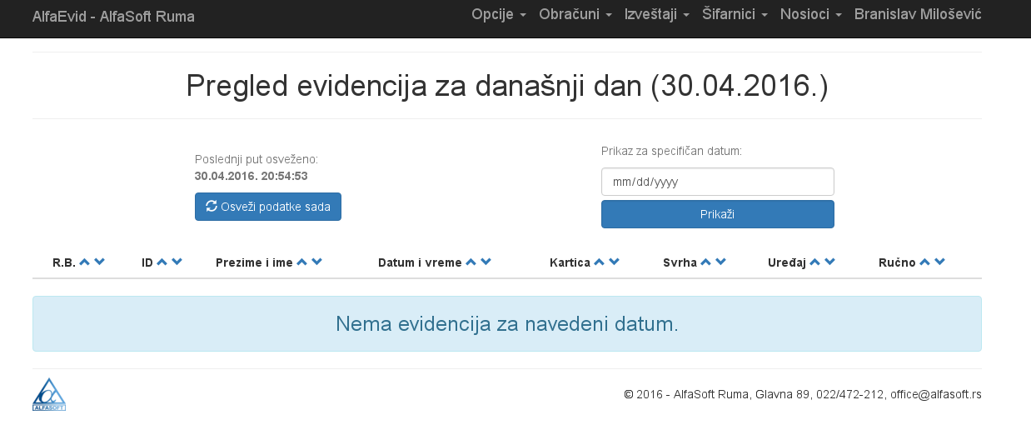
AlfaEvid – worktime tracking

Slide 40
AlfaEvid – worktime tracking
MVC6 application
95% of development done in VSC on Fedora Workstation Linux
ASP.NET core rc1-update2
Hosted on Azure (Windows)
EF Core with MSSQL database on Azure
No issues so far ☺

Slide 41
DEMO 2:
Where the hell is it running from?

Slide 42
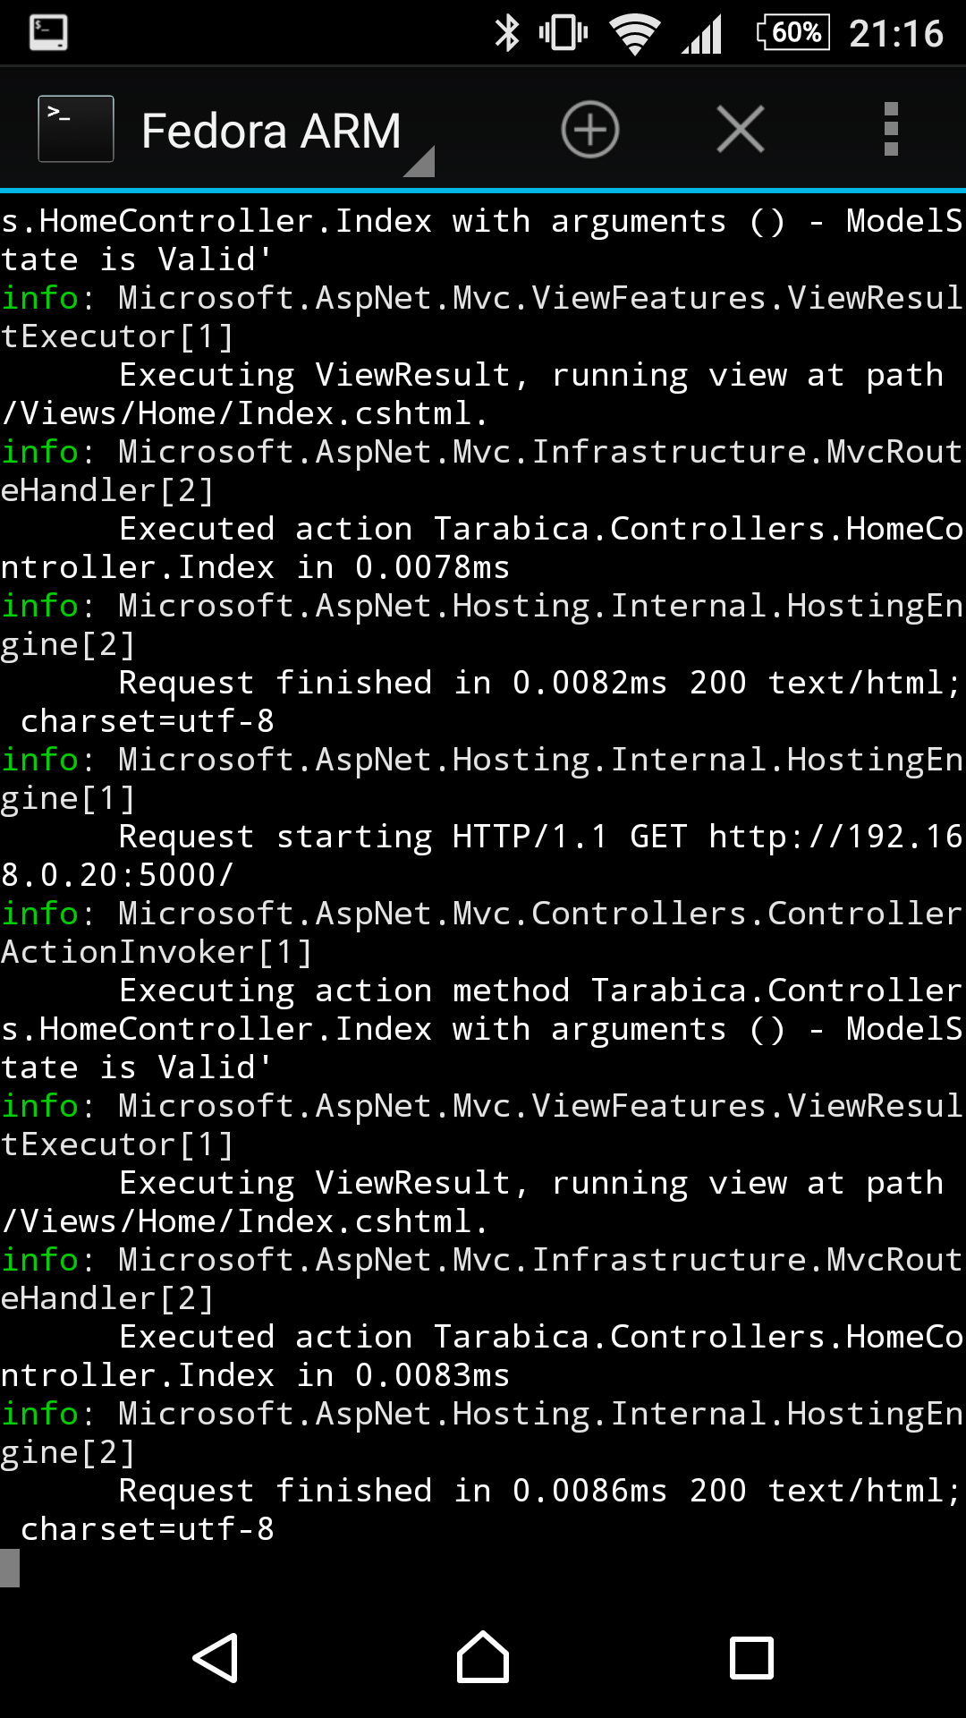

Slide 43
Tarabica .NET Core
Runs with Kestrel Web server (with libuv)
Inside a Fedora 23 ARM chroot environment
On an Android 6.0 phone
Which is not modified! (not rooted or anything)
Kestrel is very fast even on ARM!
Uses LiteDB (NOSQL, document based) - from Awesome .NET list
Proof that you can run .NET on anything

Slide 44
Q & A
* original and rare Fedora 23 Live DVDs up for grabs!

Slide 45
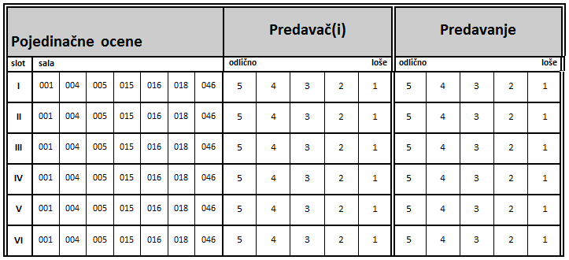
Survey - Tarabica

Slide 46
Thank you!
Feel free to contact me!
nmilosev@fedoraproject.org
nmilosev@alfasoft.rs
nmilosev@live.com
Visit my blog at http://nmilosev.svbtle.com
This presentation (and other stuff from today) is available at: https://github.com/nmilosev/tarabica

