Slide 1
Fedora 27 Release Party
University of Novi Sad
Faculty of Sciences
Department of Mathematics and Informatics
March 17th 2018

Slide 2

Agenda
12:00 - Welcome
12:00 - 12:30 "What's new in Fedora 27?" - Nemanja Milosevic
12:30 - 13:00 "How to browse the Web as inconvenient as possible" - Doni Pracner
13:00 - 13:30 Coffee/Snacks break
13:30 - 14:00 "Linux based development environment" - Igor Sarcevic
14:00 - 14:30 "Fedora Atomic Workstation" - Marko Kostic
14:30 - 14:45 "Fedora localization" - Marko Kostic
14:45 - 15:00 Fedora quiz - Natasa Sukur and Doni Pracner
15:00 - Fedora/Linux Q&A

Slide 3
What’s new in Fedora 27?
F27 Release Party Novi Sad
Nemanja Milošević
Fedora Ambassador

Slide 4


Fedora 27
2017-11-14
Final release was on
Kernel 4.13 (now 4.15)
GNOME 3.26
Many incremental improvements

Slide 5
What’s new
32-bit UEFI support
No more Alpha release
OpenJDK9 tech preview
New packages: Go, glibc, Node, ...
Aarch64 Images (RPi3)

Slide 6
What’s new
sudo pip is safe again
PipeWire
LibreOffice 5.4
Even more FlatPak applications

Slide 7
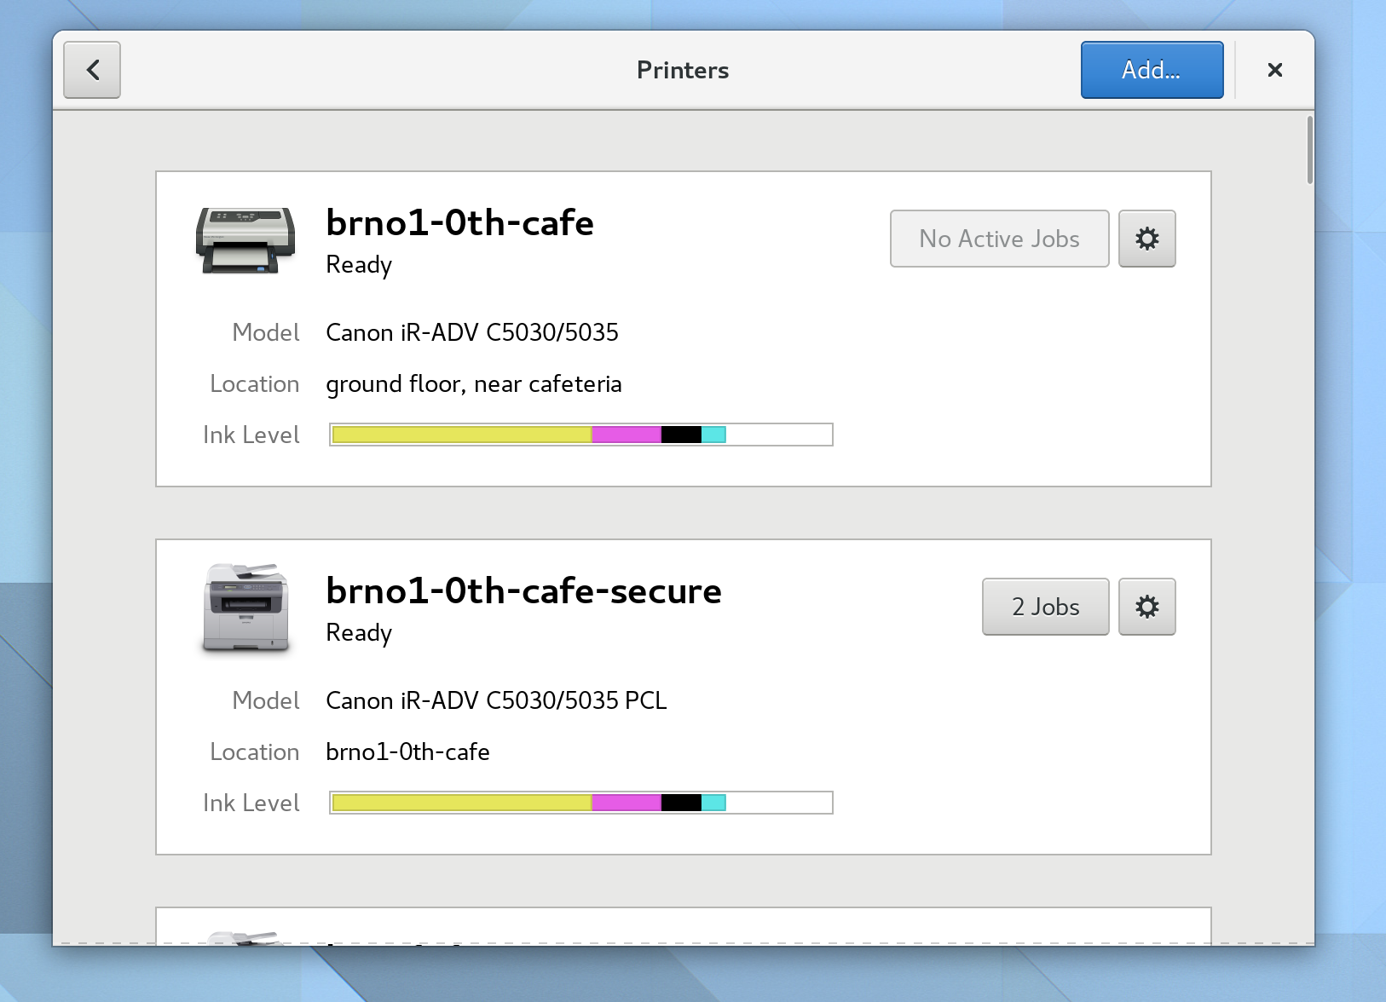
What’s new
Printing improvements

Slide 8
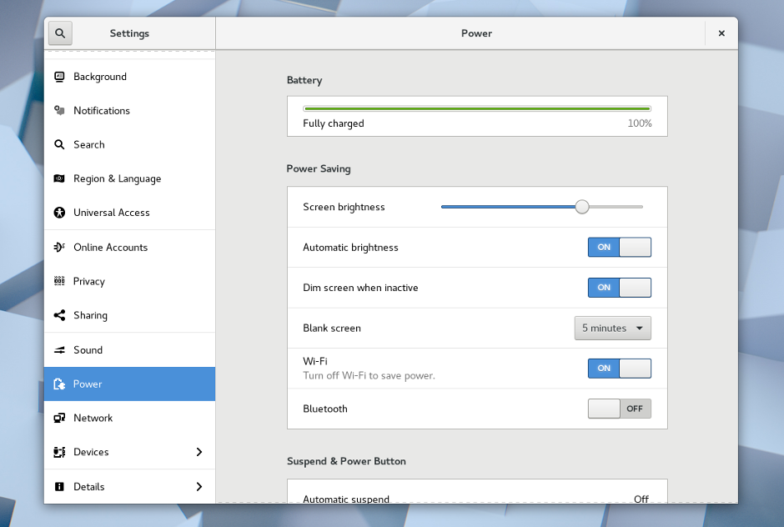
What’s new
New look for the Settings application

Slide 9
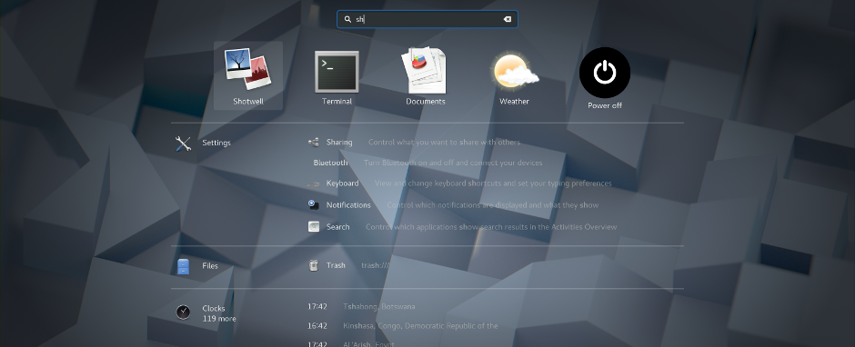
What’s new
Improved Search

Slide 10
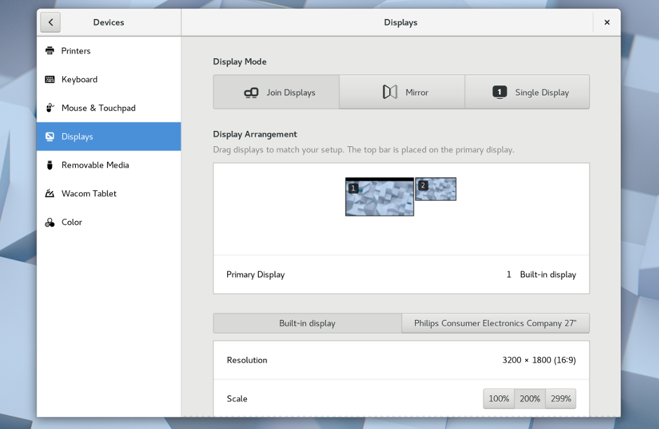
What’s new
Redesigned Display Settings

Slide 11
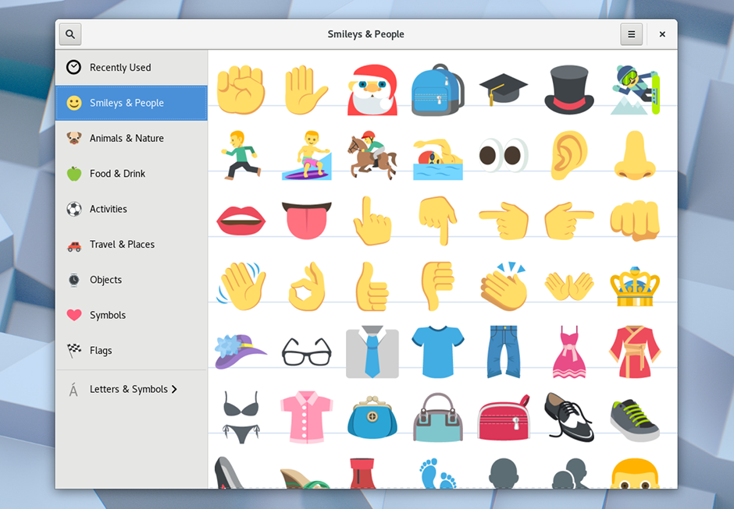
What’s new
Color emoji have arrived

Slide 12
Questions?
Contact:
nmilosev@fedoraproject.org

