Slide 1
Introduction to neural networks with Keras and Tensorflow
Nemanja Milošević
nmilosev@fedoraproject.org
nmilosev@dmi.rs
PySer 2018
With thanks to the original author: Tariq Rashid

Slide 2
Background
Ideas
Handwriting
Thoughts

Slide 3
Background

Slide 4
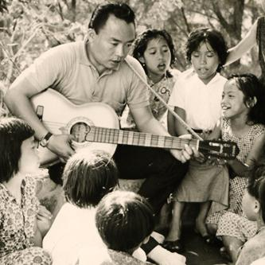
Start With Two Questions
locate people in this photo
add these numbers
2403343781289312
2843033712837981
2362142787897881
3256541312323213
9864479802118978
8976677987987897
8981257890087988
= ?

Slide 5

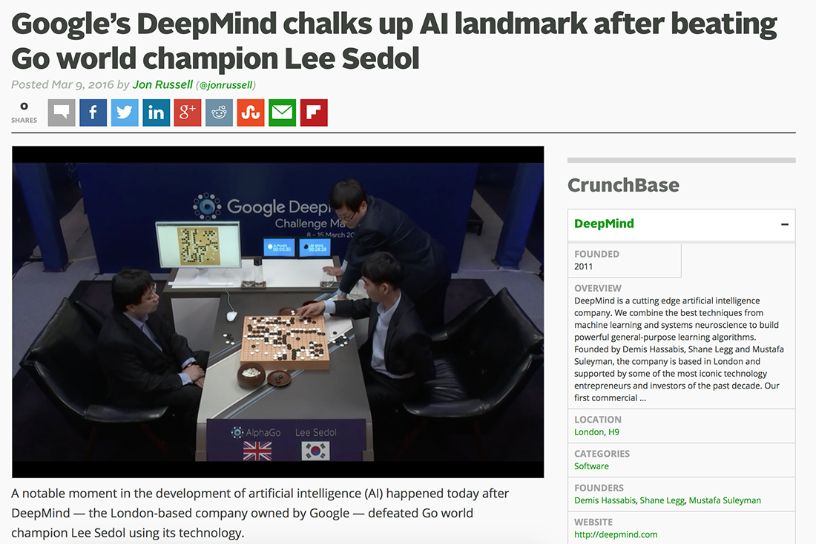
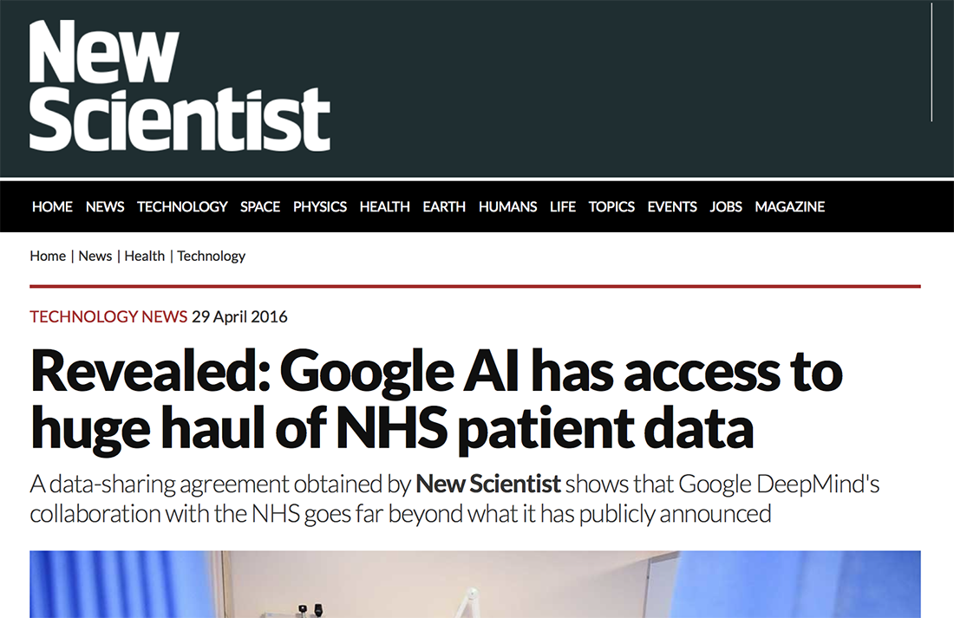

AI is Huge!

Slide 6
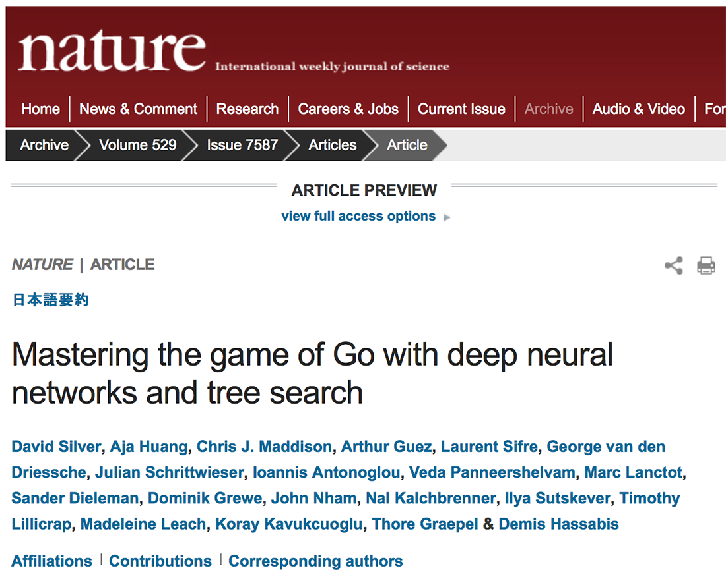
Google’s and Go

Slide 7
Ideas

Slide 8

Simple Predicting Machine

Slide 9
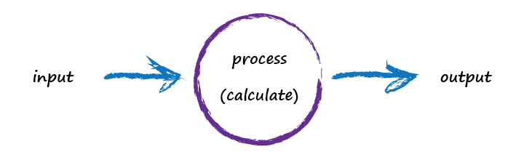
Simple Predicting Machine

Slide 10
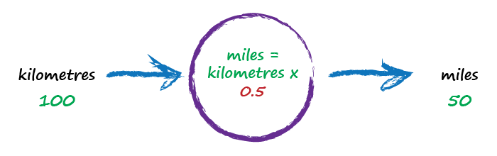
Kilometres to Miles
random starting parameter
try a model - this one is linear

Slide 11
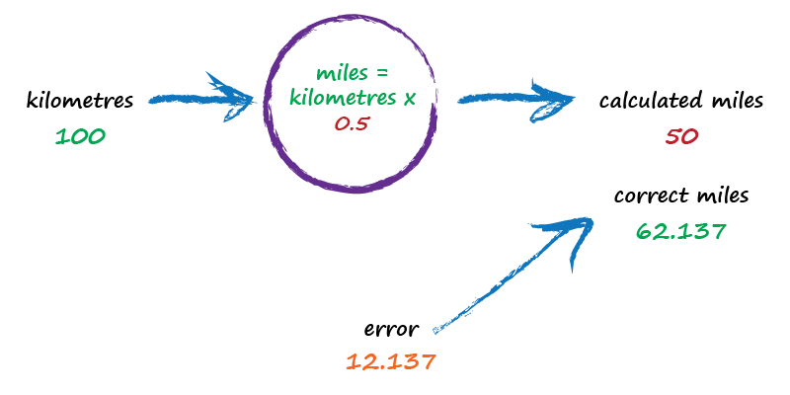
Kilometres to Miles
not great

Slide 12
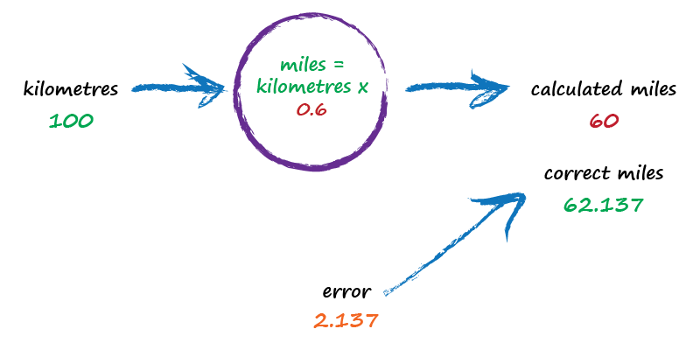
Kilometres to Miles
better

Slide 13
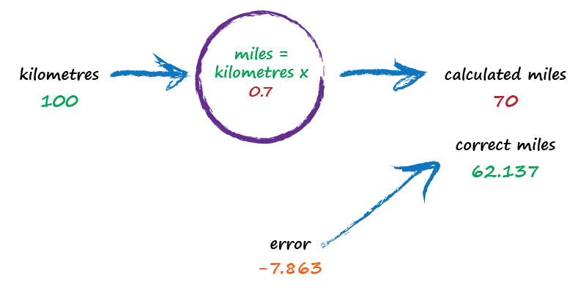
Kilometres to Miles
worse !

Slide 14

Kilometres to Miles
best yet !

Slide 15

Key Points
Don’t know how something works exactly? Try a model with adjustable parameters.
Use the error to refine the parameters.

Slide 16
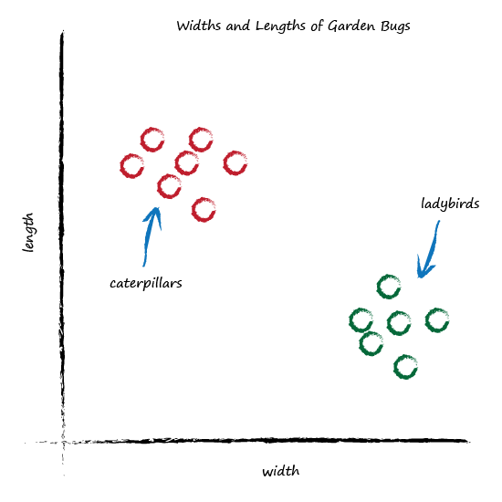
Garden Bugs

Slide 17
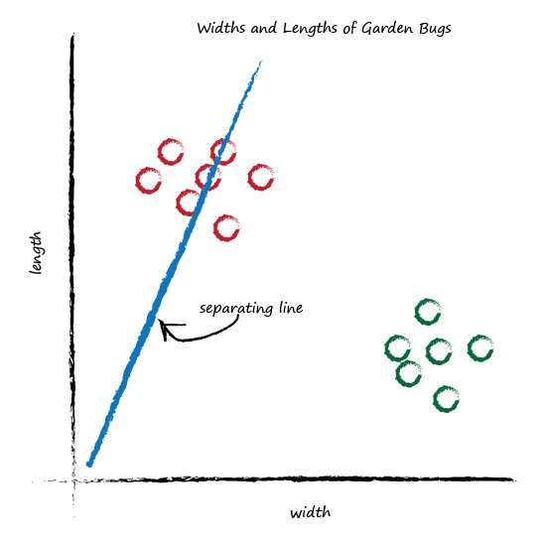
Classifying Bugs

Slide 18
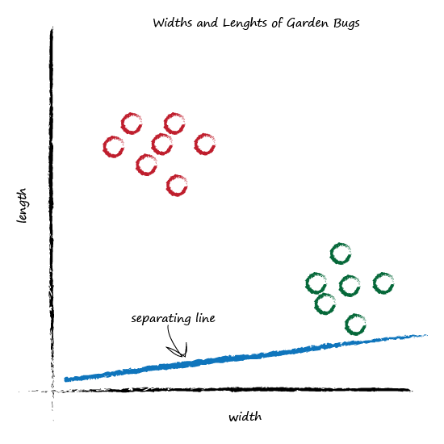
Classifying Bugs

Slide 19
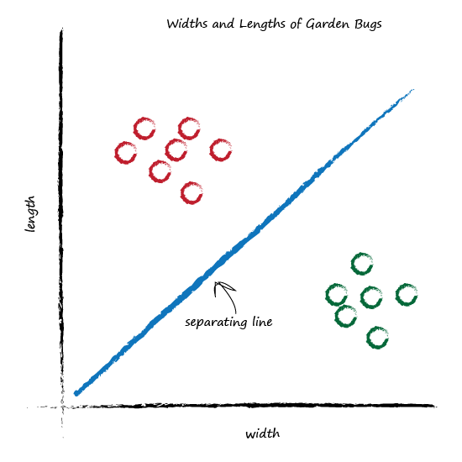
Classifying Bugs

Slide 20
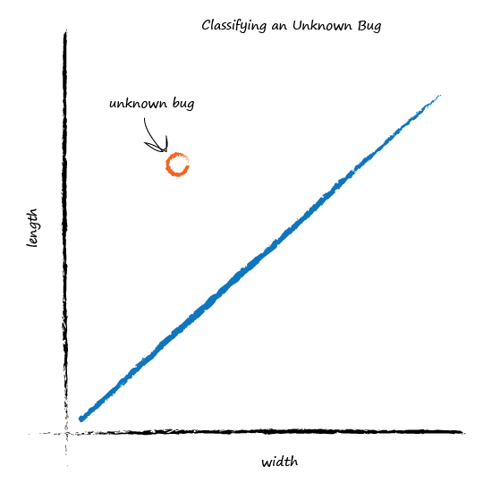
Classifying Bugs

Slide 21
Key Points
Classifying things is kinda like predicting things.

Slide 22
Learning from Data
Example | Width | Length | Bug
1 | 3.0 | 1.0 | ladybird
2 | 1.0 | 3.0 | caterpillar

Slide 23
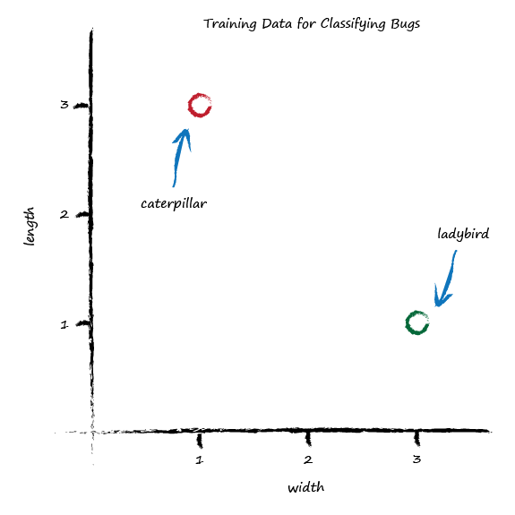
Learning from Data

Slide 24
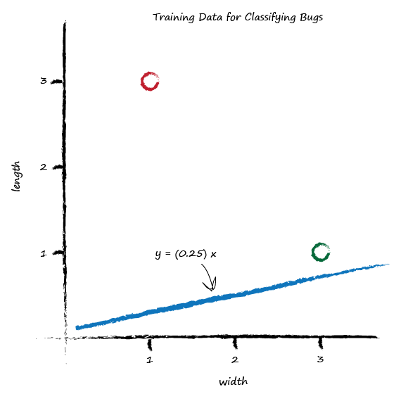
Learning from Data
not a good separator

Slide 25
Learning from Data
shift the line up
just above the training data point

Slide 26
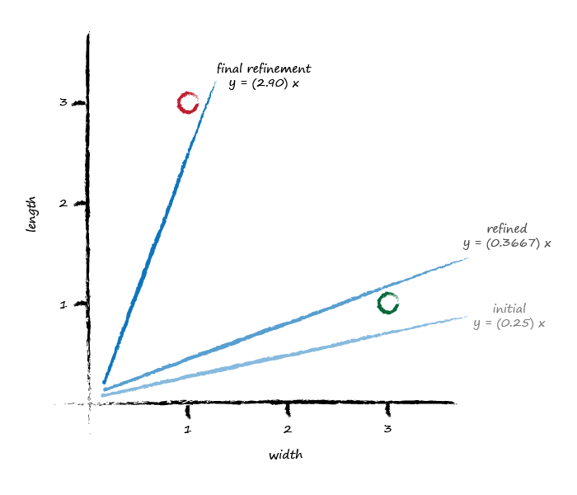
Learning from Data

Slide 27
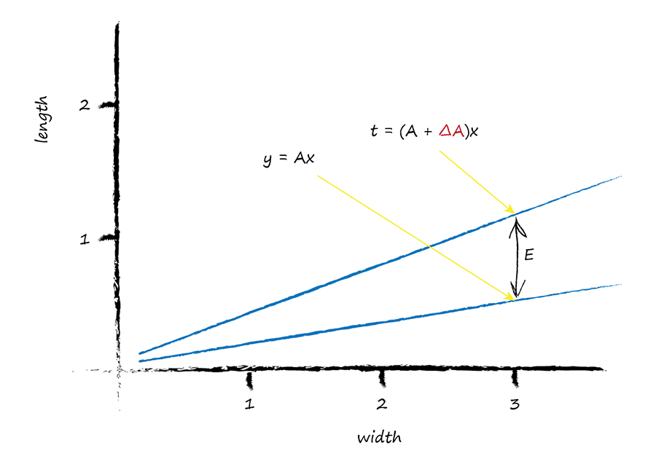
How Do We Update The Parameter?
error = target - actual
E = (A + ΔA)x - Ax
ΔA = E / x

Slide 28
Hang On!
Oh no!
each update ignores
previous examples

Slide 29
Calm Down the Learning
ΔA = L · (E / x)
learning rate

Slide 30
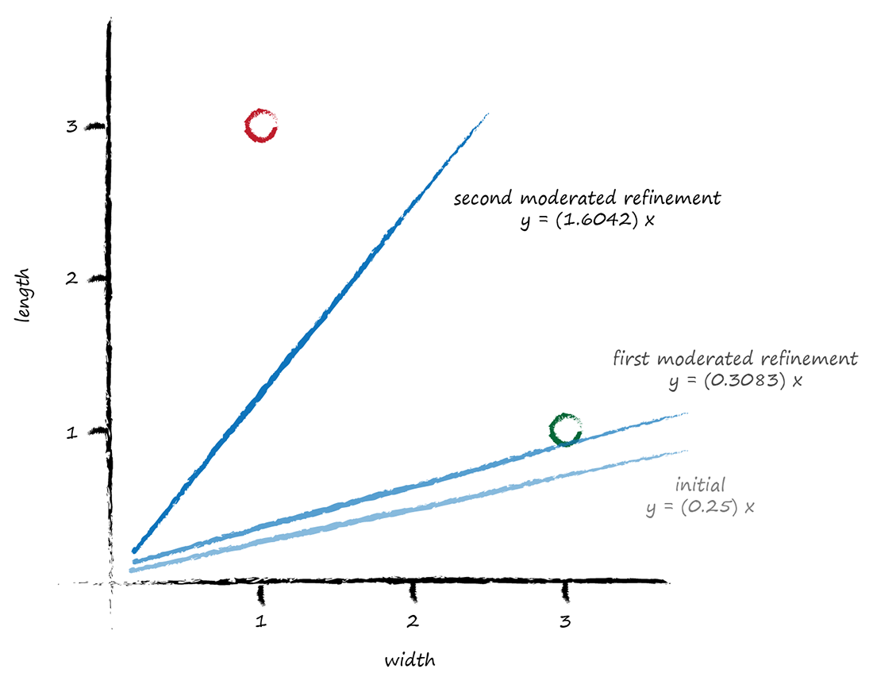
Calm Down the Learning
learning rate = 0.5

Slide 31
Key Points
Moderating your learning is good - ensures you learn from all your data, and reduces impact of outliers or noisy training data.

Slide 32
Boolean Logic
IF I have eaten my vegetables AND I am still hungry THEN I can have ice cream.
IF it’s the weekend OR I am on annual leave THEN I’ll go to the park.
Input A | Input B | AND | OR
0 | 0 | 0 | 0
0 | 1 | 0 | 1
1 | 0 | 0 | 1
1 | 1 | 1 | 1

Slide 33
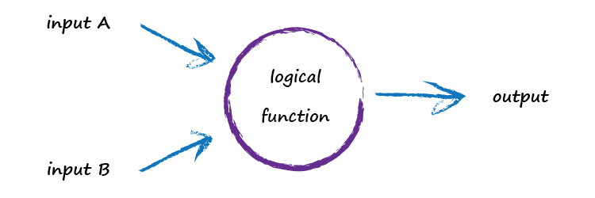
Boolean Logic

Slide 34
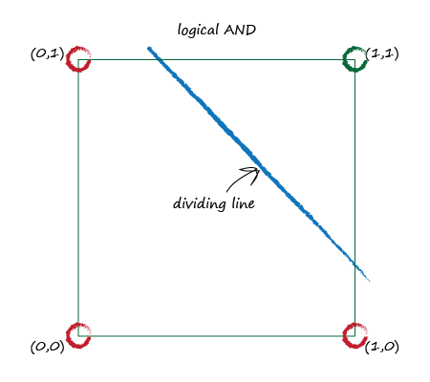
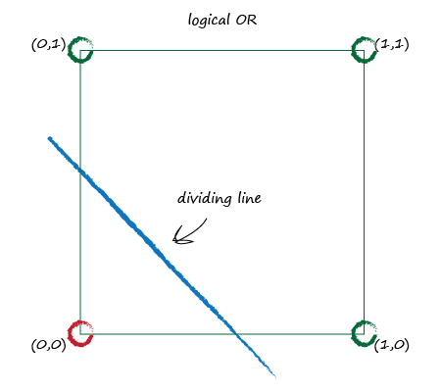
Boolean Logic

Slide 35
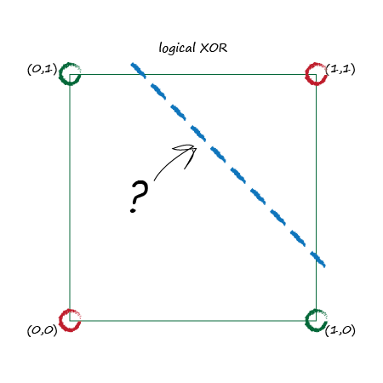
XOR Puzzle!
Input A | Input B | XOR
0 | 0 | 0
0 | 1 | 1
1 | 0 | 1
1 | 1 | 0

Slide 36
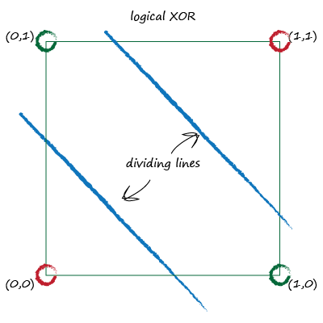
XOR Solution!
… Use more than one node!

Slide 37
Key Points
Some problems can’t be solved with just a single simple linear classifier.
You can use multiple nodes working together to solve many of these problems.

Slide 38
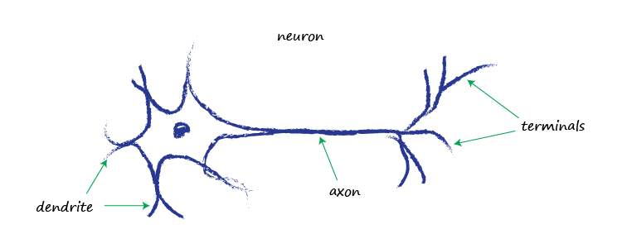
Brains in Nature

Slide 39
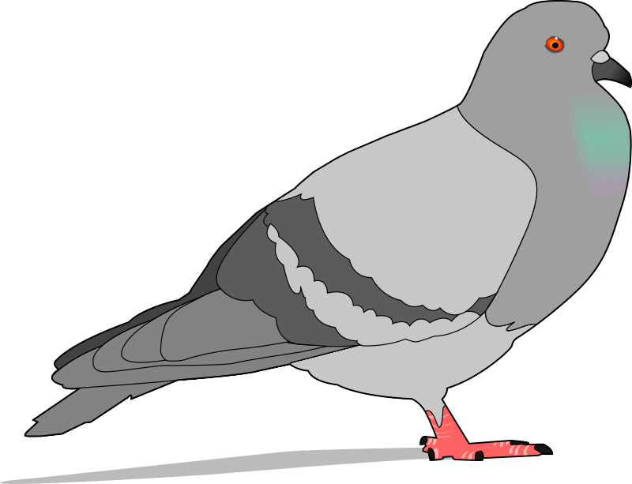
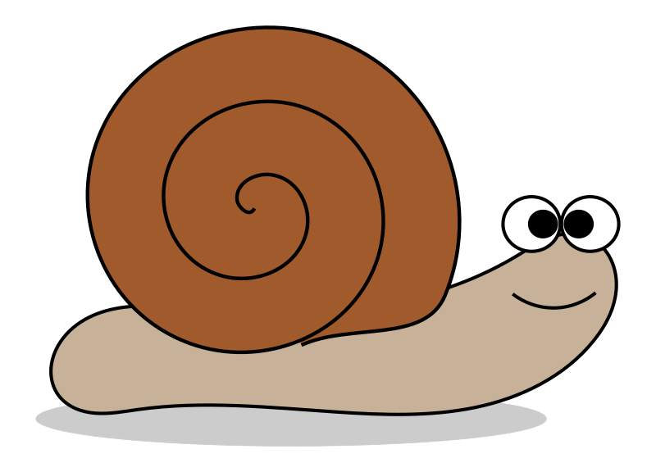


Brains in Nature
brain 0.4 grams
11,000 neurons
nature’s brains can eat, fly, navigate, fight, communicate, play, learn …
.. and they’re resilient
302 neurons
37 billion neurons
(humans 20 billion)
https://en.wikipedia.org/wiki/List_of_animals_by_number_of_neurons
https://faculty.washington.edu/chudler/facts.html

Slide 40
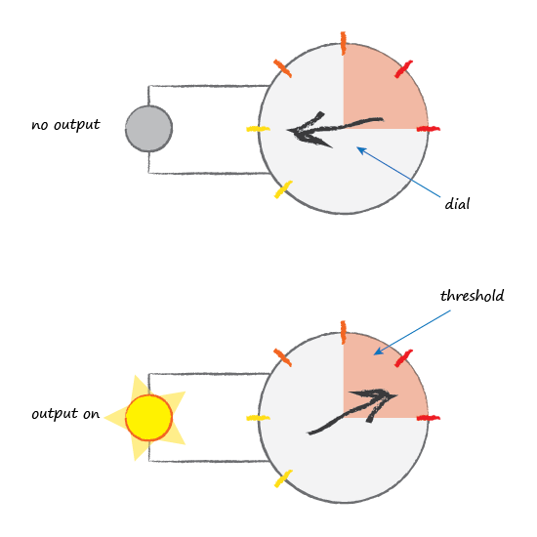
Brains in Nature

Slide 41
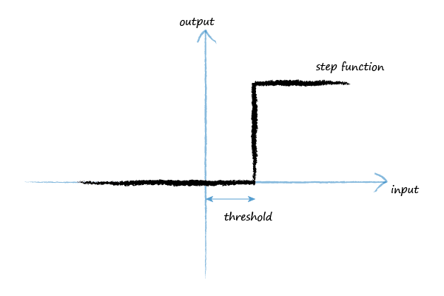
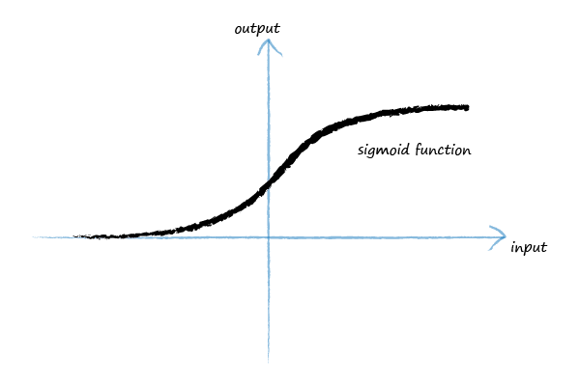
Brains in Nature
logistic function
y = 1 / (1 + e^{-x})

Slide 42
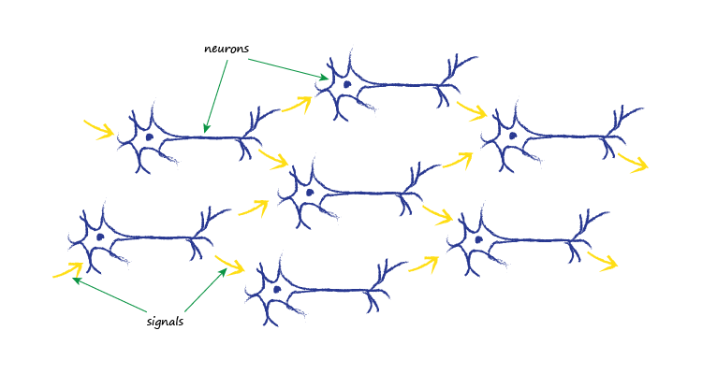
Brains in Nature

Slide 43
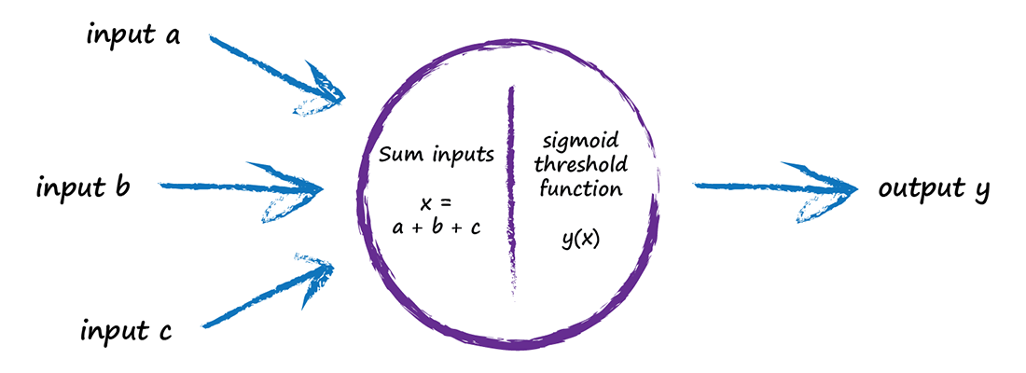
Artificial Neuron

Slide 44
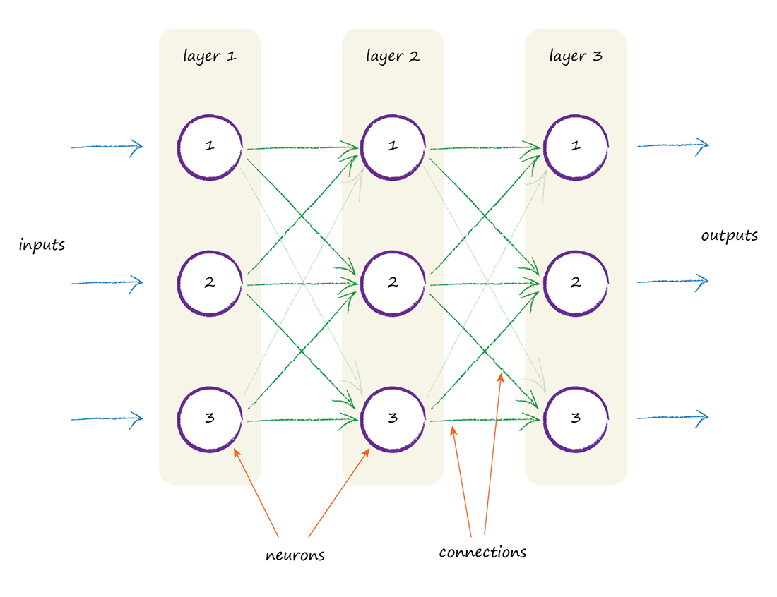
Artificial Neural Network .. finally!

Slide 45
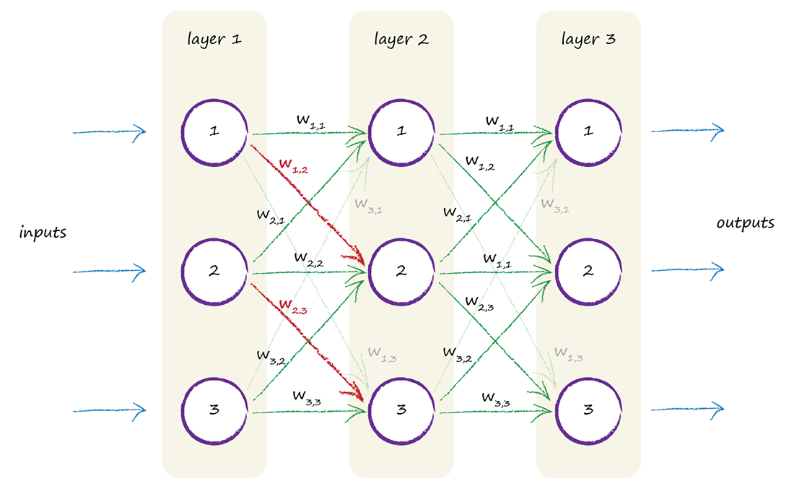
Where Does The Learning Happen?
link weight?
sigmoid function slope?

Slide 46
Key Points
Natural brains can do sophisticated things, and are incredibly resilient to damage and imperfect signals .. unlike traditional computing.
Trying to copy biological brains partly inspired artificial neural networks.
Link weights are the adjustable parameter - it’s where the learning happens.

Slide 47
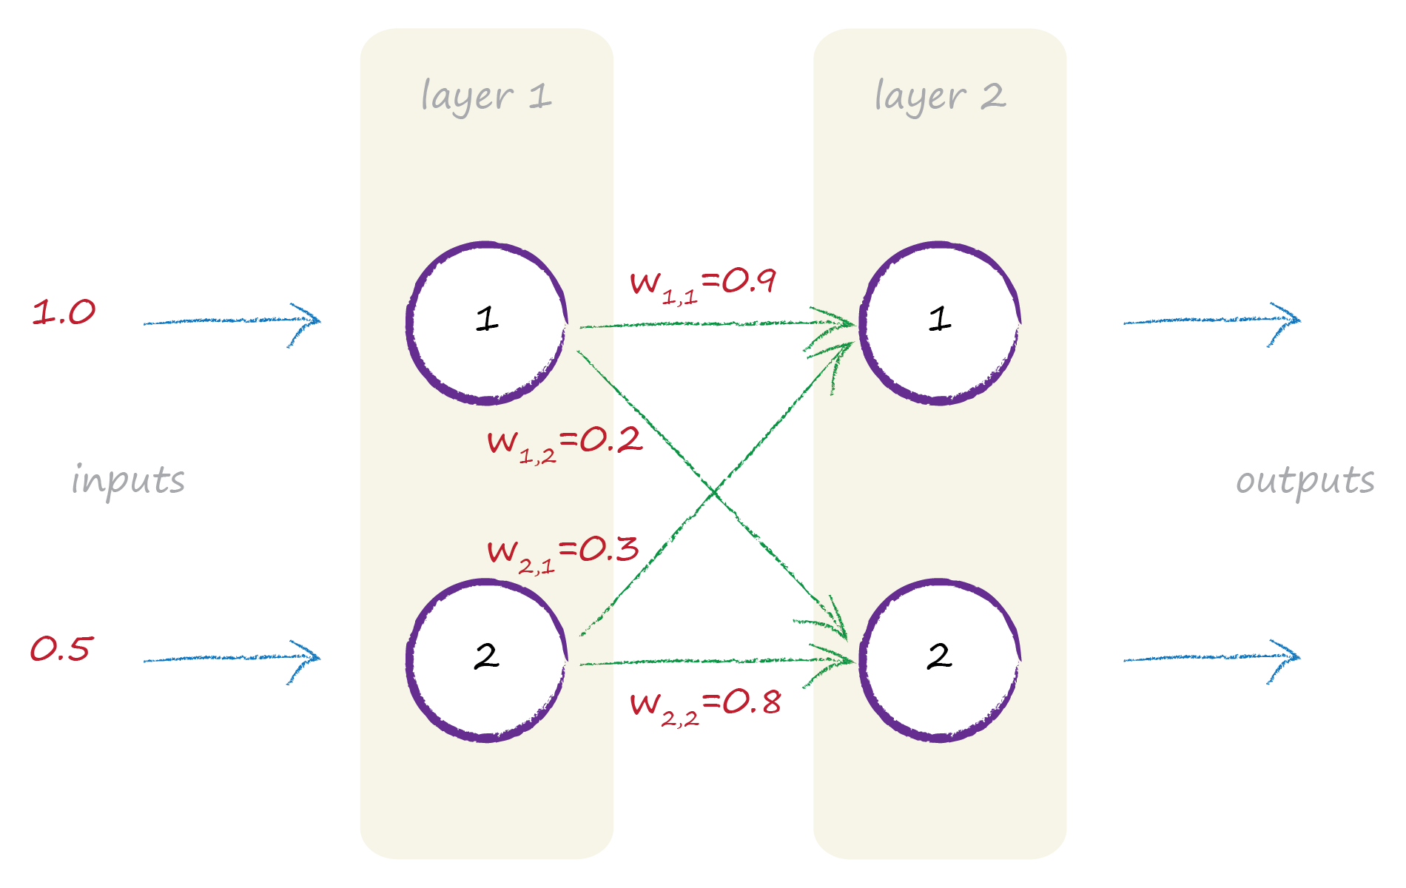
Feeding Signals Forward

Slide 48
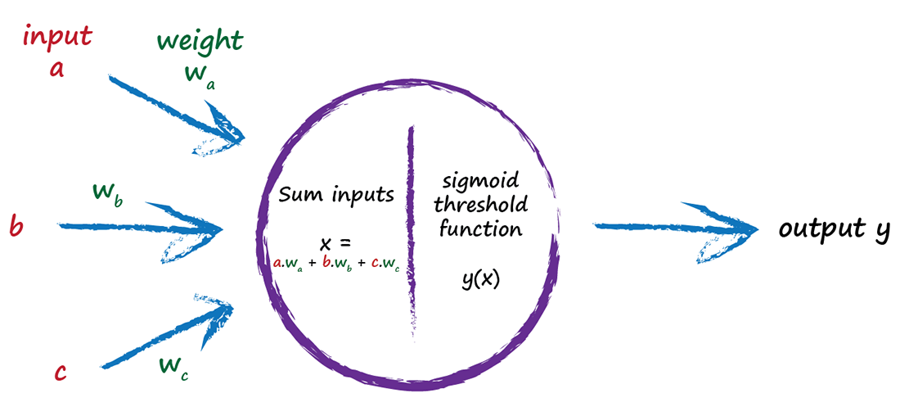
Feeding Signals Forward

Slide 49
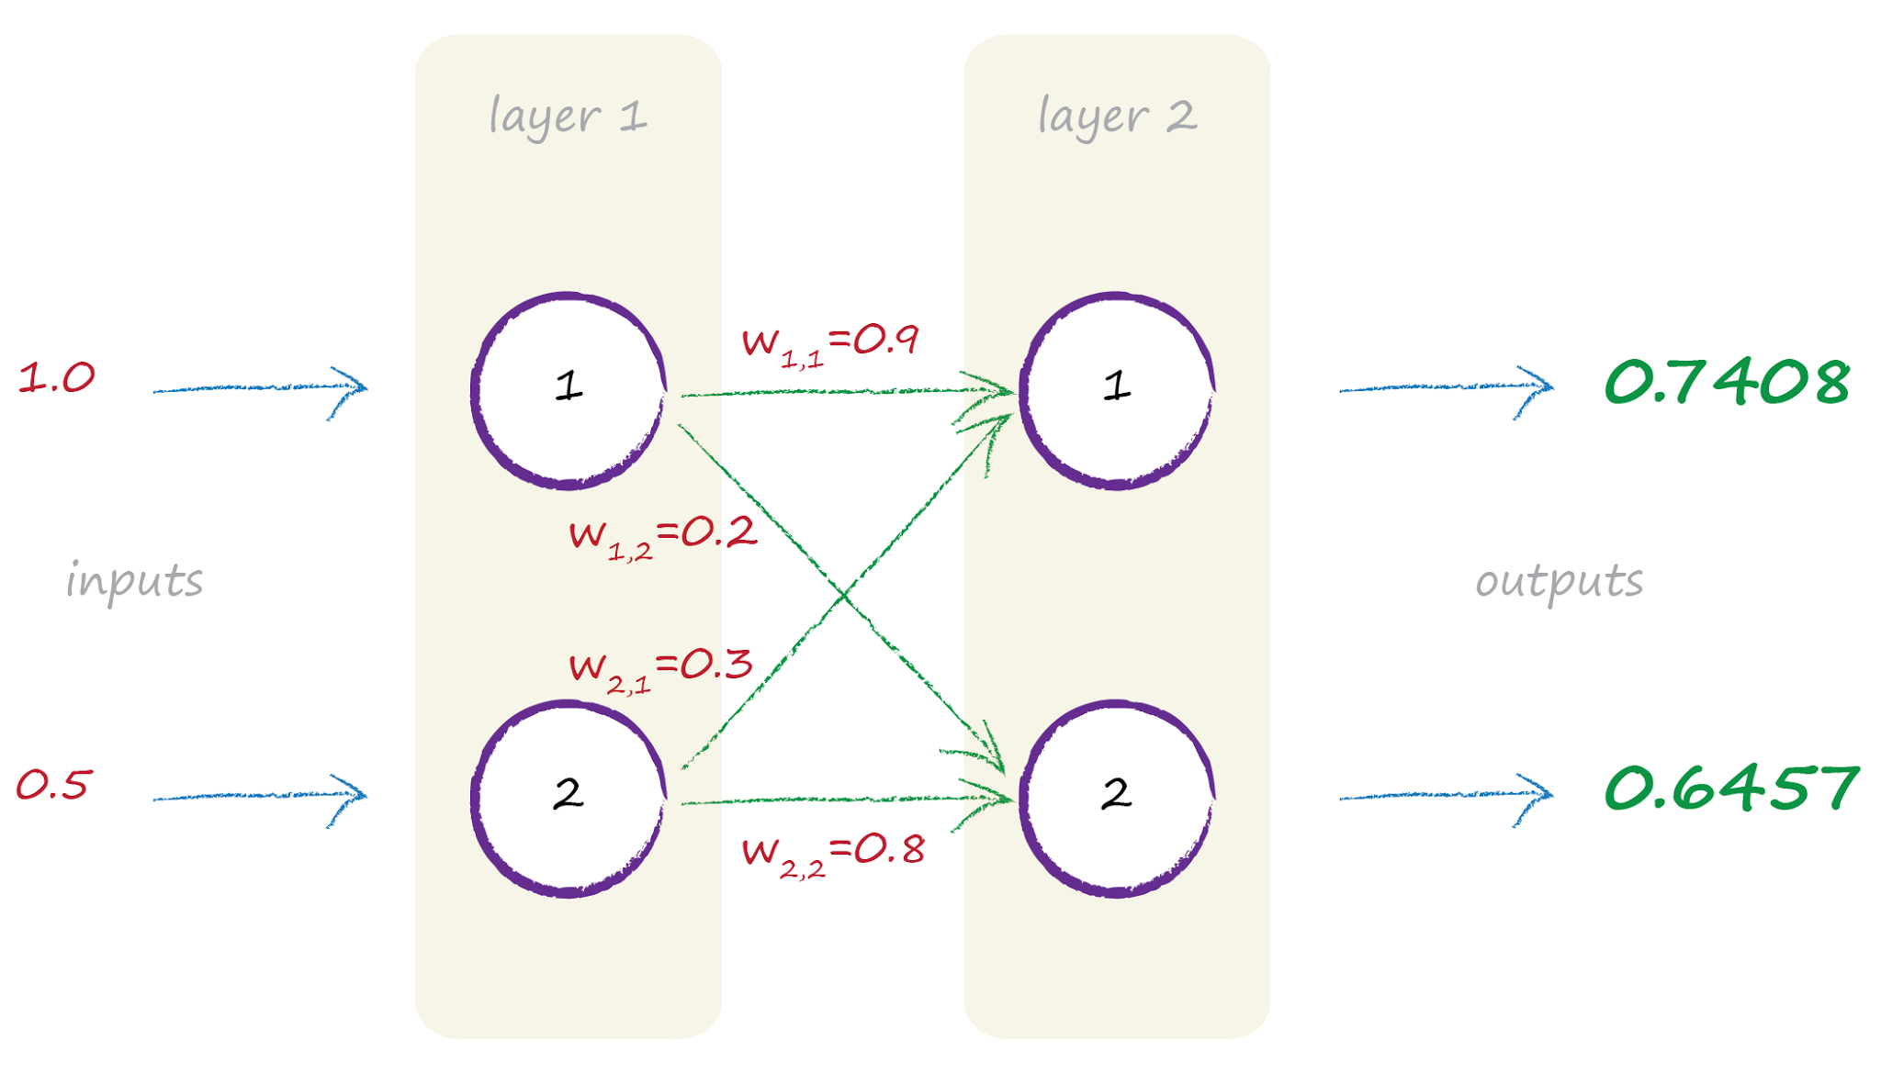
Feeding Signals Forward

Slide 50
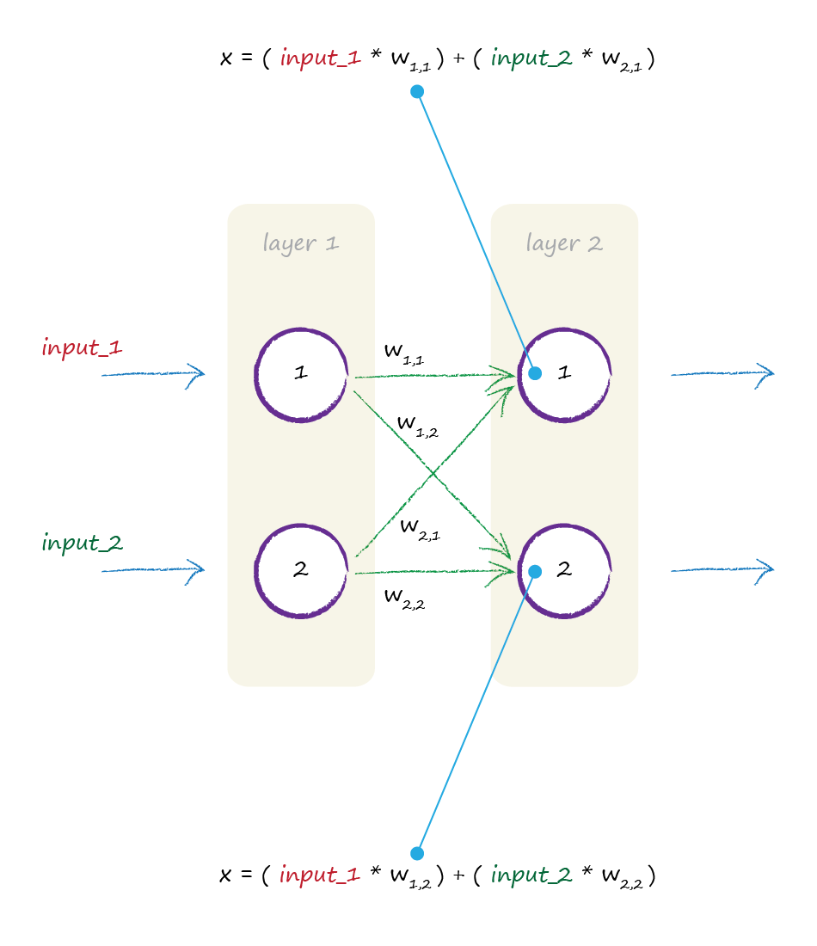
Matrix Multiplication

Slide 51
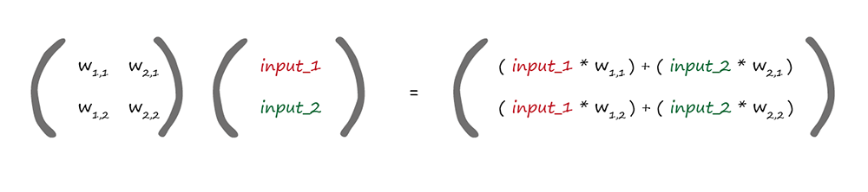
Matrix Multiplication
weights
incoming signals
W·I = X
dot product

Slide 52
Key Points
The many feedforward calculations can be expressed concisely as matrix multiplication, no matter what shape the network.
Some programming languages can do matrix multiplication really efficiently and quickly.

Slide 53
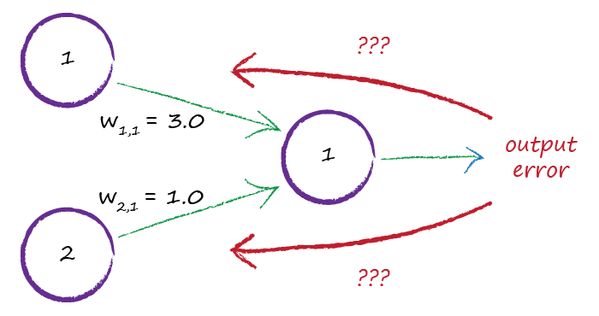
Network Error

Slide 54
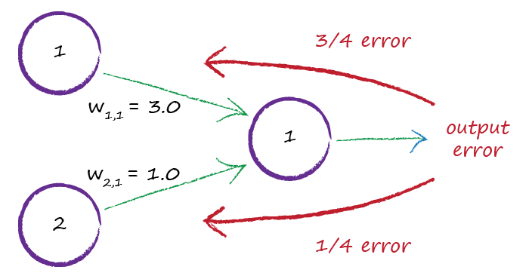
Network Error

Slide 55
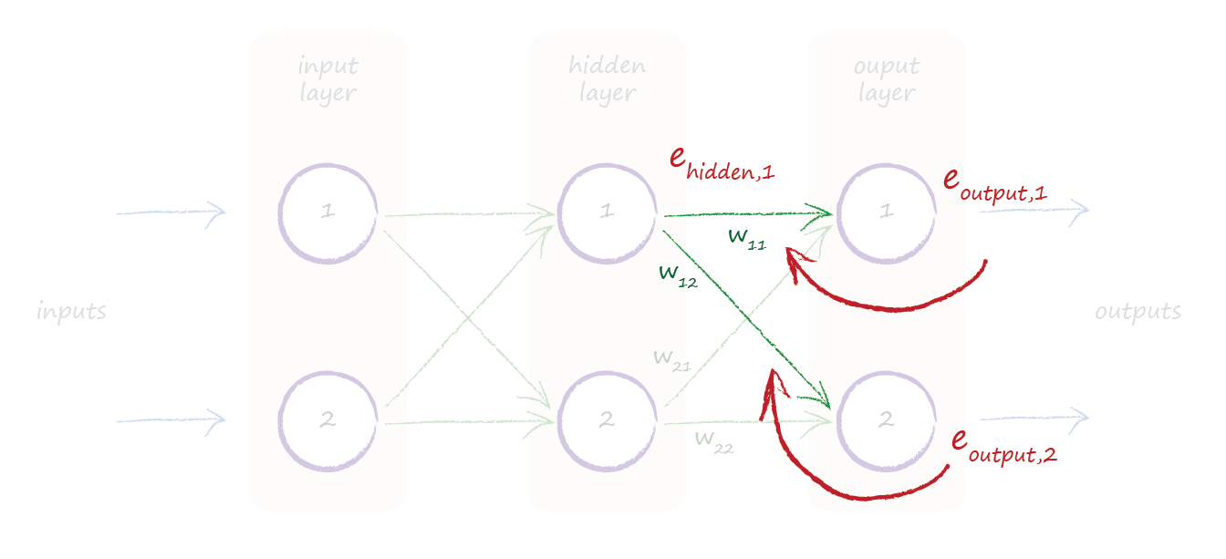
Internal Error

Slide 56
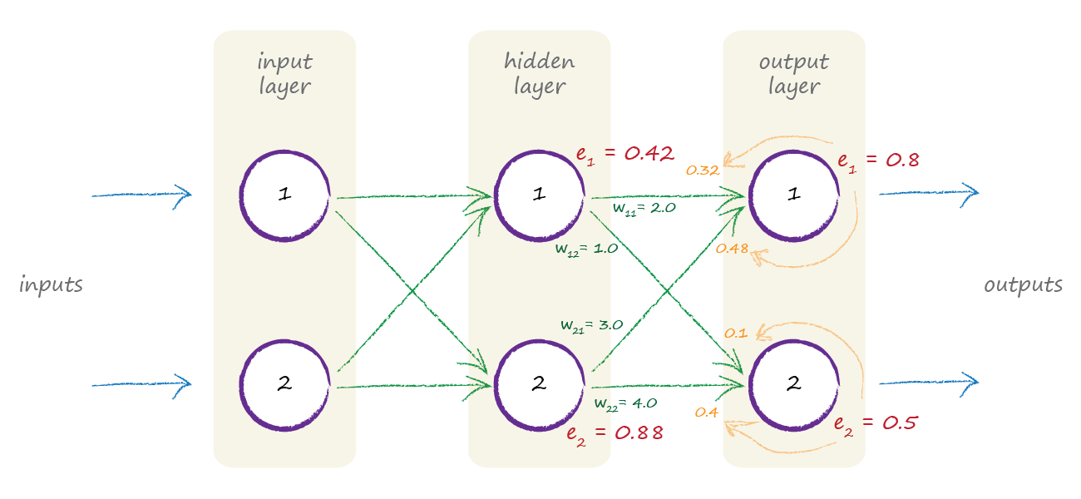
Internal Error

Slide 57
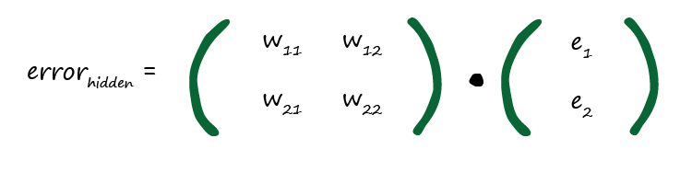

Matrices Again!

Slide 58
Key Points
Remember we use the error to guide how we refine a model’s parameter - link weights.
The error at the output nodes is easy - the difference between the desired and actual outputs.
The error at internal nodes isn’t obvious. A heuristic approach is to split it in proportion to the link weights.
… and back propagating the error can be expressed as a matrix multiplication too!

Slide 59
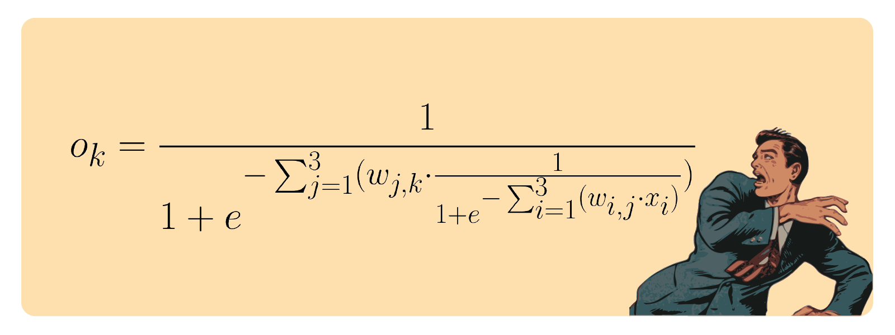
Yes, But How Do We Actually Update The Weights?
Aaarrrggghh!

Slide 60

Perfect is the Enemy of Good
landscape is a complicated difficult mathematical function ..
… with all kinds of lumps, bumps, kinks …

Slide 61
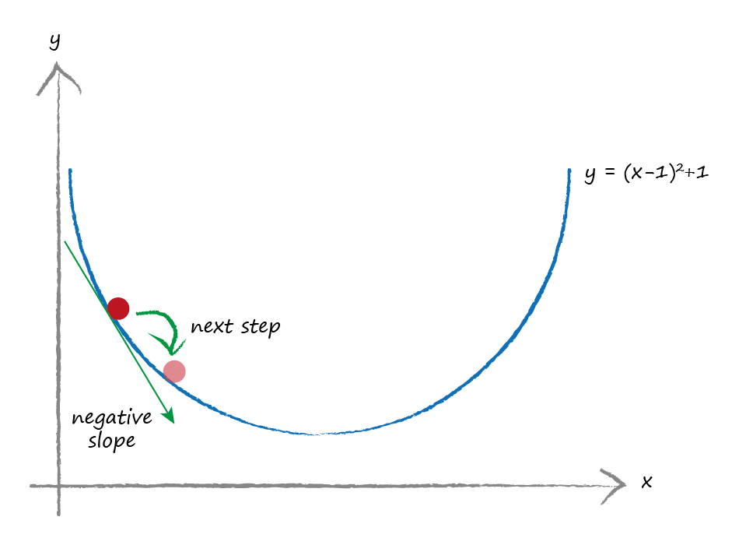
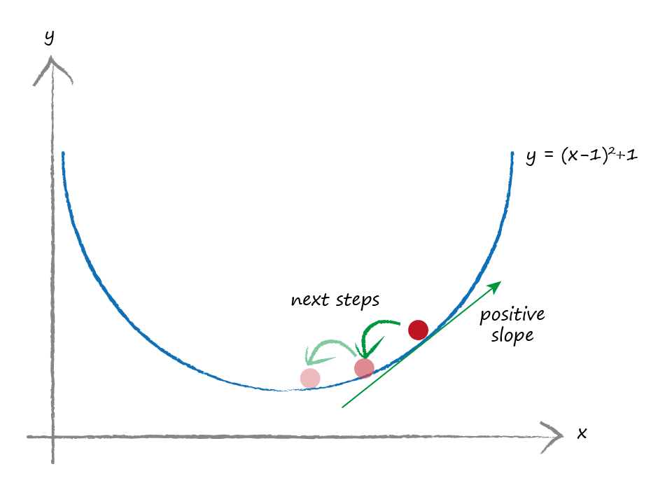
Gradient Descent
smaller gradient .. you’re closer to the bottom … take smaller steps?

Slide 62
Key Points
Gradient descent is a practical way of finding the minimum of difficult functions.
You can avoid the chance of overshooting by taking smaller steps if the gradient gets shallower.
The error of a neural network is a difficult function of the link weights … so maybe gradient descent will help ...

Slide 63
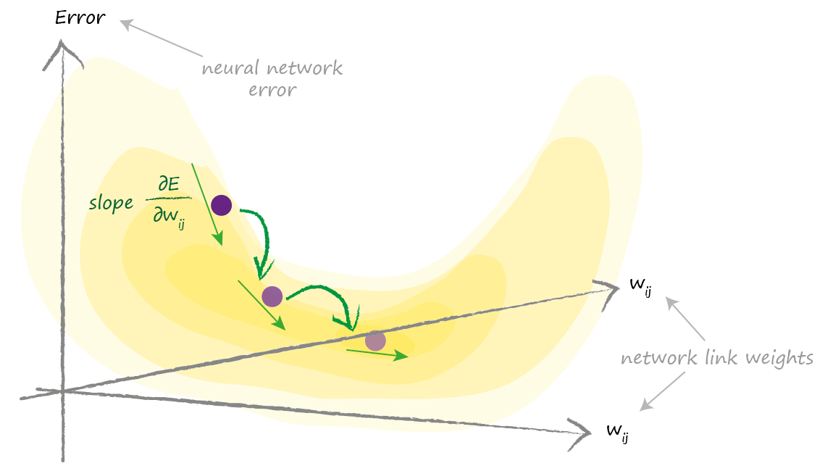
Climbing Down the Network Error Landscape
We need to find this gradient

Slide 64
Error Gradient
E = (desired - actual)²
chain rule
dE/dw_{ij} = - e_{j} . o_{j} . (1 - o_{j}) . o_{i}
previous node

Slide 65
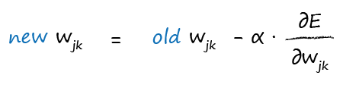
Updating the Weights
move w_{jk} in the opposite direction to the slope
remember that learning rate

Slide 66
Handwriting

Slide 67
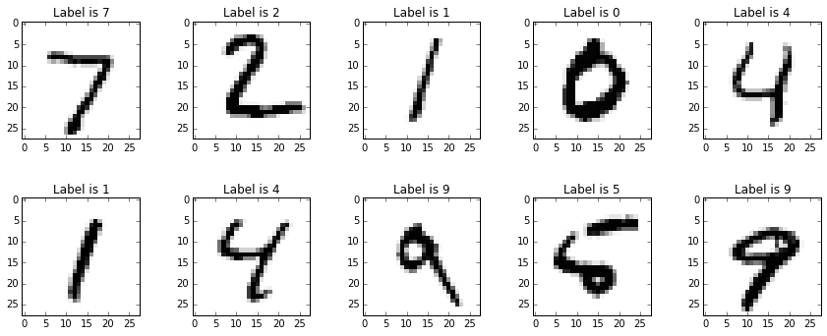
Handwritten Numbers Challenge

Slide 68

MNIST Datasets
MNIST dataset:
60,000 training data examples
10,000 test data examples

Slide 69

MNIST Datasets
label
784 pixels
values
28 by 28 pixel image

Slide 70

Output Layer Values

Slide 71



Experiments
random processes
do go wonky!

Slide 72


More Experiments

Slide 73
Thoughts

Slide 74

Peek Inside The Mind Of a Neural Network?

Slide 75

Peek Inside The Mind Of a Neural Network?

Slide 76
GANs

Slide 77


Slide 78
DIWHY

Slide 79



Tensorflow
●
Originally developed by the Google
Brain Team within Google's Machine
Intelligence research organization
●
TensorFlow provides primitives for
defining functions on tensors and
automatically computing their
derivatives.
●
An open source software library for
numerical computation using data
flow graphs
Tensors can be viewed as a
multidimensional array of numbers.
This means that:
A scalar is a tensor,
A vector is a tensor,
A matrix is a tensor...

Slide 80

Tensorflow – Computational Graphs
●
Computations are represented as graphs:
●
Nodes are the operations (ops)
●
Edges are the Tensors
(multidimensional arrays)
●
Typical program consists of 2 phases:
●
construction phase: assembling a
graph (model)
●
execution phase:
pushing data through the graph

Slide 81

Keras
open source neural network library written in Python
can run on top of TensorFlow, Microsoft Cognitive Toolkit, Theano, or MXNet
enables fast experimentation with deep neural networks, it focuses on being user-friendly, modular, and extensible
in 2017 Google's TensorFlow team decided to include Keras in TensorFlow's core library
offers a higher-level, more intuitive set of abstractions that make it easy to develop deep learning models regardless of the computational backend used.

Slide 82
Thanks!

