Slide 1
OCULAR CONDITIONS
AND HEADACHE OUTCOMES
A Retrospective Analysis
Andrea Gaiter
Master of Science in Applied Statistics · The University of Akron
May 2026

Slide 2
PICTURE SOMEONE
A woman, mid-forties.
Fifteen years of headaches.
PCP. Neurologist. MRI.
Two preventatives. Riboflavin.
Magnesium. An elimination diet. A sleep study.
Then, she goes to an eye doctor.
2 / 28

Slide 3
WHAT THIS STUDY IS
324 patient records.
One ophthalmology practice.
One question:
Three points
01 Why the eye and the head are wired together
02 What the data showed across 324 patients
03 Questions the findings raise for clinicians
How often is a headache patient's actual problem an eye problem,
and if we treat the eye, does the headache improve?
3 / 28

Slide 4
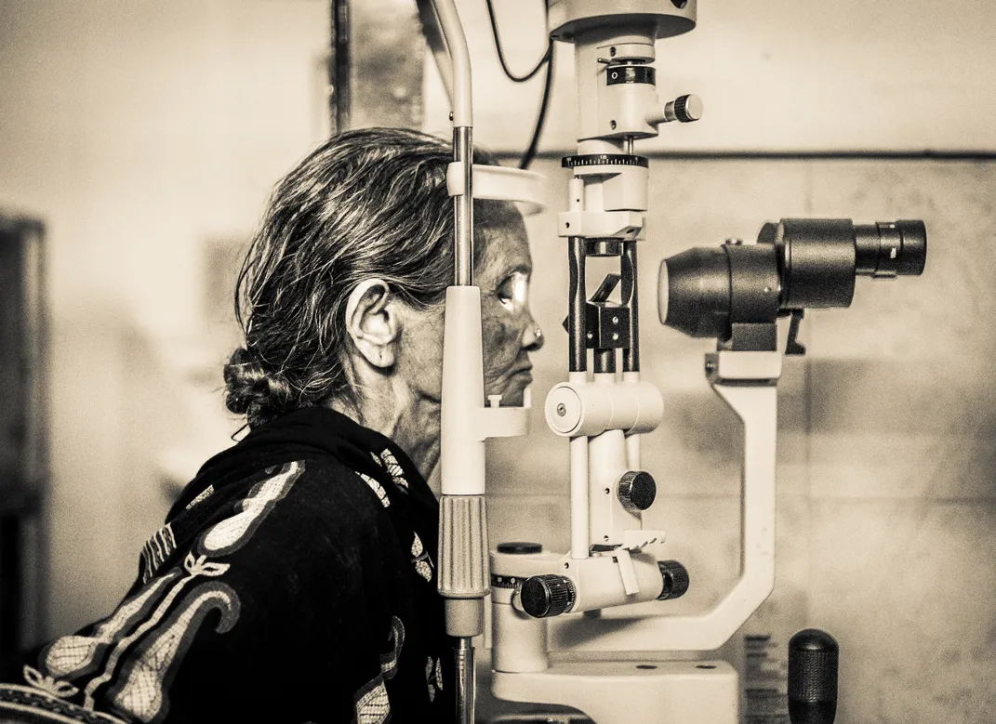
A QUICK ORIENTATION
Ophthalmology?
Ophthalmology is the branch of medicine that deals with the anatomy, function, and disease of the visual system. Optometry is the related profession that handles vision testing, refraction, and detection of ocular disease. Together they see between 88 and 100 million U.S. adults each year.
THE COMPREHENSIVE EYE EXAM COVERS
Visual acuity
Refraction
Intraocular pressure
Slit-lamp exam
Ocular motility
Pupillary function
Photo: Slit Lamp Examination, Smithsonian Magazine Photo Contest
4 / 28

Slide 5
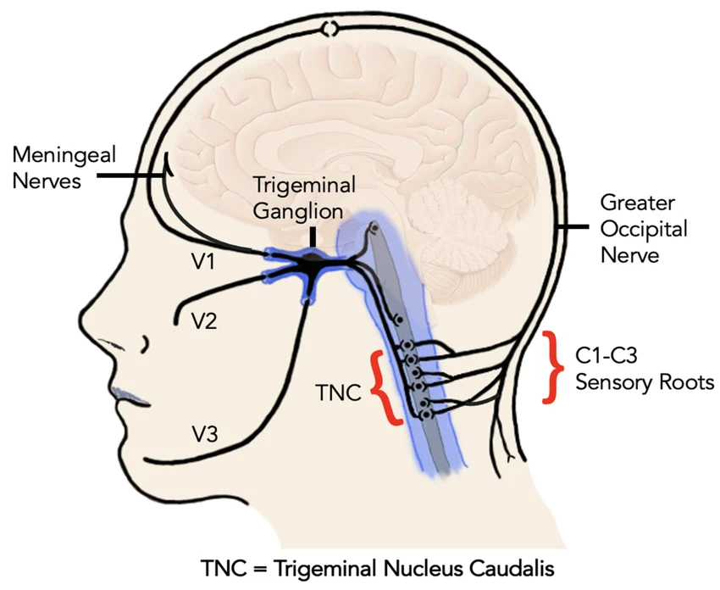
THE WIRING
The eye and the head
share a nerve
V1, the ophthalmic branch of the trigeminal nerve, carries sensation from the cornea, the forehead, and the dura mater inside the skull.
All of those signals converge at the trigeminal nucleus caudalis (TNC) before reaching the brain.
Two different pain sources sharing one relay. Referred pain follows.
Diagram: trigeminocervical complex, via ResearchGate
5 / 28

Slide 6
WHY MILD EYE CONDITIONS MATTER
Two facts about the connection
01
02
Central sensitization
Shared chemistry
The cornea has one of the highest densities of pain receptors in the body. Chronic low-grade irritation keeps the trigeminal pathway firing, and the system turns up its own gain. A stimulus that used to register as nothing starts registering as pain.
CGRP, the molecule the new migraine drugs are designed to block, shows up in the trigeminal pain pathway and in tissues of the ocular surface. The eye and the head run on overlapping signaling.
Galor et al. (2015): dry eye patients showed elevated pain sensitivity at distant body sites, not just the eye.
Ashina et al. (2019); Yin et al. (2024).
6 / 28

Slide 7
WHY THIS IS STILL AN OPEN QUESTION
Two specialties, separate worlds
Neurology
Ophthalmology
Treats nervous system disorders, including headache.
Uses its own classification (ICHD-3) and screening tools (HIT-6, MIDAS).
Treats eye disease and the visual system.
Uses its own equipment (slit lamp, refraction) and billing codes.
ICHD-3 recognizes
4 ocular headache subtypes · out of more than 150 total classifications
7 / 28

Slide 8
WHAT THE LITERATURE SAYS
Three converging signals
40.8%
73%
OR 1.59
of school-age children
with refractive errors
developed asthenopia,
including headache
of patients with chronic
eye pain in neuro-
ophthalmology had a
primary headache syndrome
for dry eye disease in
patients with any
headache (95% CI
1.41 – 1.79)
Wajuihian 2015
Szatmáry 2016
Liu et al. 2022, n > 3.5M
8 / 28

Slide 9
THE INFRASTRUCTURE PROBLEM
The asking is happening. The tooling is not.
And yet,
81%
almost none of them know about validated headache screening instruments like the HIT-6 or MIDAS.
of optometrists ask patients about
headache during routine eye exams
The question is being asked without the tools to fix the answer.
Nguyen et al. 2020
9 / 28

Slide 10
THE STUDY
Retrospective chart review
324
SITE
Single ophthalmology practice
DESIGN
Retrospective, no control group
SAMPLE
≈80% female, mean age 54
INCLUSION
Documented ocular condition + headache data + pre/post refraction
patient records
SOFTWARE
R 4.5.3, α = 0.05
10 / 28

Slide 11
WHAT I ASKED
Five research questions
01
Do men and women differ in time to headache improvement after ocular treatment?
02
Do ocular findings appear on the same side as the headache, become more diffuse when both eyes are involved, and match its severity, type, and location?
03
Do age- and sex-defined subgroups (presbyopia in 40s, dry eye in peri/menopausal women) show distinct associations?
04
Do patients with treated ocular findings improve, even when they reported no eye symptoms?
05
Do changes in visual acuity and refractive correction predict headache improvement?
11 / 28

Slide 12
T H E V A R I A B L E S
What's in the dataset
101 variables across 324 patients, grouped by what they describe
PATIENT & HEADACHE
OCULAR FINDINGS, BASELINE
REFRACTION WORN AT INTAKE
patient_id age gender
dur_sym_days time_to_imp
ha_meds ha_sev ha_type
side_gen side_spec
od_retro os_retro n_eyes_pain
od_tear_base os_tear_base
od_conj_base os_conj_base
od_pee_base os_pee_base
od_mgd_base os_mgd_base
od_sev_base os_sev_base
rx_wear_{od/os}_sph
rx_wear_{od/os}_cyl
rx_wear_{od/os}_ax
rx_wear_{od/os}_add
REFRACTION PRESCRIBED
SYMPTOMS REPORTED
OCULAR FINDINGS, FINAL & CHANGE
rx_give_{od/os}_sph
rx_give_{od/os}_cyl
rx_give_{od/os}_ax
rx_give_{od/os}_add
pres_ocul_sym
osd_sym
blur_vis
od_tear_final os_tear_final
od_tear_chg os_tear_chg
od_conj_final os_conj_final
od_conj_chg os_conj_chg
od_pee_final os_pee_final
od_pee_chg os_pee_chg
od_mgd_final os_mgd_final
od_mgd_chg os_mgd_chg
od_sev_final os_sev_final
TREATMENTS DELIVERED
REFRACTION CHANGE & SIG. FLAGS
tx_art_tears tx_punct_plugs
tx_gels tx_mrx
tx_cataract tx_laser
tx_pred_drops tx_glauc_drops
tx_blephar tx_resp
n_visits
d_sph_{od/os} sig_d_sph_{od/os}
d_cyl_{od/os} sig_d_cyl_{od/os}
d_ax_{od/os} sig_d_ax_{od/os}
d_add_{od/os} sig_d_add_{od/os}
VISUAL ACUITY
va_pre_{od/os} va_post_{od/os}
d_va_{od/os} sig_d_va_{od/os}
POWER-VECTOR ASTIGMATISM
od / os = right eye / left eye _base / _final / _chg = baseline, post-treatment, change sig_ = clinically meaningful change flag
12 / 28
vec_{od/os}_cyl vec_{od/os}_ax
sig_d_vec_{od/os}

Slide 13
T H E V A R I A B L E S
What's in the dataset
101 variables across 324 patients, grouped by what they describe
PATIENT & HEADACHE PROFILE
OCULAR TREATMENTS DELIVERED
REFRACTION WORN & PRESCRIBED
Patient ID
Age
Sex
Headache duration at intake (days)
Time to headache improvement
Headache medications taken
Headache severity (0–3)
Headache type (migraine, tension, etc.)
Headache side, general
Headache side, specific
Retro-orbital pain, each eye
Number of eyes with pain
Artificial tears
Punctal plugs
Gels and ointments
New refraction prescribed
Cataract surgery
Laser procedure
Prednisone (steroid) drops
Glaucoma drops
Blepharitis treatment
Treatment response (improved / not)
Number of follow-up visits
each eye, throughout this column · intake and exit
Sphere
Cylinder
Axis
Add power (reading)
REFRACTION CHANGE & FLAGS
Sphere change & flag
Cylinder change & flag
Axis change & flag
Add power change & flag
OCULAR FINDINGS
VISUAL ACUITY
each eye · baseline, post-treatment, change
Pre-treatment
Post-treatment
Change & meaningful-change flag
SYMPTOMS REPORTED
Tear film
Conjunctival staining
Punctate epithelial erosions (PEE)
Meibomian gland dysfunction (MGD)
Composite severity score (0–4)
Presenting ocular symptom
Ocular surface disease symptoms
Blurry vision
POWER-VECTOR ASTIGMATISM
Vector cylinder & axis
Meaningful-change flag
Pre/post measures and meaningful-change flags applied per eye, totaling 101 columns in the working dataset.
12 / 28

Slide 14
ASSUMPTIONS & DIAGNOSTICS
What each test assumes, and what I checked
01
Missingness handled by complete-case analysis. MCAR is implausible; MAR is the working assumption, with the MNAR direction noted.
02
Proportional hazards checked with Schoenfeld residuals and log-log plots. Global test p = .962, so the PH assumption holds for the Cox model.
03
Pearson and likelihood-ratio chi-square for nominal contingency tests, with LR preferred when expected cell counts fall below 5.
04
Logistic models checked with Box-Tidwell for log-odds linearity, VIFs for multicollinearity, and events-per-predictor for sample-size adequacy.
05
Multiple comparisons addressed within each hypothesis family with Holm-Bonferroni.
13 / 28

Slide 15
PART ONE
The nulls
Two things that didn't replicate, and what each one tells us about the design.
14 / 28

Slide 16
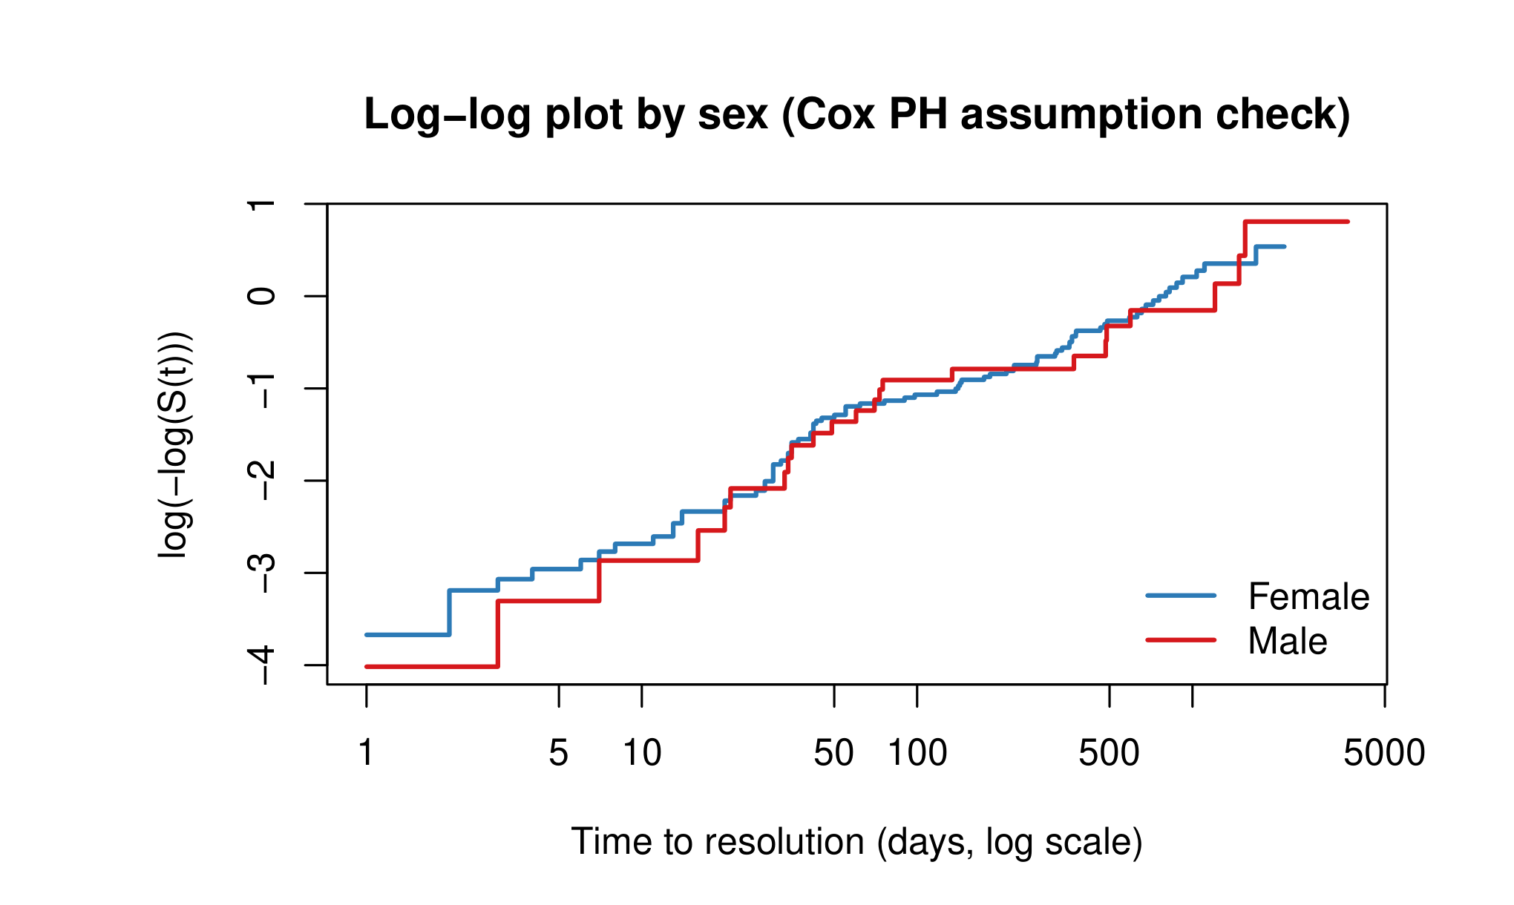
NULL #1 · TIME TO IMPROVEMENT BY SEX
Men and women improve at indistinguishable rates
Cox proportional hazards (male vs. female)
HR = 0.91 95% CI [0.57, 1.44] p = .685
Log-rank χ² = 0.162, df = 1, p = .687 · Schoenfeld global test p = .962 (PH assumption holds)
Reading
Headache disorders skew female in prevalence. In this sample, once headache is present and ocular treatment begins, the time-to-improvement curves do not separate by sex. The literature wouldn't predict a sex difference in recovery time, and the data agrees.
15 / 28

Slide 17
NULL #2 · REFRACTIVE CHANGE AND HEADACHE IMPROVEMENT
An underpowered null
COMPOSITE VECTOR
CYLINDER CHANGE
AXIS CHANGE
OR 0.51
OR 0.89
OR 0.66
95% CI [0.19, 1.35]
95% CI [0.31, 2.52]
95% CI [0.20, 2.04]
What you’re seeing
This analysis is underpowered, the binary coding limits sensitivity, and the point estimates are in a direction that warrants follow-up.
16 / 28

Slide 18
PART TWO
What the data showed
Six findings: PEE asymmetry tracks headache side, ocular severity tracks headache severity, blurry vision predicts migraine, ocular surface symptoms predict frontal headache, conjunctival staining tracks headache severity in women 60+, and 63% improvement in patients who didn't know they had an eye problem.
17 / 28

Slide 19
FINDING 1 · LATERALITY × PEE ASYMMETRY
PEE asymmetry tracks headache side
Side concordance
p = .010
In a 4×3 contingency table (headache side × PEE asymmetry, n = 324), unilateral headaches tended to align with the eye showing more PEE; diffuse headaches were associated with symmetric PEE. Six of twelve cells have expected counts under 5, so the likelihood-ratio chi-square (p = .010) is more reliable than the Pearson statistic.
headache side × PEE asymmetry
Pearson p = .023 · n = 324
Likelihood-ratio χ²(6) = 16.70
4 × 3 contingency table · Minitab
Pattern is suggestive; small unilateral subset.
18 / 28

Slide 20
FINDING 2 · SEVERITY TRACKS SEVERITY
A small ordinal association
Both eyes show it
Goodman-Kruskal gamma
γ = 0.19
Gamma on composite ocular severity (max of OD or OS) by headache severity returns γ = 0.187, p = .006, 95% CI [0.06, 0.32]. Eye-specific tests agree: OD γ = 0.16, p = .018; OS γ = 0.20, p = .005. The magnitude is modest, the direction is consistent.
p = .006 · n = 324
ocular severity scale 0–4
headache severity scale 0–3
Worse eye findings come with worse headaches.
19 / 28

Slide 21
FINDING 3 · HEADACHE TYPE AND OCULAR PREDICTORS
Blurry vision more than doubles the odds of migraine
Migraine or aura
OR 2.13
Patients reporting blurry vision were over twice as likely to have a migraine diagnosis as patients who didn't, controlling for OSD symptoms, slit-lamp findings, and ocular severity.
95% CI [1.27, 3.58]
The association is specific to migraine. Multinomial LRT for the full model: p = .018.
p = .003 · Holm p = .010
Multinomial logistic regression
20 / 28

Slide 22
FINDING 4 · OCULAR SURFACE DISEASE AND HEADACHE LOCATION
Ocular surface symptoms predict frontal-only headache
Patients reporting ocular surface disease symptoms were 3.6 times more likely to localize their headaches to the front of the head than to other locations. The location prediction tracks the anatomy.
Frontal-only headache
OR 3.64
95% CI [1.56, 8.77]
Ocular surface afferents enter via V1 and converge with frontal scalp signals at the trigeminal nucleus caudalis. The CI is wide; magnitude needs prospective confirmation.
p = .001 · Holm p = .003
Logistic regression · binary frontal vs. non-frontal
21 / 28

Slide 23
Conjunctival staining tracks headache severity
FINDING 5 · DRY EYE IN WOMEN 60+
What the test shows
p = .026
Tested in females aged 60+ (n = 124). Patients with conjunctival staining tended to have higher headache severity than those without. Two cells have expected counts under 5, so the likelihood-ratio chi-square (p = .029) is the more reliable read.
conjunctival staining (either eye) × headache severity
Pearson χ²(6) = 14.38 · n = 124
Right eye p = .010 · Left eye p = .004
females aged 60+ · Minitab
Older women with dry eye showed more severe headaches.
22 / 28

Slide 24
FINDING 6 · THE ASYMPTOMATIC SUBGROUP
63%
of patients with treated ocular findings improved
when they had reported no eye symptoms at baseline
31 of 49 · 95% CI [48.3%, 76.6%] · binomial p = .085 (vs. 50% null)
23 / 28

Slide 25
ROBUSTNESS CHECK
The improvement is not concentrated in one treatment
Refractive correction
n=23
70%
Gels and ointments
n=31
65%
Punctal plugs
n=8
63%
Artificial tears
n=30
57%
Blepharitis treatment
n=6
50%
Prednisone drops
n=6
50%
Glaucoma drops
n=6
50%
Fisher's exact across treatment types · p = .905
24 / 28

Slide 26
Questions for future work on this topic
WHAT THE FINDINGS RAISE
01
Diagnostic yield in headache workup
Niazi 2024's identification of refractive error as a leading ocular cause of headache in ophthalmology populations, combined with this study's 63% asymptomatic improvement rate, suggests the diagnostic value of an eye exam in chronic headache may be higher than current practice assumes. A question worth taking to a prospective design.
02
Closing the asking-tooling gap
Optometrists are already asking. Validated headache instruments exist. Closing the gap between asking and tooling is an implementation problem, and one a joint working group could take on without waiting for new science.
03
ICHD-3 vocabulary
Four ocular subtypes does not match the literature's documented breadth. Whether the classification should expand is a call for the headache medicine community, but practice-based evidence like this is part of the case for revisiting it.
25 / 28

Slide 27
Where the design falls short
CONSTRAINTS
Single-site retrospective sample. No control group, no causal inference.
Duration variable derived from chart documentation rather than prospective follow-up.
Outcomes (severity, type, headache improvement) drawn from chart fields rather than validated instruments like HIT-6 or MIDAS. The improvement event definition is study-specific.
Small subgroup cell counts.Post-hoc power for the dry-eye 41-60 subgroup was approximately 25%. Several chi-square contingency tables (PEE asymmetry, conjunctival staining in 60+ women) have expected counts below 5 in some cells.
Findings are best read as preliminary, with prospective replication as the next step.
26 / 28

Slide 28
TO CLOSE
The pattern
Ocular conditions track with headache type and severity.
Treating ocular pathology can improve headache outcomes, even in patients who never reported eye symptoms.
These results are preliminary. The next step is a prospective, multi-site design with a control group. The questions for that study are clearer now than they were at the start.
27 / 28

Slide 29
Thank you
Questions welcome.
Andrea Gaiter · M.S. Applied Statistics · The University of Akron · May 2026
28 / 28

