Slide 1
Fall26 - Intro to Machine Learning
(W5) Ch4-Lab
Logistic Regression, SMOTE, and AI

Slide 2
(+) Review on Default data
Ch4-LabA1
Ch4-LabA2
1. Load Data from ISLR pakage
2. Data Separation (Seed needed – Why? )
3. Logistic Regression on Training set – just as an example
4. Search for best model using CV
5. Final Fit on Training Set
6. Determine the Best Threshold (give cost function)

Slide 3
Compare two models
Resp = default
Model (1) resp ~ balance
Model (2) resp ~ balance + student
How and What number do we compare?

Slide 4
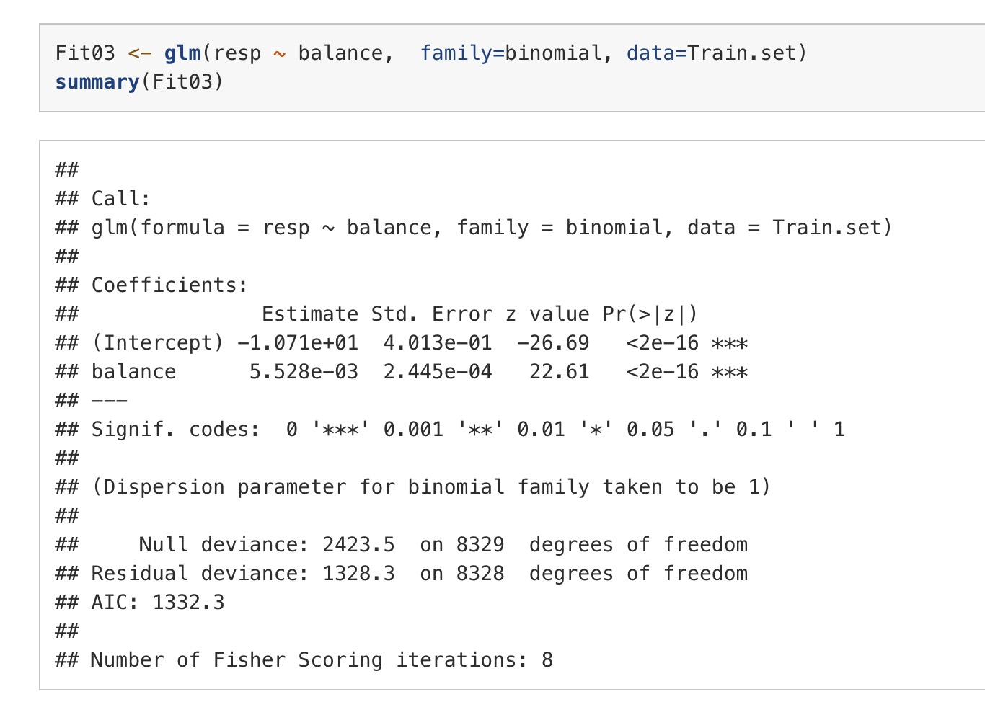
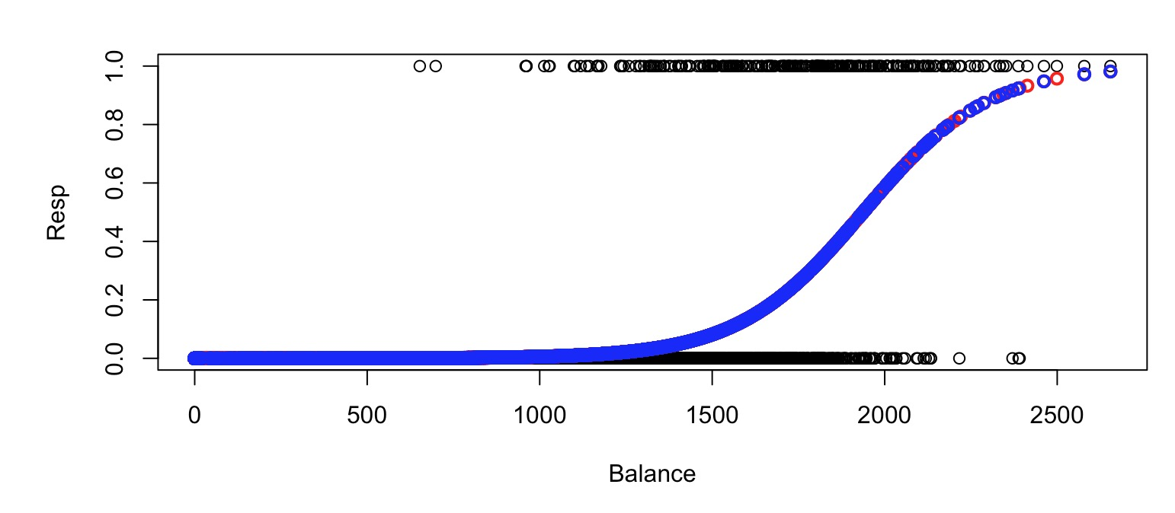

Slide 5
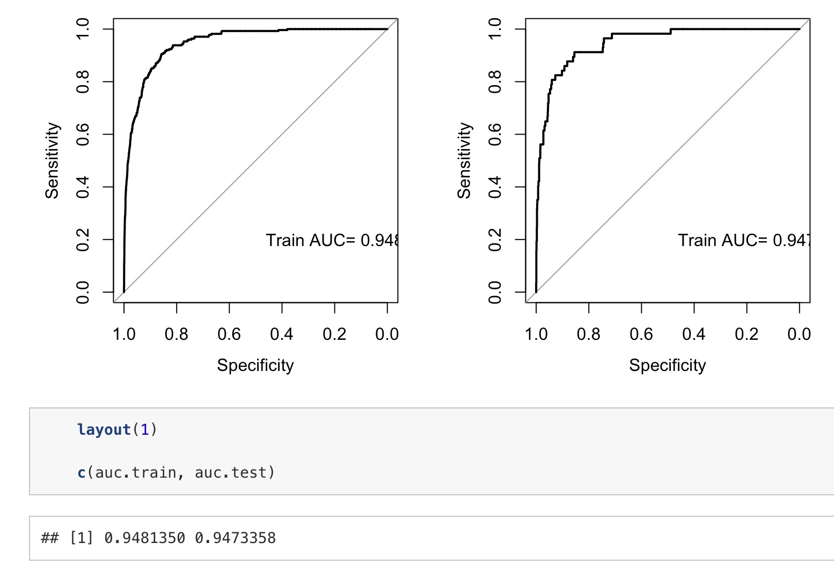
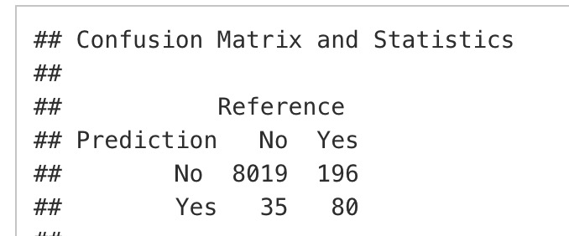
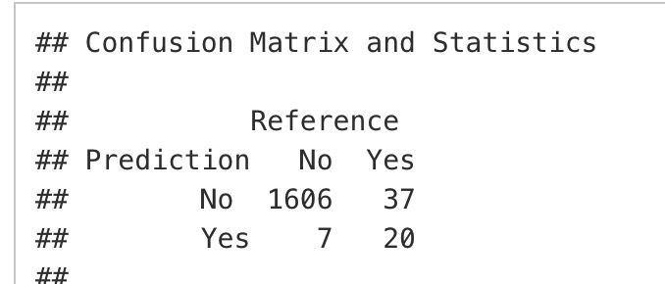

Training
Test

Slide 6
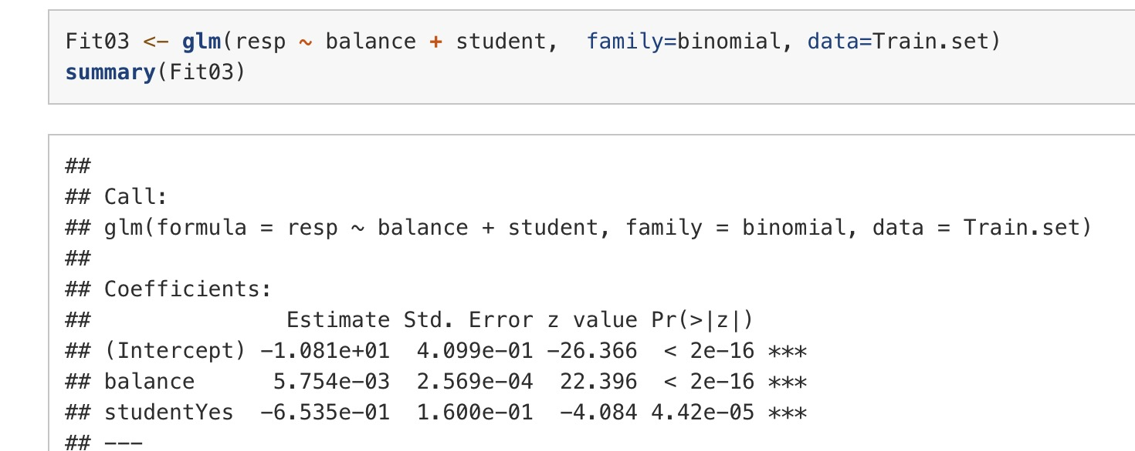
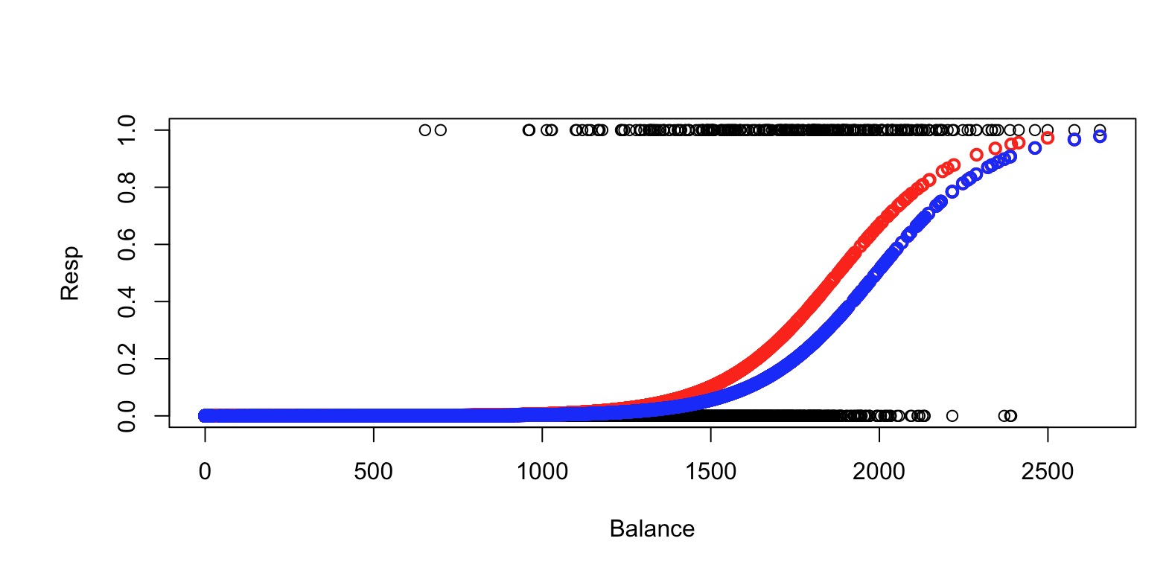

Slide 7
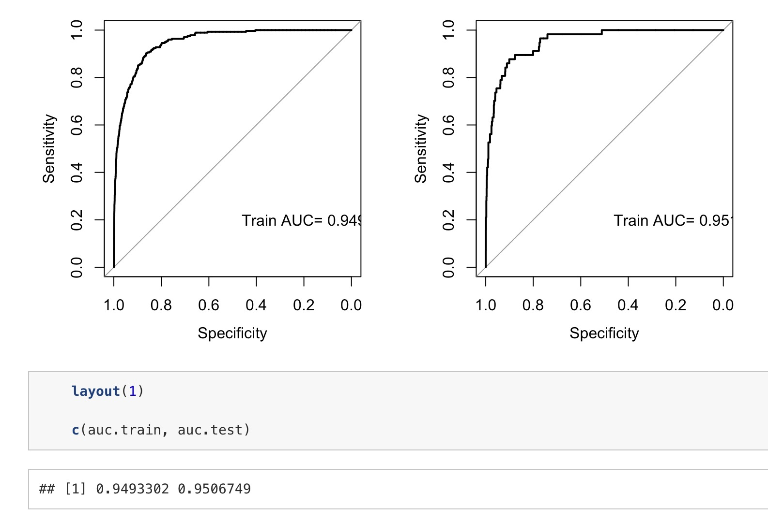
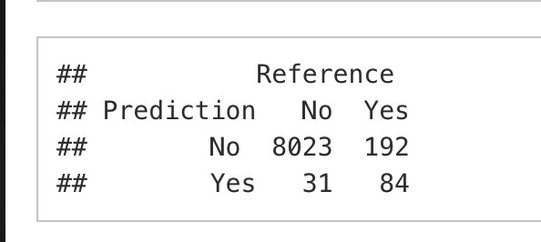
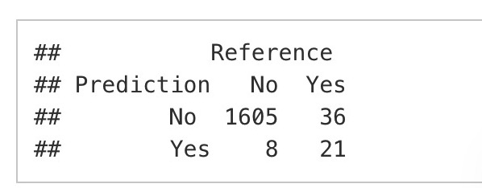
Training
Test

Slide 8
Compare
Model Adequacy
Balance Only
Balance + Student

Slide 9
Compare
Model Adequacy
Balance + Student is the better model at explaining who will default.
Balance Only
Balance + Student

Slide 10
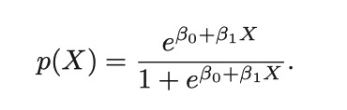
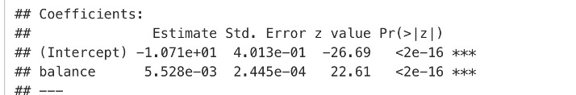
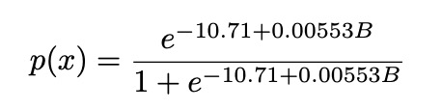
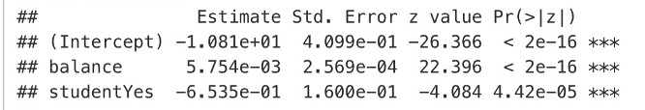
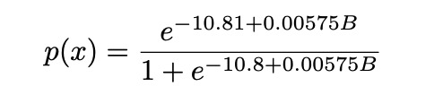
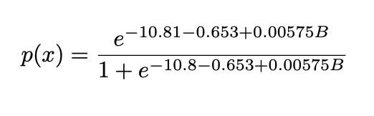
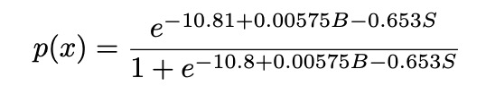
Logistic Function
For non-student
For student

Slide 11
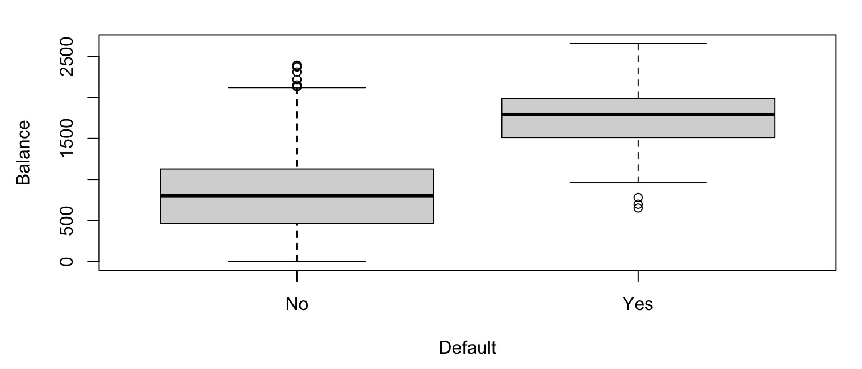
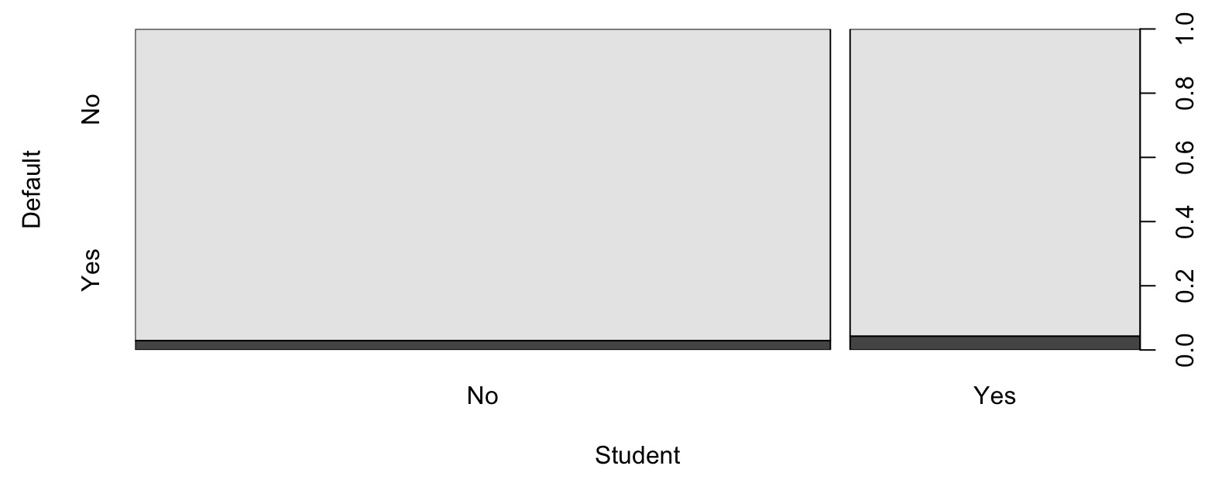
Balance + Student

Slide 12
Balance + Student
For same balance, being student brings the risk down.
Without knowing the balance, being a student is higher risk, because students tend to have higher balance.

Slide 13
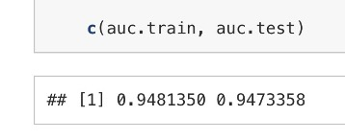
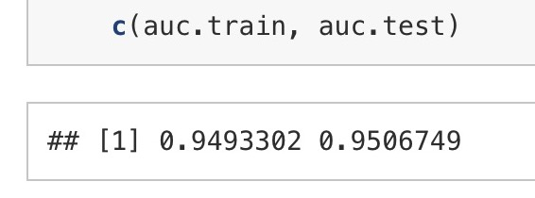
Predictive Ability
Don’t compare CM vs CM.
They depend on threshold
If you compare CM vs CM, then make sure they are both using the threshold optimized by the same cost function (TP, TN, FP, FN)
Training
Test
Balance Only
Balance + Student

Slide 14
Is it really better?
Is this improvement in test AUC significant?
Training
Test
Balance Only
Balance + Student

Slide 15
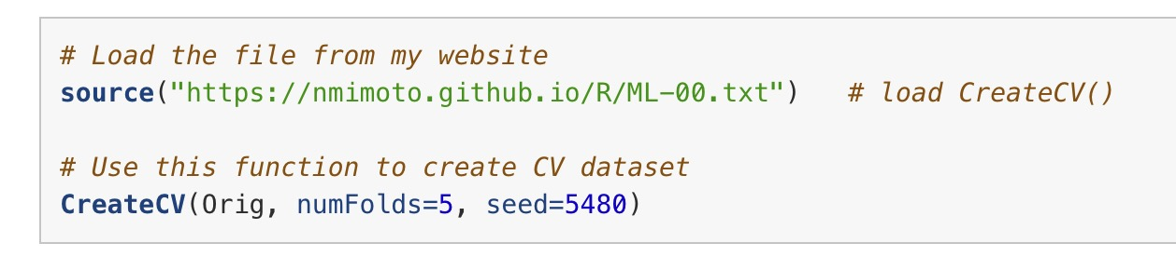
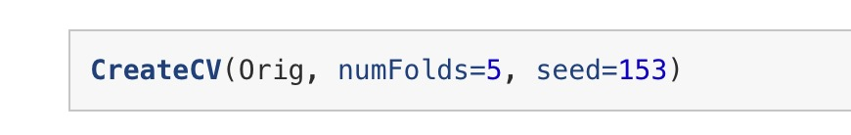
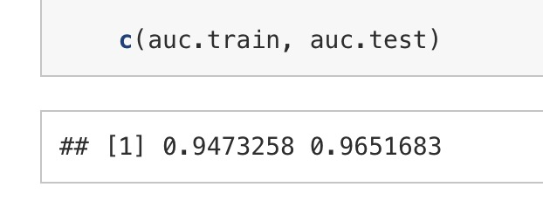
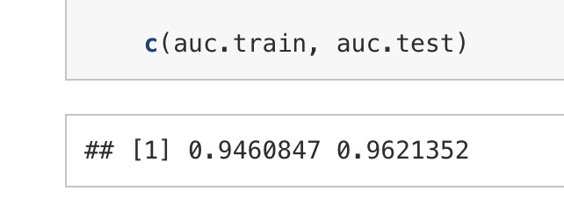
Try changing the seed
Balance Only
Balance + Student

Slide 16
(+) Heads up on Assignment 4 w Heart data
Ch4-LabA3
Ch4-LabA4
You need class change for couple of columns.

Slide 17
(+) Usage of AI
Red light, Yellow light, Green light courses.
I want this course to be Blue Light – you should go above AI’s answer (where appropriate).
Next is an example of that.

Slide 18
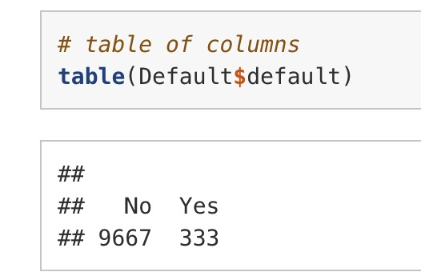
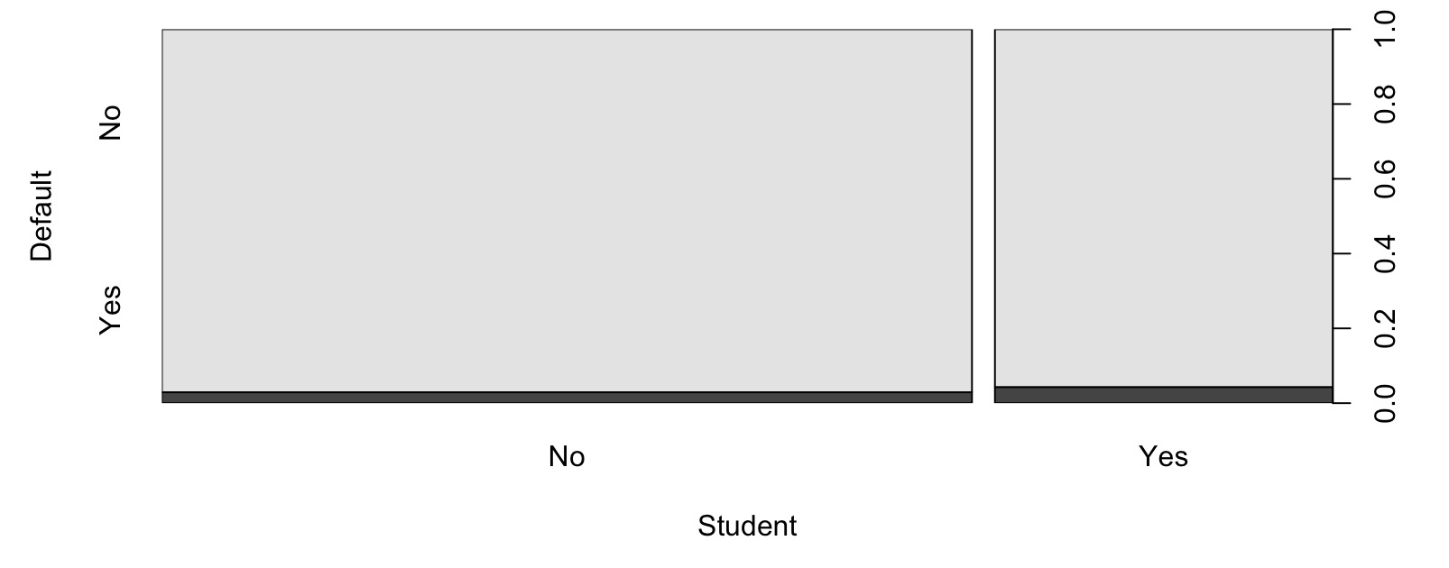
(+) Imbalanced data and SMOTE
Often times data for classification task is imbalanced.
SMOTE (Synthetic Minority Over-sampling Technique) is a highly popular data augmentation algorithm used to resolve class imbalance in machine learning datasets.

Slide 19
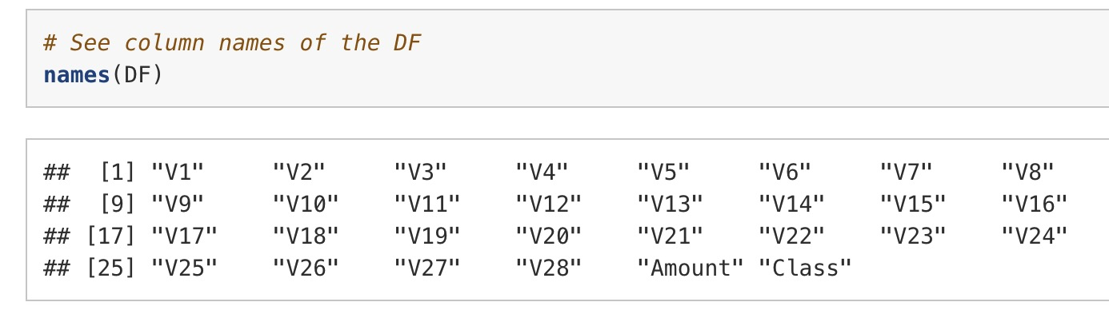
Kaggle Credit Card fraud data
[Kaggle page](https://www.kaggle.com/datasets/mlg-ulb/creditcardfraud)
SMOTE + Logistic Regression on the Kaggle "Credit Card Fraud Detection” dataset
Anonymized European cardholder transactions, Sep 2013, ULB Machine Learning Group.
284,807 transactions, 492 frauds (0.173%)
30 predictors already rotated using PCA (Principal Component Analysis).

Slide 20
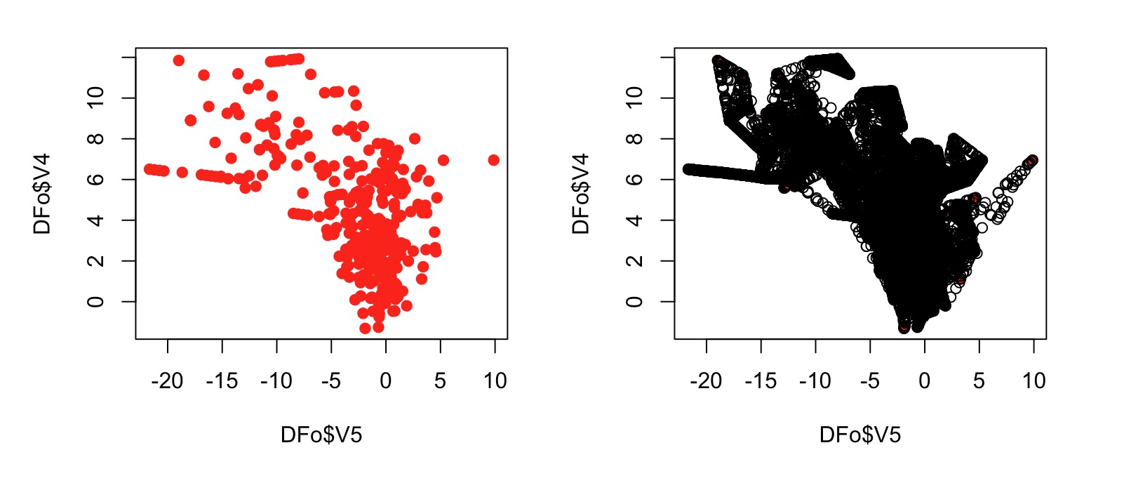
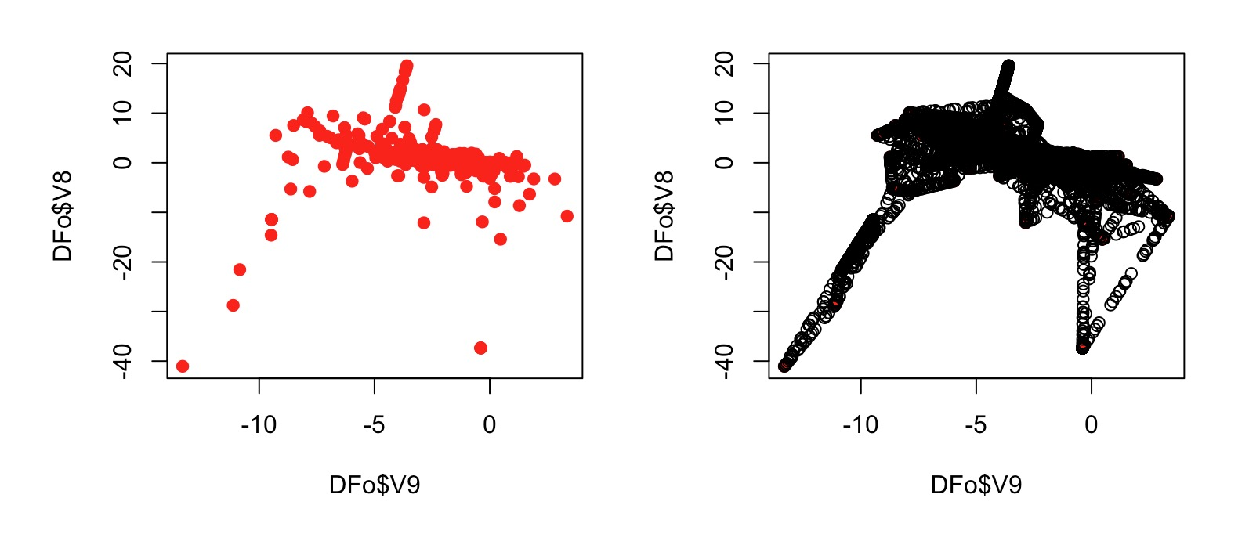
SMOTE
SMOTE only oversamples within training set. Test set is left alone.

Slide 21
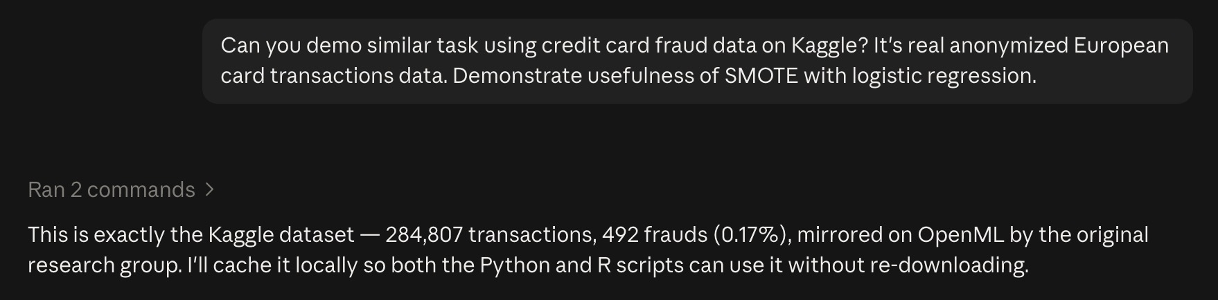
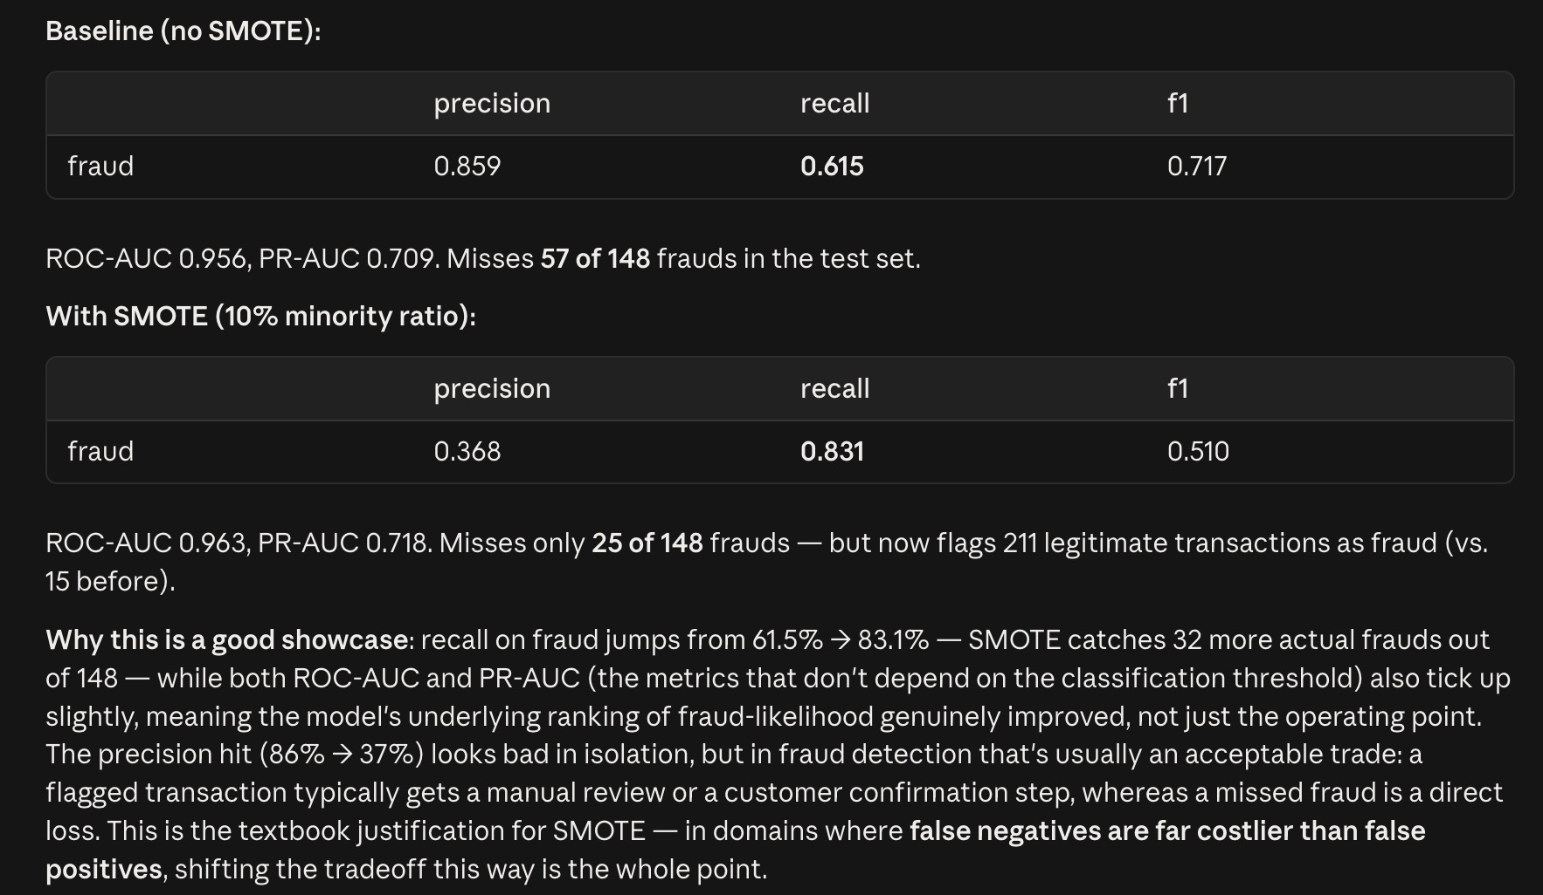
Ask claude:

Slide 22
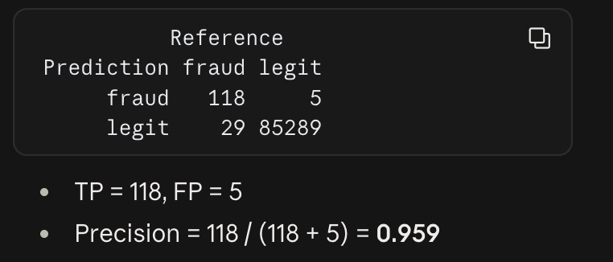
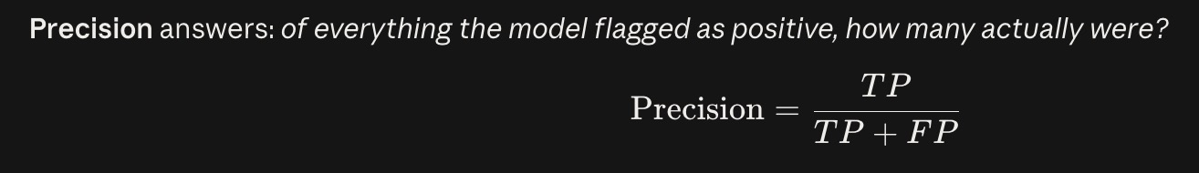
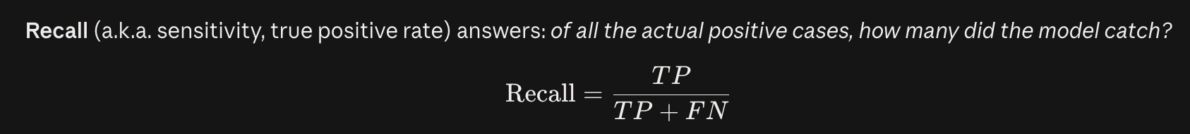
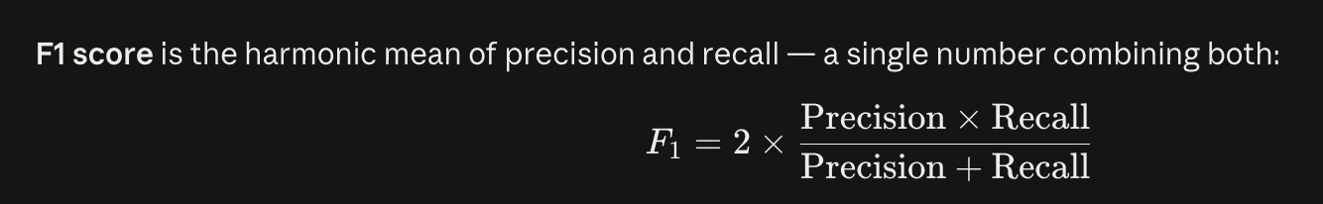
Precision, recall, F1 score:

Slide 23
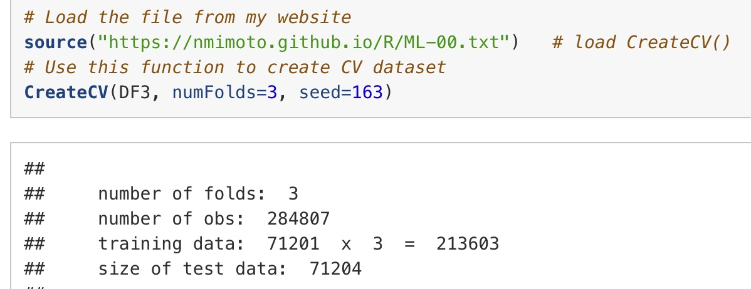
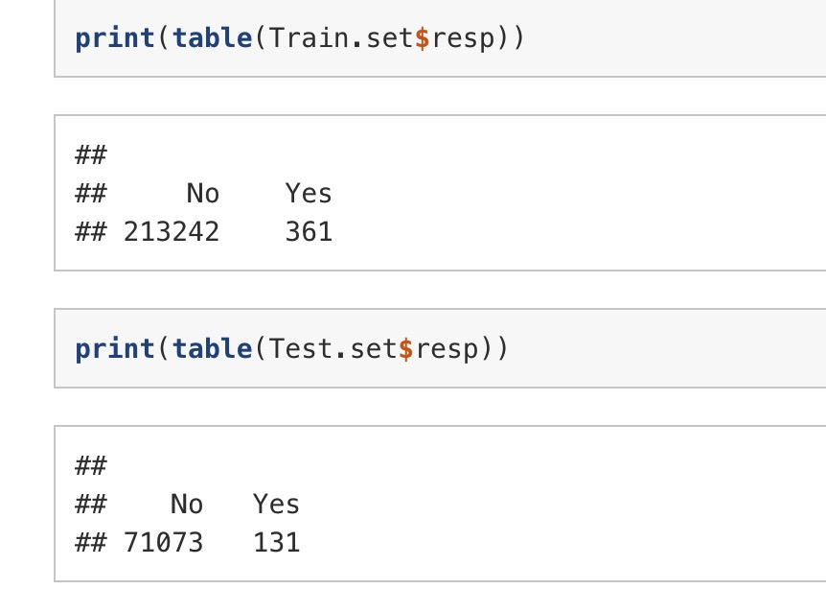
Run the code:
See Ch4-LabA5.
1. Load Data
2. Separate Data

Slide 24
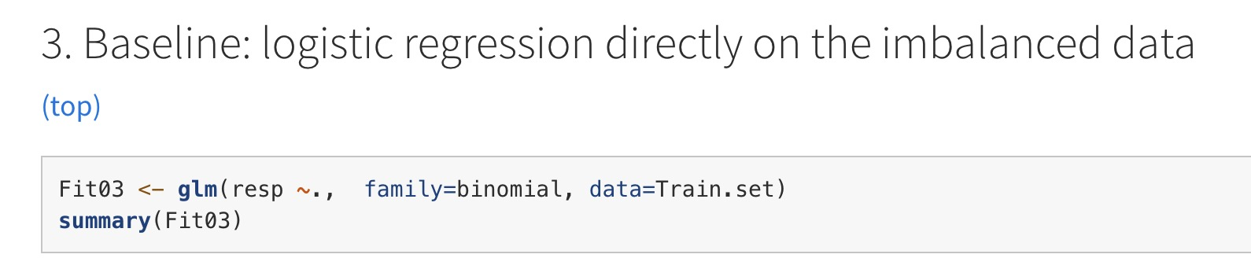
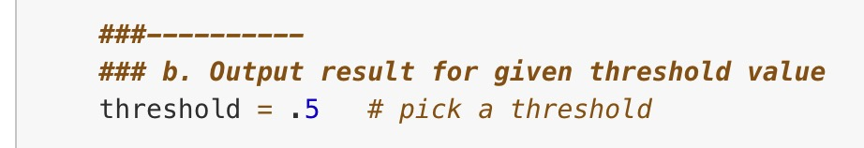
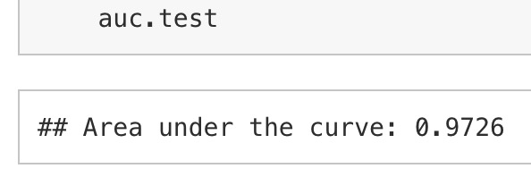
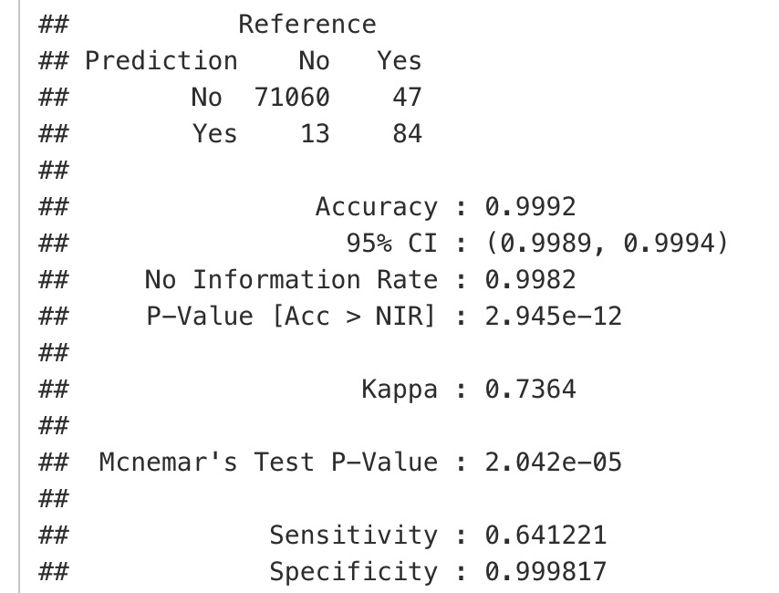

Slide 25
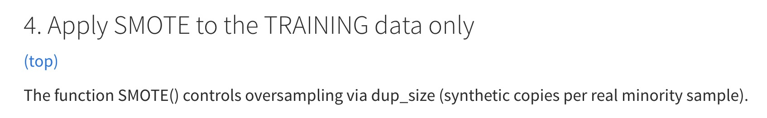
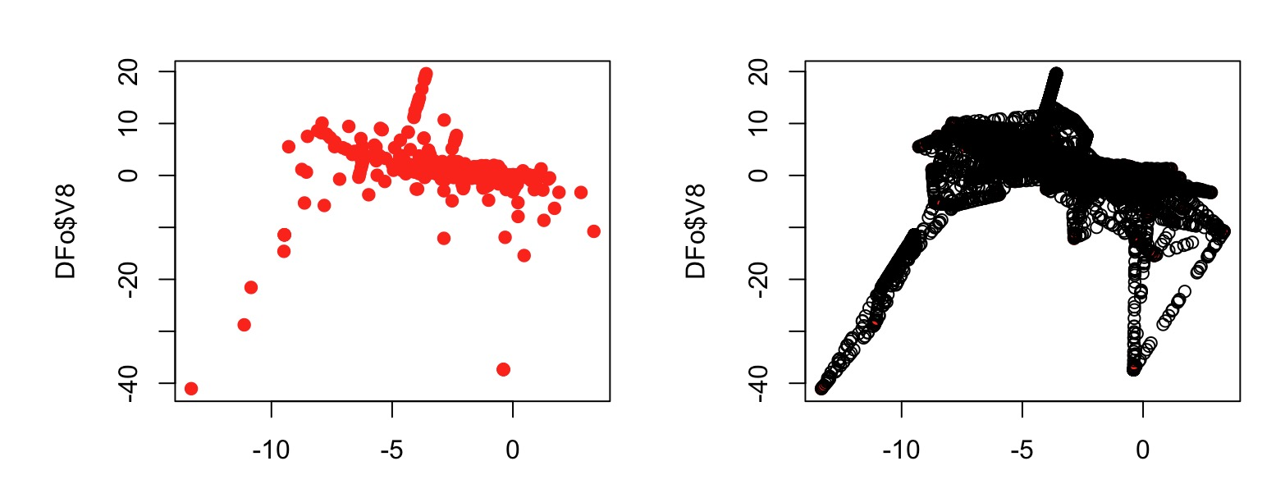
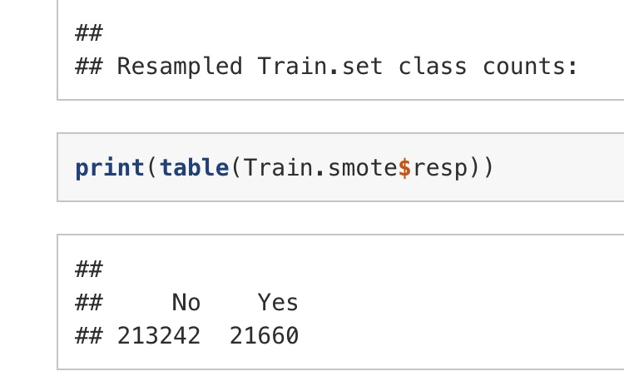

Slide 26
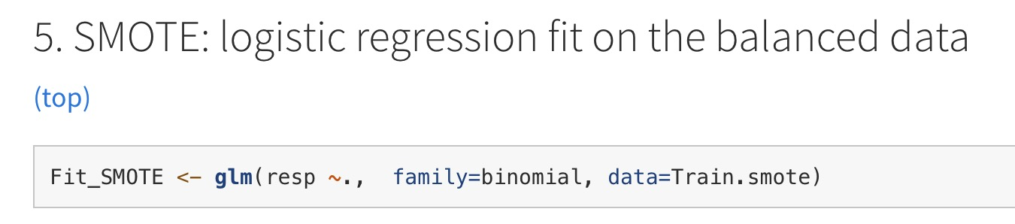
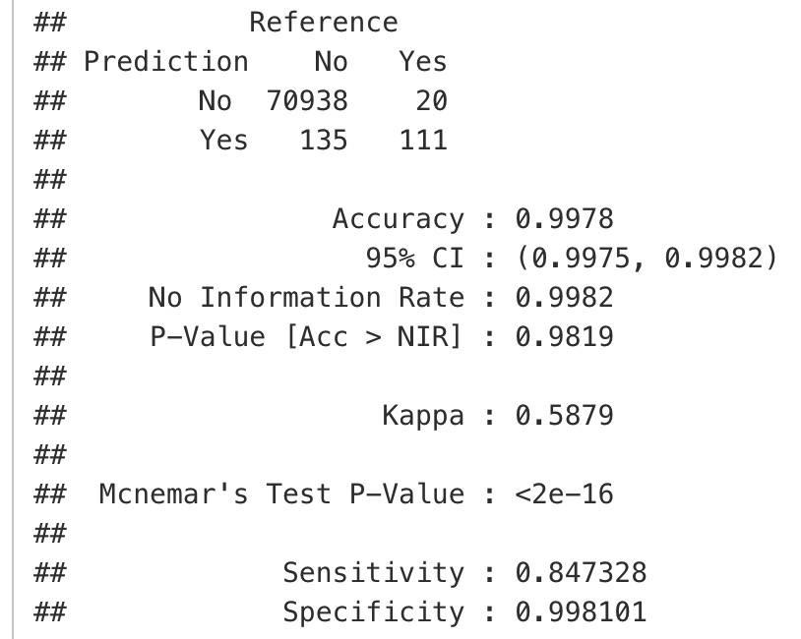
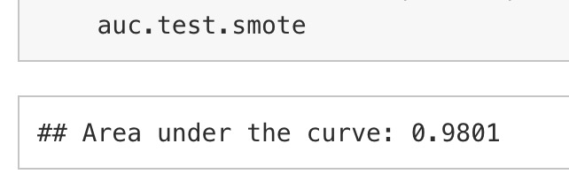
Base
SMOTE

Slide 27
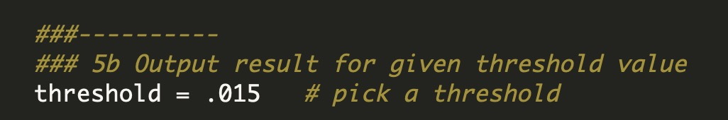
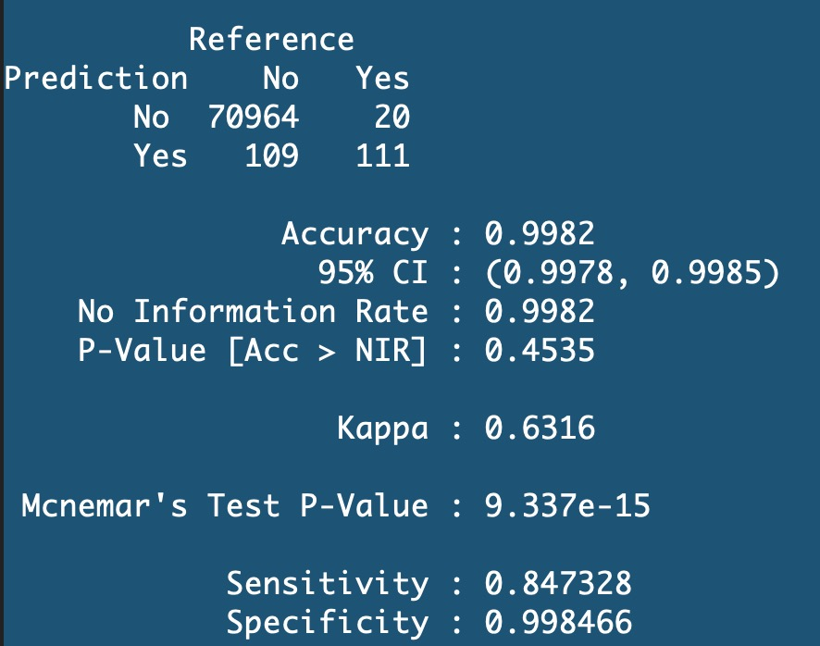
Did we really need SMOTE for that?
Base
SMOTE

Slide 28




Did we really need SMOTE for that?
Base
SMOTE

Slide 29
(+) Intro to R markdown
One way to keep output of R.
Excellent way to archive your work.
Not ideal while you are actively working on the dataset.
Download some template form the class webpage.

Slide 30
End of File
Nao Mimoto nmimoto@uakron.edu

