Slide 1


Design and Evaluation of Multi-Agent Architectures for Stock Price Prediction: A Vietnam Case Study
NGUYỄN MINH DƯƠNG (23010441)

Slide 2
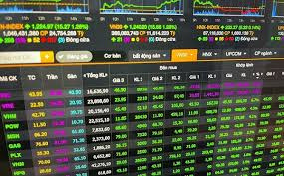
Introduction: Vietnam stock market
DATA ANALYSIS CHALLENGES
  The Vietnamese stock market is currently facing a massive volume of data and constant real-time volatility.
  Stock prices, economic news, and macroeconomic policies change rapidly, creating a complex and unpredictable investment environment.
  Investors must process and analyze this large amount of information to seize opportunities and mitigate risks in the decision-making process.
  The high volatility of the market makes investing require keen insight, data analysis skills, and modern support tools.
  In this context, the application of data analytics and artificial intelligence (AI) technology becomes essential to help investors make accurate and timely decisions.

Slide 3
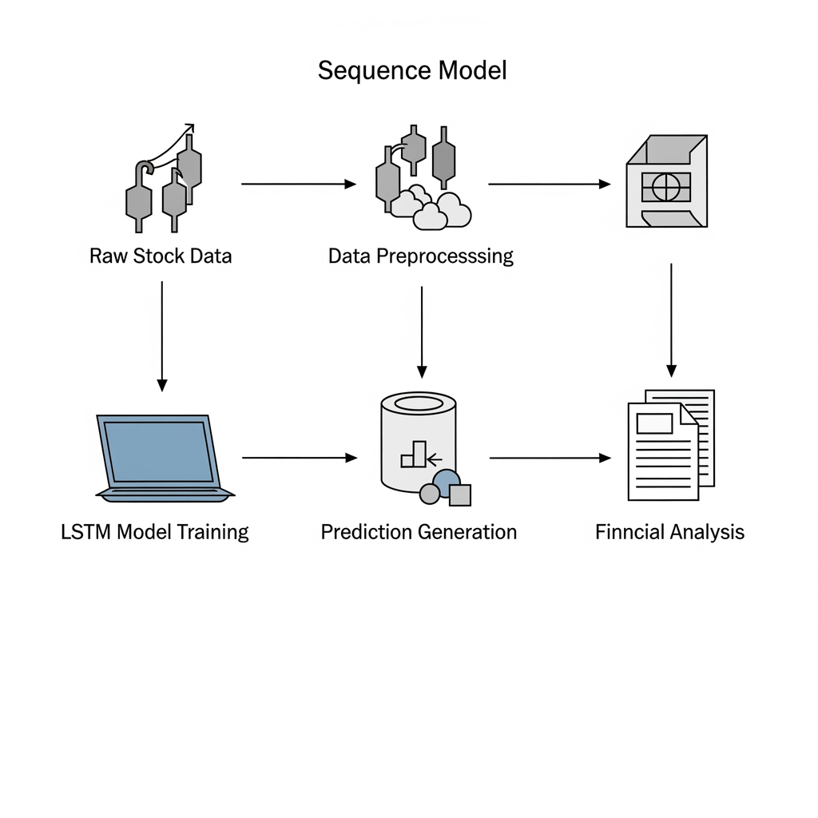

The goal of building the system.
DATA AUTOMATION
The Multi-Agent system will automatically collect and process securities data, helping investors make quick decisions.
ANALYSIS AND PREDICTION
Using AI/LSTM for stock price prediction, the system will provide accurate recommendations on investment strategies.
INVESTMENT RECOMMENDATIONS
The system will provide Buy, Sell, or Hold recommendations, helping investors optimize profits and minimize risks.

Slide 4
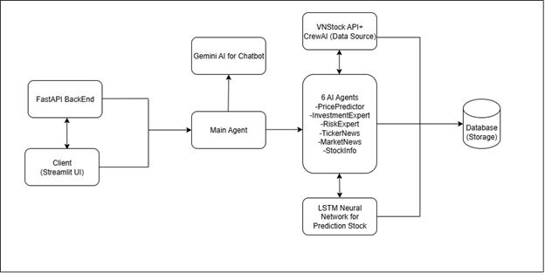
Overall architecture
CLIENT-SERVER MODEL
  The Multi-Agent system is built on a Client-Server model, ensuring scalability and efficient communication between components.
  Streamlit acts as the user interface (Client), displaying data, charts, and analysis results in a user-friendly and intuitive manner.
  FastAPI acts as the server, responsible for processing, managing, and providing data for analytical tasks.
  Agents in the system work in parallel to perform multiple tasks such as collecting real-time data, analyzing trends, predicting price movements, and generating intelligent reports.
  The integration of Streamlit and FastAPI enables the system to achieve high performance and fast processing speeds, while optimizing the process of collecting and analyzing stock market data.
  Thanks to its distributed and flexible architecture, the system supports accurate and timely investment decision-making and enhances the efficiency of market information management for investors.

Slide 5



The main agents in a multi-agent system.
COLLECTORS
ANALYSTS
MAINAGENT
Collect data from multiple sources.
Data analysis and trend prediction
Coordinate and manage system activities.

Slide 6
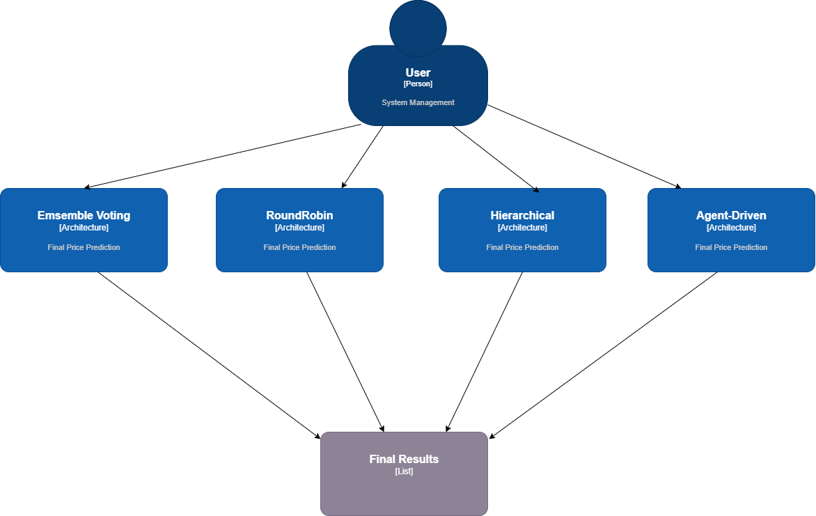
Data collection agent
Function: Collects news data from sources such as CafeF, VietStock, VCI, and market data from VNStock API/ServerAI.
Operating process:
1. Connect to the data source (multi-source crawling).
2. Filter and process data (sentiment analysis, risk-based filtering).
3. Temporarily store data and transfer it to other agents.
Sơ đồ lớp và hoạt động

Slide 7
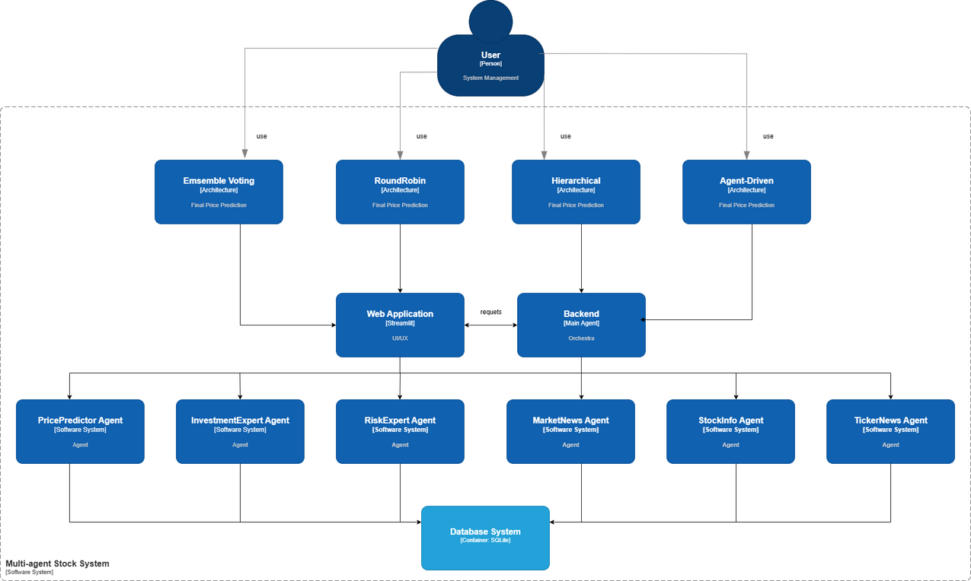
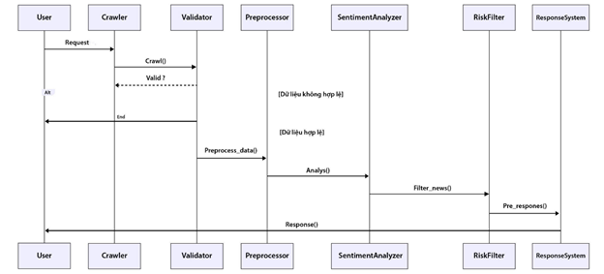
C4-level2
Data collection agent state diagram

Slide 8
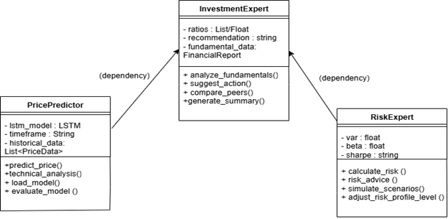
Data Analyst Agent
  Functions:
  PricePredictor: Predicts stock prices using LSTM Neural Network and technical analysis.
  InvestmentExpert: Performs fundamental analysis (P/E, P/B) and provides recommendations (BUY/SELL/HOLD).
RiskExpert: Assesses risk (VaR, Beta, Sharpe ratio).
Data Analysis Agent Class Diagram

Slide 9
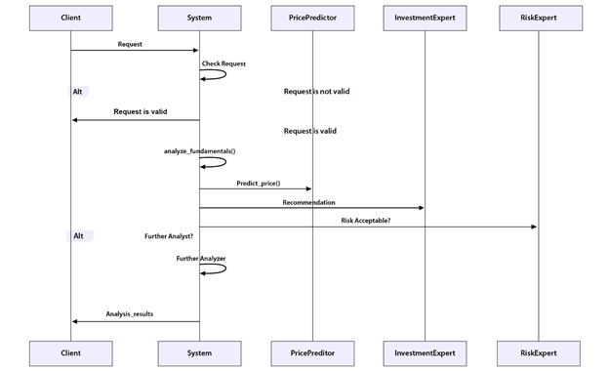
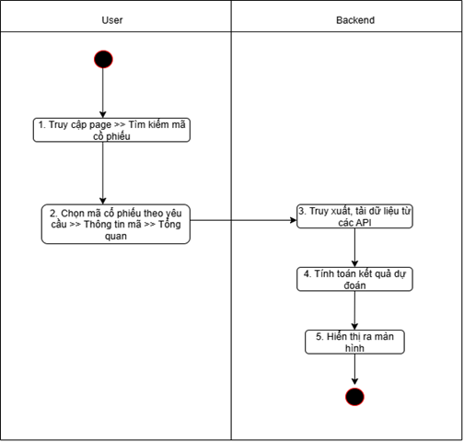
Data Analyst Agent
Flowchart of the sequence and operation of the data analysis agent.

Slide 10
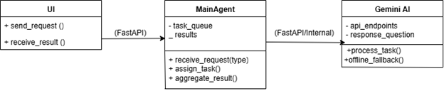
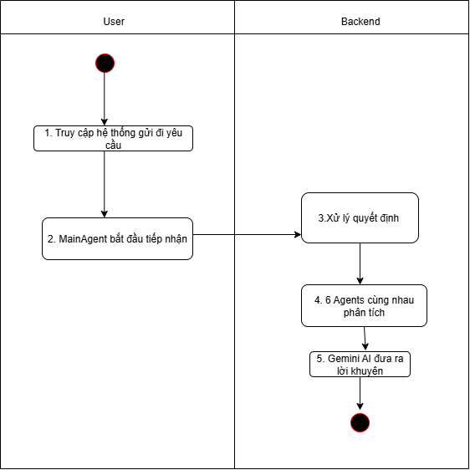
Communication & Collaboration Agent
  Information exchange mechanism: FastAPI endpoints are used to transmit data between agents and the user interface. MainAgent acts as an orchestrator, coordinating tasks between agents.
  Task coordination: MainAgent receives requests from the User (UI) and assigns tasks to the appropriate agents.
  Gemini AI supports chatbots with intelligent responses and offline fallback capabilities, communicating via API or internal mode.
sơ đồ lớp và hoạt động của Agent Hợp tác

Slide 11
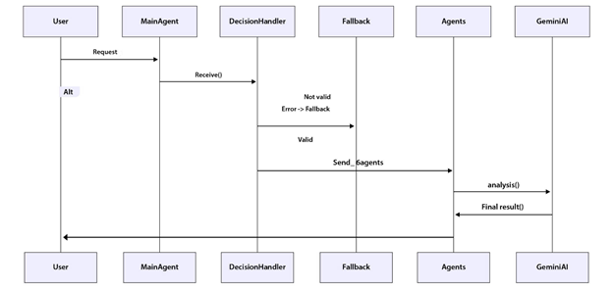
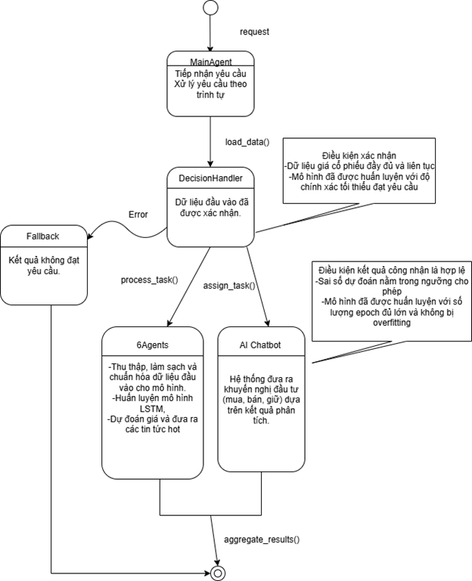
Communication & Collaboration Agent
Agent communication and collaboration sequence and state diagram

Slide 12
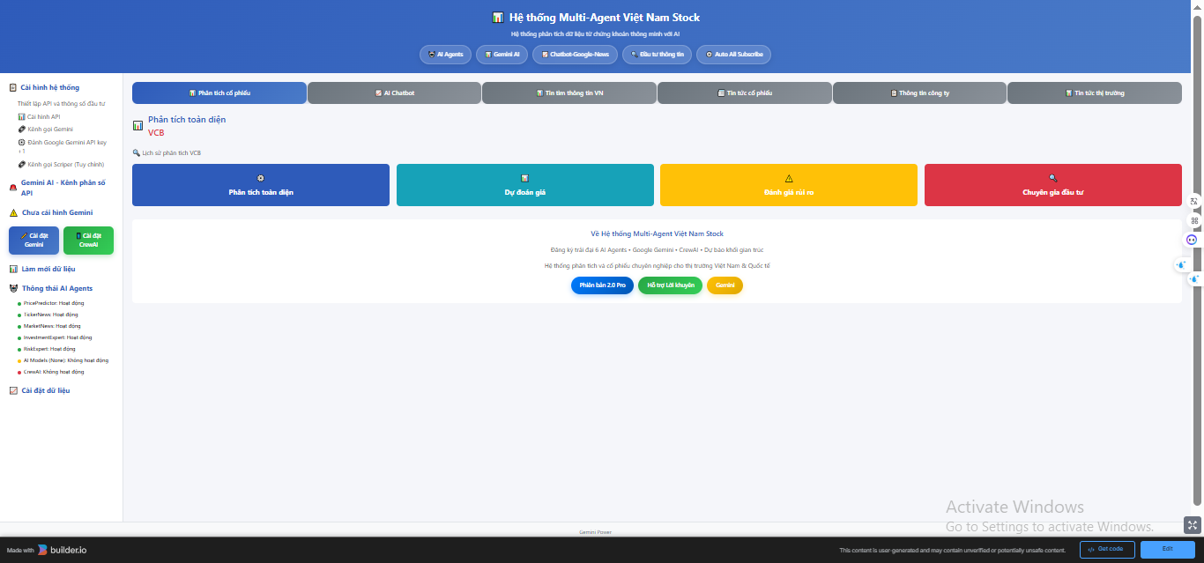
Designed by Figma
https://www.builder.my/p/3547ec285caf4f409809588d73ea380b/153d903c0b47452ea3b23d058596c0c8

Slide 13
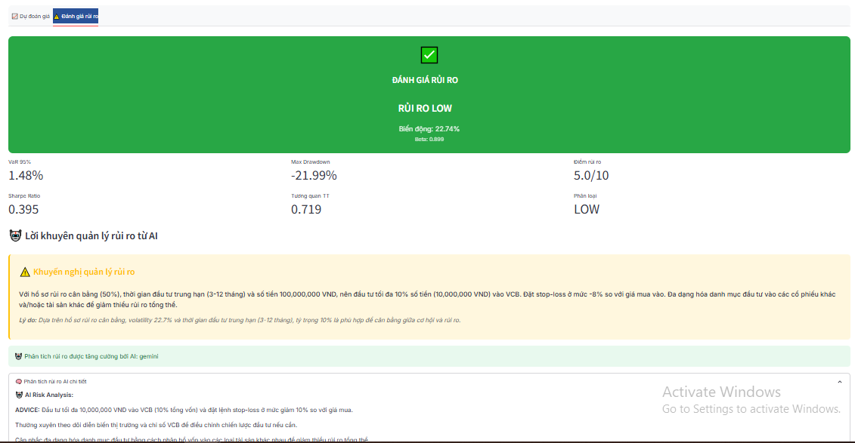
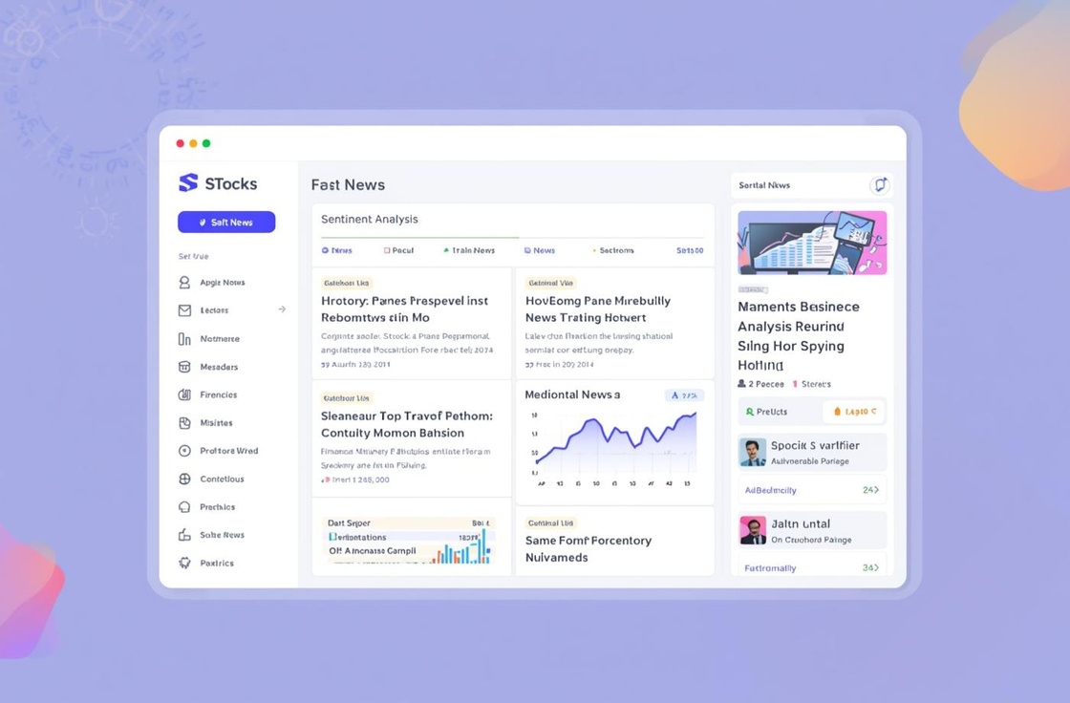
The main interface and functions of the system.
ANALYSIS
NEWS
An intuitive interface for predicting stock prices.
Automatically collect and analyze market news.

Slide 14
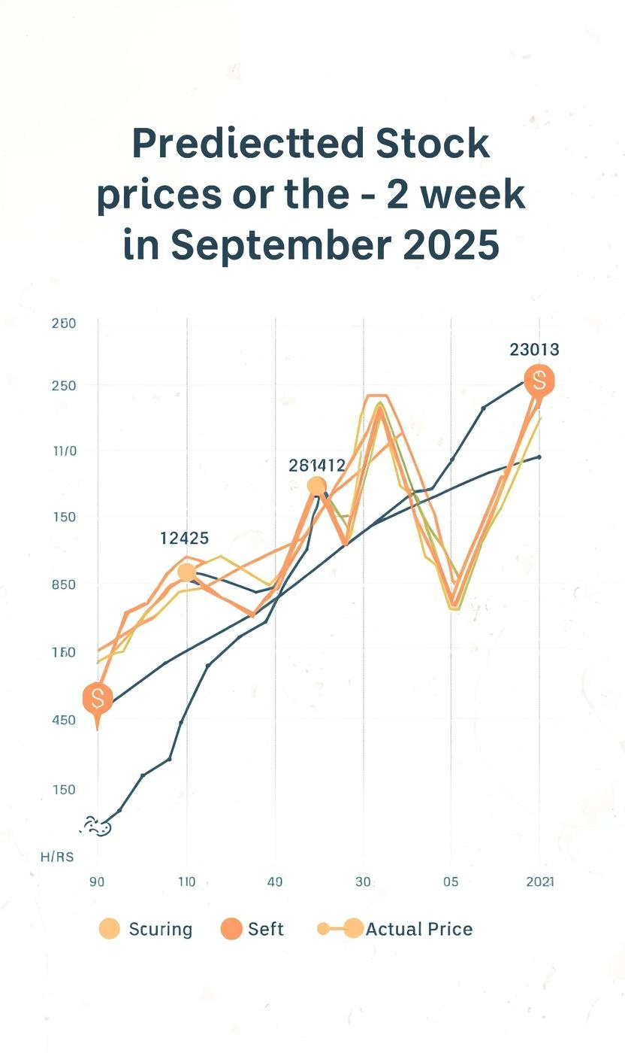
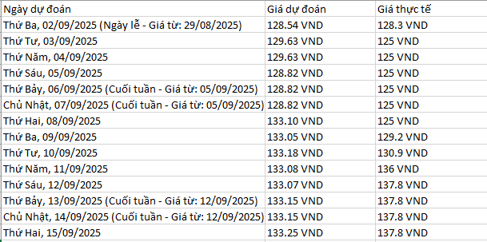
LSTM Prediction Test Results
COMPARE ACTUAL PRICES
The system predicted stock prices with high accuracy, illustrated by charts showing both actual and predicted prices.

Slide 15
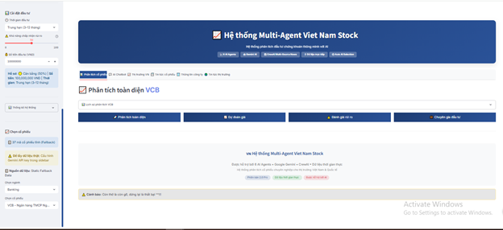
Limitations and Future Development
Upgrading the AI ​​Model
To improve accuracy, the current AI model needs to be upgraded by applying new technologies such as Transformer.
Developing a Mobile App
Developing a mobile application will make it easier for users to access information and integrate APIs with the exchange for greater convenience.

Slide 16


Conclusion
THE PROJECT HAS SUCCESSFULLY DEVELOPED THE MULTI-AGENT SYSTEM, AN EFFECTIVE TOOL FOR ANALYZING AND RECOMMENDING INVESTMENTS IN THE VIETNAMESE STOCK MARKET. THE SYSTEM HAS COMPREHENSIVELY AUTOMATED THE ENTIRE PROCESS, FROM DATA COLLECTION AND PROCESSING TO ANALYSIS AND FORECASTING, USING ADVANCED MACHINE LEARNING MODELS SUCH AS LSTM.
With its flexible agent architecture and intuitive user interface, the system not only meets the set technical objectives but also demonstrates its practical application potential, becoming a powerful assistant for investors in decision-making.
However, the system still has room for improvement, particularly in the accuracy of forecasting models and its ability to process data at a large scale in real time.

Slide 17
Thanks for listening !!! Good luck on your bet !!!

