Slide 1
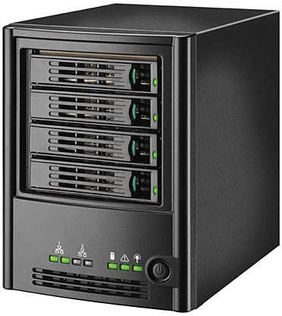

microsamples
microsamples
energy models
energy models
microsamples
energy models
microsamples
energy models

Slide 2
Captures System Dynamics?
No
Yes
ML
CALOREE
Handles Non-Linearities?
No
Yes
Not Useful
Control

Slide 3
Model 1
Model 2
Model N
Model
…
…
App
1
App
2
App
N
App
1
App
2
App
N
Mean,
Variance
Model 1
Model 2
Model N
…
App
1
App
2
App
N

Slide 4
Model
Model 1
Model 2
Model N
…
…
App
1
App
2
App
N
App 1
App 2
App N
Model
Mean,
Variance
…
Model 1
Model 2
Model N
App 1
App 2
App N
…
App
1
App
2
App
N

Slide 5
Application
-
Control
System
Performance
Requirement
big cores
big speeds
LITTLE cores
LITTLE speeds
Performance Feedback

Slide 6
Server: Running HBM
Model
Performance/Power Samples
…
Performance
Hash Table
+ Model Variance
App 1
App 2
App N
Embedded/Mobile Device: Running Generalized Control System
Application
Performance
Requirement
Control
System
App-specific
Optimizer
big cores
big speeds
-
LITTLE cores
LITTLE speeds
Performance Feedback

Slide 7
Learning System
i
1
2
o
j
App
1
3
k
p
4
Application
Model,
Variance,
Confidence
Control System
Control
System
App-specific
Optimizer
big cores
big speeds
Performance
Requirement
-
LITTLE cores
LITTLE speeds
Performance Feedback

Slide 8
Observe
Act
Software Hardware
Decide
i
1
i
1
o
j
2
o
j
2
k
3
p
k
3
p
4
4
C(z)
P(z)
-
SEEC
g(t)
-
C(z)
P(z)
e(t)
SEEC
s(t)
-
Controller
g(t)
-
e(t)
Controller
s(t)
h(t)
h(t)

Slide 9
i
1
2
o
j
k
3
p
4

Slide 10
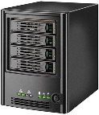

Collecting
Samples
Model
Estimation
Learner sleeps or supports other apps
Learning
1
2
3
4
Control
Time
Generic control model
Learned Control Model
1
An application starts: the controller begins with a generic model and
queries the learner for the number of samples to take
2
The learner responds with the number of samples needed, the controller continues
3
The controller sends its samples back to the learner which asynchronously assembles a model
4
The learner responds with a model customized for the application

Slide 11
0
0.1
0.2
0.3
Configuration Array
0.4
Speedup Index
c = 0
sc = 0
pc = .01
c = 1
sc = .2
pc = .08
c = 2
sc = .8
pc = .6
c = 3
sc = 1
pc = 1
0.5
0.6
0.7
0.8
0.9
1

