Slide 1
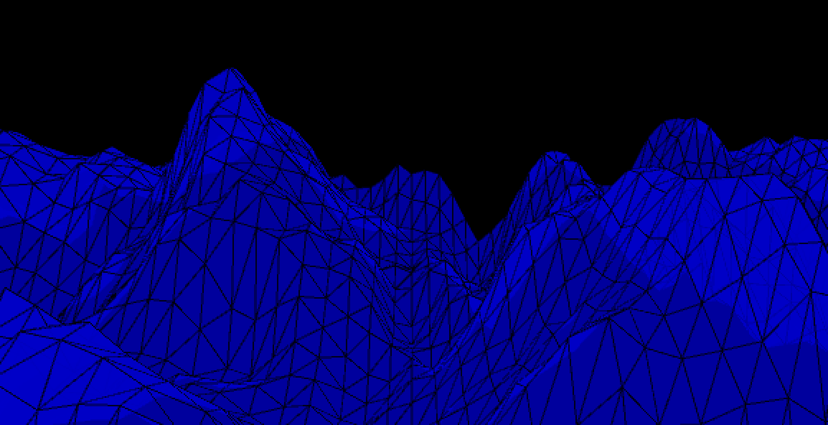
Aequor

Slide 2
Concept
Aequor examines hidden secrets beneath sea level to unmask, not only the present and future models of nature, but the unnoticed past we are not fully discovering through history. Thereby, this piece allows the viewer to overtake the biological and physical world that creates an exploratory portraiture of human being’s dominance over nature. Viewers become controllers of the landscape transformations with various interactive possibilities. At this point, the individual is an agent affecting the geological structure that questions our mode of exploitation.

Slide 3
Research-creation
Concept
Sea Levels data
Create the design and aesthetic of the artwork
Research the meaning of interaction
Implement the interaction
Return the interaction values
Creating transitioning between three functions
Research the best possible presentation for future presentation

Slide 4
Challenges
Solutions
The meaning of interaction with the environment (Research)
JSON file
Mapping Leap Motion values to the landscape
Keeping track of the values changing from initial to middle and end state
Transition between each three functions
Fluid Movement across the landscape with or without interaction
Sensitivity (STILL A PROBLEM)
Opacity of my program
A Geology of Media
Converting from Excel to JSON
Function screenX, screenY and screenZ
Tracking and differentiating the original, middle and target values of the interaction
Changing program states (no interaction, height interaction, finger interaction)
Function learp and calcZ
Rewriting the classes

Slide 5
Additional intentions
Improving the fluid movement of the interaction
Designating an area of interaction where the vertexes are affected with curved movement.
Adding gestures
More control over vertexes
Presentation (different methods of presentation)

Slide 6
DEMO

Slide 7
THANK YOU

