Slide 1
AWT
Abstract Window Toolkit

Slide 2
GUI Controls
Every user interface encompasses the following three main aspects:
UI elements : These are the core visual elements the user eventually sees and interacts with. AWT provides a huge list of widely used and common elements.
Layouts: They define how UI elements should be organized on the screen and provide a final look and feel to the GUI (Graphical User Interface).
Behavior: These are events which occur when the user interacts with UI elements. This is called event handling

Slide 3
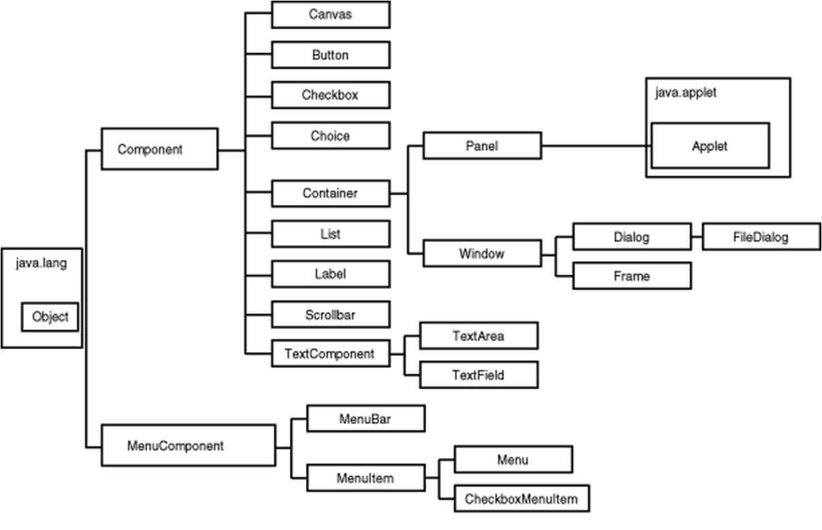
Class hierarchy

Slide 4
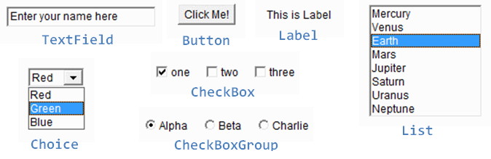
GUI Controls

Slide 5
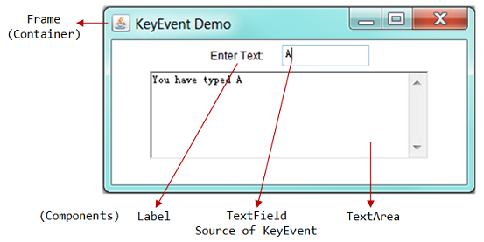
GUI Controls

Slide 6
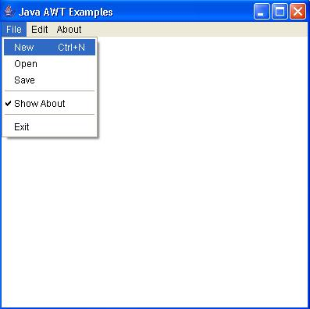
GUI Controls

Slide 7
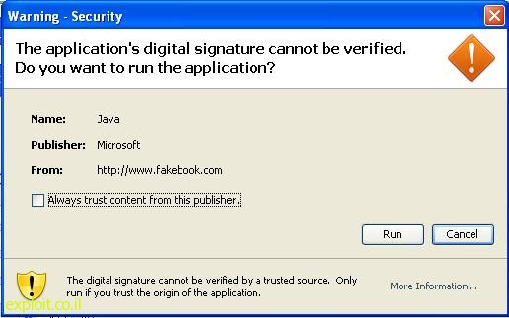
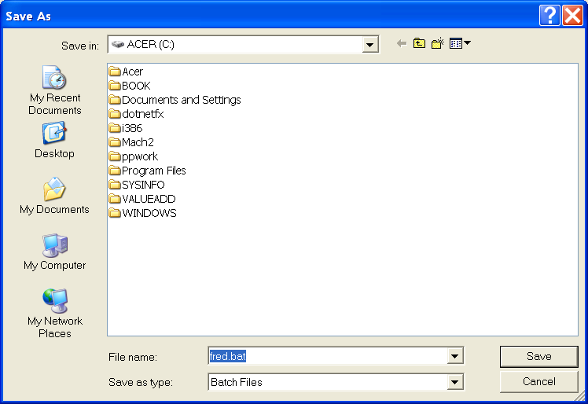
GUI Controls

Slide 8
UI Elements
No. | Control & Description
1 | Label A Label object is a component for placing text in a container.
2 | Button This class creates a labeled button.
3 | CheckBox A check box is a graphical component that can be in either an on (true) or off (false) state.
4 | CheckBoxGroup The CheckboxGroup class is used to group the set of checkbox.

Slide 9
UI Elements
No. | Control & Description
5 | List The List component presents the user with a scrolling list of text items.
6 | TextField A TextField object is a text component that allows for the editing of a single line of text.
7 | TextArea A TextArea object is a text component that allows for the editing of a multiple lines of text.
8 | Choice A Choice control is used to show pop up menu of choices. Selected choice is shown on the top of the menu.

Slide 10
UI Elements
No. | Control & Description
9 | Canvas A Canvas control represents a rectangular area where application can draw something or can receive inputs created by user.
10 | ScrollBar A Scrollbar control represents a scroll bar component in order to enable user to select from range of values.

Slide 11
UI Elements
No. | Control & Description
11 | Dialog A Dialog control represents a top-level window with a title and a border used to take some form of input from the user.
12 | FileDialog A control represents a dialog window from which the user can select a file.

Slide 12
Containers
No. | Container & Description
1 | Panel Panel is the simplest container. It provides space in which any other component can be placed, including other panels.
2 | Applet An Applet is a Container Panel that is displayed in a web page.
3 | Window A Window object is a top-level window with no borders and no menubar.
4 | Frame A Frame is a top-level window with a title and a border

Slide 13
Menus
Sr. No. | Control & Description
1 | MenuComponent It is the top level class for all menu related controls.
2 | MenuBar The MenuBar object is associated with the top-level window.
3 | Menu The Menu object is a pull-down menu component which is displayed from the menu bar.
Notes:
55

Slide 14
Menus
Sr. No. | Control & Description
4 | MenuItem The items in the menu must belong to the MenuItem or any of its subclass.
5 | CheckboxMenuItem CheckboxMenuItem is subclass of MenuItem, which can be checked and unchecked.
6 | PopupMenu PopupMenu can be dynamically popped up at a specified position within a component.

Slide 15
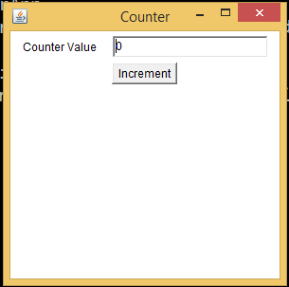
Example

Slide 16
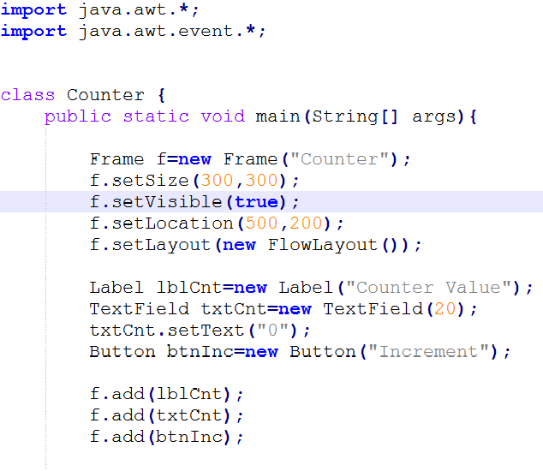

Slide 17
Sub classing Frame
It is a better idea to subclass Frame so that, one can design an application with an extended functionality of the Frame class.
The constructor of such a class can be used to design the GUI of the application and add event handlers.
Create an object of that class to display the application designed.

Slide 18
Sub classing Frame
Class Counter extends Frame {
Counter(){
super(“Counter”);
setSize(300,300);
setVisible(true);
//add GUI elements
}
}

Slide 19
Sub classing Frame
Class CounterDemo {
public static void main(String[] args){
Counter cnt=new Counter();
}
}

Slide 20
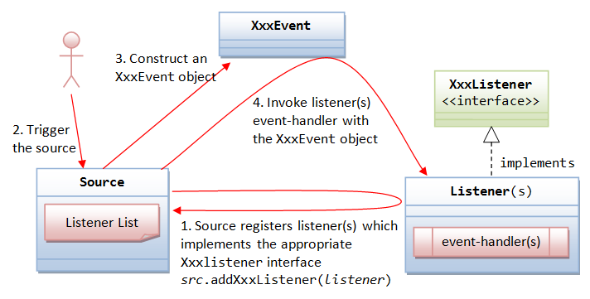
Event Handling

