Slide 1
AWT
Abstract Window Toolkit

Slide 2
Abstact Window Toolkit
Provides rich set of GUI controls.
These classes can be used are extended to create GUI applications.
Frame class facilitates the creation of Window applications.
Generally Frame class is extended to create an application. By default it is invisible with minimal size and location at 0,0.
Use setVisible(boolean), setSize(int,int), setLocation(int,int) to display it.

Slide 3
GUI Controls
Every user interface encompasses the following three main aspects:
UI elements : These are the core visual elements the user eventually sees and interacts with. AWT provides a huge list of widely used and common elements.
Layouts: They define how UI elements should be organized on the screen and provide a final look and feel to the GUI (Graphical User Interface).
Behavior: These are events which occur when the user interacts with UI elements. This is called event handling

Slide 4
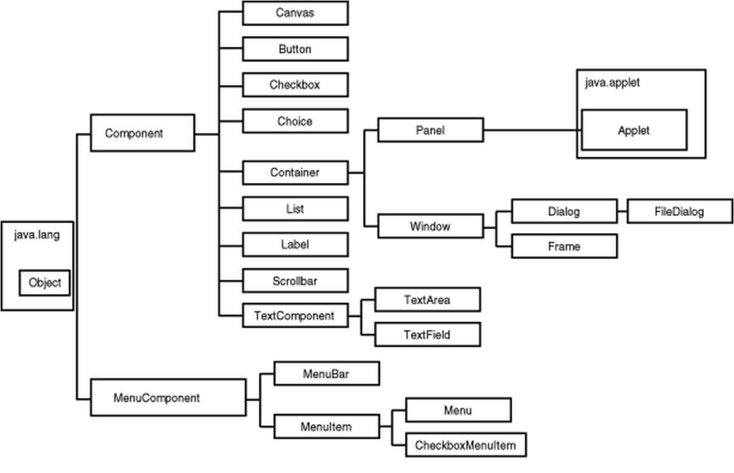
Class hierarchy

Slide 5
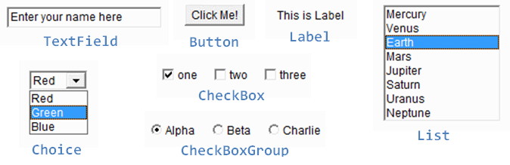
GUI Controls

Slide 6
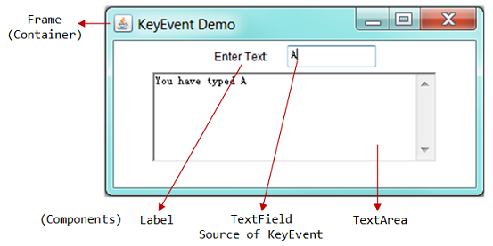
GUI Controls

Slide 7
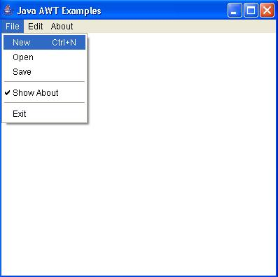
GUI Controls

Slide 8
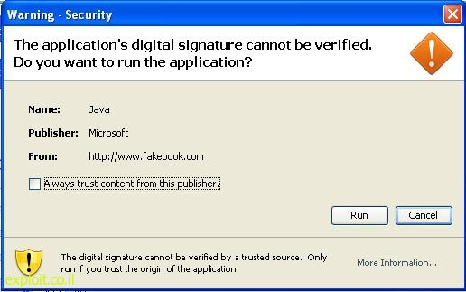
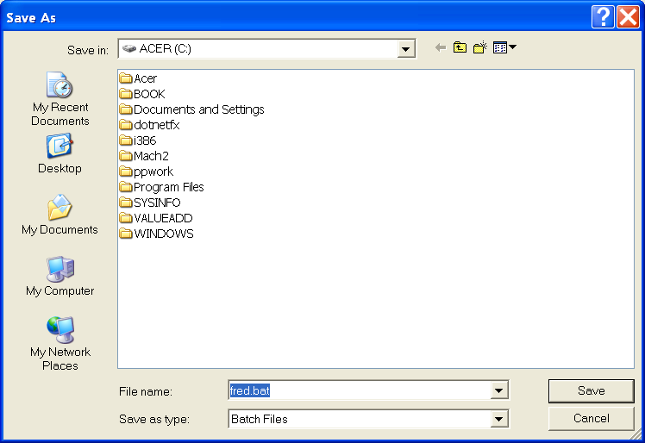
GUI Controls

Slide 9
Label
A Label object is a component for placing text in a container. A label displays a single line of read-only text. The text can be changed by the application, but a user cannot edit it directly.
Label(),Label(String t) are the constructors.
String getText() gets the text of this label.
void setText(String t) sets the text of this label.

Slide 10
TextField
A TextField object is a text component that allows for the editing of a single line of text.
TextField()Constructs a new text field.
TextField(int columns) Constructs a new empty text field with the specified number of columns.
TextField(String text)Constructs a new text field initialized with the specified text.
String getText() gets the text of this textfield.
void setText(String t) sets the text of this textfield.

Slide 11
Button
This class creates a labeled button. The application can cause some action to happen when the button is pushed.
Button(String label) Constructs a button with the specified label.
String getLabel() gets the label of this button.
void setLabel(String t) sets the label of this button.

Slide 12
Button-Event handling
If an application wants to perform some action based on a button being pressed and released, it should implement ActionListener and register the new listener to receive events from this button, by calling the button's addActionListener() method.
ActionListener:
void actionPerformed(ActionEvent e)
Invoked when an action occurs.

Slide 13
Button-Event handling
ActionEvent:
String getActionCommand() Returns the command string associated with this action. Normally, the label of the button.
Object getSource() Returns the reference to the object which is the source of the event, e.g. Button, TextField,… This method is available in the

Slide 14
List
The List component presents the user with a scrolling list of text items. The list can be set up so that the user can choose either one item or multiple items.
List() Creates a new scrolling list.
List(int rows) Creates a new scrolling list initialized with the specified number of visible lines.
List(int rows, boolean multipleMode) Creates a new scrolling list initialized to display the specified number of rows.

Slide 15
List
void add(String item) Adds the specified item to the end of scrolling list.
void add(String item, int index) Adds the specified item to the the scrolling list at the position indicated by the index.
int getSelectedIndex() Gets the index of the selected item on the list,
int[] getSelectedIndexes() Gets the selected indexes on the list.
String getSelectedItem() Gets the selected item on this scrolling list.
String[] getSelectedItems() Gets the selected items on this scrolling list.

Slide 16
List-Event Handling
When an item is selected or deselected by the user, AWT sends an instance of ItemEvent to the list.
When the user double-clicks on an item in a scrolling list, AWT sends an instance of ActionEvent to the list following the item event.
Implement ItemListener or ActionListener as appropriate and register the new listener to receive events from this list.

Slide 17
List-Event Handling
void itemStateChanged(ItemEvent e) Invoked when an item has been selected or deselected by the user.
ItemEvent:
Object getItem() Returns the item affected by the event.
ItemSelectable getItemSelectable() Returns the originator of the event.
int getStateChange() Returns the type of state change (SELECTED or DESELECTED).

Slide 18
Choice
The Choice class presents a pop-up menu of choices. The current choice is displayed as the title of the menu.
Choice() Creates a new choice menu.
void add(String item) Adds an item to this Choice menu.
void addItemListener(ItemListener l) Adds the specified item listener to receive item events from this Choice menu.

Slide 19
Choice
int getSelectedIndex() Returns the index of the currently selected item.
String getSelectedItem() Gets a representation of the current choice as a string.
void remove(String item) Removes the first occurrence of item from the Choice menu.
void removeAll() Removes all items from the choice menu.

Slide 20
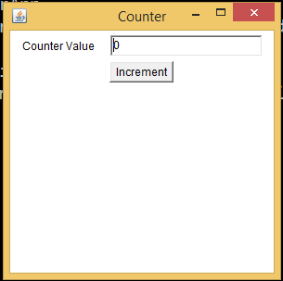
Example

Slide 21
Sub classing Frame
It is a better idea to subclass Frame so that, one can design an application with an extended functionality of the Frame class.
The constructor of such a class can be used to design the GUI of the application and add event handlers.
Create an object of that class to display the application designed.

Slide 22
Sub classing Frame
Class Counter extends Frame {
Counter(){
super(“Counter”);
setSize(300,300);
setVisible(true);
//add GUI elements
}
}

Slide 23
Sub classing Frame
Class CounterDemo {
public static void main(String[] args){
Counter cnt=new Counter();
}
}

Slide 24
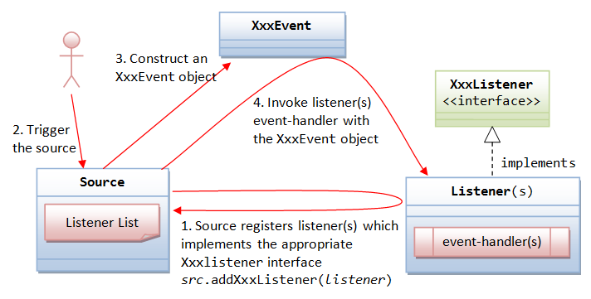
Event Handling

Slide 25
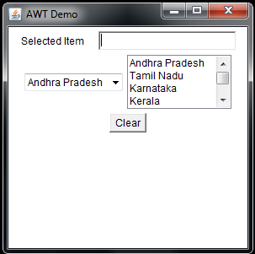
Example

Slide 26
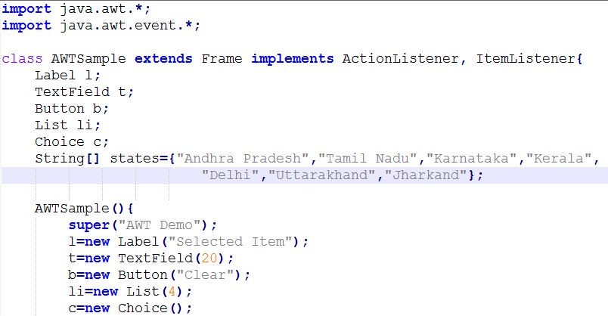

Slide 27
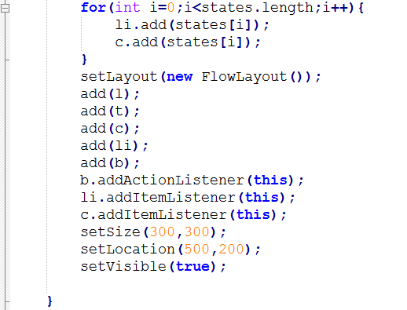

Slide 28
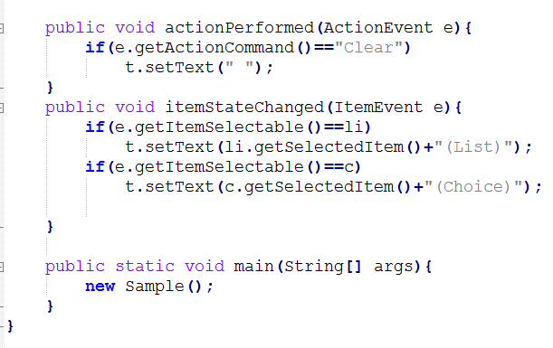

Slide 29
TextArea
A TextArea object is a multi-line region that displays text. It can be set to allow editing or to be read-only.
TextArea() Constructs a new text area with the empty string as text.
TextArea(int rows, int columns) Constructs a new text area with the specified number of rows and columns and the empty string as text.
TextArea(String text) Constructs a new text area with the specified text.

Slide 30
TextArea
void append(String str) Appends the given text to the text area's current text.
void insert(String str, int pos) Inserts the specified text at the specified position in this text area.

Slide 31
Checkbox
A check box is a graphical component that can be in either an "on" (true) or "off" (false) state. Clicking on a check box changes its state from "on" to "off," or from "off" to "on."
Checkbox() Creates a check box with an empty string for its label.
Checkbox(String label) Creates a check box with the specified label.
Checkbox(String label, boolean state) Creates a check box with the specified label and sets the specified state.
Checkbox(String label, boolean state, CheckboxGroup group) Constructs a Checkbox with the specified label, set to the specified state, and in the specified check box group.

Slide 32
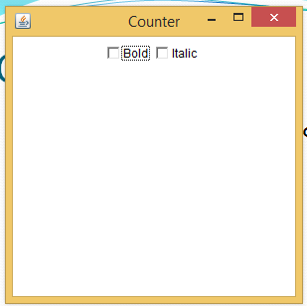
Checkbox
Checkbox cbBold=new Checkbox("Bold");
Checkbox cbItalic=new Checkbox("Italic");
add(cbBold);
add(cbItalic);
boolean getState() Determines whether this check box is in the "on" or "off" state.

Slide 33

CheckboxGroup
CheckboxGroup gender=new CheckboxGroup()
Checkbox cbMale=new Checkbox(“Male“,gender,true);
Checkbox cbFemale=new Checkbox(“Female“,gender,false);
add(cbMale);
add(cbFemale);

Slide 34
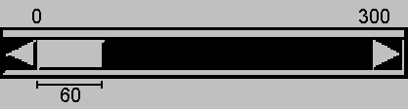
Scrollbar
The Scrollbar class embodies a scroll bar, a familiar user-interface object. A scroll bar provides a convenient means for allowing a user to select from a range of values.
ranger = new Scrollbar
(Scrollbar.HORIZONTAL, 0, 60, 0, 300);

Slide 35
Scrollbar-Event handling
int getValue() : returns the current value of the Scrollbar
When the user changes the value of the scroll bar, the scroll bar receives an instance of AdjustmentEvent.
The scroll bar processes this event, passing it along to any registered listeners.
Any object that wishes to be notified of changes to the scroll bar's value should implement AdjustmentListener, an interface defined in the package java.awt.event.

Slide 36
Scrollbar-Event handling
Listeners can be added and removed dynamically by calling the methods addAdjustmentListener and removeAdjustmentListener.
AdjustmentListner:
void adjustmentValueChanged
(AdjustmentEvent e): Invoked when the value of the adjustable has changed.

Slide 37
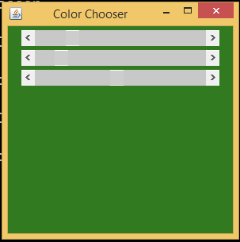
Scrollbar-Event handling

Slide 38
Mouse Events
To handle mouse events MouseListener interface is to be implemented.
The methods in the interface:

Slide 39
Mouse Events
Method | Purpose
mouseClicked(MouseEvent) | Called just after the user clicks the listened-to component.
mouseEntered(MouseEvent) | Called just after the cursor enters the bounds of the listened-to component.
mouseExited(MouseEvent) | Called just after the cursor exits the bounds of the listened-to component.
mousePressed(MouseEvent) | Called just after the user presses a mouse button while the cursor is over the listened-to component.
mouseReleased(MouseEvent) | Called just after the user releases a mouse button after a mouse press over the listened-to component.

Slide 40
MouseEvent
MouseEvent class has the following methods to identify the current x and y coordinates of the mouse.
int getX() returns the x coordinate
int getY() returns the y coordinate

Slide 41
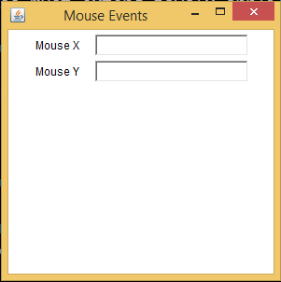

Slide 42
Paint and draw operations
There are four situations when the GUI thread calls paint() spontaneously.
A window is covered by another and then re-exposed. paint() is called to reconstruct the erarsed parts of the uncovered window
after deiconification
in an applet after init() has finished
when a browser returns to a page which contains an applet, provided the applet is at least partially exposed.

Slide 43
Paint and draw operations
The second case, when paint() calls are genereted is when the program calls repaint() or update().
The repaint() method is the one invoked by a program to do drawing.
Their are 4 versions of this method but the one with no arguments is usually used.
Drawing via repaint() most often takes place in response to user input.

Slide 44
Paint and draw operations
repaint() ==> update() ==> paint()
repaint() does not invoke paint() directly.
It schedules a call to an intermediate method, update().
Finally, update() calls paint() (unless you override update).
This sequence is applicable to all components with paint() method available, e.g. Window, Applet, Canvas

Slide 45
MouseMotionListener
The listener interface for receiving mouse motion events on a component.
The class that is interested in processing a mouse motion event implements this interface .
The listener object created from that class is then registered with a component using the component's addMouseMotionListener method.
A mouse motion event is generated when the mouse is moved or dragged.

Slide 46
MouseMotionListener
void mouseDragged(MouseEvent e) Invoked when a mouse button is pressed on a component and then dragged.
mouseMoved(MouseEvent e) Invoked when the mouse cursor has been moved onto a component but no buttons have been pushed.

Slide 47
Adapter Classes
Java provides a special feature, called an adapter class, that can simplify the creation of event handlers in certain situations.
An adapter class provides an blank implementation of all methods in an event listener interface.
Adapter classes are useful when you want to receive and process only some of the events that are handled by a particular event listener interface.

Slide 48
Adapter Classes
You can define a new class to act as an event listener by extending one of the adapter classes and implementing only those events in which you are interested.
class MouseHandler extends MouseAdapter{
public void mouseClicked(MouseEvent e){
x=e.getX();
y=e.getY();
tf.setText(x+"");
tg.setText(y+"");
}
}

Slide 49
Adapter Classes
Listener Interface | Adapter Class
ComponentListener | ComponentAdapter
ContainerListener | ContainerAdapter
FocousListener | FocousAdapter
KeyListener | KeyAdapter
MouseListener | MouseAdapter
MouseMotionListener | MouseMotionAdapter
WindowListener | WindowAdapter

Slide 50
Canvas
A Canvas component represents a blank rectangular area of the screen onto which the application can draw or from which the application can trap input events from the user.
An application must subclass the Canvas class in order to get useful functionality such as creating a drawing surface.
The paint method must be overridden in order to perform custom graphics on the canvas.

Slide 51
Canvas
Canvas() Constructs a new Canvas.
void paint(Graphics g) Paints this canvas.
void update(Graphics g) Updates this canvas.

Slide 52
Dialog
A Dialog is a top-level window with a title and a border that is typically used to take some form of input from the user.
The default layout for a dialog is BorderLayout.
A dialog can be either modeless (the default) or modal. A modal dialog is one which blocks input to some other top-level windows in the application.

Slide 53
Dialog
Dialog(Frame owner) Constructs an initially invisible, modeless Dialog with the specified owner Dialog and an empty title.
Dialog(Frame owner, String title) Constructs an initially invisible, modeless Dialog with the specified owner Dialog and title.
Dialog(Frame owner, String title, boolean modal) Constructs an initially invisible Dialog with the specified owner Dialog, title, and modality.

Slide 54
FileDialogs
The FileDialog class displays a window from which the user can select a file.
The FileDialog window is modal--the application cannot continue until it is closed.
Only applications, not applets, can use a FileDialog because only applications can access files.
Every FileDialog window is associated with a Frame.

Slide 55
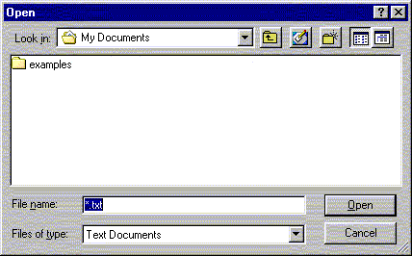
Typical FileDialog window

Slide 56
FileDialog constructors
FileDialog(Frame f)
Creates a FileDialog attached to Frame f
FileDialog(Frame f, String title)
Creates a FileDialog attached to Frame f, with the given title
FileDialog(Frame f, String title, int type)
Creates a FileDialog attached to Frame f, with the given title; the type can be either FileDialog.LOAD or FileDialog.SAVE

Slide 57
FileDialog methods
String getDirectory()
Returns the selected directory
String getFile()
Returns the name of the currently selected file, or null if no file is selected
void setDirectory(String directory)
Changes the current directory to directory
void setFile(String fileName)
Changes the current file to fileName

Slide 58
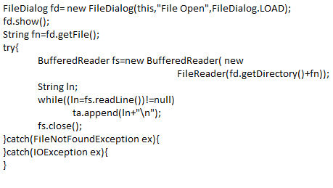

Slide 59
KeyListener
The KeyListener interface is for receiving keyboard events (keystrokes).
The class that is interested in processing a keyboard event either implements this interface (and all the methods it contains) or extends the abstract KeyAdapter class (overriding only the methods of interest).

Slide 60
KeyListener
void keyPressed(KeyEvent e)
Invoked when a key has been pressed.
void keyReleased(KeyEvent e)
Invoked when a key has been released.
void keyTyped(KeyEvent e)
Invoked when a key has been typed and a key is generated.

Slide 61
KeyEvent
char getKeyChar()
Returns the character associated with the key in this event.
int getKeyCode()
Returns the integer keyCode associated with the key in this event. The codes are KeyEvent.VK_A,…, KeyEvent.VK_LEFT, KeyEvent.VK_UP, KeyEvent.VK_DOWN,…
static String getKeyText(int keyCode)
Returns a String describing the keyCode, such as "HOME", "F1" or "A".
boolean isActionKey()
Returns whether the key in this event is an "action" key.

Slide 62
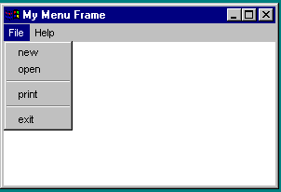
Menus
Java provides several classes—MenuBar, Menu, MenuItem to implement menus in a frame.
A Frame or Applet can hold a menu bar to which the pull-down menus are attached. Menus consist of menu items that the user can select (or toggle on or off). Menu bars can be viewed as a structure to support menus.

Slide 63
The MenuBar Class
A menu bar holds menus; the menu bar can only be added to a frame. Following is the code to create and add a MenuBar to a frame:
Frame f = new Frame();
f.setSize(300, 200);
f.setVisible(true);
MenuBar mb = new MenuBar(); f.setMenuBar(mb);

Slide 64
The Menu Class
You attach menus onto a MenuBar. The following code creates two menus, File and Help, and adds them to the MenuBar mb:
Menu fileMenu = new Menu("File”);
Menu helpMenu = new Menu("Help”);
mb.add(fileMenu);
mb.add(helpMenu);

Slide 65
The MenuItem Class
You add menu items on a menu. The following code adds menu items and item separators in menu fileMenu:
fileMenu.add(new MenuItem("new"));
fileMenu.add(new MenuItem("open"));
fileMenu.addSeparator();
fileMenu.add(new MenuItem("print"));
fileMenu.add(new MenuItem("exit"));
fileMenu.addSeparator();

Slide 66
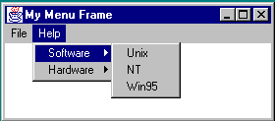
Submenus
You can add submenus into menu items.

Slide 67
UI Elements
No. | Control & Description
1 | Label A Label object is a component for placing text in a container.
2 | Button This class creates a labeled button.
3 | CheckBox A check box is a graphical component that can be in either an on (true) or off (false) state.
4 | CheckBoxGroup The CheckboxGroup class is used to group the set of checkbox.

Slide 68
UI Elements
No. | Control & Description
5 | List The List component presents the user with a scrolling list of text items.
6 | TextField A TextField object is a text component that allows for the editing of a single line of text.
7 | TextArea A TextArea object is a text component that allows for the editing of a multiple lines of text.
8 | Choice A Choice control is used to show pop up menu of choices. Selected choice is shown on the top of the menu.

Slide 69
UI Elements
No. | Control & Description
9 | Canvas A Canvas control represents a rectangular area where application can draw something or can receive inputs created by user.
10 | ScrollBar A Scrollbar control represents a scroll bar component in order to enable user to select from range of values.

Slide 70
UI Elements
No. | Control & Description
11 | Dialog A Dialog control represents a top-level window with a title and a border used to take some form of input from the user.
12 | FileDialog A control represents a dialog window from which the user can select a file.

Slide 71
Containers
No. | Container & Description
1 | Panel Panel is the simplest container. It provides space in which any other component can be placed, including other panels.
2 | Applet An Applet is a Container Panel that is displayed in a web page.
3 | Window A Window object is a top-level window with no borders and no menubar.
4 | Frame A Frame is a top-level window with a title and a border

Slide 72
Menus
Sr. No. | Control & Description
1 | MenuComponent It is the top level class for all menu related controls.
2 | MenuBar The MenuBar object is associated with the top-level window.
3 | Menu The Menu object is a pull-down menu component which is displayed from the menu bar.
Notes:
55

Slide 73
Menus
Sr. No. | Control & Description
4 | MenuItem The items in the menu must belong to the MenuItem or any of its subclass.
5 | CheckboxMenuItem CheckboxMenuItem is subclass of MenuItem, which can be checked and unchecked.
6 | PopupMenu PopupMenu can be dynamically popped up at a specified position within a component.

