Slide 1
FileDialog

Slide 2
FileDialogs
The FileDialog class displays a window from which the user can select a file.
The FileDialog window is modal--the application cannot continue until it is closed.
Only applications, not applets, can use a FileDialog because only applications can access files.
Every FileDialog window is associated with a Frame.

Slide 3
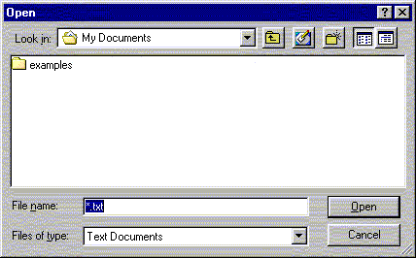
Typical FileDialog window

Slide 4
FileDialog constructors
FileDialog(Frame f)
Creates a FileDialog attached to Frame f
FileDialog(Frame f, String title)
Creates a FileDialog attached to Frame f, with the given title
FileDialog(Frame f, String title, int type)
Creates a FileDialog attached to Frame f, with the given title; the type can be either FileDialog.LOAD or FileDialog.SAVE

Slide 5
FileDialog methods
String getDirectory()
Returns the selected directory
String getFile()
Returns the name of the currently selected file, or null if no file is selected
void setDirectory(String directory)
Changes the current directory to directory
void setFile(String fileName)
Changes the current file to fileName

Slide 6
