Slide 1
Input-Output
streams

Slide 2
Streams
An I/O Stream represents an input source or an output destination.
A stream can represent many different kinds of sources and destinations, including disk files, devices, other programs, and memory arrays.
A program uses an input stream to read data from a source.
A program uses an output stream to write data to a destination.

Slide 3
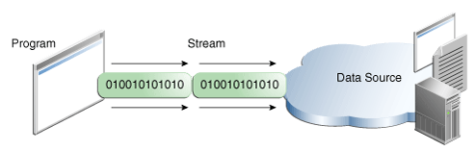
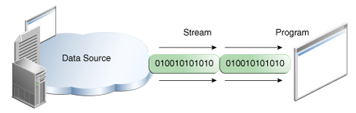
Streams

Slide 4
Streams
The java.io package contains a collection of stream classes that support methods for reading and writing.
To use these classes, a program needs to import the java.io package.
The stream classes are divided into two class hierarchies,
Character streams.
Byte streams (8-bit bytes).

Slide 5
Byte Streams
InputStream is an abstract super class that represents an byte stream.
OutputStream is an abstract super class that represents an ouput byte stream.
FileInputStream is a concrete input byte stream.
FileOutputStream is a concrete output byte stream.

Slide 6
Methods
FileInputStream(String name)
Creates a FileInputStream by opening a connection to an actual file with the given file name, for reading.
FileOutputStream(String name)
Creates a FileOutputStream by opening a connection to an actual file with the given file name, for writing.

Slide 7
Methods-input
throws IOException if an I/O error occurs. This is a checked exception
int read()
Reads a single byte. Returns it as integer. -1 on EOI.
int read(byte[] buffer)
Reads bytes and places them into buffer (max = size of buffer)
returns the number of bytes read
int read(byte[] buffer, int offset, int length)
Reads up to length bytes and places them into buffer
First byte read is stored in buffer[offset]
returns the number of bytes read

Slide 8
Methods-input
available() method returns the number of bytes which can be read without blocking
skip() method skips over a number of bytes in the input stream
close() method will close the input stream and release any system resources
input streams optionally support repositioning the stream. can mark the stream at a certain point and 'rewind' the stream to that point later.
boolean markSupported() returns true if repositioning is supported
mark() places a mark in the stream
reset() 'rewinds' the stream to a previously set mark

Slide 9
Methods-output
void write(int data)
Writes a single character
Note: even though data is an integer, data must be set such that:
0 <= data <= 255
void write(byte[] buffer)
Writes all the bytes contained in buffer to the stream
void write(byte[] buffer, int offset, int length)
Writes length bytes to stream starting from buffer[offset]

Slide 10
Methods-output
flush()
To improve performance, almost all output protocols buffer output.
Data written to a stream is not actually sent until buffering thresholds are met.
Invoking flush() causes the OutputStream to clear its internal buffers.
close()
Closes stream and releases any system resources.

Slide 11
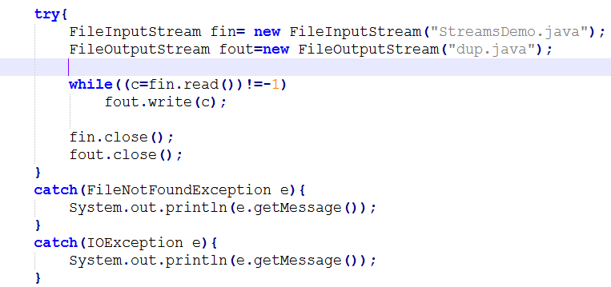

Slide 12
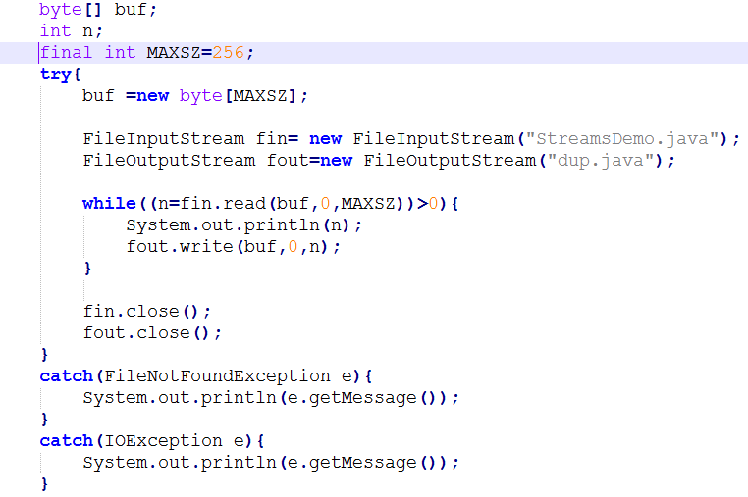

Slide 13
Character Streams
There are many different types of Character-Oriented Streams represented by different classes within the java.io package.
All character-oriented streams are subclasses of an abstract class java.io.Writer
Readers are subclasses of the abstract class java.io.Reader

Slide 14
Character Streams
Character oriented streams can be used in conjunction with byte-oriented streams:
Use InputStreamReader to "convert" an InputStream to a Reader
Use OutputStreamWriter to "convert" an OutputStream to a Writer

Slide 15
Methods-input
int read()
Reads a single character. Returns it as integer. -1 on EOI
int read(char[] buffer)
Reads bytes and places them into buffer (max = size of buffer)
returns the number of bytes read
int read(char[] buffer, int offset, int length)
Reads up to length bytes and places them into buffer
First byte read is stored in buffer[offset]
returns the number of bytes read

Slide 16
Methods-Input
mark(int readAheadLimit) marks the current location
Parameter specifies the number of characters which can be read before the marks becomes invalid
reset() returns the stream to its previously marked location
ready() returns true if there is data to be read from the stream
skip(long n) skips over n characters.
close() method closes the stream

Slide 17
Methods-output
void write(int c)
Writes a single character.
void write(char[] buffer)
Writes an array of characters
void write(char[] buffer, int offset, int length)
Writes a portion of an array of characters
First character written is starts at buffer[offset]
length indicates how many characters to write.

Slide 18
Methods-output
void write(String a)
Writes aString to the stream
void write(String a, int offset, int length)
Writes a portion of a String to the stream
First character written is starts at offset.
length indicates how many characters to write.

Slide 19
Methods-output
Writer append(char c)
appends a character to the stream
void flush()
Flushes pending characters to the stream
void close()
Closes the stream.

Slide 20
Buffered Streams
BufferedReader and BufferedWriter support buffering of characters for efficient Input/Output.
BufferedReader provides readLine() method which reads a line of input.
BufferedWriter supports newLine() method to write a newline character.
These are created as wrappers of Reader and Writer objects.

Slide 21
File I/O
FileReader and FileWriter can be used to perform character input and output from files directly.
Printwriter can be used formatted and typed data ouput to files. Provides print() and println() methods.

Slide 22
File class
Class File provides four constructors:
Takes String specifying name and path (location of file on disk)
Takes two Strings, first specifying path and second specifying name of file
Takes File object specifying path and String specifying name of file
Takes URI object specifying name and location of file
Different kinds of paths
Absolute path – contains all directories, starting with the root directory, that lead to a specific file or directory
Relative path – normally starts from the directory in which the application began executing

Slide 23
File class

Slide 24
File class

