Slide 1
GUI Programming
java

Slide 2
Introduction
Java is a programming language and a platform.
Java is a high level, robust, secured and object-oriented programming language.
Platform: Any hardware or software environment in which a program runs, is known as a platform.
Since Java has its own runtime environment (JRE) and API, it is called platform.

Slide 3
Introduction
Different types of Applications
Desktop Applications such as acrobat reader, media player, antivirus etc.
Web Applications such as irctc.co.in etc.
Enterprise Applications such as banking applications.
Mobile
Embedded System
Smart Card
Robotics
Games etc.

Slide 4
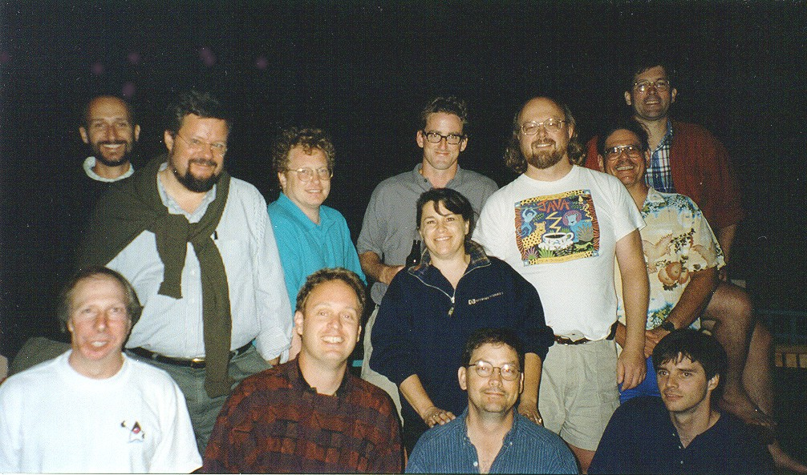

Introduction
Originally developed by James Gosling of ‘Green Team’ at Sun Microsystems (which is now a subsidiary of Oracle Corporation) and released in 1995.

Slide 5
Introduction
Simple
Object-Oriented
Platform independent, Portable and Architecture neutral
Secured
Robust and High Performance
Interpreted
Multithreaded
Distributed

Slide 6
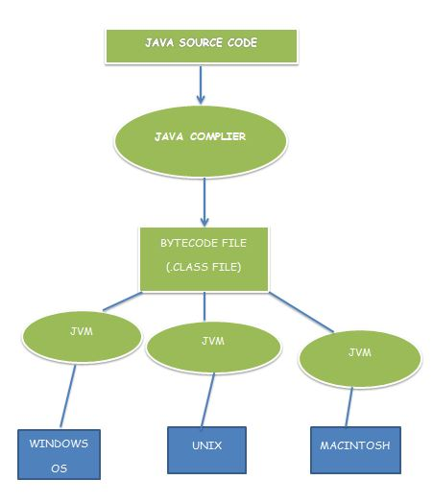
Introduction

Slide 7
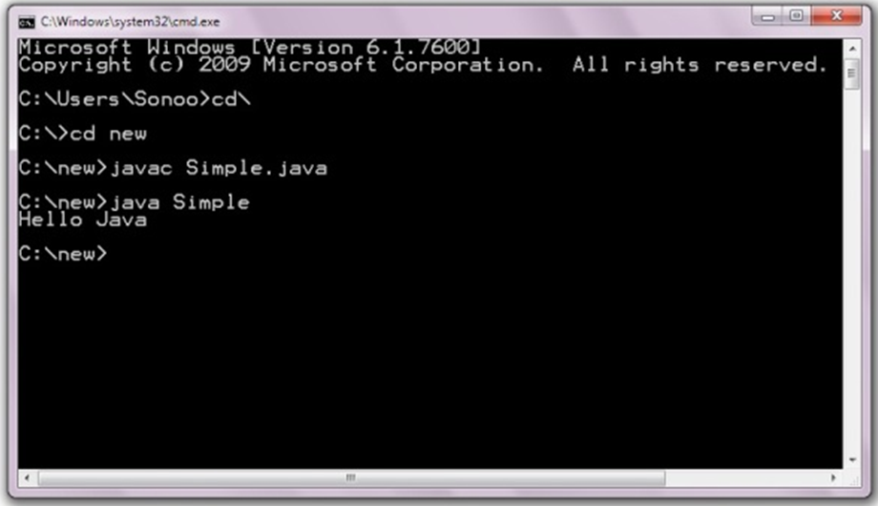
Introduction

Slide 8
Introduction
JVM (Java Virtual Machine) is an abstract machine. It is a specification that provides runtime environment in which java bytecode can be executed.
JVMs are available for many hardware and software platforms.
JVM, JRE and JDK are platform dependent because configuration of each OS differs.
But, Java is platform independent.
The JVM performs following main tasks:
Loads code
Verifies code
Executes code
Provides runtime environment

Slide 9
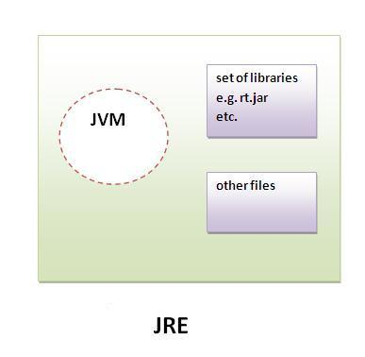
Introduction

Slide 10
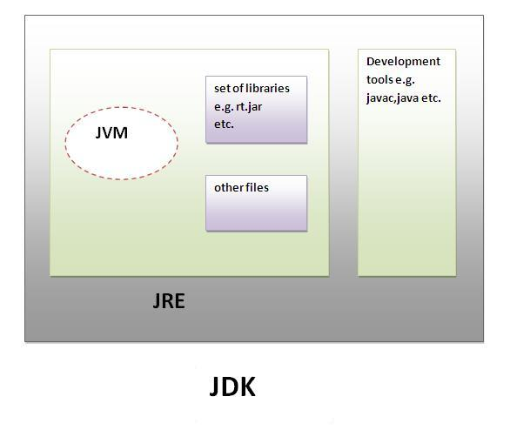
Introduction

Slide 11
Introduction
Variable names are case-sensitive. A variable's name an unlimited-length sequence of Unicode letters and digits, beginning with a letter, "$", or the underscore "_".
Subsequent characters may be letters, digits, dollar signs, or underscore characters.
If the name consists of only one word, spell that word in all lowercase letters, else capitalize the first letter of each subsequent word.

Slide 12
Introduction
Type | Values | Default | Size | Range | Example Literals
byte | signed integers | 0 | 8 bits | -128 to 127 | 120, 1000, 023(octal) 0x23a(hex)
short | signed integers | 0 | 16 bits | -32768 to 32767
int | signed integers | 0 | 32 bits | -2³¹ to 2³¹-1
long | signed integers | 0L | 64 bits | -2⁶³ to 2⁶³-1 | 123456, 987654L

Slide 13
Introduction
Type | Values | Default | Size | Range | Example Literals
float | IEEE 754 floating point | 0.0f | 32 bits | +/-1.4E-45 to +/-3.4E+38, +/-infinity, +/-0, NAN | 123.4, 1.234e2 123.4f
double | IEEE 754 floating point | 0.0d | 64 bits | +/-4.9E-324 to +/-1.79E+308, +/-infinity, +/-0, NaN | 1.234e2 1234.56789d
char | Unicode character | \u0000 | 16 bits | \u0000 to \uFFFF | ‘a’,’\u0108’, ’\\’,’\t’
boolean | true, false | false | 1 bit | NA | true, false

Slide 14
Introduction
Precedence | Operator | Type | Associativity
15 | (args),[],· | Method call, Array Subscript, Member selection | Left to Right
14 | ++, -- | Unary post-increment, post-decrement | Right to left
13 | ++,--,+,-,!,~, ( type ) | Unary pre-increment, decrement, Unary plus, minus, logical negation, bitwise complement, type cast | Right to left
12 | *,/,% | Multiplication, Division, Modulus | Left to right
11 | +,- | Addition, Subtraction | Left to right
10 | <<,>>,>>> | Bitwise left shift, right shift with sign extension, right shift with zero extension | Left to right

Slide 15
Introduction
Precedence | Operator | Type | Associativity
9 | <,<=,>,>= instanceof | Relational operators Type comparison (objects only) | Left to right
8 | ==,!= | Relational is equal to, is not equal to | Left to right
7 | & | Bitwise AND | Left to right
6 | ^ | Bitwise exclusive OR | Left to right
5 | | | Bitwise inclusive OR | Left to right
4 | && | Logical AND | Left to right
3 | || | Logical OR | Left to right
2 | &: | Ternary conditional | Right to left
1 | =,+=,-=,*= /=.%= | Assignment operators | Right to left

Slide 16
expression
An expression is a construct made up of variables, operators, and method invocations, which are constructed according to the syntax of the language that evaluates to a single value.

Slide 17
statement
A statement forms a complete unit of execution. The different kinds of statements are: declaration statements, expression statements and control flow statements.
A declaration statement declares a variable.
An expression statement is an assignment expression, a prefix or postfix expression, a method invocation expression, an instantiation expression terminated by a semicolon.
Finally, control flow statements regulate the order in which statements get executed.

Slide 18
block
A block is a group of zero or more statements between balanced braces and can be used anywhere a single statement is allowed.

Slide 19
break
An unlabeled break statement terminates the innermost switch, for, while, or do-while statement, but a labeled break terminates an outer statement which is labeled.
The unlabeled continue statement skips to the end of the innermost loop's body and evaluates the boolean expression that controls the loop.
A labeled continue statement skips the current iteration of an outer loop marked with the given label.

Slide 20
return
The return statement exits from the current method, and control flow returns to where the method was invoked.
The return statement has two forms: one that returns a value, and one that doesn't.
The two forms are
return;,
return <expr>.

Slide 21
Arrays
Arrays: An array is a container object that holds a fixed number of values of a single type. The length of an array is established when the array is created.
After creation, its length is fixed.
The indices of an array begin with 0. An array is declared T [] <array-name>, where T specifies the type array elements.

Slide 22
Arrays
A declaration should not contain size and does not create an array.
An array is created explicitly by a new statement <array-name> = new T [<size>].
Arrays can be initialized as int [] a = {1, 2, 3}.
An element of the array is referred by the expression <array-name>[<index>].

Slide 23
2D Arrays
Two-dimensional arrays are array of arrays and are declared as T [][] <array-name>.
When allocating memory the size of the first dimension is mandatory.
The second dimension if not specified, each row is to be instantiated.
This allows the possibility of each row having a different size.
An element of the array is referred by the expression <array-name> [<rindex>][<cindex>].

Slide 24
2D Arrays
Examples:
int[][] a = new int[5][4]; // both dimensions specified.
double[][] d = new double[4][]; // each row created later.
d[i]= new int[n];
int[][] b={ {1,2,3},{4,5,6}}; //creation by initialization.

Slide 25
enumeration
An enum type is a type whose fields consist of a fixed set of constants.
Common examples include compass directions (values of NORTH, SOUTH, EAST, and WEST) and the days of the week. An example is
public enum Day {
SUNDAY, MONDAY, TUESDAY, WEDNESDAY, THURSDAY, FRIDAY, SATURDAY
}
Day today=Day.SATURDAY;

Slide 26
final
final facilitates constants.
final int days=31;
A final field without initialization is called blank final.
Such a field can be initialized in the constructor.

Slide 27
Access Modifiers/Specifiers
Access Levels
Modifier | Class | Package | Subclass | Others
public | Y | Y | Y | Y
protected | Y | Y | Y | N
no modifier (package-private) | Y | Y | N | N
private | Y | N | N | N

Slide 28
Access Modifiers/Specifiers
public Class A
public int x; protected int y; int z; privatae p;
Class D:A
Class C
Class E
Class B:A
package p2
package p1

Slide 29
Default package
public Class A
public int x; protected int y; int z; privatae p;
Class C
Class D
Class B:A

