Slide 1
JDBC

Slide 2
Java Database Connectivity(JDBC)
Java Database Connectivity(JDBC) is an Application Programming Interface(API) used to connect Java applications with Databases. It consists of several classes and interfaces.
JDBC is used to interact with various types of Databases such as Oracle, MS Access, My SQL and SQL Server.
It allows java program to execute SQL statements and retrieve results from database.

Slide 3
Java Database Connectivity(JDBC)
Java Application
JDBC API
Data Base Drivers
Access
SQL Server
DB2
Oracle
MySQL
Server
Sybase

Slide 4
Java Database Connectivity(JDBC)
The JDBC classes and interfaces are in the java.sql package.
To connect with individual databases, JDBC (the Java Database Connectivity API) requires drivers for each database.
The JDBC driver facilitates connection to the database and implements the protocol for transferring the query and result between client(java program) and the database.

Slide 5
JDBC Driver
Database commands
JDBC calls
Driver
Java
Program
Database

Slide 6
JDBC Driver
JDBC drivers fit into one of four categories.
JDBC-ODBC bridge Driver
Native-API Driver
Network-Protocol Driver(Pure java MiddleWare Driver)
Database-Protocol Driver(Pure Java Driver using TCP/IP)

Slide 7
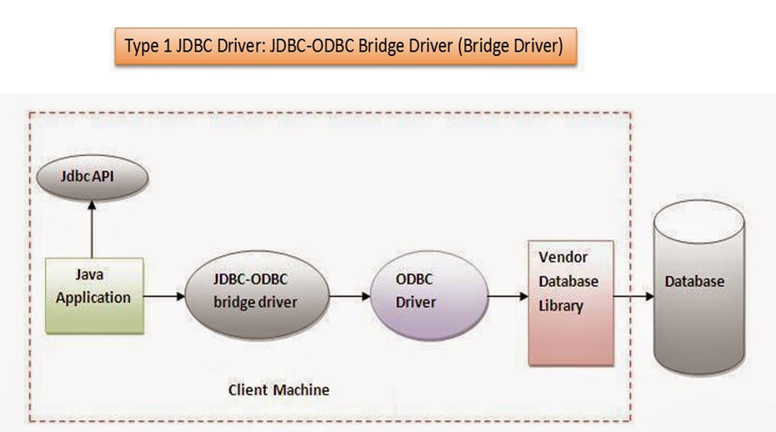
JDBC-ODBC bridge driver

Slide 8
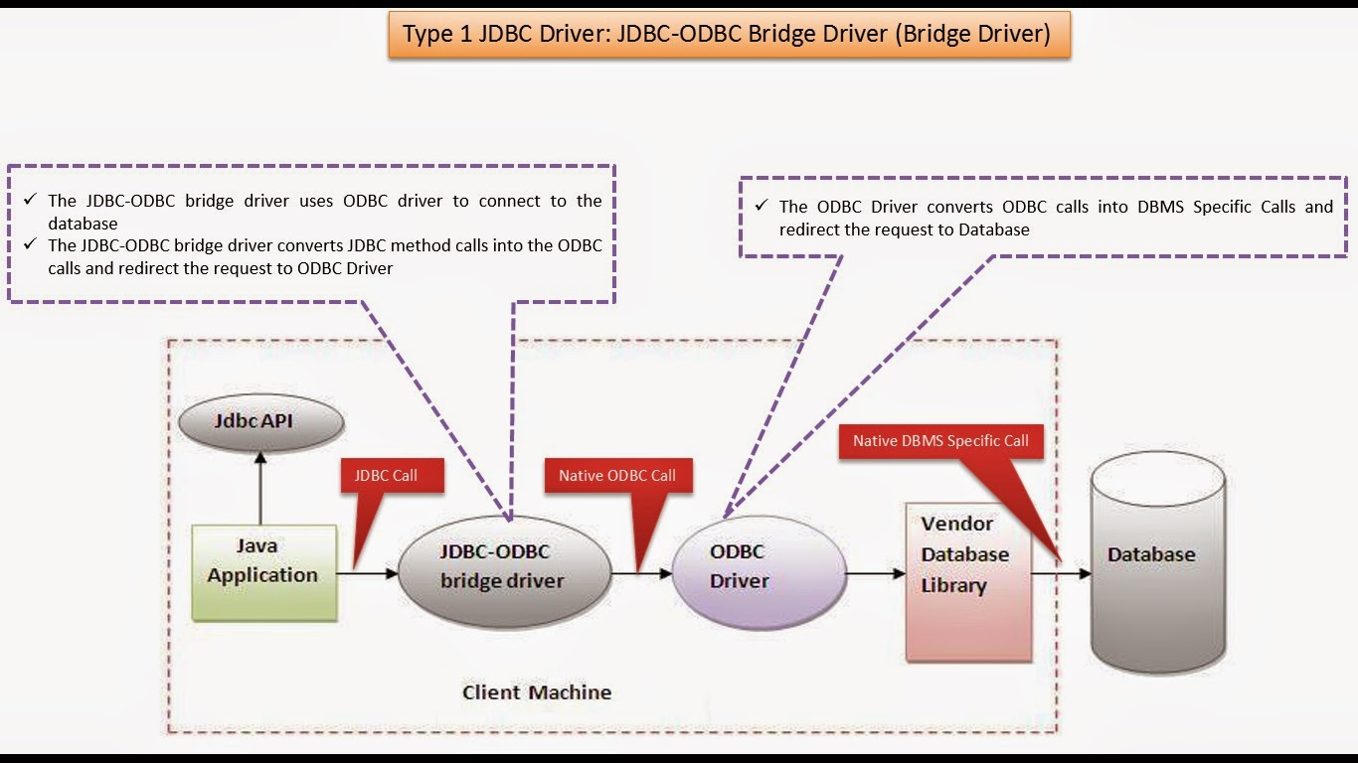

Slide 9
JDBC program steps
Import the packages: Import the packages containing the JDBC classes needed for database programming.
import java.sql.* ;

Slide 10
JDBC program steps
Register the JDBC driver: Initialize a driver so you can open a communication channel with the database.
Class.forName("sun.jdbc.odbc.JdbcOdbcDriver");
or
DriverManager.registerDriver(new sun.jdbc.odbc.JdbcOdbcDriver());

Slide 11
JDBC program steps
Open a connection: Requires using the DriverManager.getConnection() method to create a Connection object, which represents a physical connection with the database which is facilitated by the driver loaded in the previous step.
Connection con;
con = DriverManager.getConnection(“jdbc:odbc:mydsn”,”uname”,”password”);

Slide 12
JDBC program steps
Create a Statement object:
Statement stmt = conn.createStatement();
Define a query:
String query=“select * from emp”;
Execute a query:
ResultSet rs = stmt.executeQuery(query);

Slide 13
JDBC program steps
Extract data from ResultSet object:
while(rs.next()){
int n=rs.getInt(1);
String name=rs.getString(2);
System.out.println(n+” : “+name);
}
rs.close();
stmt.close();
conn.close();

Slide 14
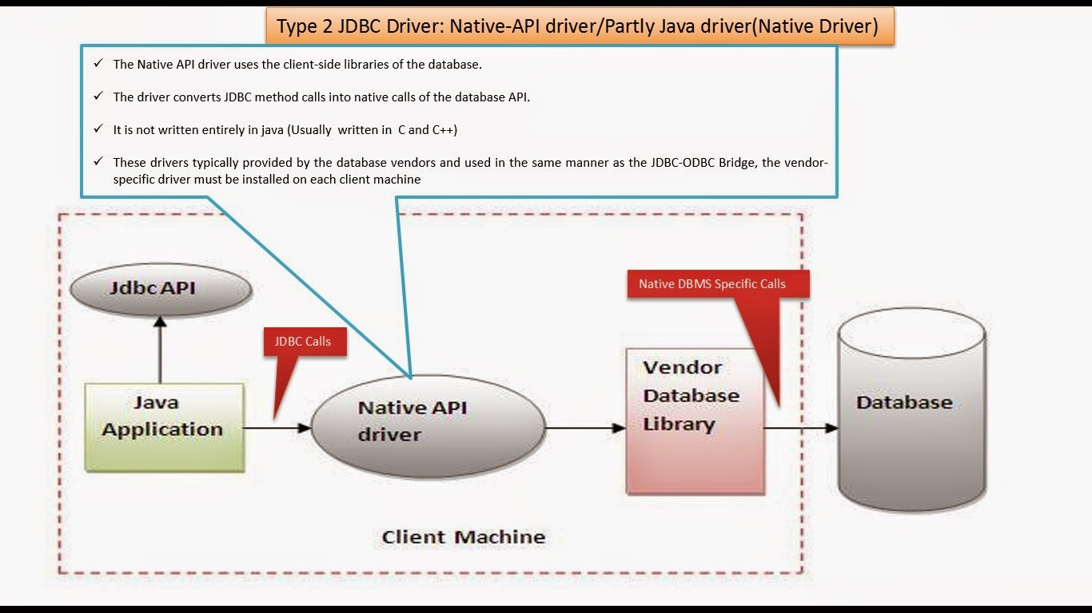

Slide 15
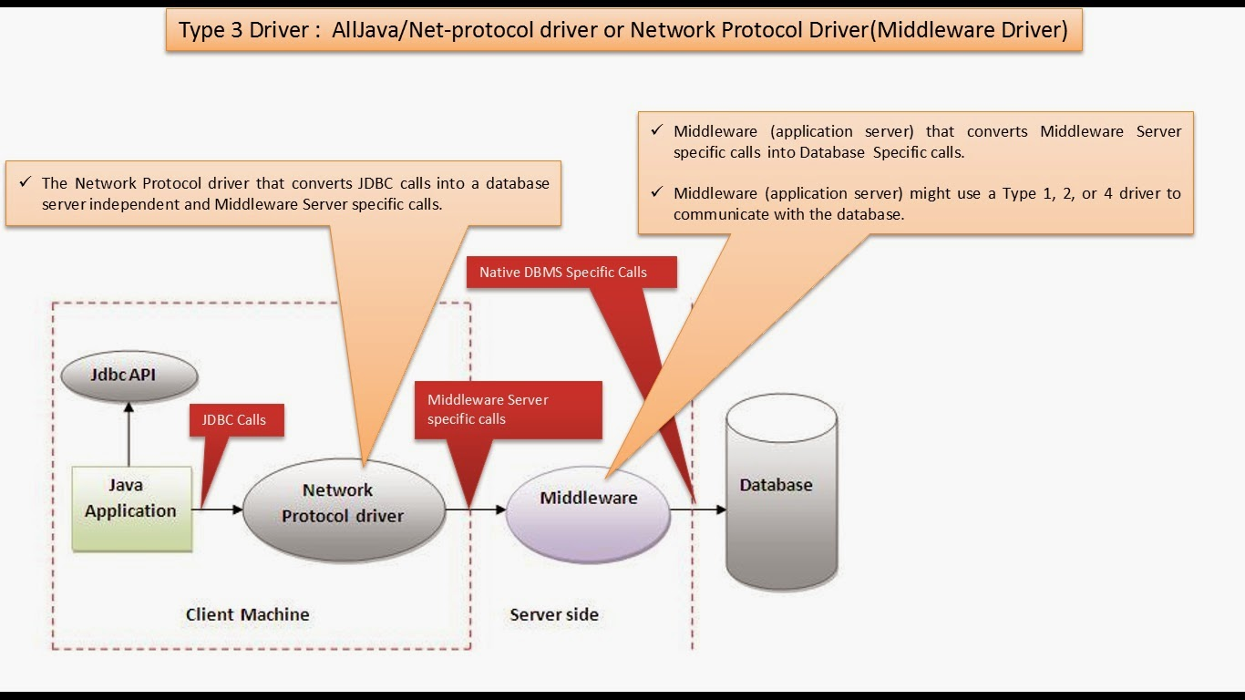

Slide 16
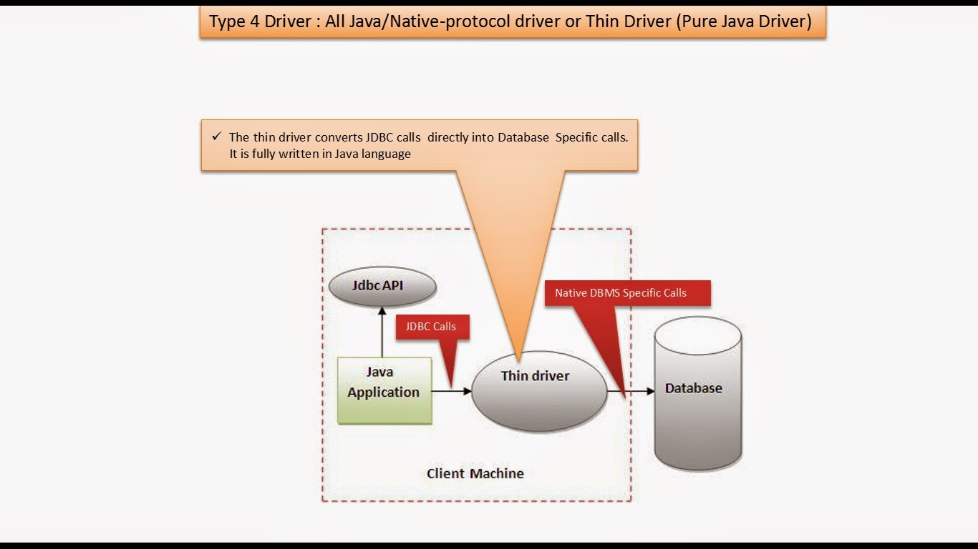

Slide 17
JDBC Classes and interfaces
DriverManager
Manages JDBC Drivers
Used to Obtain a connection to a Database
Driver
All JDBC Drivers must implement the Driver interface. Used to obtain a connection to a specific database type
Connection
Represents a connection to a specific database
Used for creating statements
Used for managing database transactions
Used for accessing stored procedures
Used for creating callable statements

Slide 18
JDBC Classes and interfaces
Statement
Used for executing SQL statements against the database
ResultSet
Represents the result of an SQL statement
Provides methods for navigating through the resulting data
DatabaseMetaData
Provides access to a database's system catalogue

Slide 19
Meta data
Data about data is known as meta data.
Data is normally the rows stored in a table.
Meta data is the information about the database, tables in the database, column names and their types in the table.
java.sql.DatabaseMetaData facilitates the meta data about the database you have connected to.
For instance, you can see what tables are defined in the database, and what columns each table has

Slide 20
Meta data
DatabaseMetaData dbMetaData = con.getMetaData();
DatabaseMetaData has several methods to get meta data about the database to which the connection is made.

Slide 21
Database Product Name and Version
int majorVersion = dbMetaData.getDatabaseMajorVersion();
int minorVersion = dbMetaData.getDatabaseMinorVersion();
String productName = dbMetaData.getDatabaseProductName();
String productVersion = dbMetaData.getDatabaseProductVersion();

Slide 22
Listing Tables
String[] type={“TABLE”);
ResultSet result = dbMetaData.getTables(null,null,null,type);
while(result.next()) {
String tbl= result.getString(3);
System.out.println(tbl);
}

