Slide 1


Slide 2
Layout Managers
Each container has a layout manager, which controls the way the components are positioned in the container.
The layout manager automatically handles the calculation of absolute coordinates where each component is to be placed or the dimensions of the component.
Whenever the dimensions of the container change (e.g. user resizes the window), layout manager recalculates the absolute coordinates of components for them to fit the new container size.
Different layout managers can be used interchangeably and one inside the other.

Slide 3
Flow Layout
The Flow Layout manager arranges the components left-to-right, top-to-bottom in the order they were inserted into the container.
When the container is not wide enough to display all the components, the remaining components are placed in the next row, etc.
Each row is centered.

Slide 4

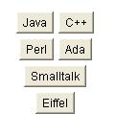
Flow Layout Examples

Slide 5
Flow Layout Constructors
FlowLayout(align, hgap, vgap)
align – alignment used by the manager.
hgap – horizontal gaps between components.
vgap – vertical gaps between components.
FlowLayout(align)
align – alignment used by the manager. A default 5-unit horizontal and vertical gap.
FlowLayout()
A centered alignment and a default 5-unit horizontal and vertical gap.

Slide 6
Flow Layout Alignment
The line alignment can be:
  FlowLayout.LEFT
  FlowLayout.CENTER
  FlowLayout.RIGHT
  FlowLayout.LEADING
  FlowLayout.TRAILING

Slide 7
Grid Layout
The Grid Layout manager lays out all the components in a rectangular grid.
All the components have identical sizes, since the manager automatically stretches or compresses the components as to fill the entire space of the container.

Slide 8
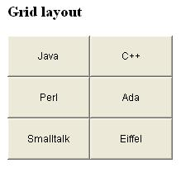

Grid Layout Examples

Slide 9
Grid Layout Constructors
GridLayout(r, c, hgap, vgap)
r – number of rows in the layout
c – number of columns in the layout
hgap – horizontal gaps between components
vgap – vertical gaps between components
GridLayout(r, c)
r – number of rows in the layout
c – number of columns in the layout
No vertical or horizontal gaps.
GridLayout()
A single row and no vertical or horizontal gaps.

Slide 10
Border Layout
The Border Layout manager arranges components into five regions: North, South, East, West, and Center.
Components in the North and South are set to their natural heights and horizontally stretched to fill the entire width of the container.
Components in the East and West are set to their natural widths and stretched vertically to fill the entire width of the container.
The Center component fills the space left in the center of the container.

Slide 11
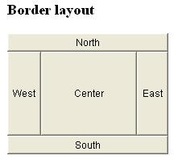
Border Layout Arrangement
If one or more of the components, except the Center component, are missing then the rest of the existing components are stretched to fill the remaining space in the container.

Slide 12
Border Layout Constructors
BorderLayout(hgap, vgap)
hgap – horizontal gaps between components
vgap – vertical gaps between components
BorderLayout()
No vertical or horizontal gaps.

Slide 13
CardLayout
The CardLayout class represents several different layouts.
Each layout is on a separate card (Panel), stacked one over another. At any given time, one card can be brought to the top and displayed.
CardLayout( )
CardLayout(int horz, int vert)

Slide 14
CardLayout
Create CardLayout object.
Create a Panel object, which will act as deck.
Set the layout of the deck to the CardLayout.
Create individual components / cards(Panels) and add them to the deck panel.
void add(Component panelObj, Object name);
name is a string that specifies the name of the card whose panel is specified by panelObj.

Slide 15
CardLayout
methods defined by CardLayout:
void first(Container deck)
void last(Container deck)
void next(Container deck)
void previous(Container deck)
void show(Container deck, String cardName)

