Slide 1
The Object class

Slide 2
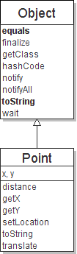
The class Object
The class Object forms the root of the
overall inheritance tree of all Java classes.
  Every class is implicitly a subclass of Object
The Object class defines several methods
that become part of every class you write.
For example:
  public String toString()
  Returns a text representation of the object,
  usually so that it can be printed.

Slide 3
Object methods
method | description
protected Object clone() | creates a copy of the object
public boolean equals(Object o) | returns whether two objects have the same state
protected void finalize() | called during garbage collection
public Class<?> getClass() | info about the object's type
public int hashCode() | a code suitable for putting this object into a hash collection
public String toString() | text representation of the object
public void notify() public void notifyAll() public void wait() public void wait(...) | methods related to concurrency and locking (seen later)

